Slide 1
Odyssey
Empowering Minecraft Agents with Open-World Skills
Shunyu Liu, Yaoru Li, Kongcheng Zhang, Zhenyu Cui, Wenkai Fang, Yuxuan Zheng, Tongya Zheng, and Mingli Song
S1312002 EINHEUSER Kiran

Slide 2
Motivation
Why use Minecraft for autonomous open-world agents?
Previous attempts at open-world agents tended to focus on solving smaller tasks, and tended to struggle with long term planning
Despite recent advances in LLMs, development in open-world settings remains a challenge due to the specific need for well-defined environments
Minecraft provides an ideal testbest for autonomous agents, with various biomes, terrains, and resources
Past Minecraft agents were more focused on basic tasks like collecting diamonds, and tended limit the agents’ capacity for diverse and creative solutions.
Some methods heavily relied on expensive models like GPT-4

Slide 3
The Odyssey Framework
A modular framework for open-world intelligence
LLM-based interactive agent with an open-world skill library, with 40 primitive and 183 compositional skills.
The agent is composed of a planner for goal decomposition, an actor for skill retrieval and subgoal execution, and a critic for feedback and strategy refinement
Fine tuned LLaMA-3 model for Minecraft agents with a comprehensive question-answer dataset
A “new agent capability benchmark” evaluates long-term planning, dynamic immediate planning, and autonomous exploration
The goal is not to design a LLM-based agent architecture, but to provide a comprehensive framework for developing and evaluating autonomous agents in open-world environments

Slide 4
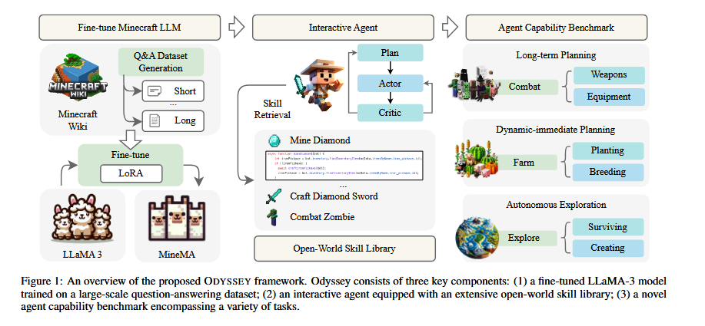
Syllabus/Course
Overview #1
(20xx-20xx)

Slide 5
Open-World Skill Library
Primitive Skills:
  32 operational skills; foundational interfaces for parameterized input
  8 spatial skills; allow for environmental interactions based on agent coordinates
Compositional Skills:
  Primitive skills encapsulated into higher level ones, functioning to address a variety of basic programmatic tasks
  183 compositional skills classified into types like mineX, craftX, plantX, etc
The skill library is constructed with a recursive method, simplifying task decomposition by ensuring prerequisites are met

Slide 6
Planner-Actor-Critic Architecture
LLM Planner: develops comprehensive plan, facilitating efficient exploration through long term goal decomposition. The input prompt to the planner consists of ultimate goals and behavioral constraints, the agent’s state in-game (hunger, health, position, nearby entities), and achievements of the agent so far (current inventory, unlocked equipment, previously succeeded or failed tasks)
LLM Actor: invoked to sequentially execute the subgoals generated by the planner. The mapping from subgoals to executable skills is done through query context encoding and skill similarity retrieval. The text based subgoals are encoded to vectors through a sentence transformer, which is then compared to the vectors of skill descriptions to determine semantic closeness. The top 5 relevant skills are identified, and the actor selects the most appropriate code for execution based on the environment descriptions.

Slide 7
Planner-Actor-Critic Architecture
LLM Critic: during the execution of the action, an agent documents the experience, mainly noting the points of success and failure. An established feedback system can correct discrepancies in the initial plan that cause execution errors. Feedback is categorized into three types.
  Execution feedback: captures the progress of a skill execution, highlighting reasons for skill failure but also providing guidelines to address issues
  Self-validation: presenting inventory changes post-action to the critic, it can evaluate whether the subgoal has been achieved
  Self-reflection: the critic serves as an analyst, evaluating the current state of the agent and the environment, offering more efficient strategies for completing the task

Slide 8
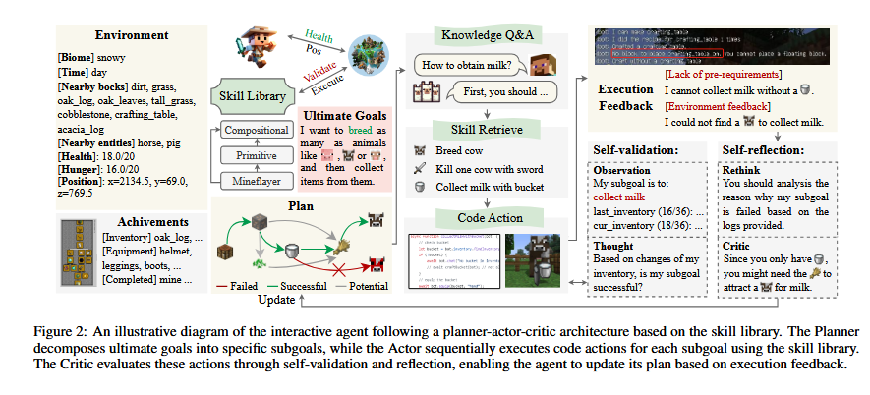
Syllabus/Course
Overview #1
(20xx-20xx)

Slide 9
Fine-tune Minecraft LLM
Dataset Generation: crawl relevant content from Minecraft Wiki, which is then categorized based on content type. GPT-3.5-Turbo is then used with different customized prompts to generate diverse Q&A pairs, then categorized into four types depending on the nature of the answer (short, normal, long, boolean), yielding 390k+ entries.
Model Fine-Tuning: For parameter-efficient training, a LoRa introduces small, trainable, low-rank matrices to adapt a pre-trained neural network. This is used to fine-tune LLaMA models with the Minecraft dataset.
Model Evaluation: GPT-4 was used to generate two Multiple-Choice Question datasets based on different themes and keywords related to Minecraft.

Slide 10
Agent Capability Benchmark
Three tasks to test multiple skills in diverse scenarios
Long-term planning task:
  Presents a suite of combat scenarios to assess agent’s abilities to prepare. Performance is measured by remaining health and time taken during combat. After each battle, agents can iteratively optimize their plan. Beyond combat, scenarios with animal breeding and cooking were also evaluated.
Dynamic-immediate planning task:
  Agents must dynamically generate and execute plans based on immediate environmental feedback. Presents farming scenarios and evaluates performance through completion times and success rates.
Autonomous exploration task:
  Agents are required to determine their subsequent objectives based on the game context. They must discover and utilize resources, and adapt to unforeseen encounters. To adapt, agents need to develop strategies for resource management and task priority. Performance is measured by distinct items obtained, items crafted, recipes and advancements unlocked, and distance travelled.

Slide 11
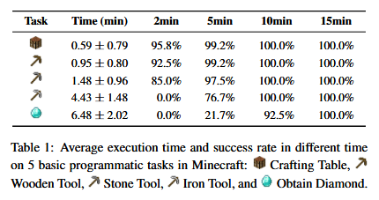
Experiments
Aim to answer the following
Can the open-world skill library improve the efficiency of agents in Minecraft?
How well do agents with different LLMs perform on the agent capability benchmark tasks?
What is the contribution of different components of the ODYSSEY agent to its overall performance?.

Slide 12
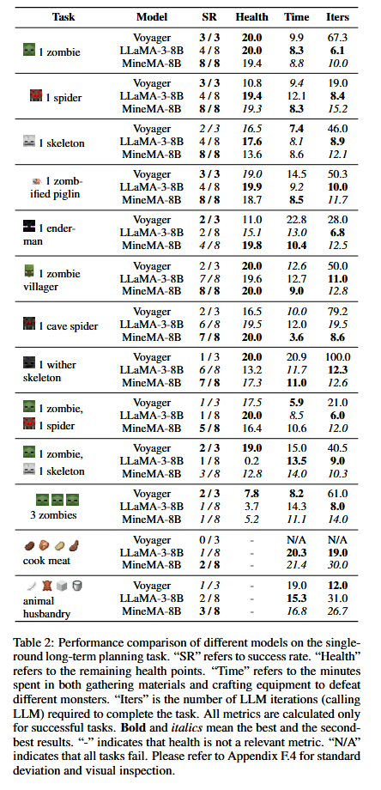
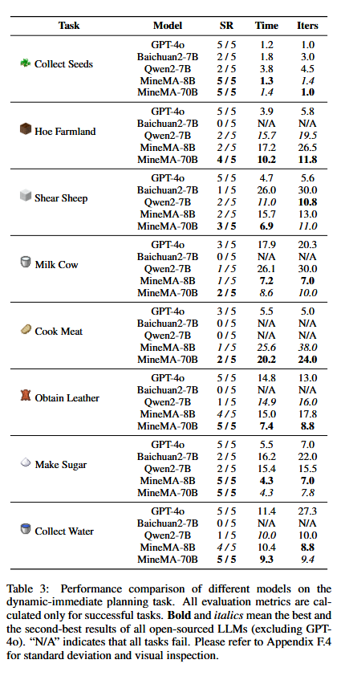
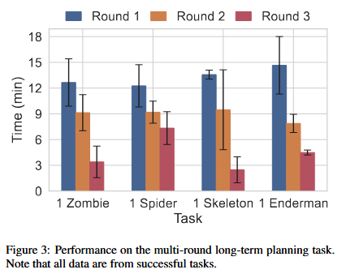

Slide 13
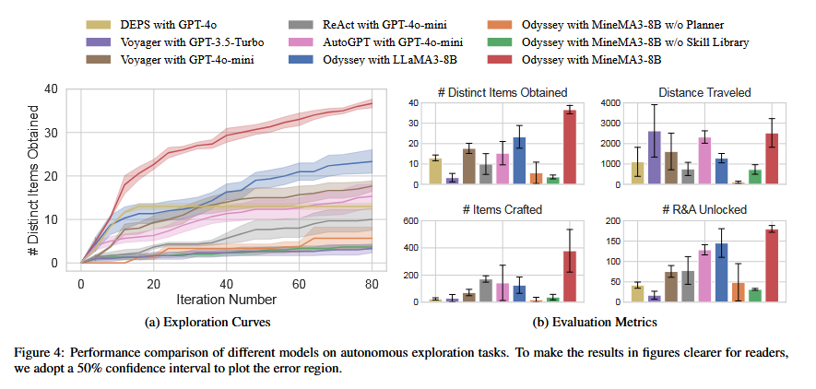

Slide 14
Conclusion
Odyssey can empower agents in the open-world Minecraft environment, using open-source LLMs as a foundation for the open-world skill library to call upon skills, avoiding the high costs associated with models like GPT-4.
For future work, the authors note the open-source LLMS have become prone to more hallucinations which could cause a decrease in agent performance.

Slide 15
Questions?

