Slide 1
Level Generation Through Large Language Models
Paper Written By: Graham Todd, New York University Tandon
Sam Earle, New York University Tandon Muhammad Umair Nasir, University of the Witwatersrand Michael Cerny Green, New York University Tandon
Julian Togelius, New York University Tandon
Published in Foundations of Digital Games(FDG) 2023

Slide 2
Introduction
With the right tuning, LLMs have been shown to generate coherent text in a number of styles, produce working snippets of computer code, and even respond naturalistically to human questions and conversation. While the architectures underlying these models have been leveraged for tasks outside the realm of standard text generation, spent on analyzing the capacity of the LLMs themselves to produce non-linguistic artifacts. The Paper Investigated the ability of LLMs to generate video game levels and the extent to which truths about these about the models taken from natural language processing apply to the domain of game level generation. They also conducted experiments on the capacity to control the levels generated by the LLMs using data augmentation and prompting.

Slide 3
Introduction: hurdles acknowledged by the paper
The first hurdle is representational. Traditional procedural content generation through machine learning which represent game levels spatially which allow local spatial dynamics to be better captured. LLMs however, operate over linear sequences, so levels must be converted to token sequences that have a harder time maintaining spatial relationships.
The second hurdle is data. Datasets of game levels are small, hard to collect and lack standardization which raises questions of whether level generation would depend on the size of the dataset and whether any pretraining actually assists in producing game levels.
The paper however highlighted advantages of LLMs notably controllability, this refers to to the possibility of using natural language prompts to generate levels with particular characteristics and generalizability which is LLMs ability to adapt to new domains and generalize allowing for one LLM-based model to develop levels for multiple games.

Slide 4
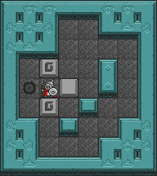
Data
The model was trained on levels from the game Sokoban, a block pushing puzzle game released in 1982 by Thinking Rabbit. In Sokoban, the player is tasked with navigating along a rectangular grid in order to push boxes into specified target squares.A level can easily be represented as a grid of ASCII characters, where each character is mapped to either: a wall, an empty space, the player, a box, a goal, a box on top of a goal, or a player on top of a goal.
Two sets of Sokoban levels were used to train the models:
Microban a dataset consisting of roughly 500 levels created by David W.Skinner, however, the model was restricted to 282 levels which an ASTAR search agent was able to find a solution. The levels range in size from 5 by 3 to 27 by 12, with solution lengths ranging from 1 to 279.
Boxoban a dataset consisting of 438,000 procedurally generated Levels each level is 10 by 10 and contains 4 boxes/goals, with solution lengths from 6 to 206.

Slide 5
Models
The core experimental model is the Generative Pre-Trained Transformer (GPT), a class of attention-based language model. Both GPT-2 and GPT-3 are trained by attempting to predict the next “token” (typically a word or word piece) given the context of preceding tokens. Owing to its greater availability, they focused the majority of their experiments on GPT-2 and its variants.

Slide 6
Metrics
To measure the ability of the LLM these four metrics were used:
Playability measures how many generated levels are valid and solvable. For Sokoban, a level must be rectangular, use only valid characters, contain exactly one player, and have an equal, nonzero number of boxes and goals. Solvability is tested with an ASTAR search agent, and levels that remain unsolved after 150,000 steps are considered unplayable. This provides a lower bound on true playability.
Novelty measures how different generated levels are from those in the training set. Two levels are treated as distinct if their string edit distance exceeds a threshold of 𝑘 = 5. This definition of novelty however doesn’t take into account functional differences between levels.
Diversity measures the proportion of generated levels that are mutually distinct from one another. Using the same same string edit distance threshold of 𝑘 = 5. They used an undirected graph where each edge connects two nodes (levels) that exceed the threshold then the approximate largest clique (subset of fully connected nodes) on the graph was found and the diversity was set as the size of the clique divided by the number of generated levels.
Accuracy is in the case of controllability experiments measured as the proportion of generated levels that adhere to the given prompt. However, rather than enforce an exact match between prompt and output, the model is allowed to generate levels that are within specified tolerances.

Slide 7
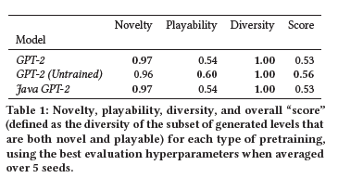
Experiments: effects of pretraining
Three models were tested to evaluate the influence of pretraining:
Standard GPT-2, pretrained on the WebText corpus (45M links).
Java-adapted GPT-2, pretrained on the CodeSearchNet Java dataset (1.6M java methods).
Untrained GPT-2, unsurprisingly untrained
Each model was trained for 100,000 steps with 5 random seeds on the Boxoban dataset using these training hyperparameters: learning rate of 0.0001, weight decay of 0.0001, a batch size of 32 and the AdamW optimizer. With each model taking roughly 24 hours and trained on a single A100 GPU.

Slide 8
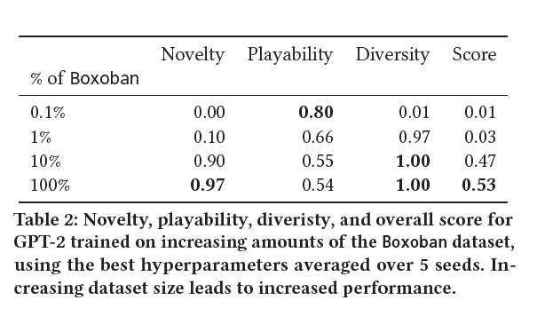
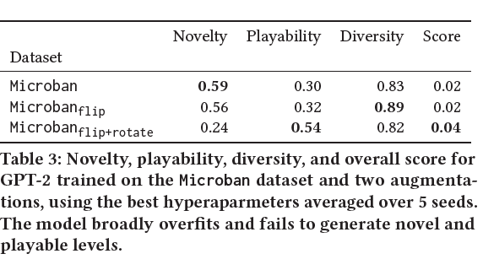
Experiments: Effects of Dataset Size

Slide 9
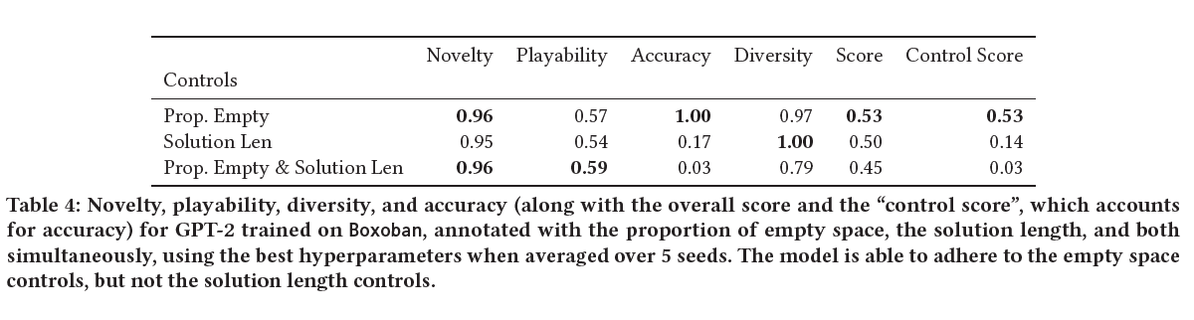
Experiments: Controllability
The researches then examined whether LLMs can be controllably guided to generate game levels with specific, measurable characteristics using natural-language-style prompts. Zero-shot prompting was likely to be difficult due to the strict structural constraints of valid game levels and their dissimilarity from typical pre training data. Thus,they instead focused on LLMs that were trained with specific prompts during level generation, where each level is prepended with an “annotation” describing target properties. During generation, the model is provided only with this annotation and must produce a level matching the specified values.
The Provided annotations were:
Proportion of empty space, a tolerance of 0.01 was used
Solution lengths, a tolerance of 5 was used

Slide 10
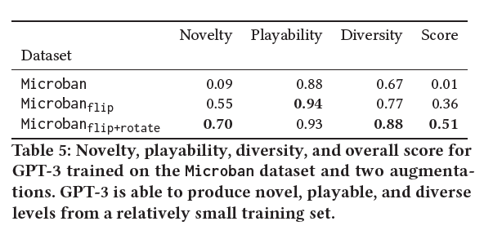
Experiments: Preliminary Investigation of GPT-3

Slide 11
Conclusion
The researchers concluded that LLMs are highly versatile being capable of creating playable and novel game levels. They showed that pretraining didn’t hinder the models ability to produce game levels, though it’s actual effect was not clear in the experiments. Their results also showed that performance of the model was still beholden to the size of the available dataset as with many other domains of natural-language models. In terms of controllability they showed that for more simplistic prompts the trained models are capable of handling it but struggle with more complex prompts. Overall the paper suggests that LLMs have the potential to be a new tool forward for procedural content generation and will overcome the limitations of lack of available game level data.

