Slide 1
“Other-Play” for Zero-Shot Coordination
Hengyuan Hu, Adam Lerer, Alex Peysakhovich, Jakob Foerster Proceedings of the 37th International Conference on Machine Learning, PMLR 119:4399-4410, 2020.

Slide 2
Introduction
Zero-Shot Coordination Agents collaborating to earn high rewards with unknown partners. This study proposes an algorithm for zero-shot coordination called “other play”.
Self play(SP) Traditionally, this has been used in games played with unknown opponents. The agent learns by repeatedly playing games against itself during training. This is unsuitable for tasks where “cooperation” is important.

Slide 3
Introduction
Other play (OP) This is the algorithm developed in this study for zero-shot collaboration. The goal of the opening is to find the most robust strategy possible, even when the opponent employs various tactics. OP leverages known “symmetries” underlying the game to facilitate cooperation with unknown agents. The OP employs reinforcement learning (RL) to maximize rewards based on known symmetries.

Slide 4
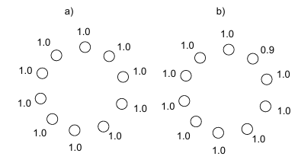
Introduction
Example of OP As an example, consider the lever coordination game (a) and (b). In these games, players simultaneously select one lever from ten available levers with an unknown opponent. If both players select the same lever, they receive the reward value written on that lever. In Figure (a), players can only choose randomly, and the expected reward is 0.1.

Slide 5
Introduction
Example of OP:(b) In Figure 1b, only one lever has a reward of 0.9, and the others are indistinguishable. SP: SP attempts to coordinate by selecting one of the levers with a reward of 1.0. The expected reward is only about 0.11. OP: Select the only distinguishable 0.9 bar. Attempts to coordinate using only the characteristics of the problem description.

Slide 6
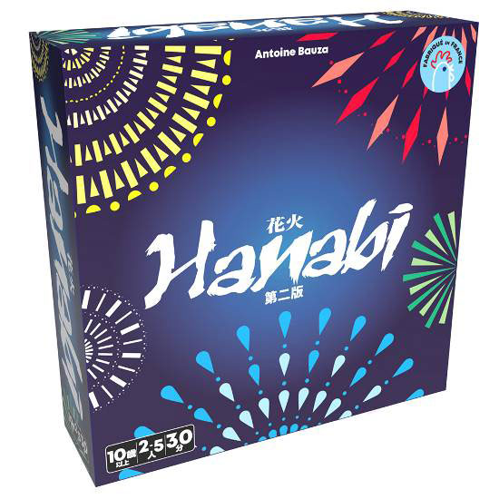
Introduction
The contributions of this study are as follows:
1) Introducing OP as a method to solve the zero-shot coordination problem
2) Demonstrating that OP is a meta-equilibrium with the highest reward in the zero-shot coordination problem
3) Showing how to implement OP using deep reinforcement learning (deep RL)
4) Evaluating OP in the cooperative card game “Hanabi”

Slide 7
Related Work
Self-Play (SP) in Cooperative Games
Cooperation and Emphasis Based on Observation of Partner's Actions
Game Theory and Implicit Understanding of Play＊
Predicting Human Decision-Making
Domain Randomization
Utilizing Symmetry in Other Contexts

Slide 8
Related Work
Game Theory and Implicit Understanding of Play Research on tacit understanding in behavioral game theory. A famous example is the question: “If you get separated from a friend in New York City, where should you meet?”
Relationship with the OP A special implicit coordination requiring no shared exogenous characteristics using OP is necessary.

Slide 9
Zero-Shot Coordination
Environment The environment addressed in this study is a “fully cooperative Markov game.” This is based on the Dec-POMDP (Decentralized Partially Observable Markov Decision Process), which models situations involving multiple agents.
Decentralized…There are multiple agents.
Partially Observable…Agents cannot know the complete state of the situation.
Markov Decision Process…The agent selects action according to policy based on its observation history.

Slide 10
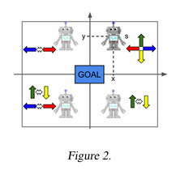
Zero-Shot Coordination
Symmetry refers to the property where the game's rules remain fundamentally unchanged even if the labels for the game's “state,” “action,” and “observation” are arbitrarily swapped.
Figure 2 Consider a grid world with a goal at its center. In this environment, flipping the x-axis or flipping the y-axis does not change the goal's position. This is “symmetry.”

Slide 11
Zero-Shot Coordination
Why is symmetry necessary? SP agents end up learning specific “conventions” to break symmetry by coordinating with each other during joint training. Therefore, agents trained separately may interfere with each other's strategies, potentially leading to catastrophic failure.
Purpose of the OP the purpose of the OP proposed in this paper is to construct a policy that is as robust as possible against this partner breaking symmetry in different ways

Slide 12
Other play Algorithm
Comparison Consider the case of training with two agents. SP Learning Rules: π1, π2…Strategies for Agents 1 and 2 π*…Game collaboration strategy In this approach, π¹ and π² end up “overfitting” to each other throughout the training process, learning a habit that independently disrupts the game's symmetry.

Slide 13
Other play Algorithm
OP Learning Rules:
The OP will be enhanced for robustness against symmetry. Φ… Set of Symmetries φ… A mapping with specific symmetry randomly selected from Φ The randomly selected symmetry enables the discovery of a robust strategy π.

Slide 14
Experiments
As a specific implementation method for OP, introducing a special technique called “asymmetric domain randomization” into the training process of multi-agent reinforcement learning (MARL) is proposed. MARL training procedure is as follows:
At the start of the game, each agent uniformly selects a random permutation (symmetry mapping).
2. Each agent observes and acts in the environment with the altered order.

Slide 15
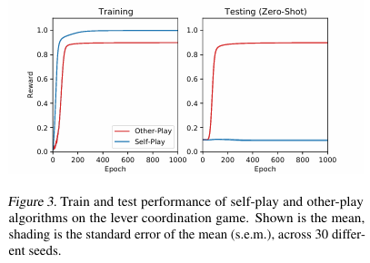
Other play Algorithm
1. Lever Game The same as the introduced one. SP ended up choosing 1.0, resulting in failed coordination. OP was able to coordinate with the only identifiable 0.9 option during both training and testing. (Figure 3)

Slide 16
Other play Algorithm
2. Hanabi Evaluation was conducted using the more complex cooperative card game “Hanabi.” In this OP implementation, the permutation of card colors was used as the game's symmetry, and the base algorithm for the OP employed SAD, the highest-performing reinforcement learning agent for “Hanabi.” The training categories are the following four: SAD (Standard SP) SAD+OP (SAD with OP applied) SAD+AUX (SP with auxiliary tasks added to SAD) SAD+AUX+OP (SAD+AUX with OP applied)

Slide 17
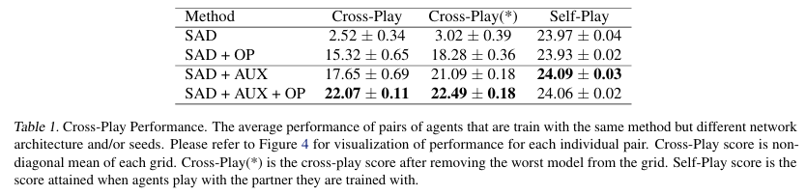
Other play Algorithm
Result: SAD achieved high scores in self-play but suffered catastrophic results in crossplay. SAD+OP significantly improved crossplay scores to 15.32 points. SAD+AUX+OP achieved the best crossplay performance (22.07 points).

Slide 18
Other play Algorithm
Agents using SAD alone learned highly complex conventions per pair that were difficult for humans to comprehend, leading to fatal misalignments in crossplay and disastrous outcomes. SAD+OP eliminated these symmetry-breaking conventions, resulting in a more understandable and easier-to-emphasize system.

Slide 19
Other play Algorithm
3. Hanabi, Human-AI pairs An experiment was conducted with 20 participants who knew the rules of “Hanabi” pairing them with AI agents to play the game and measure their scores.

Slide 20
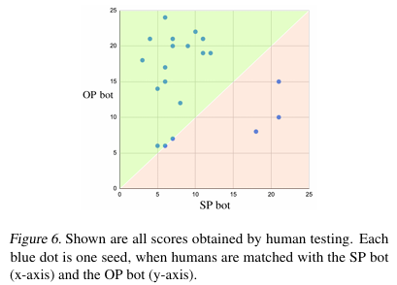
Other play Algorithm
Result: Human and OP bot The average score was 15.75 points, and the probability of life reaching zero and the game ending forcibly was 45%. Human and SP bot The average score was 9.15 points, and the probability of life reaching zero and the game ending forcibly was 85%. From the above, it was found that OP is superior to SP.

Slide 21
Conclusion
This study demonstrates that Other Play (OP), an extension of Self Play (SP), enables the construction of agents capable of better zero-shot coordination with unknown partners. While OP does not achieve zero-shot coordination with all partners, it can be combined with many algorithms that improve SP.

