Slide 1
Dynamic Game Difficulty Scaling Using Adaptive Behavior-Based AI
Chin Hiong Tan, Kay Chen Tan, and Arthur Tay
IEEE TRANSACTIONS ON COMPUTATIONAL INTELLIGENCE AND AI IN GAMES, VOL. 3, NO. 4, DECEMBER 2011

Slide 2
Motivation and Research Goal
High-quality game AI is important, but players still prefer human opponents
Game AI quality is generally perceived as low
Static AI cannot cater to diverse player skills and gaming styles
Develop adaptive game AI that entertains opponents
Play an even game by adapting to player proficiency

Slide 3
SIMULATED CAR RACING
Game Field
400×400 pixels competition field, no walls/obstacles
Vehicles can drive outside field
Only competition field visible to human players

Slide 4
SIMULATED CAR RACING
Waypoint System
Pass as many waypoints as possible within time limit
Each waypoint generated on circumference of circle centered on previous waypoint
Prevents overlapping waypoints and ensures fair point allocation
First waypoint always on vertical line through field center

Slide 5
SIMULATED CAR RACING
Vehicle Controls
9 discrete control actions (accelerate, decelerate, left/right turn, neutral, combinations)
Input from keyboard or AI algorithm

Slide 6
Behavior-Based Controller
This research use Behavior Based Controller
The behavior-based controller has 7 components that is 4 driving behaviors and 3 tactical behaviors
  Hyperbolic Tangent Speed Regulator: Speed control by distance
  Reversing: Drive backward
  Direction Switching Compensation: Handles steering during direction changes
  Tight Angle Turning: Turning the orbital trap at a small turning angle
  Waypoint Prediction: Predicts which car reaches current waypoint first, chooses optimal target
  Time Wasting: Stop near waypoint without collecting if opponent far away
  Blocking: Drive between opponent and waypoint to obstruct

Slide 7
ADAPTIVE CONTROLLERS
Satisfying Gameplay Experience
Two Satisfaction Indicators
  Minimize |W - L| (wins minus losses, the lower the better)
  Minimize D (draws are frustrating, the lower the better)
  Minimize |s1 - s2| (small score difference, the lower the better)
  Maximize max(s1, s2) (high average scores, the higher the better)

Slide 8
ADAPTIVE CONTROLLERS
Artificial Stupidity
Make AI mistakes intentional but plausible
Requires overdesigned AI because AI must be able to win first, then handicap itself
Implementatiois below
  Selectively activate/deactivate behavior components
  Adaptive controller estimates opponent competency during game
  Progressively selects subset of behaviors to match opponent

Slide 9
ADAPTIVE CONTROLLERS
Adaptive Uni-Chromosome Controller (AUC)
1 chromosome encoding 7 real numbers [0, 1]
Each numberis activation probability for one behavior component
Randomly initialized at game start

Slide 10
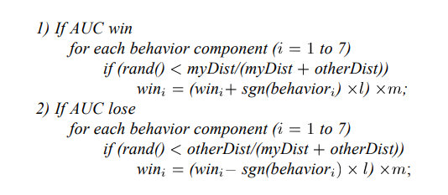
ADAPTIVE CONTROLLERS
Winning strategy encoded in chromosome
Complement of winning probabilities is losing strategy
Complement calculated as: p'ᵢ = 1 - pᵢ
Strategy Selection:
If losing/draw → use winning chromosome
If winning → use losing chromosome

Slide 11
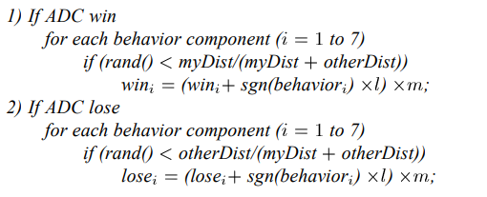
ADAPTIVE CONTROLLERS
Adaptive Duo-Chromosome Controller
Difference from AUC
  Applied to BOTH chromosomes independently(Winning chromosome and Losing chromosome)
  Maintain both throughout the game

Slide 12
STATIC CONTROLLERS
Heuristic Controller (HC)
  Simple rule-based controller
  Parameters optimized by evolution strategies
  Ignores opponent, always heads to current waypoint
Neural Network Controller (NNC)
  9 inputs, 6 hidden nodes, 2 outputs
  Smoother, more refined driving than HC
  Trained with ES, but best evolved candidate lacks predictive ability

Slide 13
STATIC CONTROLLERS
Reverse Enabled Controller (RC)
  Simplified behavior-based controller
  Hard speed limit: 5 px/step
  Uses reversing and direction switching only
  Recovers quickly from collisions
Predictive Slow Controller (PSC)
  HC + waypoint prediction (tactical component)
  Speed limit: 8 px/step
  Fast but risks overshooting, includes stopping mechanism

Slide 14
STATIC CONTROLLERS
Solo Game Results
HC, NNC, RC, PSC are similar driving capability
NNC is slightly less consistent
PFC is worst performer (high speed causes skidding and overshooting)

Slide 15
RESULTS AND DISCUSSIONS
The results were obtained over 5000 games and each game lasted 1000 time steps.
Fully Activated Behaviors
  Verify basis controller is overdesigned and can defeat opponents
Randomly Activated Behaviors
  Show need for guided learning that is not just random behavior selection

Slide 16
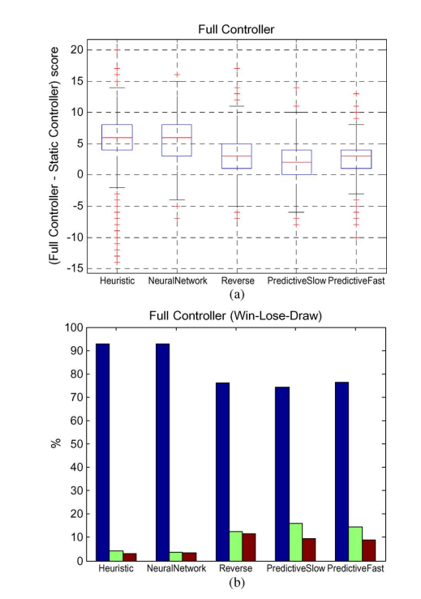
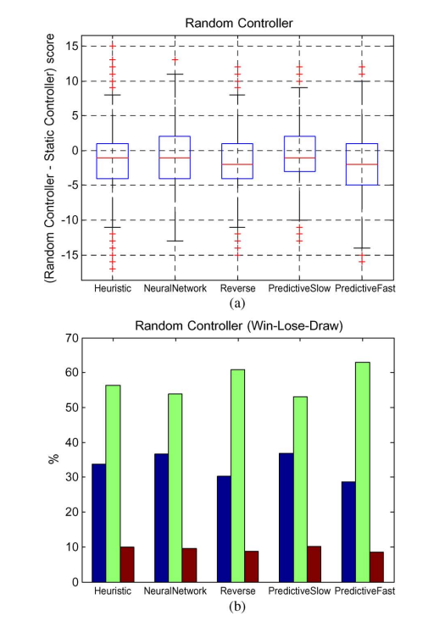

Slide 17
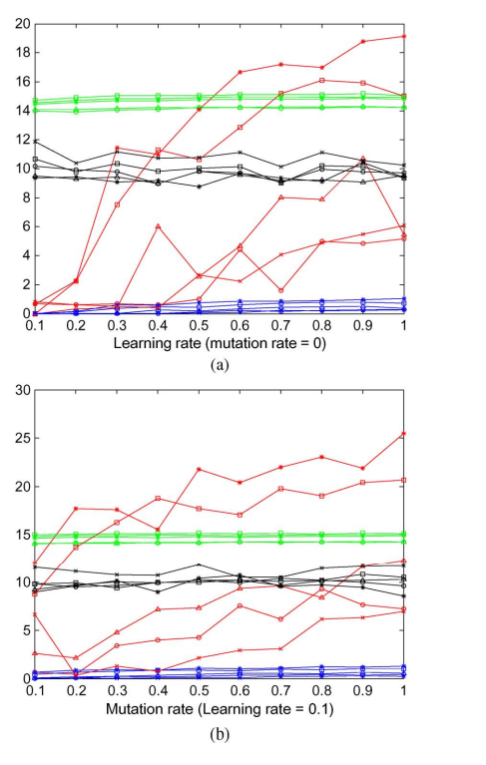
RESULTS AND DISCUSSIONS
Analysis of AUC
(a)
  When the learning rate is high, chromosomes saturate to 0 or 1, resulting in unstable behavior
  l = 0.1 (best for 7 out of 10 criteria)
(b)
  When the mutation rate is high, fluctuations become large, leading to overcompensation (e.g., amplification of PID noise).
  m = 0.1 (7 out of 10 criteria)
  Worse than l-only results
  In AUC, m=0 is advanced

Slide 18
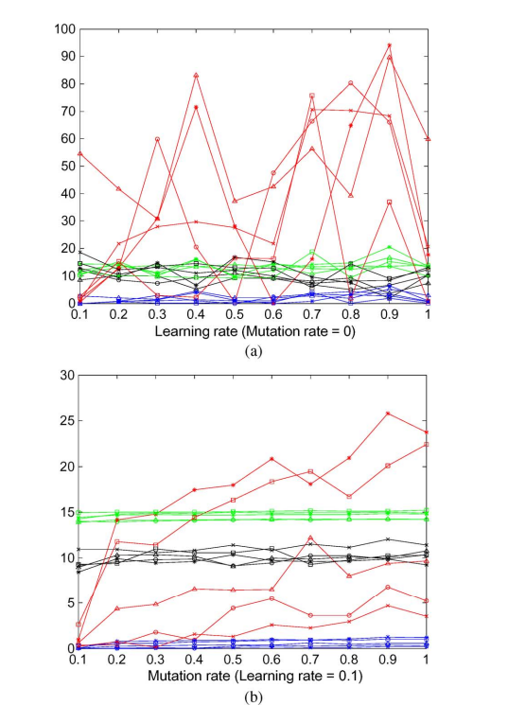
RESULTS AND DISCUSSIONS
Analysis of ADC
  The same verification as before
(a)
  No clear trends
(b)
  m = 0.1 (9 out of 10 criteria)
  ADC results greatly improved with mutation

Slide 19
RESULTS AND DISCUSSIONS
Score Difference Distribution
  Median = 0 for both AUC and ADC
  Minimum 70.22% of games had score difference ≤ 4
  ADC has lower draw frequency than AUC

Slide 20
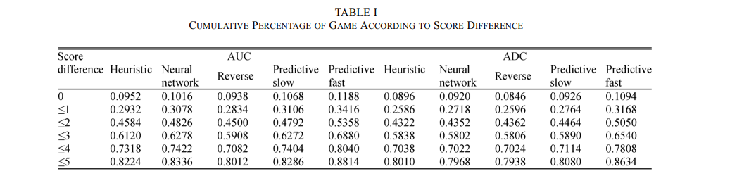
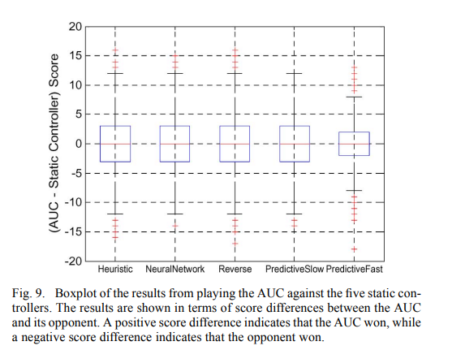
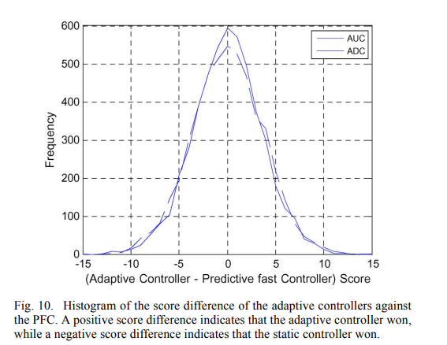

Slide 21
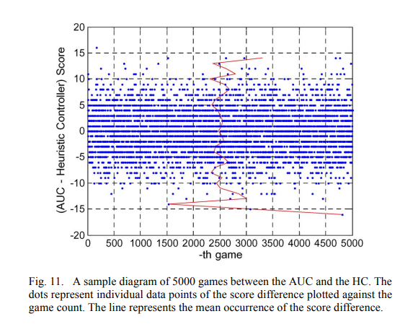
RESULTS AND DISCUSSIONS
Distribution of Occurrence
  When the score difference is greater than 5, the average occurrence value tends to move away from the center line.
  These score differences are infrequent (82.24% of games have a score difference of 5 or less).
  Therefore, only score differences of 5 or less are considered.

Slide 22
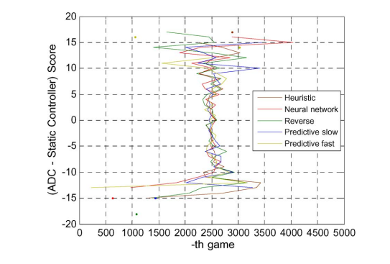

Slide 23
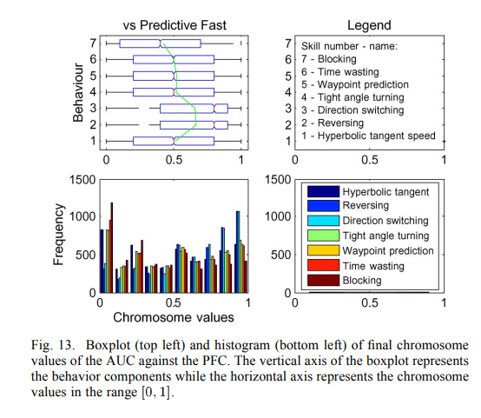
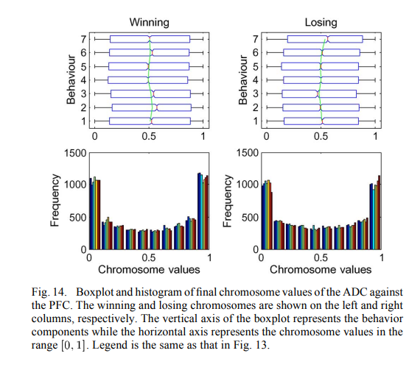
RESULTS AND DISCUSSIONS

Slide 24
CONCLUSION
This research create two adaptive algorithms (AUC and ADC) for real-time difficulty scaling
No offline training, adapts during gameplay
Successfully matched up with opponents (e.g., average score difference is zero)
Both algorithms were able to achieve a score difference of 4 or lower for a minimum 70.22% of the games
Extend to 3-player games (2 AIs + 1 human) in the future

Slide 25
Thank you for listening

