Slide 1
Opponent Behaviour Recognition for Real-Time Strategy Games
Froduald Kabanza and Philipe Bellefeuille and Francis Bisson Universit ́e de Sherbrooke Sherbrooke, QC J1K 2R1,Canada {kabanza, philipe.bellefeuille,francis.bisson}@usherbrooke.ca Abder Rezak Benaskeur and Hengameh Irandoust Defence R&D Canada – Valcartier Qu ́ebec, QC G3J 1X5, Canada {abderrezak.benaskeur, hengameh.irandoust}@drdc-rddc.gc.ca

Slide 2
Contents
1.Introduction
2.Related Work
3.HICOR’s Plan Recognition Features
4.HICOR’s Intent Recognition Algorithm
5.Preliminary Experiments
6.Conclusion

Slide 3
1.Introduction

Slide 4
Introduction
RTS(Real time strategy) video game Manage resources to defeat enemy forces. ex) Collect “iron” and build a base. Collect “army” and attack an enemy base.
Example of RTS video game Crash of Crans 新信長の野望 Ultimate General: Civil War

Slide 5
Introduction
StarCraft RTS game released in 1998. In SF world, player explore planets while batting enemy forces. This thesis is based on this game.

Slide 6
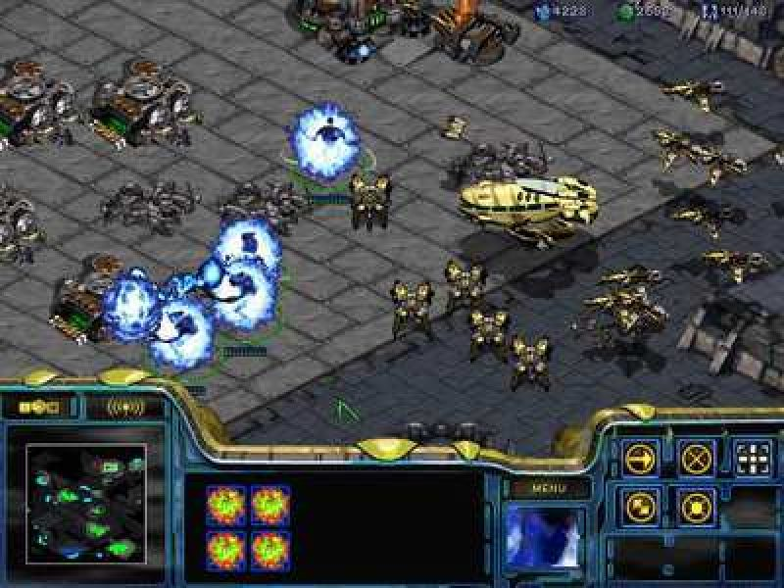
StarCraft(1998) by Blizzard Entertainment Windows game: https://www.uvlist.net/game-16956-StarCraft

Slide 7
Introduction
Main Strategy in StarCraft ・Build facilities ・Make army ・Fight enemies ->Efficient attack and defense are necessary. In StarCraft, player can take enemy information using reconnaissance(scout). Human player’s actions are creative and unpredictable. ->Prediction is very difficult problem for AI! AI player need get “Enemy behavior guidelines” to response flexibly.

Slide 8
Introduction
What kind of AI should we create? Information necessary for AI ->Enemy’s opponents, behavior, goals, their plans to achieve those goal. Strategies necessary for AI ->Most efficiency attack and defense strategies.

Slide 9
2.Rerated Work

Slide 10
Related Work
Plan Recognition In RTS game, not all information is available. Therefore, it is necessary to enable AI to recognize enemy actions. In AI research, a method called “Plan Recognition” is used. Plan Recognition is method which guess plan and goals use from recognize action.

Slide 11
Related Work
PHATT PHATT(Probabilistic Hostile Agent Task Tracker) Models created in previous research The basis for the model(HICOR) used this time. Feature ・guess plans based on observation ・can process plans in parallel ・can handle situations where plans are abandoned ・easy to implement

Slide 12
3. HICOR’s Plan Recognition Features

Slide 13
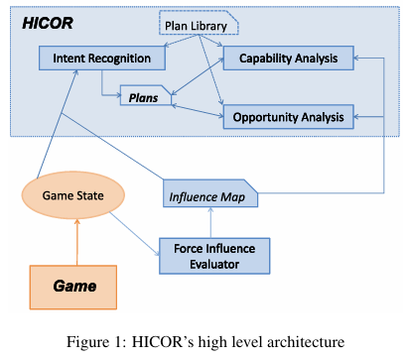
HICOR’s Plan Recognition Features
HICOR HICOR(Hostile Intent, Capability and Opportunity Recognizer) Extension of PHATT What has been expanded? ・set time limits ・reflect the overall game state and dynamically reflect enemy objectives using an “Influence map” ・able to deal with provocative actions (=bluff) by the enemy

Slide 14
HICOR’s Plan Recognition Features
Plan Classification Improve efficiency by processing the two separately 1, Strategic Plans long-term plan 2, Tactical Plans short-term plan

Slide 15
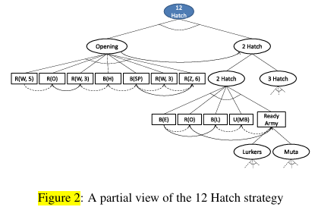
HICOR’s Plan Recognition Features
1, Recognition of Strategic Plans Use typical strategies as prior knowledge. ・Eliminate strategies using information obtained through reconnaissance(scout) ・Eliminate strategies using time limit.

Slide 16
HICOR’s Plan Recognition Features
2, Recognition of Tactical Plans Understand the enemy‘s intentions behind enemy’s observed actions ・Evaluate enemy actions and the safety and danger of each area. Utilizing influence maps.

Slide 17
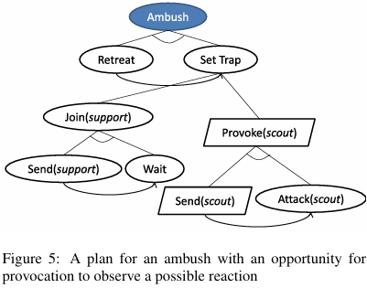
HICOR’s Plan Recognition Features
Active Observations AI acts to extract necessary information. ・Accurate plan through reconnaissance(scout) AI acts not only passive, but also active.

Slide 18
4. HICOR’s Intent Recognition Algorithm

Slide 19
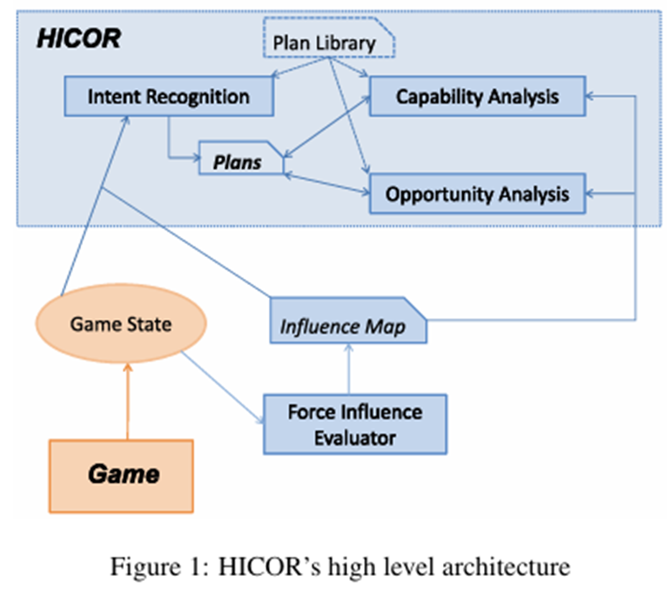
HICOR’s Intent Recognition Algorithm
Definition of Plan Library Plan Library(PL) contain all the plans that enemies can adopt. PL=(Π,Pr,O) ・Π…All plans group ・Pr(Prior Probability) … Prior Probability of each plan ・O(Observations) … Possible observations group

Slide 20
HICOR’s Intent Recognition Algorithm
PES management PES … Plan Execution Status PES shows how far along the plan is and what the next steps should be. PES=(T, <En0, En1, …, Enn>) ・T…Partially completed plan trees group ・En…”Enable actions” Enable actions … Actions you can take now

Slide 21
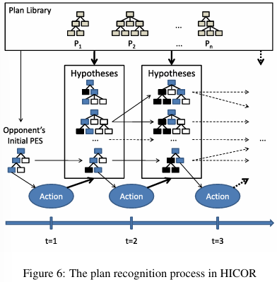
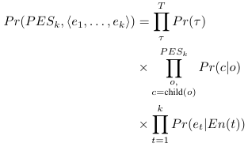
HICOR’s Intent Recognition Algorithm
Update Plan ・PES update If AI make a new observation, PES update. ・Probability update Pr(c|o) … OR node selection probability Pr(et|En(t)) … observerd action probability

Slide 22
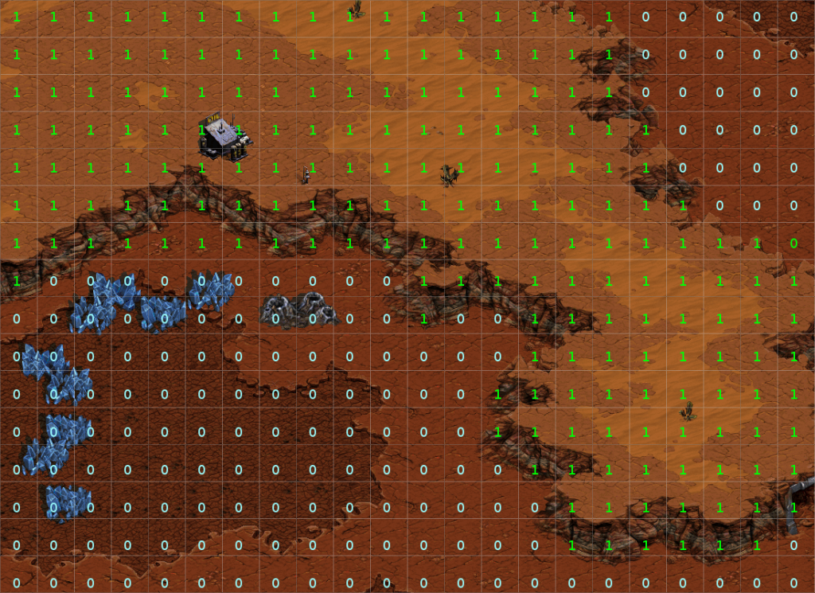
HICOR’s Intent Recognition Algorithm
Influenced map Grid map superimposed on the physical map of the game Each cell stores the value of influence in that area ・Recognition strategy action ・Probability correction for plan branching selection
Image is for illustration purposes only.

Slide 23
5. Preliminary Experiments

Slide 24
Preliminary Experiments
Experimental environment and setting Platform … StarCraft C++ API (for the AIIDE competition) Execution environment … Intel Core 2 Duo 2.4 GHz Observation conditions ... Full Observability(can fully understand what your enemies are doing) Usage data ... Zerg vs. Terran match replays collected from Team Liquid.
Strategy Plan Number of Action … 20~60 primitive actions Number of OR node … 0~3

Slide 25
Preliminary Experiments
Performance Update processing time per observation: Maximum of 50 ms or less Actual observation frequency: once every 3 seconds ->high speed performance

Slide 26
Preliminary Experiments
Recognition accuracy Operate HICOR predictions as “valid inferences only when the probability is 50% or higher.” The misrecognition rate is only about 11%
Limit ・Enemy actions are completely observable ・Enemies generally use a single strategy. ・Few planned libraries

Slide 27
6. Preliminary Experiments

Slide 28
Conclusion
Achievements ・Clarified the difficulty of plan recognition in RTS games ・Proposed HICOR as a solution ・In HICOR, it enables more detailed and realistic planning modeling by handing time.

Slide 29
Conclusion
Future challenges ・Simultaneous recognition of multiple goals ・Recognition at the tactical level ・Partial observation and incomplete information ・Use of provocation and active scouting ・Interactive judgment and coordinated action in real time

Slide 30
Thank you for listening!

