Slide 1
Combining Deep Reinforcement Learning
and Search for Imperfect-Information Games (ReBeL)
Noam Brown, Anton Bakhtin,
Adam Lerer, Qucheng Gong
NeurIPS 2020
Notes:
I will talk about a paper/titled “Combining Deep Reinforcement Learning/ and Search / for Imperfect-Information Games”/written by Noam Brown and his colleagues / at NeurlPS 2020.

Slide 2
Introduction
Games like poker hide information from players.
AI must guess hidden parts and opponent beliefs.
Perfect-information methods do not work here.
Notes:
In games like poker, / some cards are hidden. / If an AI / for perfect information games / such as AlphaZero / must guess those cards /, because of a lack of visible information, / the AI method doesn’t work well, / so / we need new ideas. (old maid)

Slide 3
Background
AlphaZero succeeded in games like Go and Chess.
DeepStack and Pluribus use search only at test time.
No method combined search during training.
Notes:
AlphaZero showed that / combination between / deep networks / and Monte-Carlo tree search / can achieve superhuman performance /in perfect information games /like Go and Chess. / Also / for imperfect information games, / DeepStack and Pluribus made breakthrough, / but they used search / only after training, / not during training, / so no method / combined search during training.

Slide 4
Problem Statement
AlphaZero-style search fails for hidden-info games.
Example: Rock-Paper-Scissors needs mixed play, simple search misses it.
Notes:
AlphaZero-style search / fails for hidden-information games. / Consider a simple Rock-Paper-Scissors / where you don’t know / the rivals choice of hands. / If you run a one-step search / in Rock-Paper-Scissors, / you probably / end up with a single move / and become easy to beat. / We need a way /to keep the right mix of moves.

Slide 5
Motive
Goal: Let AI learn with search in hidden-info games like poker.
Improve over methods that only search during play.
Notes:
The main goal of this paper/ is to teach the agent / with search guiding, / rather than / just use search / after the network is trained. / In detail, / an AI framework called ReBeL / challenges search / during every training step / to get stronger and / harder-to-defeat play. /

Slide 6
Public Belief State (PBS)
PBS: probability distribution over hidden histories from public observations.
PBS ≒ P( hide info | public game history )
Generalizes POMDP belief states to multi-agent games.
Notes:
ReBeL uses / a Public Belief State,/ or PBS. / You understand that PBS is a probability / that hidden information is true, / based on / what we are given some information / by game history. / It is like the belief state / in a POMDP, / or partially observable Markov decision process/ but for many players.

Slide 7
ReBeL Framework Overview
1. Make a subgame with limited steps at current PBS.
2. Solve subgame with CFR guided by networks.
3. Update networks from results (=leaf PBS and values).
4. Repeat self-play many times.
Notes:
At each PBS, / the agent does as follows.

Slide 8
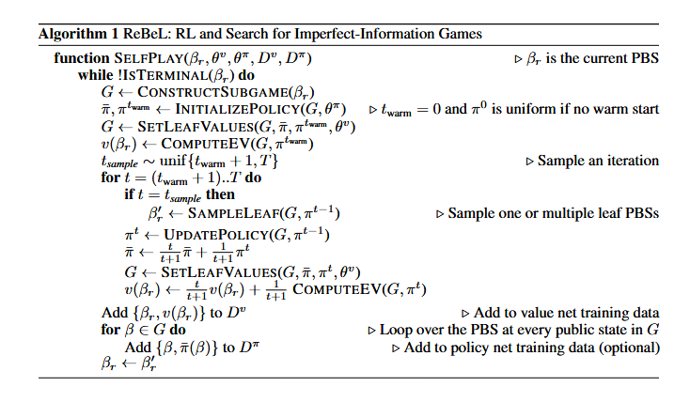
Notes:
Here is the algorithm / of ReBel.

Slide 9
Self-Play Training
Value network learns how good a situation is via regression on search leaf values.
Policy network learns which action to take.
Updates each other to improve networks.
Notes:
In self-play training, / The value network learns / to match the pay-offs / found by search. / And the policy network learns / to copy the equilibrium strategy / from Counterfactual Regret Minimization / or CFR. / Running continuautholy / and Taking turns / updating them / makes both better.

Slide 10
Depth-Limited Search
Perform CFR-AVG on each subgame.
Use value network outputs as leaf payoffs to estimate end results.
Obtain approximate equilibrium per subgame.
Notes:
In every move, / ReBel runs CFR-Average / for a fixed number of steps. / Leaf nodes use / the value network, / so as / the network gets better, / search also gets better. / So / we obtain approximate equilibrium / per subgame.

Slide 11
Theoretical Guarantee
ReBeL can learn near-best play in two-player zero-sum games.
Under perfect information (no hidden info), works like AlphaZero.
Notes:
For 2-player zero-sum games, / this loop moves toward / a Nash equilibrium/, that is to say/ guaranteed way / to win /. If all information were visible, / ReBeL would act / like AlphaZero.

Slide 12
Experimental Setup
Games tested: Heads-up No-Limit Texas Hold’em and Liar’s Dice variants.
Compared with: DeepStack, Libratus, Pluribus, Tabular CFR, LBR(Poker), Full game FP, Full game CFR
Notes:
Tests were run on / Heads-up No-Limit Texas Hold’em / and Liar’s Dice for several sizes. / Baselines are / Libratus, / Pluribus, / tabular CFR / and Local Best Response or LBR.

Slide 13
HUNL Poker Results
Beats a professional player and top bots over 7,500 hands.
Inference time < 5s per hand.
Notes:
Over 7500 hands, / ReBeL beats / a top human professional player / by won 165 ± 69 mili big blinds in spite of thinking time / in all hands/ is under five seconds. / This is better than the latest poker AIs.

Slide 14
Table 1: Head-to-head results of our agent against benchmark bots BabyTartanian8 and Slumbot, as well as top human expert Dong Kim, measured in thousandths of a big blind per game. We also show performance against LBR [39] where the LBR agent must call for the first two betting rounds, and can either fold, call, bet 1× pot, or bet all-in on the last two rounds. The ± shows one standard deviation. For Libratus, we list the score against all top humans in aggregate; Libratus beat Dong Kim by 29 with an estimated ± of 78.
Notes:
This table represents / the degrees of AI’s beating / player or some AIs. / For these metrics, / higher values are considered better.

Slide 15
Liar’s Dice Results
Low exploitability like simple CFR in small games.
Remains tractable as game size increases.
Notes:
In case small Liar’s Dice games, / ReBeL’s score is / as low as full games ones. / But, In bigger games, / full games fails / while ReBeL still works.

Slide 16
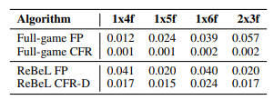
Table 2: Exploitability of different algorithms of 4 variants of Liar’s Dice: 1 die with 4, 5, or 6 faces and 2 dice
with 3 faces. The top two rows represent baseline numbers when a tabular version of the algorithms is run on the entire game for 1,024 iterations. The bottom 2 lines show the performance of ReBeL operating on subgames of depth 2 with 1,024 search iterations. For exploitability computation of the bottom two rows, we averaged the policies of 1,024 playthroughs and thus the numbers are upper bounds on exploitability.
Notes:
This table represents / the exploitability of those algorithms./ For these metrics, / lower values are considered better. / We understand / the ReBuL’s performance of small games / is similar to or less than full games. / However the change toward / big games / is more gradual / than tabular CFR.

Slide 17
Discussions
PBS representation grows linearly with public history size—big games are hard.
Theory guarantee only two-player zero-sum.
Future: PBS compression, general-sum and multiplayer extension.
Notes:
The more history longer, / the more PBS larger, / so / very long games need / more memory. / Also, / the proof covers/ only two-player-zero-sum games. / So future work / is compressing PBS / and extending /for general-sum games / and multiplayer.

Slide 18
Conclusion
ReBeL combines RL and search for imperfect-information games.
Demonstrated superhuman performance in Poker and low exploitability in Liar’s Dice.
Works like AlphaZero when no hidden information.
Significant step for multi-agent interaction research.
Notes:
In conclusion, / ReBeL unites /deep reinforcement learning or RL / and search to handle imperfect-information games. / ReBeL achieves superhuman performance /in Texas Hold’em and Liar’s Dice. / When ReBeL applied / to perfect-information settings, / it behaves / like AlphaZero./ Overall, / this work represents a significant advance toward / general multi-agent / decision-making methods.

