Slide 1
Few-shot Image Generation via Cross-domain Correspondence
Utkarsh Ojha Yijun Li Jingwan Lu
Alexei A. Efros Yong Jae Lee
Eli Shechtman Richard Zhang
Adobe Research UC Davis UC Berkeley
https://arxiv.org/pdf/2104.06820

Slide 2
Abstract
The method described in this paper allows for image generation using a small number of images. (10 or more)
It is necessary to find a way to maintain the diversity of the source domain.
The differences between generated images in the source domain must be maintained in the target domain.

Slide 3
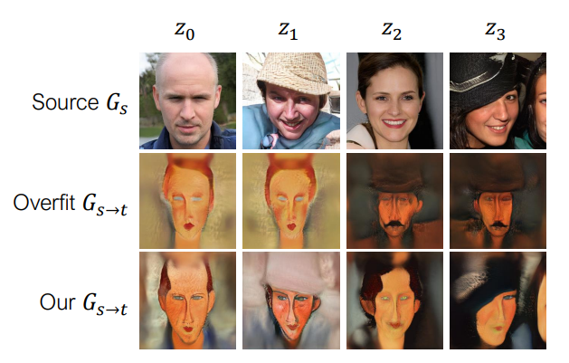
Specifical Example
Let’s consider changing a photo of a person to look like a certain artist.
When we use simple fine-tune, the training data will be output as is, as in the second line. Different source images generate almost same output images.
However, using the method in this paper, it is possible to generate images that capture the features, as in the third line, from very small amounts of images.

Slide 4
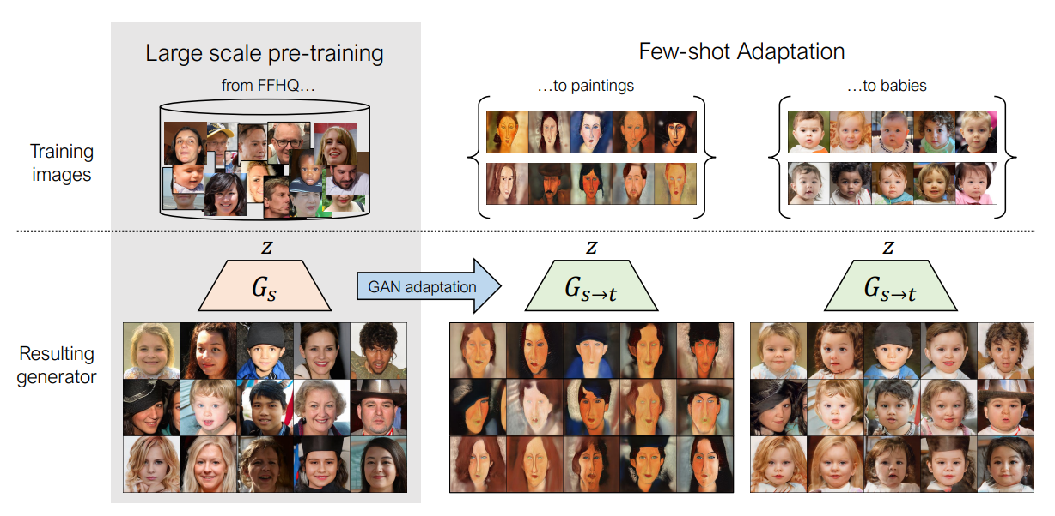

Slide 5
Problem
When using a regular GAN, if the target dataset does not contain at least 1,000 images, it will overfit. (Below formula is regular GAN)
Source generator: Gs Discriminator: D Target dataset (10 or more): Dt
Target generator: Gs->t (We want this!)

Slide 6
Solution
To avoid overfitting …
Maintain diversity in the source domain (Section 3.1)
The discriminator does not remember the dataset (Section 3.2)
I will explain points 1 and 2 in order.

Slide 7
Maintain diversity in the source domain
For a certain latent variable zi and the other N latent variables zj, we focus on the difference in the generated image (Equation 2) and match the source and target.
Equation 3 is the expected value calculated with zi under the above conditions.
Note: “sim” in equation 2 is cosine similarity
(3)

Slide 8
2. The discriminator does not remember the dataset
When the dataset is small, the data distribution A that the generator can learn becomes small, as does the space of latent variables Z.
When determining whether the discriminator is real or fake, the normal discriminator (Dimg) is only used for the above A, and a different discriminator (Dpatch) is used for data that belongs to other than A.
Dpatch performs discrimination on a patch-by-patch basis for input images.
Images generated from the anchor latent space are discriminated using Dimg, and images generated from other latent spaces are discriminated using Dpatch.

Slide 9
Other methods for learning from small datasets
Transferring GANs (simple fine-tune)
Batch Statistics Adaptation
MineGAN (Strongly relate the source latent space to the target latent space)
Freeze-D
Non-leaking data augmentations
EWC

Slide 10
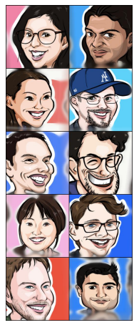
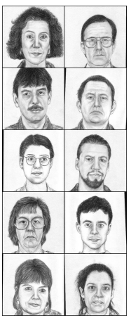
Experiment Datasets
Caricature =>
Sketch =>
These 10 images are all the datasets in each domain.
Buildings, broken cars, people wearing sunglasses

Slide 11
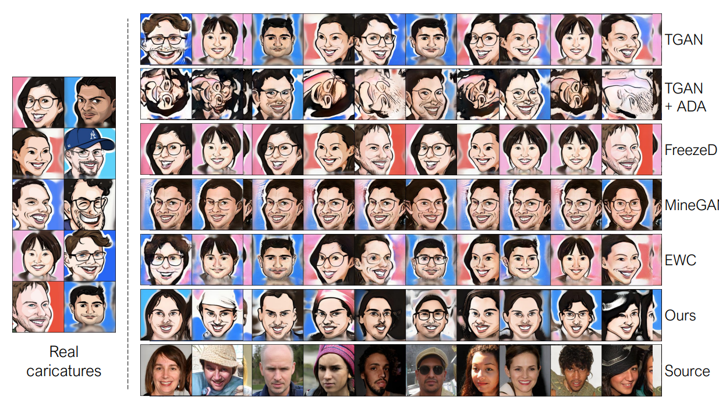
Result
Each vertical column uses the same latent variable.
The training data is often output as is.

Slide 12
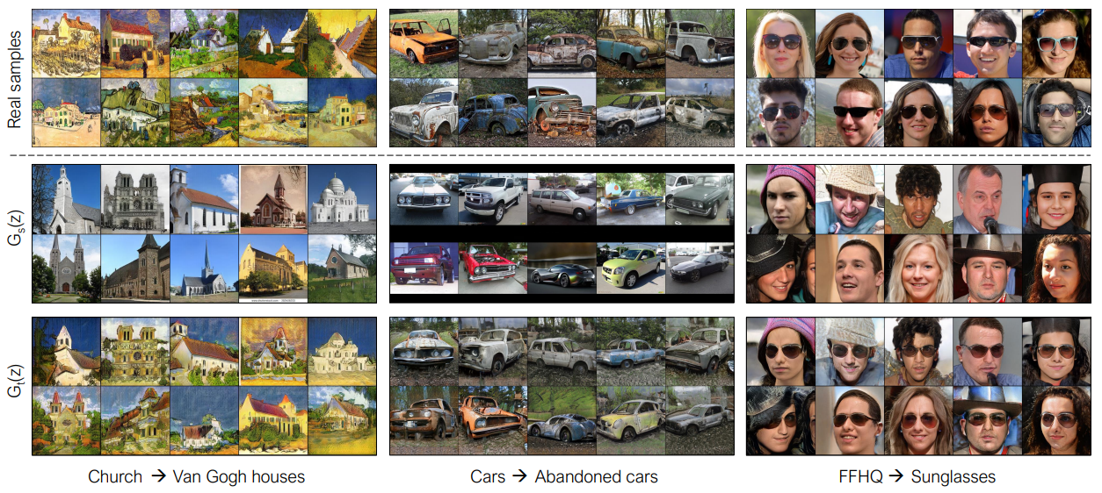
The source generation result (the second line) is made to look like the training data (first line) in its original atmosphere. This is obtained as the target generation result (third line), which is actually shows quite good results.

Slide 13
When transferring between domains with dissimilar image features. If we change the top images of the people to a caricature style in the second row, or a haunted house style in the third row, the characteristics of the original image are revealed.

Slide 14
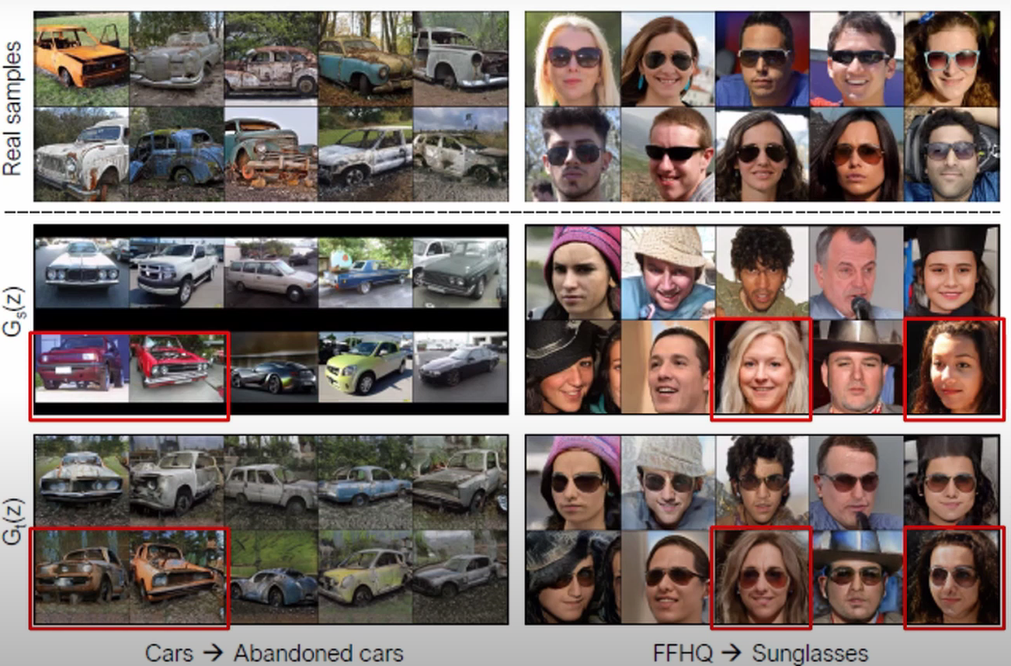
Remaining tasks
In the transformation on the left, a red car turns orange, and when wearing sunglasses, the hair color changes to black.
To generate more diversity, we need to find better correspondences between the source and target domains.

