Slide 1
The Game of Tetris in Machine Learning
Simón Algorta

Slide 2
Abstract
Tetris is an important benchmark for research in AI.
In this context, genetic algorithm and reinforcement learning have achieved excellent results.
However, with unlimited time, AI cannot beat better players.
This research has the potential to contribute to important studies such as feature discovery.

Slide 3
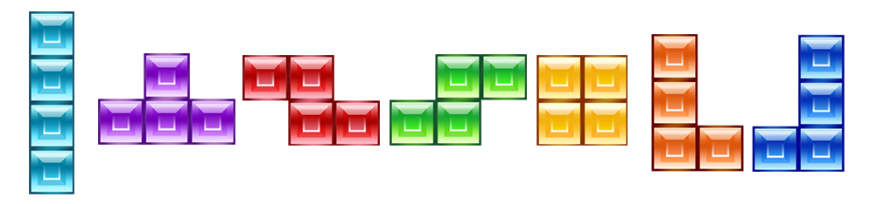
Tetris Game
There are objects called "Tetromino", and you can see what you have now and what you will have next.
Not only erase normally, there are some techniques with big scores with less tetrominoes such as perfect clear, T-spin and streak.
Calculate the evaluation value from the current board and tetrominoes you have and try to maximize it.

Slide 4
Tetris Game 2
There are 7 * 2 ^ 200 states.
It is impossible to explore most of them.
We need to use feature value.

Slide 5
History
1996 (30 lines) - use simple features: number of holes and height of highest column.
2002 (6800 lines) - use difference between the height of successive columns.
2005 (5 billion lines!!!) - use genetic algorithm and added some new features. (only a few changes)
2013 (51 million lines) - use reinforcement learning (it is difficult than genetic algorithm)

Slide 6
Beyond Tetris
Let's consider the open world game.
In such a case, we should use spatial features.
We might need to consider the number of allies to decide attack or retreat.
Anyway, we have to decide which features to use. (it need many experiences)
But it requires experience, and finding general answers are very difficult.

Slide 7
Beyond Tetris 2
In a limited world like Tetris, the number of possibilities is not so large.
But in real world, there are countless parameters. (almost infinite)
How our brains adapt to this situation? (There are many unknowns)
However, we know some of its learning tendencies.
After all, simulating the brain is likely to be the breakthrough for more powerful AI.

Slide 8
Boring personal story
In fact, this paper seems a bit out of date.
Recently, AI is improving rapidly, and some are even rivaling humans.
However, I wanted to learn a basic, so I study the classic Tetris AI in this case.
A few years ago, I wrote a Tetris AI from scratch.
The results were not good (average is 100 lines), but I remember it was difficult to choose right feature.
If I used data that I talk today, I would have a bit better score. (but thinking is fun)

Slide 9
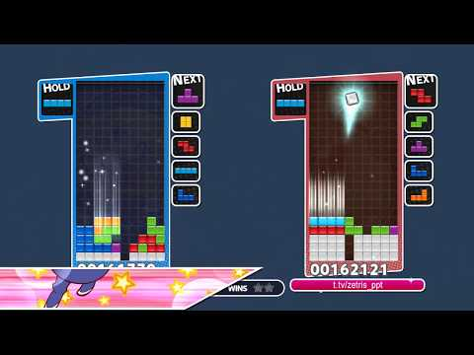

Slide 10
Boring personal story (Conclusion)
It was a learning experience for me (I don't know a lot about AI), but maybe a little too easy for everyone in this lab.
Anyway, thank you for listening!

