Slide 1
Keep Calm and Aim for the Head: Biofeedback-Controlled Dynamic Difficulty Adjustment in a Horror Game
Paraschos Moschovitis and Alena Denisova
IEEE Transactions on Games ( Early Access ) 03 June 2022

Slide 2
Purpose
The aim of this research is to empirically investigate how biofeedback-controlled DDA in a horror game affects the player’s perceived challenge and intrinsic motivation.
They also provided two hypothesizes:
H1: Biofeedback-controlled DDA has a positive effect on intrinsic motivation of players in a horror game.
H2: Biofeedback-controlled DDA has a positive effect on perceived challenge of players in a horror game.
Low-cost light weighted biofeedback-controlled DDA system
Try to keep player calm during playing the game

Slide 3
Game
Caroline is a horror game set in a forest where the player takes on the role of a preacher tasked to exorcise an evil spirit possessing a woman named Caroline.
The player must find and destroy artifacts that the evil spirit is using to draw power before being killed.
The game is designed in an open-world format with different areas to explore and enemies to encounter. Caroline is the main enemy, and there are several instances of her in the game world. She can hear and investigate sounds made by the player, and if seen, she will chase player.
The game has sound cues that range from relaxing to eerie, creating a tense atmosphere. The purpose of the sound cues is to create an emotional bond with the character and signify the location of an artifact.

Slide 4
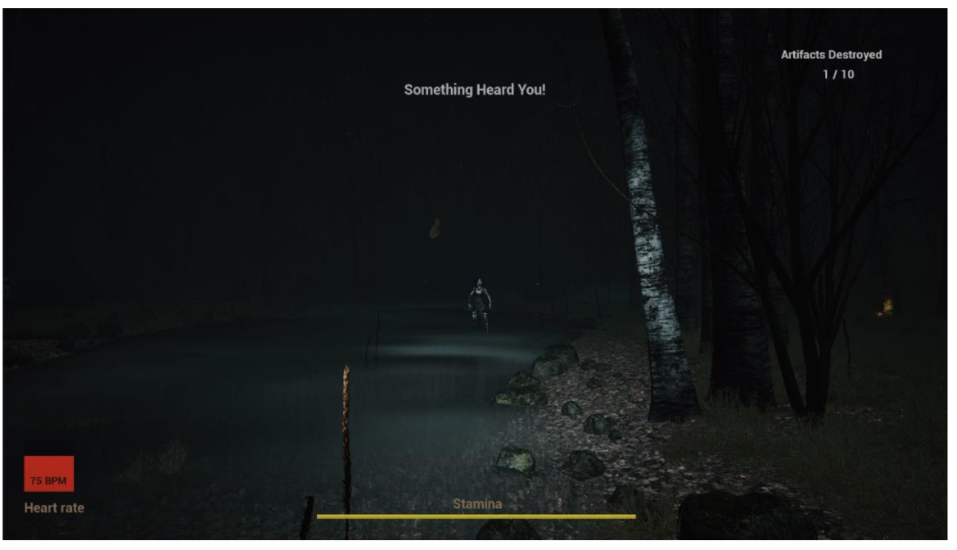
Caroline

Slide 5
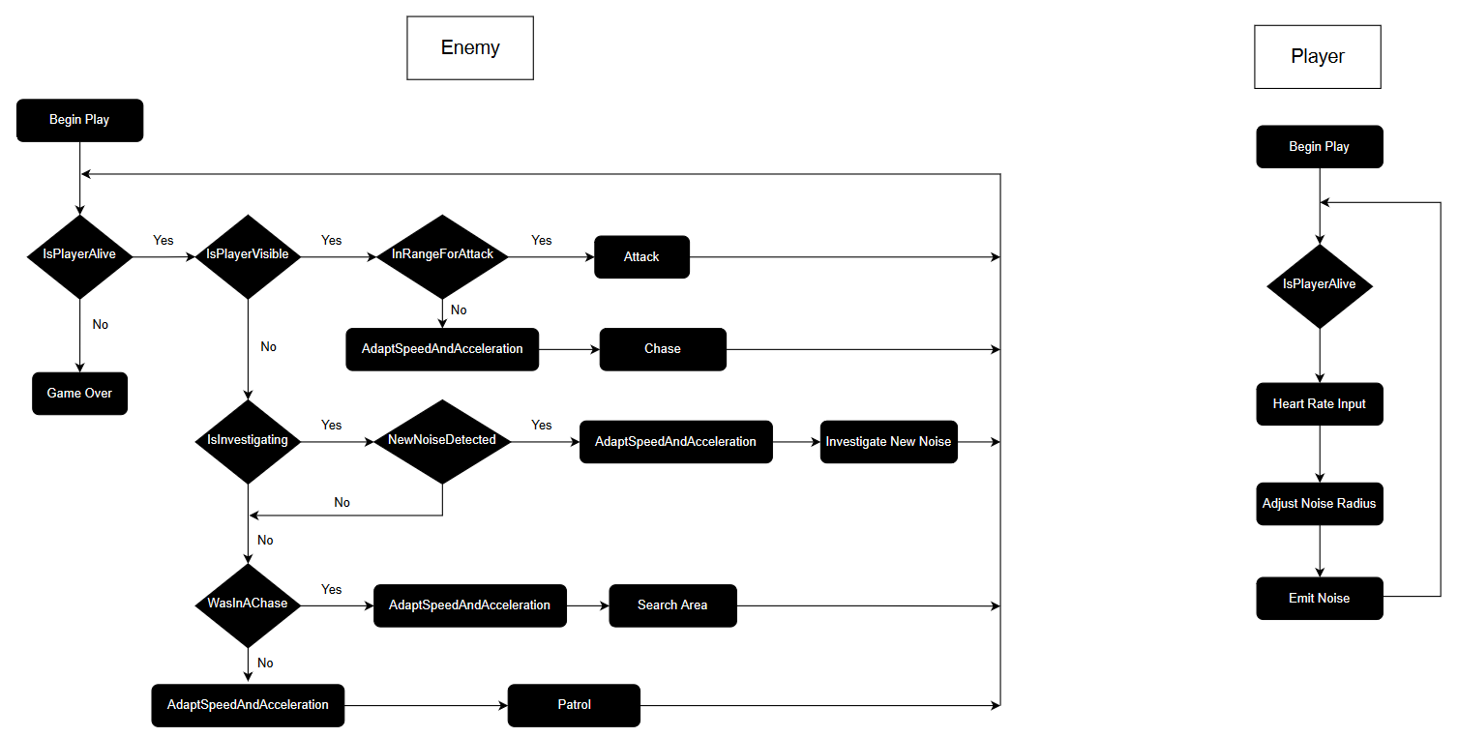
Rules

Slide 6
Method-Dynamic Difficulty Adjustment
If Heart beats range from 75bmp – 120bmp
Max speed and acceleration range from 187.5-300 Unreal Units
Maxim noise radius range from 2812.5 – 4500 UnrealUnits
Caroline:
Player:

Slide 7
Method - Apparatus

Slide 8
Method - Questionnaires
IMI: Intrinsic Motivation Inventory https://selfdeterminationtheory.org/wp-content/uploads/2022/02/IMI_Complete.pdf
CORGIS: The 30item Challenge Originating from Recent Gameplay Interaction Scale (CORGIS) https://www.sciencedirect.com/science/article/abs/pii/S1071581919301491?via%3Dihub

Slide 9
Experiment
Participants were split into two groups(21 per group), one playing a game with biofeedback-controlled adaptive difficulty (experimental), and the other playing the same game without adaptive difficulty (control).
The experimental group was instructed that their heart rate controls the game difficulty. The participants were asked to attach a clip-on heart sensor to their ear and wear headphones, followed by a short calibration stage.
The gameplay session lasted approximately 20 minutes, and after completion, participants were asked to fill out three questionnaires. Each participant was debriefed after the study.

Slide 10
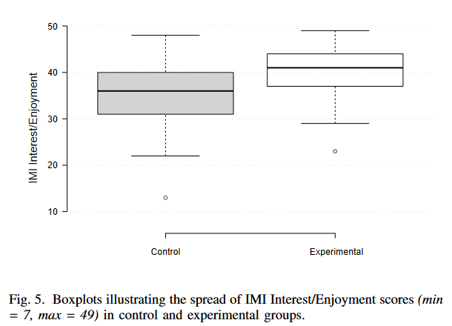
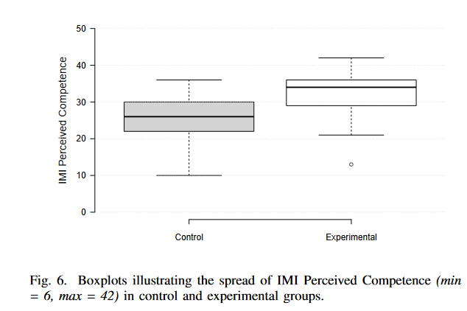
Result
The data were normally distributed, so the researchers used a One-Way ANOVA to compare the means between two groups of players. They also used Pearson's correlation analysis to establish the relationship between two player experiences. The statistical significance was set at p < 0.05.

Slide 11
Result

Slide 12
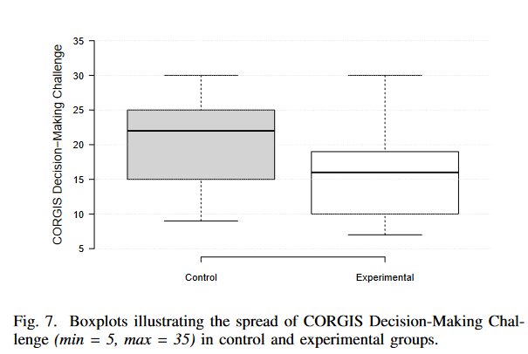
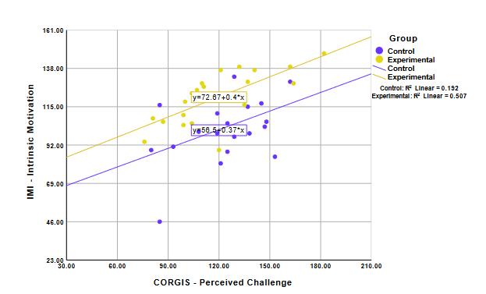
Result

Slide 13
Result

Slide 14
Conclusion
H1: Biofeedback-controlled DDA has a positive effect on intrinsic motivation of players in a horror game.
H2: Biofeedback-controlled DDA has a positive effect on perceived challenge of players in a horror game.
Experience of decision making.
Above all shows that the low-cast light weighted biofeedback-controlled DDA system works as intended and yields improved players experience.

Slide 15
Thanks for listening

