Slide 1
Playing football game using AI agents
Koyel Datta Gupta; Nishthavan Dahiya; Mayank Dabas; Pratish Pushparaj
2022 International Conference on Emerging Techniques in Computational
Intelligence (ICETCI)
Notes:
I will give a presentation about ‘Playing football game using AI agents’.

Slide 2
Abstract
Football is such a complex setting that requires the agent to learn complicated concepts like passing, shooting, dribbling etc and develop tactics to maximize chances of winning.
So, football is suited for the next phase of AI research.
Therefore, the paper takes on the game of football using AI agents.
Notes:
Football is such a complex setting that requires the agent to learn complicated concepts like passing, shooting, dribbling etc and develop tactics to maximize chances of winning. So, football is suited for the next phase of AI research. Therefore, the paper takes on the game of football using AI agents.

Slide 3
Goal
The goal is to contribute the following:
Research and development of two agents for playing football namely, Deep Q Networks (DQN) and LightGBM.
Both DQN and LightGBM are made to play against each other for comparative analysis of their performance.
Notes:
The goal of this paper is to contribute …
Research and development of two agents for playing football namely, Deep Q networks (DQN) and LightGBM based on reinforcement learning (RL) and supervised learning respectively.
And, both DQN and lightGBM are made to play against each other for comparative analysis of their performance.

Slide 4
Google Research Football (GRF)
GRF is an open-source reinforcement learning environment.
The whole game is divided into two halves of 1500 steps each.
Each team does not swap sides.
The paper controls only one player, either the player with ball or the closest player to the ball.
The agent can choose 19 actions such as moving left, long pass.
Notes:
The paper adopts Google Research Football as a football environment.
GRF is an open-source reinforcement learning environment.
The whole game is divided into two halves of 1500 steps each, and each team is assigned a half randomly but does not swap their halves after 1500 steps to keep things simple.
For convenience, the agent controls only one player.
So, if the team is attacking, controls the player with the ball.
If the team is defending, controls the closest player to the ball.
The agent can choose 19 actions such as moving left, long pass.

Slide 5
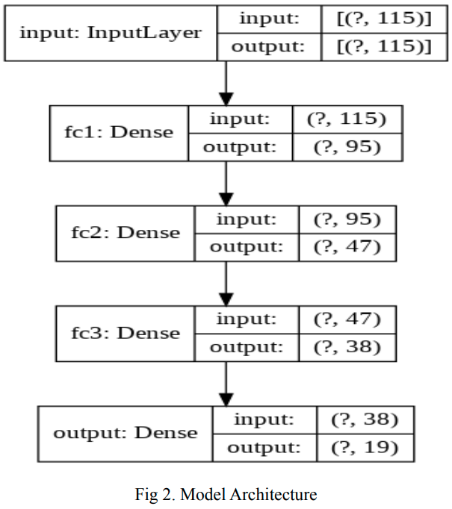
Deep Q Networks
The DQN agent consists of three components:
Model (Action and Target model)
Replay buffer
Exploration method
Notes:
The DQN agent consists of three components, model, replay buffer, and exploration method.
GRF environment returns observation as an arrays of size 115 passed as an input to a neural network with three layers. The agent uses two different model to make its learning more stable.
The first model is known as the ‘Action’ model, which is updated after every training steps. The second is known as the target model, which is updated after copying weights of the value models.
The replay buffer is responsible for storing state, action, and rewards. Once the agent is updated, the agent creates a training set by sampling a batch from the replay buffer.
Exploration method is epsilon greedy.

Slide 6
Light GBM
Light GBM is a decision tree based gradient boosting framework.
Light GBM utilizes two techniques:
Gradient-based One Side Sampling (GOSS)
Exclusive Feature Bundling (EFB)
Notes:
Light GBM is a decision tree based gradient boosting framework used for classification, ranking and varieties of other machine learning tasks.
Light GBM utilizes two techniques known as Gradient-based One Side Sampling (GOSS) and Exclusive Feature Bundling (EFB).
GOSS keeps the information gain estimation more accurate than uniform and randomly sampled data.
EFB bundles exclusive features into a single features, so improving the training speed without impacting the accuracy negatively.

Slide 7
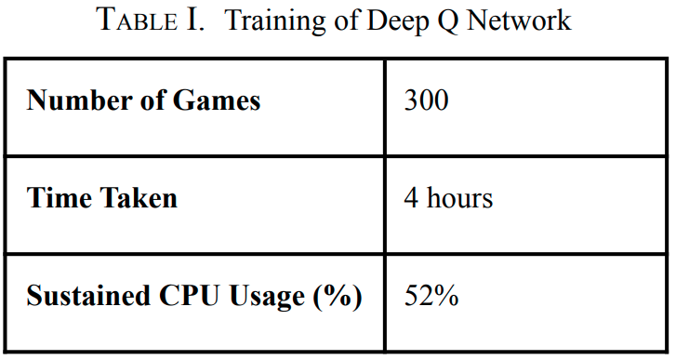
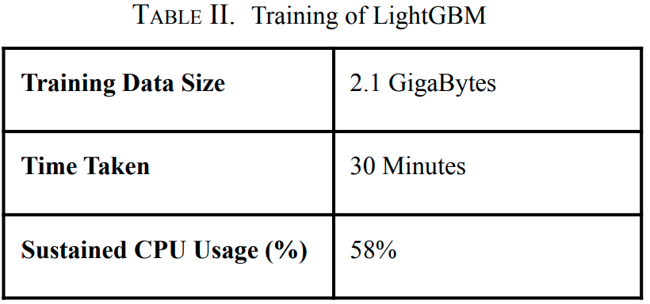
Experiment
Both DQN and Light GBM agent was played run_right agent which always chooses right run operation.
Evaluation Environment
GPU: Nvidia 3060 RTX
CPU: Intel i5 11th gen
Memory: 16GB
Notes:
DQN agent was trained on 300 games. And Light GBM was trained on 2.1 GigaBytes dataset, this size is 100 episode. The dataset is episode replays extracted from Kaggle’s API.
After training, both DQN and Light GBM agent was played run_right agent which always chooses right run operation to measure performance.

Slide 8
Result
vs run_right agent
DQN agent won 4 out of 10 games against run_right agent.
Light GBM agent won all of 10 games against run_right agent.
DQN vs Light GBM agent
DQN agent won 2 out of 25 games against Light GBM agent.
Light GBM agent won 18 out of 25 games against DQN agent.
5 games ended up being drawn.
Notes:
DQN agent won 4 out of 10 games against run_right agent.
On the other hand, Light GBM won all of 10 games against run_right agent.
Also, the paper conducted DQN vs Light GBM agent.
DQN won only 2 out of 25 games, and Light GBM won 18 games. So, 5 games ended up being drawn.

Slide 9
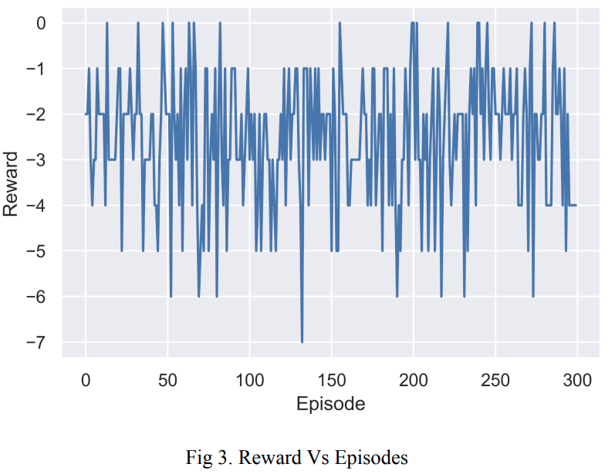
Result
Notes:
This figure is reward/episode graph of DQN.
This graph continues to go up and down even the end of episodes.
This means performance of DQN can further improve by increasing its buffer memory and allowing it to play more games.

Slide 10
Conclusion
Although Light GBM dominated the DQN agent, DQN had a lot better possession rate than Light GBM.
DQN learned concepts like passing, dribbling, and defending more effectively than Light GBM but was struggling to shoot and score the goal.
The reason can be attributed to its lack of more training.
Therefore, provided sufficient computation resources, DQN will indeed outperform Light GBM.
Notes:
In conclusion,
Although Light GBM dominated the DQN agent, DQN had a lot better possession rate than Light GBM.
And DQN learned concepts like passing, dribbling, and defending more effectively than Light GBM but was struggling to shoot and score the goal.
The reason can be attributed to its lack of more training.
Therefore, provided sufficient computation resources, DQN will indeed outperform Light GBM.

Slide 11
Thank you for listening.

