Slide 1
Autonomous Agents in Snake Game via Deep Reinforcement Learning
Zhepei Wei; Di Wang; Ming Zhang; Ah-Hwee Tan; Chunyan Miao; You Zhou
2018 IEEE International Conference on Agents (ICA)
Notes:
I will give a presentation about ‘Autonomous Agents in Snake Game via Deep Reinforcement Learning’.

Slide 2
Abstract
Deep reinforcement learning (DRL) may still need to be improved when applied to more challenging scenarios, where reward signals are sparse and delayed.
This paper develops a refined DRL model to enable the autonomous agent to play the classical Snake Game; whose constraint gets stricter as game progress.
Notes:
Deep reinforcement learning has commonly adopted method to enable the agents to learn complex policies in various video games, but may still need to be improved when applied to more challenging scenarios, where reward signals are sparse and delayed.
So, this paper develops a refined DRL model to enable the autonomous agent to play the classical Snake Game; whose constraint gets stricter as game progresses.

Slide 3
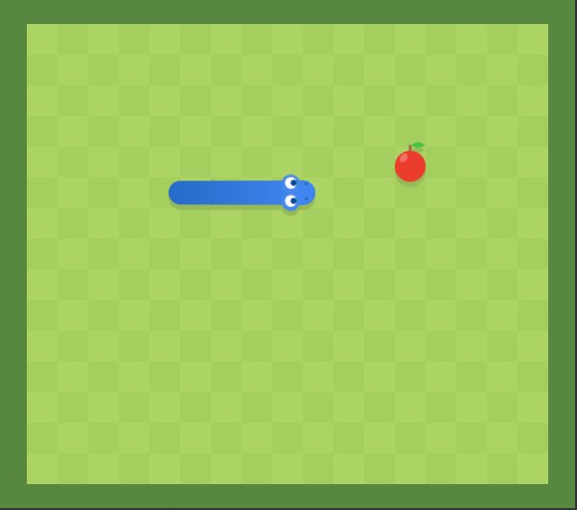
Snake Game
It is the game where the player controls the snake to maximize the score by eating an apple spawned at random places.
If the snake eat an apple, score increases 1 and the snake will grow one grid in length.
If the snake clashes the wall or itself, game over.
Notes:
Snake game is the game where the player controls the snake to maximize the score by eating an apple spawned at random places.
If the snake eat an apple, the snake will grow one grid in length.
If the snake clashes the wall or itself, it’s game over.

Slide 4
Environment
The size of map is 240x240 in pixel and divided into 12x12 large grids.
The initial settings:
Action set consists of UP, DOWN, LEFT and RIGHT.
Length of the snake | 3
direction of the snake | right
position of the apple | random
game score | 0
Notes:
Regarding the environment, the size of game map is set to 240x240 in pixel and divided into 12x12 equally large grids.
The initial length of the snake is 3, and direction is right, and position of the apple is random place, and game score is 0.
If an apple is eaten, a new apple will respawn at random place.
The game score will increase 1 if eating an apple but if the snake clashes the wall or itself, the score will reset 0.
Action set consists of UP, DOWN, LEFT, and RIGHT.

Slide 5
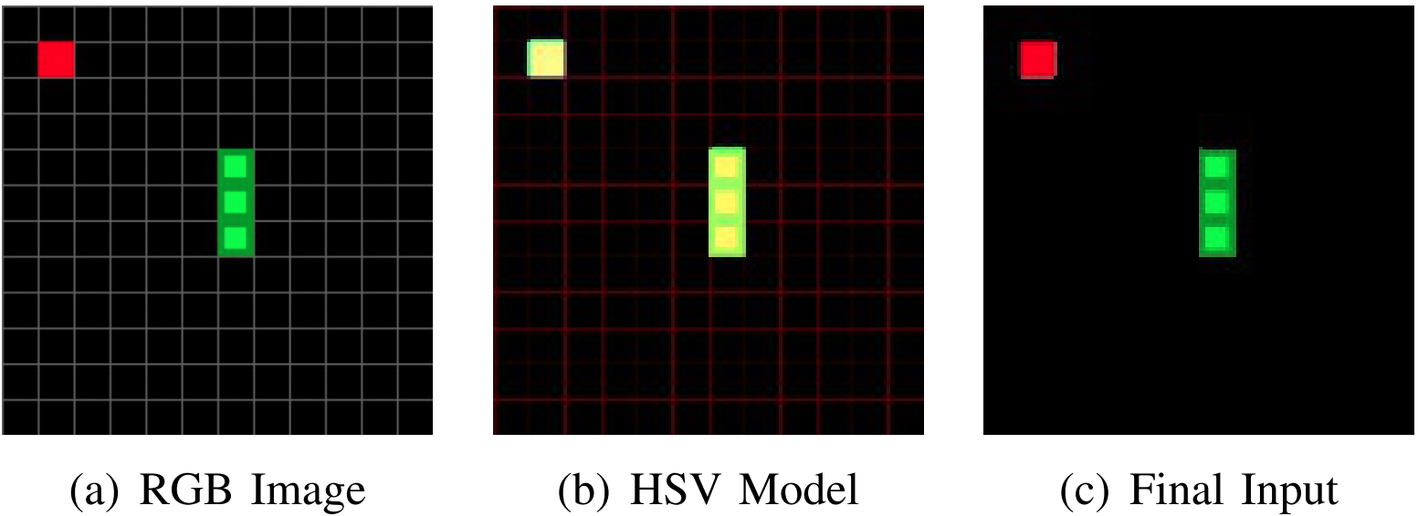
Sensory Input Preprocessing
They resize the size of 240 x 240 x 3 to 64 x 64 x 3.
Notes:
I’ll explain technical details of this refined DRL model since here.
To reduce the dimensionality of the raw sensory input in pixel, they resize the original RGB snapshots to 64x64x3 images.
To avoid interferences by the background, they convert the RGB image into HSV color model and then turn it back to RGB as the final input.
HSV color model can eliminate the unnecessary grids by bitmask.
And, 4 final input are used as the network input because a single frame input lacks necessary information and will fail to recognize the moving direction of the snake.

Slide 6
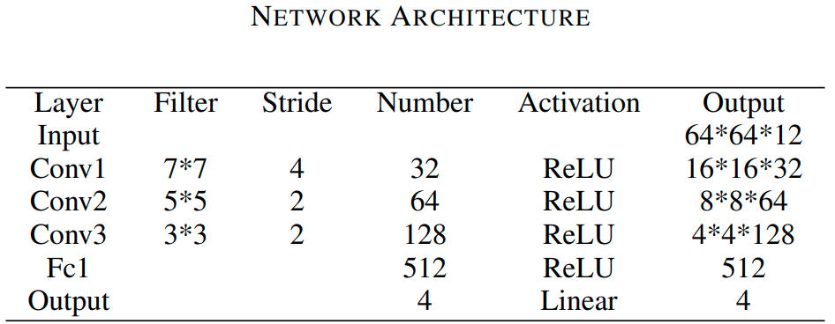
Network Architecture
Notes:
Network architecture looks like this. The reason why the input is 64x64x12 is because 4 images are used.

Slide 7
Reward Mechanism
Distance reward is a mechanism that awards or penalizes agents based on its length and distance from the target as they approach or move away from the target.
where Lt is the snake’s length, Dt is the distance between target and the head of the snake.
Notes:
They use 3 reward mechanism to solve the problem that reward is sparse and delayed.
First is Distance reward.
This is a mechanism that awards or penalizes agents based on its length and distance from the target as they approach or move away from the target.
This reward is represented by this equation.
This equation means that the closer the snake is to the target, the more rewarded; the further away the snake is, the more penalized.
Also, the longer the snake, the less penalty is given for moving away from the target because of needing to avoid clashing itself.

Slide 8
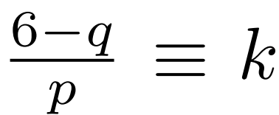
Reward Mechanism
Training gap is a mechanism that prevents the agent from learning for M time steps after it ate an apple to exclude the improper training signals.
where the values of p, q and k satisfy a , so that M(Lt) is continuous at (k, M(k)). In this paper, they heuristically set the training gap, p, q, and k to 6, 0.4, 2, and 10, respectively.
Notes:
Second is training gap.
This is a mechanism that prevents the agent from learning for M time steps after it ate an apple.
This training gap is designed to exclude the improper training signals received when the snake just ate an apple and the location of the subsequently spawned new target suddenly appear in a random location.
This training gap is represented by this equation.
This equation means that the longer the snake, the larger the training gap.

Slide 9
Reward Mechanism
Timeout strategy is a mechanism that if the snake failed to eat any apple over the past P steps, it receives a negative reward as punishment.
In this strategy, P is a positive integer, heuristically set according to the length of the snake as ⌈0.7 * Lt⌉ + 10.
Notes:
Finally it is timeout strategy.
This is a mechanism that if the snake failed to eat any apple over the past P steps, it receives a negative reward as punishment.
This timeout penalty decreases as the snake grows and aims to help the snake avoid hanging around meaninglessly with no intention to reach the target.
Also, P is decided by the length of snake.

Slide 10
Dual Experience Replay
The model use 2 independent experience sets MP1 and MP2.
MP1 stores the experience with higher reward (r ≥ 0.5).
MP2 stores the experience with lower reward (r < 0.5).
At the beginning of the learning process, it increases sampling from MP1's valuable experience early in the learning process. And, as the training progresses, it gradually decrease sampling from MP1 and finally it does sampling from MP1 and MP2 equally.
This strategy is designed to help the agent learn from the valuable knowledge in initial phase.
Notes:
The DRL model also includes improvements to experience replay.
The model use 2 independent experience sets MP1 and MP2.
MP1 stores the experience with higher reward, that is reward is greater than or equal to 0.5.
On the other hand, MP2 stores the experience with lower reward.
At the beginning of the learning process, it increases sampling from MP1's valuable experience early in the learning process.
And, as the training progresses, it gradually decrease sampling from MP1 and finally it does sampling from MP1 and MP2 equally.
This strategy is designed to help the agent learn from the valuable knowledge in initial phase.

Slide 11
Experiment
In total, the agent played 134,000 games, which lasted approximately 7 million steps.
The action selection of an agent is regulated by the ε-greedy policy with ε linearly decays from 0.5 to 0 over the first 50,000 games.
In this work, they set the observation period to 50,000 steps.
Notes:
In this experiments, in total the agent played 134,000 games, which lasted approximately 7 million steps.
The action selection of an agent is regulated by the ε-greedy policy with ε linearly decays from 0.5 to 0 over the first 50,000 steps.
In this work, they set the observation period to 50,000 steps.

Slide 12
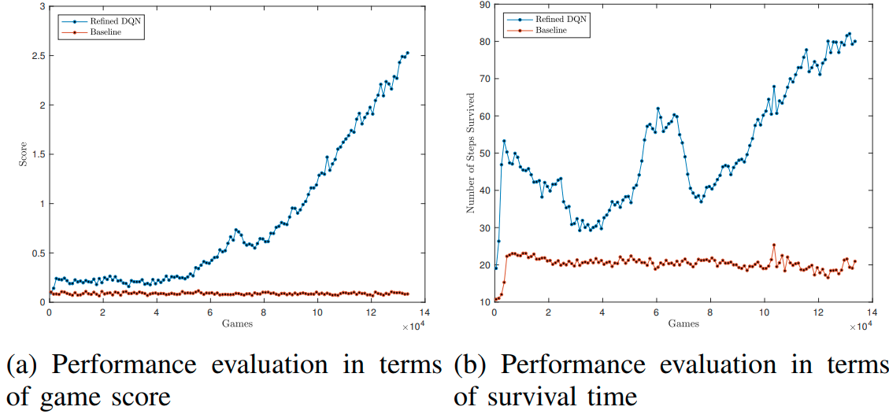
Results
Notes:
Blue line is refined DQN. Red line is baseline model. It is trained in the same manner as refined DQN model, but without reward mechanism and dual experience replay strategy.
This clearly shows that their model outperforms the baseline model in terms of both the game score and the survival time.
Also this shows that the performance of their model in terms of game score increases slowly over the first 50,000 games along with the decay of ε.
Moreover, the performance in terms of the number of steps survived even gets decreasing.
These findings are due to the exploration-exploitation tradeoff.
There is a noticeable peak in terms of the number of steps survived around 50,000th to 77,000th games.
This unexpected peak may be due to the completion of ε decay that the performance of the agent starts to improve as it relies purely on the learned knowledge for decision making.

Slide 13
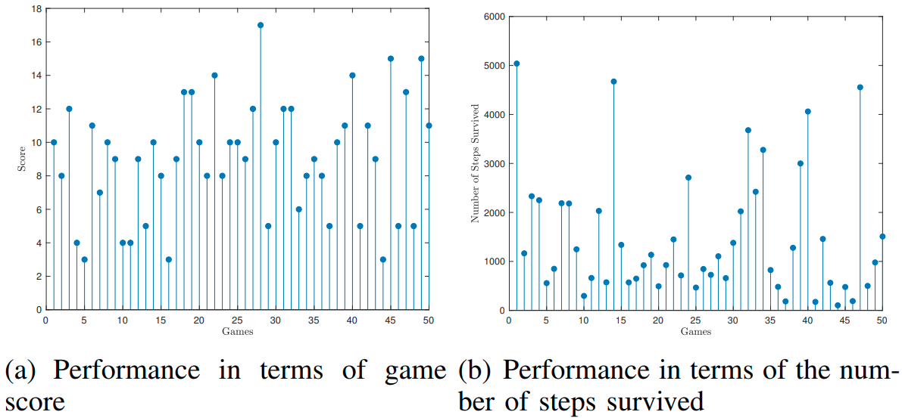
Results
Notes:
This is the result of having the learned agent play the epsilon=0 game 50 times.
In terms of game score, the agent obtains a minimum score of 3, a maximum score of 17, and the averaged score of around 9.

Slide 14
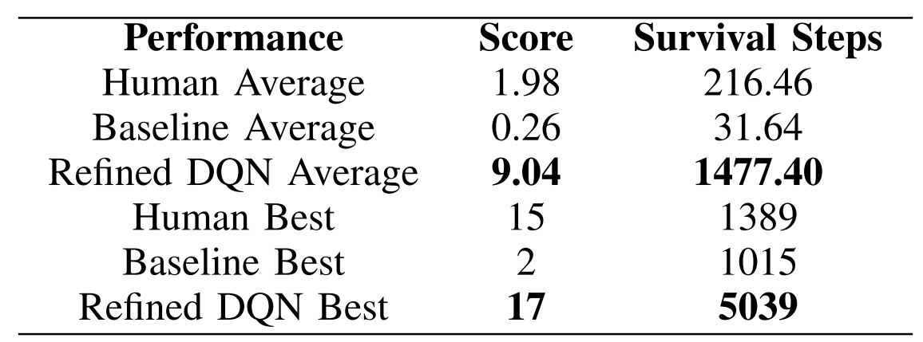
VS Human
Notes:
The results are based on 50 plays with undergraduates students, baseline model, and their model, respectively.
Before undergraduate students play 50 games for performance comparisons, each human player played at least 10 games to get familiar with this particular Snake Game implementation.
This shows that their refined DQN model obtains the best performance on both the averaged and the best categories.

Slide 15
Conclusion and Future Work
The reward mechanism and dual experience replay method improved DQN model.
Going forward, they shall apply their refined DQN model to other similar application scenarios with continuous relocated targets (such as the respawned apples) and gradually increasing constraints (such as the the growing length of the snake).
Notes:
In conclusion, the reward mechanism and dual experience replay method improved DQN model.
Going forward, they shall apply their refined DQN model to other similar application scenarios with continuous relocated targets and gradually increasing constraints.

Slide 16
Thank you for listening.

