Slide 1
A Human-Like Agent Based on a Hybrid of Reinforcement and Imitation Learning
Rousslan Fernand Julien Dossa, Xinyu Lian,
Hirokazu Nomoto, Takashi Matsubara and Kuniaki Uehara
International Joint Conference on Neural Networks. Budapest, Hungary. 14-19 July 2019

Slide 2
Introduction
・Goal: Create human-like AI with high performance
・Method: RL + IL
RL agent is too efficient for practical use
IL agent is human-like but not good in performance
> Mix them

Slide 3
Proposed Method
Two different methods: discrete and continuous
・Discrete action space
ex. Puzzle game
・Continuous action space
ex. Racing car game

Slide 4
Proposed Method (discrete case)
・Policy Distilation
Train student model by distilling teacher policy
(Teacher in this case is RL agent and human)
(https://arxiv.org/pdf/1511.06295.pdf?fbclid=IwAR2P9PcMDwVPLYL_quZlaJIiz5nqhpjIfFWOQbQfFdlVU5Y4Q3WHF1_gWgw)
α: trade-off coefficient between the RL agent and human expert

Slide 5
Proposed Method (continuous case)
・GAIL (Generative Adversarial Imitation Learning)
Learn policy by training Generator to fool Discriminator
α is trade-off coefficient between the RL policy and human expert

Slide 6
In short…
In both cases,
・RL agent is created with another method and human playing data is collected.
・Then, a student agent is trained through mixing RL agent policy and human expert policy.
・α is a weight of RL agent policy and human expert policy.

Slide 7
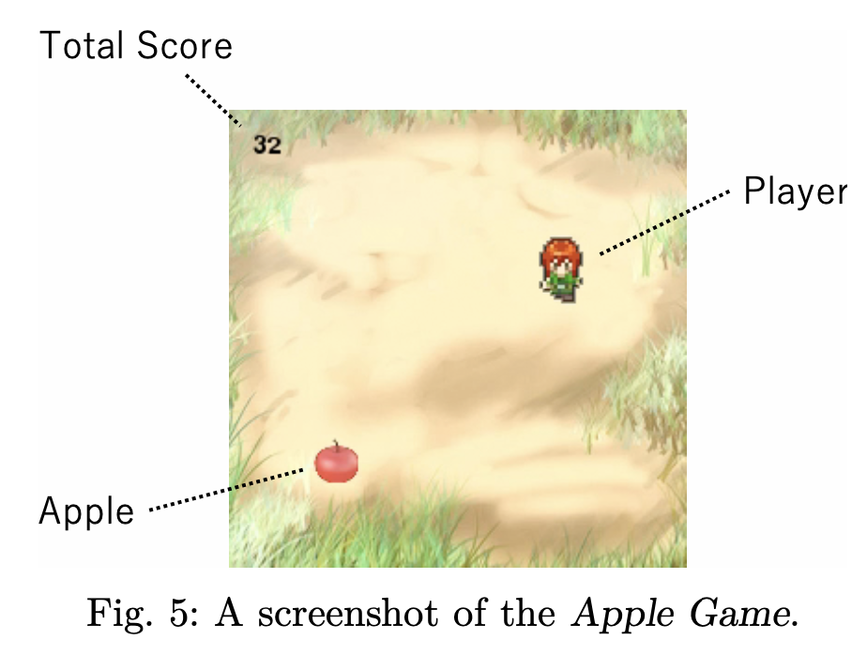
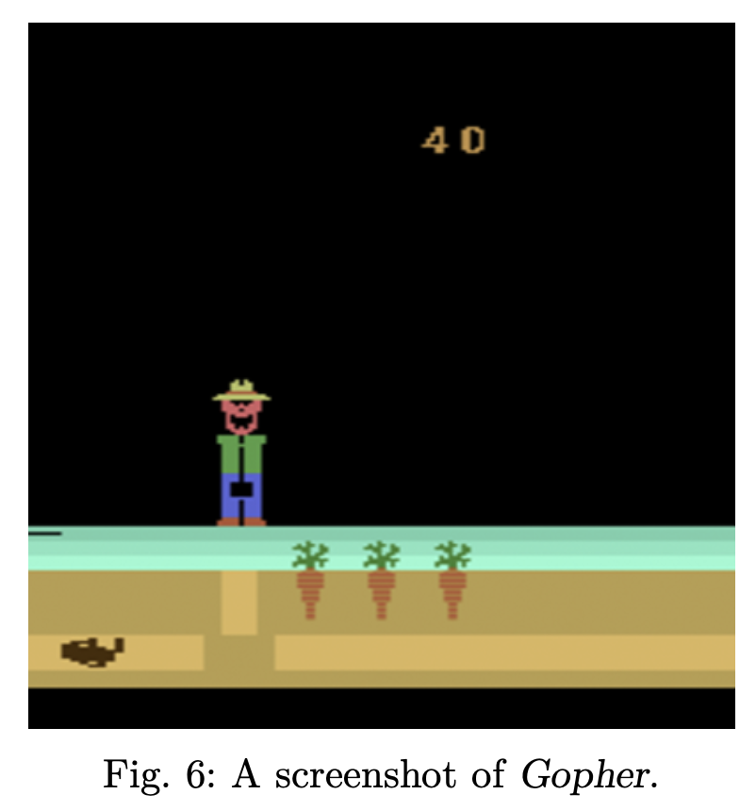
Games for experiment (discrete)
・ Apple Game (original)
Move the character and get apples
・Gopher (Atari 2600)
Control the farmer to protect
his carrot from a mole

Slide 8
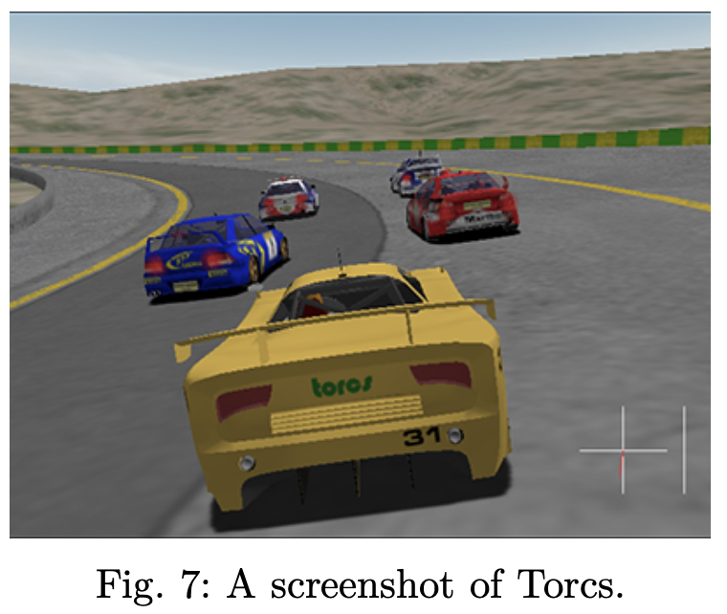
Games for experiment (continuous)
・Torcs
Racing car simulator with obstacles added

Slide 9
Experiments
・Training details
・Evaluation on both performance and human-likeliness
・Human-likeliness is evaluated by sensitivity test.
 | Apple Game | Gopher | Torcs
α | 0.93 | 0.8 | 0.5
RL algorithm | DQN | DQN | DDPG

Slide 10
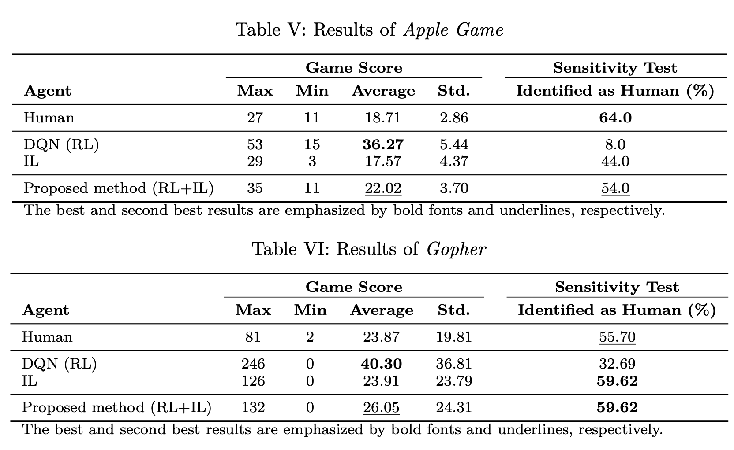
Results and Discussion (1)

Slide 11
Results and Discussion (2)

Slide 12
Conclusion
・They used hybrid method of RL and IL to achieve high performance human-like agent.
・ The created agent was successful in both performance and human-like behavior on the three games.

