Slide 1
Spatial movement pattern recognition in soccer based on relative player movements Plos One journal (2020), by Jasper Beernaerts, Bernard De Baets, Matthieu Lenoir, Nico Van de Weghe
Presentation by Mola Bogdan Georgii

Slide 2
Introduction.
Insights for coaches (or reporters)
Qualitative Trajectory Calculus (定性的軌道微積分)
Levenshtein distance
Compare fragments (with different length)
Notes:
2) a spatiotemporal qualitative calculus describing the relative movement between objects, for spatial movement pattern recognition of players movements in soccer

Slide 3
Method. Qualitative Trajectory Calculus.
Relations between two or more Moving Point Objects (MPOs)
QTC-matrix
QTC sequence or fragment

Slide 4
Fragments.
Visualization of fragment and
QTC matrix sequence
Notes:
The QTCB-matrix sequence describing the spatial movements during this fragment. In the first matrix of the sequence, the movement of each player
from t1 to t2 is described with respect to the position of all other players at t1.
If this movement is towards another player at t1, the QTC-relation is denoted by ‘-’,
if the movement is away from it, the QTC-relation is denoted by ‘+’.
If the movement is neither away from nor towards the marker, the QTC-relation is denoted by ‘0’.
The first character in each cell is the QTC-relation of the marker in the row header with respect to the marker in the column header,
the second character is the QTC relation of the marker in the column header with respect to the marker in the row header.

Slide 5
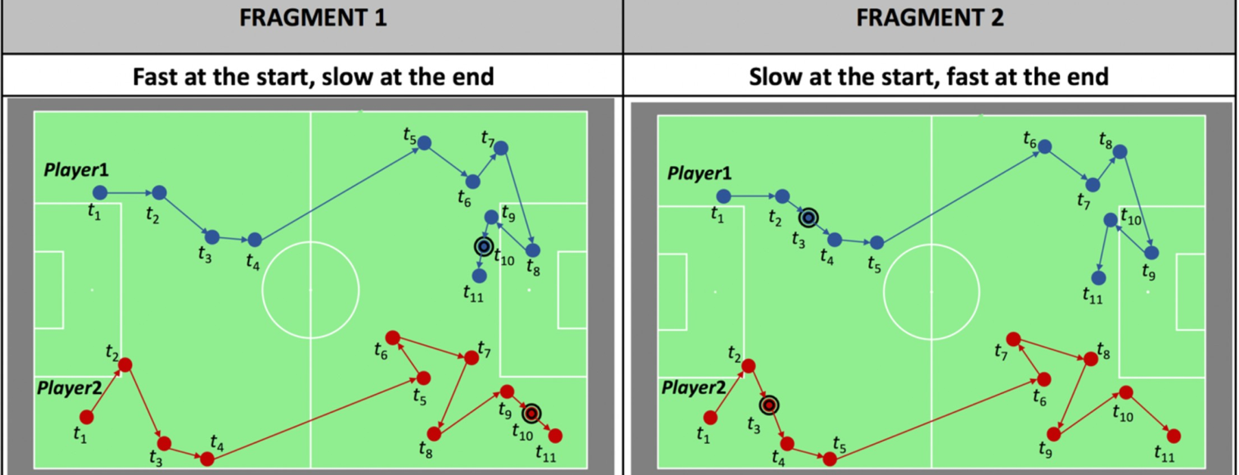
What if speed is different?

Slide 6
Different location.
0
0.1354
Notes:
Current implementation and limitations

Slide 7
Case study
Fragment is 20s
Temporal resolution reduced by factor of 10
Direction of play
Notes:
Anonymized 144086@25Hz records (~96 min)
Data includes x,y,t
“Despite the relative simplicity of this reference fragment, we are convinced that this is a
meaningful and interesting situation for a soccer coach, analyst or reporter”

Slide 8
Results
221 results
Sorted according to distance
Notes:
221 results without overlapping

Slide 9
Validation
221 results
Sorted according to distance
Notes:
the verification of spatial movement pattern recognition methods and their results in sports is not a straightforward task due to the lack of a good ground truth.
Furthermore, due to the huge variety in different methods, it cannot be assumed that finding the same results as other established methods is desirable nor that it should be the goal.

Slide 10
Discussions
Applicable for big data sets
Scale, rotation and translation invariance
Fragments with different temporal lengths can be compared
Reflects “natural” way of soccer situation perception
High computational cost
Ball is not considered (may be done with post-processing)
Notes:
In literature, it is described that, because of the limited accuracy of tracking technologies and the vast number of possible positions of players on the soccer field, it is almost impossible to
find two fragments that contain identical spatial movements [20]. With respect to the first issue, it can be noted that QTC is a relative calculus, meaning that only the relative spatial
movements in two fragments need to be the same in order to be considered as identical
Different static points could be included, however, to fix orientation and scale.

