Slide 1
Dynamic Difficulty Adjustment with Facial Recognition for improving players satisfaction in survival horror game
Andrew, Adithya Nugraha Tjokrosetio, Andry Chowanda
ICIC Express Letters Volume 14, Number 11, November 2020
ICIC International c©2020 ISSN 1881-803X

Slide 2
Purpose (Motivation)
This study aims to apply emotion based Dynamic Difficulty Adjustment(DDA) with Facial Expression Recognition(FER) in order to improve player satisfaction.
Most of DDA implementations are based on player performance. It doesn’t fit the demand of player’s satisfaction.
Emotion based DDA is also less dependent of game genre.

Slide 3
Method - Design
https://www.youtube.com/watch?v=Ws-yd9YPfdE
Game: Five Nights at Freddy’s
Rules:
Player need to survive 5 nights (5mins) in a security room
Player can’t move
Player can control 2 lamps(on/off) and 2 electric doors(open/closed)
Player can check camera to ensure the location of horror figures
Horror figures will be wandering around and move to security room.
If figure reach to security and jump scare the player, game over.

Slide 4
Method - Development
- 2 games are developed. One is with DDA, another one is without DDA.
- They used AFFDEX SDK from Affectiva for capturing and preserving facial features.
By controlling Figure Movement Interval (FMI) to apply DDA. As Formula 1,2,3
- For every minute passed(β), FMI gradually becomes smaller.
- R is a random decimal number between 0 and 4.
- α is emotion/expression value. This value depends : Valence[-100, 100] and Attention[0,100] assigned by AFFDEX SDK.
- αTEMP will incremented by 1 if Valence >=10 or Attention < 10.
- Every 60 secs, α = αTEMP , αTEMP = 0;

Slide 5
Method – Evaluation 1

Slide 6
Method – Evaluation 2
Satisfaction questionnaire is derived from the Game Experience Questionnaire which was filled by participants to evaluate the game in 6 components. Every question is scored between 0-4.

Slide 7
Result and Discussion – Experiment&Group
Experiment and participants
31 Participants with age 18-30.
74.19% male
16.13% liked Horror entertainment
58.06% played or watched FNaF before

Slide 8
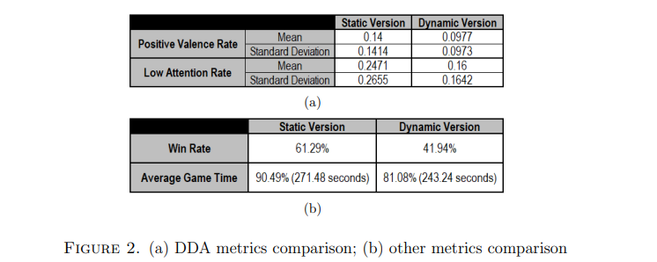
Result and Discussion – statistic result
Wilcoxon signed-rank test is selected as a non-parametric statistical hypothesis test to statistically compare the metrics in both version. The test result reveals a statistically Significant difference (p <0.05) for positive valence rate(p=0.037) and low attention rate(p = 0.043), where the metrics value IN Dynamic Version are lower than those in Static Version.

Slide 9
Result and Discussion -- Questionnaire

Slide 10
Result and Discussion -- Interview
Interview
77.42% participants agreed that the game is scary/thrilling, validating the game capacity as a survival horror.
70.97% participants noticed valid difference between the 2 versions.
81.82% of them agreed that the Dynamic Version is more challenging.
61.29% participants preferred the Dynamic Version, more challenge.

Slide 11
Conclusion and Future Work
FER accuracy
Apply multimodal emotion recognition to addressing FER weaknesses.
Other game genre

Slide 12
Furthermore
There are more and more game related research are about using emotion detection to make affective games( which player’s emotions also lead the direction of game difficulty/plots).
Vanishing scares: Biofeedback modulation of affective player experience in a procedural horror game
https://www.researchgate.net/profile/Eugenio-Oliveira-3/publication/288245996_Vanishing_scares_biofeedback_modulation_of_affective_player_experiences_in_a_procedural_horror_game/links/5885cf2b92851c21ff4d2779/Vanishing-scares-biofeedback-modulation-of-affective-player-experiences-in-a-procedural-horror-game.pdf?origin=publication_detail

