Slide 1
Where we stand now: ongoing lab activities
Maxim Mozgovoy
Active Knowledge Engineering Lab
mozgovoy@u-aizu.ac.jp

Slide 2
Intro
Over years, we got involved in many different projects. Just look at our grad works: https://wiki.rt247a.ddns.me/graduation-works
Not all these topics are equally alive, but there is still a large choice.
Here I explore the projects I participate in right now.

Slide 3
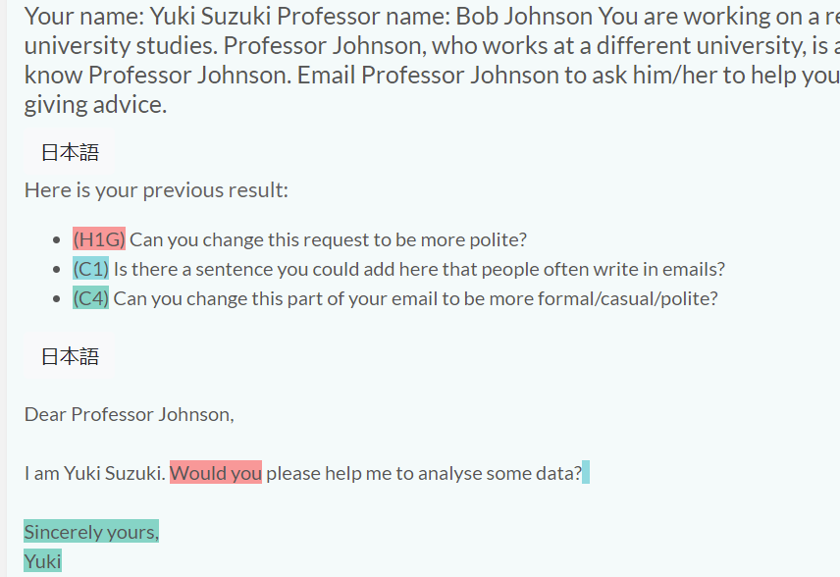
DLA (with Allan Nicholas)
A system that helps the students to write polite emails. Tech: simple rules + some NLP used
Status: close to end

Slide 4
FeatureVisualizer (with John Blake)
A system that highlights important stuff in documents (sections or linguistic elements)
Tech: some rules + quite advanced NLP modules.
Status: close to end but might be extended.

Slide 5
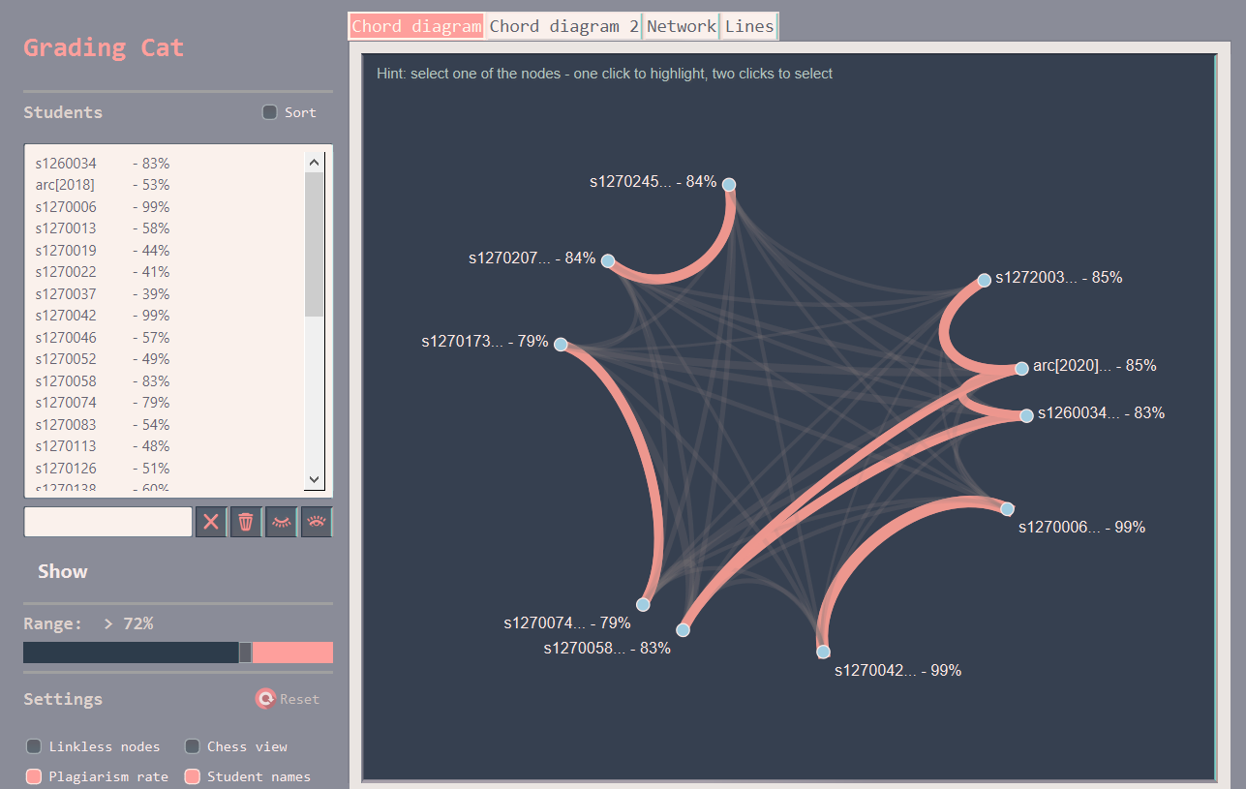
Grading Cat (with E. Pyshkin and Agnes Leung)
A system for plagiarism detection in coding assignments.
Tech: string matching
Status: works, but can be improved a lot (I hope to do it).

Slide 6
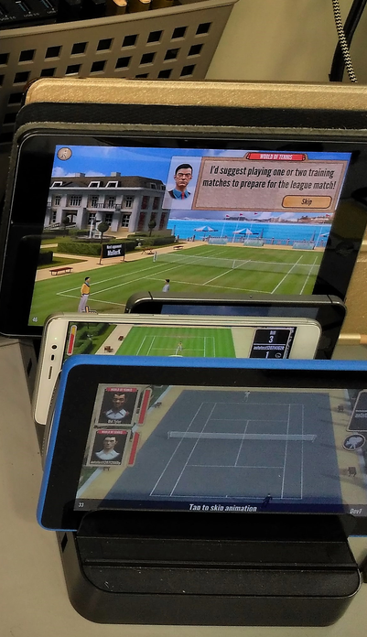
Mobile Farm
A system for automated testing of mobile applications on real devices
Tech: Appium, software engineering, OCR
Status: works but can be improved (in progress)

Slide 7
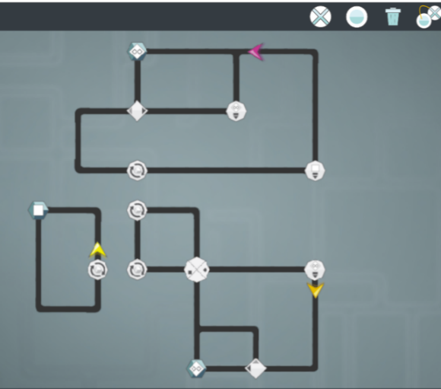
Semaphore Game
A game-like tool for teaching concurrent programming: helps to study and apply primitives.
Tech: model checking (?), software engineering.
Status: just started, needs attention ☺
A similar project “Parallel”

Slide 8
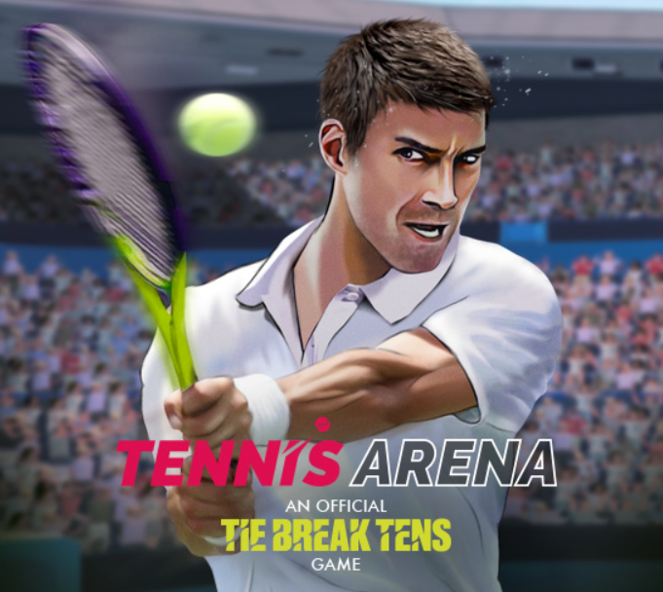
Tennis
A full-size mobile game I took part in.
Tech: Unity, software engineering, AI
Status: ready, but improvements come every day ☺
Can be mostly of interest to people who want to try game dev.

Slide 9
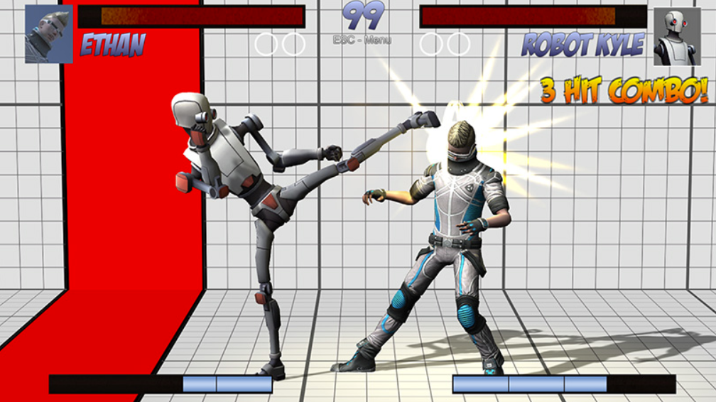
Fighting
Creating a data-driven AI for Universal Fighting Engine
Tech: Unity, game AI
Status: in progress.
Various people are working on different aspects of this task and try different approaches (like MCTS or case-based reasoning).

Slide 10
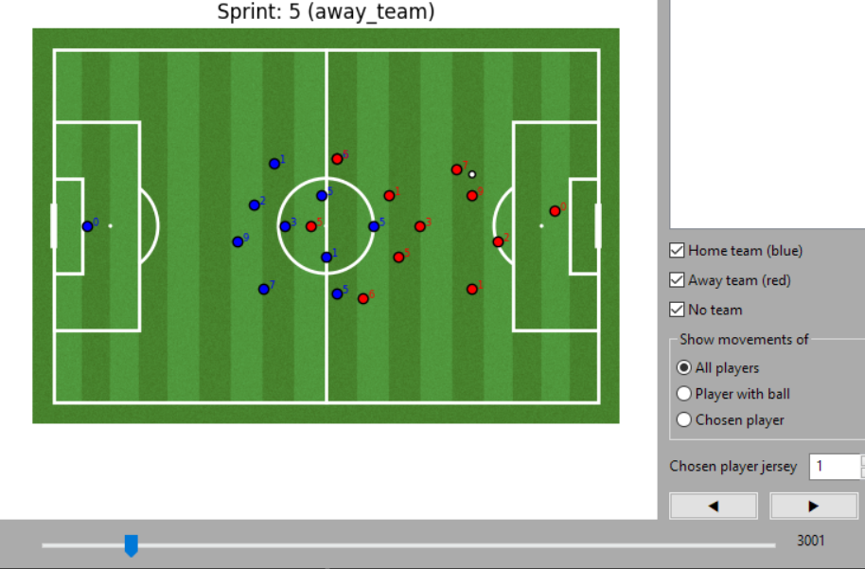
Soccer: Data Analysis & Processing
We analyze real soccer matches to create data- driven AI. To do it, the input data has to be cleaned, marked up, and converted.
We have results, but more functions needed.

Slide 11
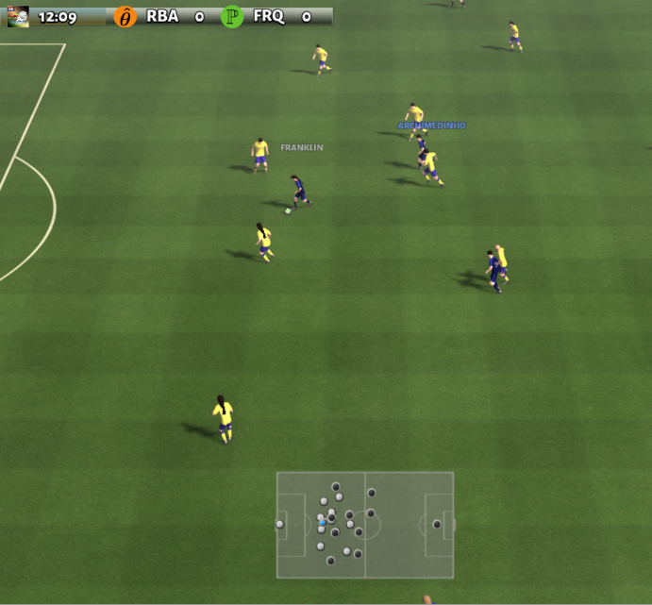
Soccer: Data-Driven AI
I want to create a human-like data-driven AI for Google Soccer.
We need good methods and data.
Tech: various
Status: in progress; testing ideas. A lot of areas to work on.

