Slide 1
Illuminating Generalization in Deep Reinforcement Learning through Procedural Level Generation
N Justesen, RR Torrado, P Bontrager, A Khalifa, J Togelius, S Risi
arXiv preprint arXiv:2018

Slide 2
Current situation
Deep reinforcement learning has shown remarkable results in a variety of different domains, especially when learning policies for video games.
However, agents overfit to their particular training environment, resulting in policies that do not generalize well.
Even small game modifications can often lead to dramatically reduced performance, leading to the suspicion that these networks learn reactions to particular situations rather than general strategies.

Slide 3
Goal
Gain a deeper understanding of overfitting and generalization in deep RL.
-NOT to achieve strong results on human levels.
Explore how procedurally generated levels during training can increase generality.
Notes:
Gain a deeper understanding of overfitting and generalization in deep reinforcement learning , ***which is an important and neglected area in AI research.
Additionally, Explore how procedurally generated levels during training can increase generality.
Procedurally generate mean the level are not created by hand but crated automatically by algorithm.

Slide 4
Goal
Four contributions
1. Show that deep reinforcement learning overfits to a large degree on 2D arcade games when trained on a fixed set of levels.
2. Show that it is possible to overcome such overfitting by introducing Procedural Content Generation (PCG).
Notes:
There are four contributions for understanding them.
2. they show that pcg can be used to create more generic policy than traditional reinforcement learning.

Slide 5
Goal
Four contributions
3. Introduce a particular form of PCG-based reinforcement learning, which it’s called Progressive PCG.
4. Analyze distribution of procedurally generated levels whether they resemble human-designed levels and how this impacts generalization.

Slide 6
General Video Game AI Framework
General Video Game AI framework (GVG-AI) which is a flexible framework designed to facilitate the advance of general AI through video game playing.
Constructive level generators were designed for four hard games in GVG-AI.
Boulderdash, Frogs, Solarfox and Zelda.
Notes:
In this paper, it is building on
Tree-search algorithms do not perform well in these games.

Slide 7
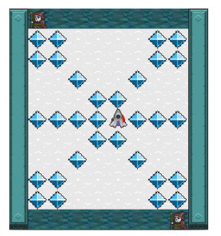
Basic rule and how to generate levels
Solarfox
the player is continuously moving in one of four directions.
The goal is to collect all the gems while avoiding the borders of the level as well as bullets from enemies in the north and the south.
Notes:
Add the player in the middle of the map.
Add some gems either in the upper half, left half, or upper left quarter.
Replicate the same pattern of gems on the remaining parts of the map.

Slide 8
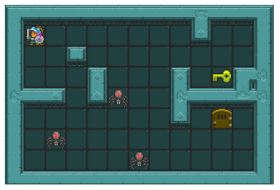
Basic rule and how to generate levels
Zelda
the goal is to grab a key and exit through a door without getting killed by enemies.
Notes:
Generate the map layout as a maze using Prim’s Algorithm .
Remove some of the solid walls in the maze at random locations.
Add the player to a random empty tile.
Add the key and exit door at random locations far from the player.
Add enemies in the maze at random locations far away from the player.

Slide 9
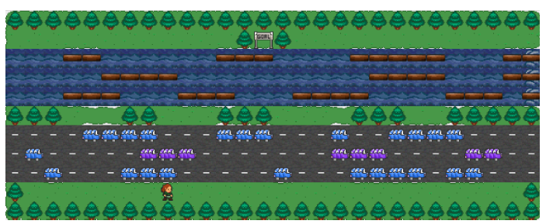
Basic rule and how to generate levels
Frog
the goal is to reach the upper goal while avoiding drowning or getting run over by a car.
Notes:
Add the player at the lowest empty row in the level.
Add the goal at the highest row in the level.
Assign the intermediate rows either as roads, water, or forest.
Add cars to rows with a road and wood logs rows with water.

Slide 10
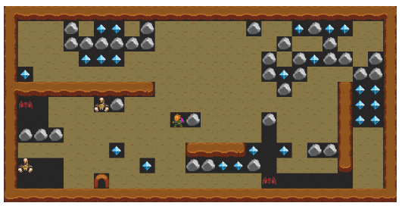
Basic rule and how to generate levels
Boulder-dash
the player tries to collect at least ten gems and then exit through the door while avoiding falling boulders and attacking enemies
Notes:
Generate the layout of the map using Cellular Automata.
Add player, door, at least ten gems, enemies to the map at random locations in sequence.
Generate the layout of the map using Cellular Automata.
Add the player to the map at a random location.
Add a door at a random location.
Add at least ten gems to the map at random locations.
Add enemies to the map at random locations in a similar manner to the third step.

Slide 11
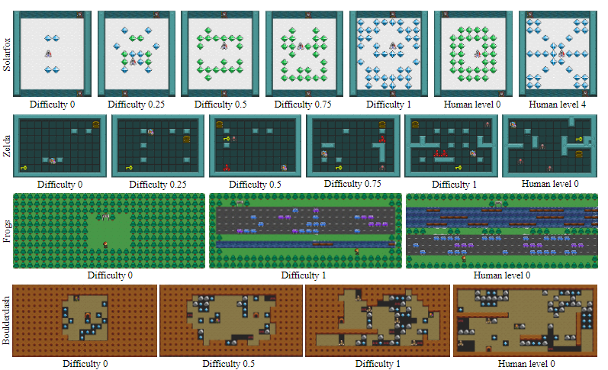
Notes:
This figure shows the effect of the difficulty parameter in the four games.
Human-designed levels are shown as well.
Increasing the (0-to-1)difficulty has three effects:
First, the area in the level where the player can move through (active level size) increases, except in Zelda and Solarfox where the level size is fixed.
Second, the number of objects that can kill the player and/or the number of objects that the player can collect is increased.
Third, the layout of the level gets more complex to navigate.
The three below make it clear. More obstacles.

Slide 12
Progressive PCG (PPCG)
Levels are initially created difficulty of 0.
If the agent wins an episode, the difficulty will be incremented such that future levels during training become harder.
Win: +α / Loss: -α (α = 0.01)
We compare PPCG to a simpler method, also using procedurally generated levels, but with a constant difficulty level. (PCGX)
Notes:
In a supervised learning setting, generality is obtained by training a model on a large dataset, typically with thousands of examples. Similarly, the hypothesis in this paper is that RL algorithms should achieve generality if many variations of the environments are used during training,
This PPCG RL framework will be used to examine that.
In the PPCG implementation in this paper, levels are initially created with the lowest difficulty of 0. If the agent wins an episode, the difficulty will be incremented such that future levels during training become harder. The difficulty is increased by alpha for a win and decreased by the same amount for a loss. In our experiments, we use alpha= 0.01.
We compare PPCG to a simpler method, also using procedurally generated levels, but with a constant difficulty level. Its called PCG X

Slide 13
Experiment
Advantage Actor-Critic (A2C)
GVG-AI Gym framework.
4 training approach
Lv X: Training level is one of the five human-designed levels.(X = 0 and 4)
Lv 0-3: Several human-designed levels (level 0, 1, 2, and 3) are sampled randomly during training.
PCG X: Procedurally generated training levels with a constant difficultyX. (X: 0.5 and 1)
ProgressivePCG (PPCG): Procedurally generated training levels with an adjusted difficulty to fit the agent’s performance
Notes:
To evaluate the presented approach, we employ the reinforcement learning algorithm AdvantageActor-Critic(A2C) [25], specifically the implementation of A2C from the Open AI Baselines together with the GVG-AI Gym framework.
-------
Procedurally generated training levels where the difficulty is adjusted to fit the performance of the agent.
Each training setting was repeated four times and tested on two sets of 30 pre-generated levels with either difficulty 0.5 and 1 as well as the five human-designed levels.
The training plots on Figure2 and the test results in Table 1 are averaged across the four trained models where each model was tested 30 times on each test setup (thus a total of 120 test episodes per test set for each training setup).All four training approaches were tested on Zelda.
Only PCG 1 and PPCG were tested on Solarfox,Frogs, and Boulderdash due to computational constraints.
The trained agents are also compared to an agent taking uniformly random actions(un-learned agent) and the maximum possible score for each test set is shown as well.

Slide 14
Result
Notes:
It shows “smoothed mean scores “ and “level difficulties during training across five repetitions” of PPCG in each games.
The three on the left are curved, allowing for a gradual increase in difficulty, but for Boulder-dush, it is almost constant.
In Frogs, it was very effective to apply padding to easy levels, creating smaller levels in the beginning, while it was not sufficient for Boulder-dash.
It will be next interesting challenge

Slide 15
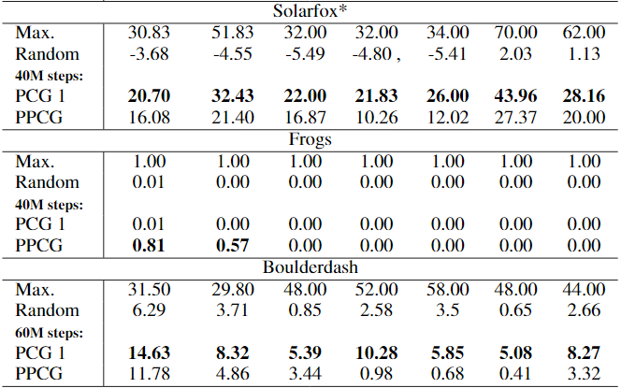
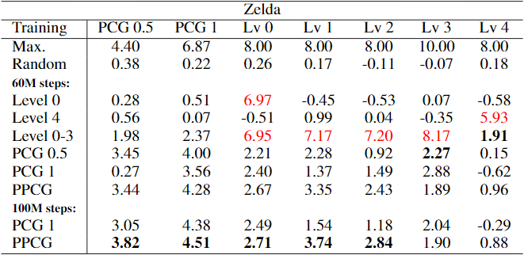
Result
Notes:
The columns show policies trained on the levels. And lines show test on the levels
Scores are in red if the training level is the same as the test level.
In Zelda
Policies trained at level 0 scored high when tested at level 0.
Similarly, level 4 also scored high when tested at the level at which it was trained
but have poor performance on all test levels (human-designed and procedurally generated).
It shows that these are prone to memorization and cannot adapt well to play new levels. a clear indication of overfitting in reinforcement learning.
Policies trained on 4 human-designed levels in Zelda also achieve high scores on all four training levels.
(The testing scores are marginally higher than when trained on a single level, on both the human-designed level 4 and the PCG levels.)
Agents trained on procedurally generated levels with a fixed difficulty (PCG 1) learned a general behavior within the distribution of procedurally generated levels, with common scores in Zelda, Solarfox, and Boulderdash, while no progress was observed in Frogs. PPCG achieves a score of 0.57 in the difficulty 1. 前ページみせる。This is close to human-designed levels.
Think about generalization on human-designed levels,
In Zelda , PCG and PPCG are decent in the human-designed levels.
In frogs, PCG and PPCG are unable to win in the human-designed levels indicating a clear discrepancy between the two level distributions.
In Boulderdash, PCG 1 scored an average of 5.08 to 10.28 (on a 20-point scale) on the human-designed levels
it scored 8.32 to 14.63 on the procedurally generated levels.
In this game, PPCG did not reach the same level of difficulty as the human-designed levels, resulting in lower performance.
PCG 1 outperformed PPCG by an average of 6 higher score.
However, PCG 1 scored similarly on the human-designed and procedurally generated levels in Solarfox, showing remarkable generalizability.
PCG 1 achieved on average a 6 higher score than PPCG on the five human-designed levels. PCG 1, however, shows remarkable generalization in Solarfox with similar scores in human-designed and procedurally generated levels.

Slide 16
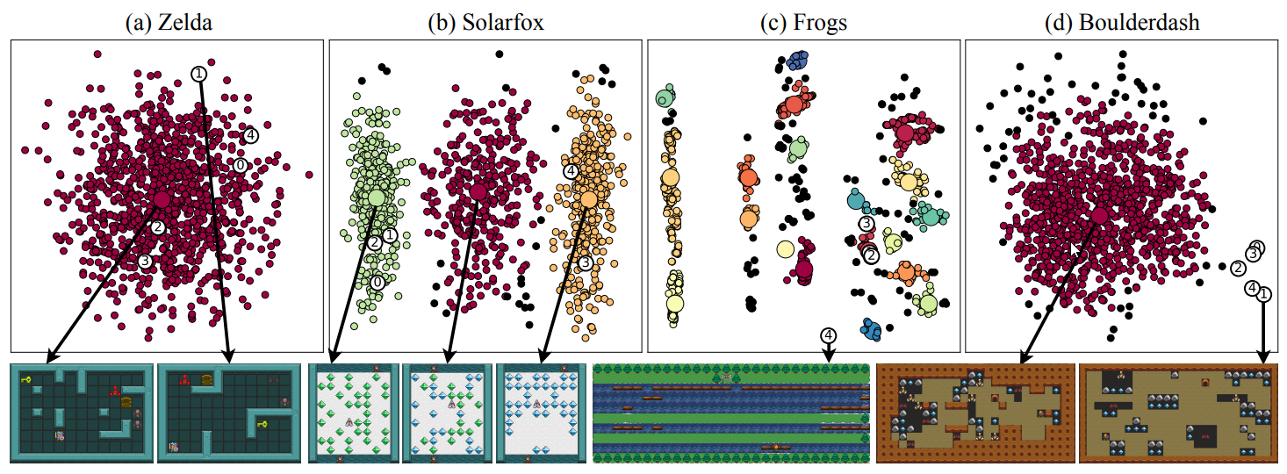
Result
-distribution of generated levels
Notes:
It’ not expect agents to play well on levels that are dissimilar from their training distribution.
To investigate the distribution of the procedurally generated levels, and how the structure of these correlate with human-designed levels, we generated 1000 levels with difficulty 1 for each game.
(
The high-dimensional structure of levels was compressed to two dimensions using principal component analysis (PCA)
and afterward clustered with the density-based spatial clustering of applications with noise (DBSCAN) approach.
)
The white circles are human-designed levels. Outliers are black. And centroids are larger.
Only one cluster appears for Zelda and Bouldering. However, while Zelda has no outliers, the bouldering has all human-designed levels as outliers.
This effect is most likely a result of the fixed amount of open space in the human-designed levels with padding of only one tile while the generated levels are more varied and cave-like.
The levels generated by Solarfox fall into three main groups according to the type of diamonds used: (1) using only green. (2) levels using both green and blue diamonds, and (3) levels using only blue diamonds; none of the human-designed levels use both diamonds and therefore belong to only two clusters.
The generated levels in Frogs have been clustered into 19 groups. This is due to the high structural effect of roads and rivers that goes across the level.
Level 4 stands out as the furthest outlier. This is due to the river in the starting row of level 4, which is a level variation not captured by the frog level generator. Levels 0-3 are around the same small cluster, but the generated levels are spread over many separate clusters; the reason PCG 1 and PPCG are not playable on all levels of the human-designed Frogs is that the level distribution is markedly different from other games, this time not exactly they don’t know.

Slide 17
Conclution
The results of this experiments affirm the original concern with the way reinforcement learning research is often evaluated and reported.
When it is reported that an algorithm has learned a policy that can play a game, it may simply mean that this policy has found optimal actions for a very small subspace of the possible observations the game offers.
Notes:
The authors believe that search-based PCG is an interesting area for future work that could lead to RL agents with more general policies.

