Slide 1
Designing Programming Exercises from Board Games
Maxim Mozgovoy

Slide 2
The Starting Point
When teaching programming, we need a method of choosing exercises that are adaptable, diverse, interesting, and vary in complexity.
Board games is a good option in many cases.

Slide 3
The Real Starting Point
The paper
P. Drake and K. Sung, “Teaching introductory programming with popular board games,” in SIGCSE'11: Proceedings of the 42nd ACM Technical Symposium on Computer Science Education, March 9-12, 2011, Dallas, Texas, USA, New York, New York, USA, 2011.
introduces most of the basic concepts I am addressing. I liked the flow of the paper and wanted to push this discussion a bit further (so, my work is a kind of “upgrade” of Drake & Sung).

Slide 4
The Meta-Problem of Choosing Exercises
Problem: at schools/universities we need to choose exercises.
We can discuss what kind of exercises are “good”.
However, it might be useful to go “one level up” and discuss the method of choosing exercises.
Basically, we need a “pool of ideas” to draw from.
Then we can adjust / filter these ideas according to certain criteria of suitability for a particular case.

Slide 5
Why Board Games are Good Exercises
What are board games and why use them

Slide 6
Board Games as The Pool
The basic suggestion is that the subset of properly filtered board games can serve as a good “idea pool” for coding exercises.
Further topics:
What are “board games”?
Why are they good as exercises?
How to filter them “properly”?
How game properites correspond with exercise goals?

Slide 7
What are Board Games?
Drake and Sung define as “board, card, or dice games that are typically not played on a computer”.
BoardGameGeek.com (BGG) lists some “out of scope” categories including dexterity sports, solo puzzles, video games, playful activities.
Some of these are not easy to separate but still distinct (“solo puzzle” vs “solo card solitaire game”).

Slide 8
Board Games: The Big Picture
BGG lists over 80 categories of board games.
While the genre of board games is ancient, older games generally belong to few categories.
There is a surge of popularity of board games since late 90s with the advent of “Euro Style games… which generally emphasize strategy and co-operation over conflict and luck, and often revolve around economic themes.”* (e.g., Catan).
Most popular games on BGG were released after 90s.
* www.cnbc.com/2016/12/22/millennials-the-board-games-revival-catan-pandemic.html

Slide 9
Why Good Exercises? (1)
Turn-based: makes complex systems like animation or physics optional.
Game rulebook is completely known, no need to reverse engineer.
No need to possess quick reflexes, etc., making game accessibility high.
Can be a good exercise for a pair of people, who can then also test it together by playing.

Slide 10
Why Good Exercises? (2)
Simple and uniform way to make a task more challenging:
Implement a text-based game.
Implement unit tests.
Implement GUI.
Add support for 3+ players (if applicable).
Implement reset functionality.
Implement save/load functionality.
Implement network play.
Implement a game AI system.

Slide 11
Filtering Board Games
Should be quick to play (under 15 mins).
Should be designed for 2 people in principle (with occasional deviations; 3+ player version is a bonus).
Should presume “full information” setup.
Should not involve long tedious tasks such as drawing maps, typing card content, etc. This also removes many copyright concerns (usually, game art is protected while rules are not).
Should not rely on language-dependent elements.
Should be at least mildly engaging (say, BGG rating 5.0+)

Slide 12
Classifying Exercises
The challenges of selecting good exercises

Slide 13
Classifying Exercises (1)
OK, we have a pool of games, but how to select the “right” game for my particular needs?
Surprisingly, there is no good unified taxonomy of tasks for CS.
There are, at best, some attempts to assign attributes to the tasks according to several dimensions.
Thus, we can set independent targets for different dimensions.

Slide 14
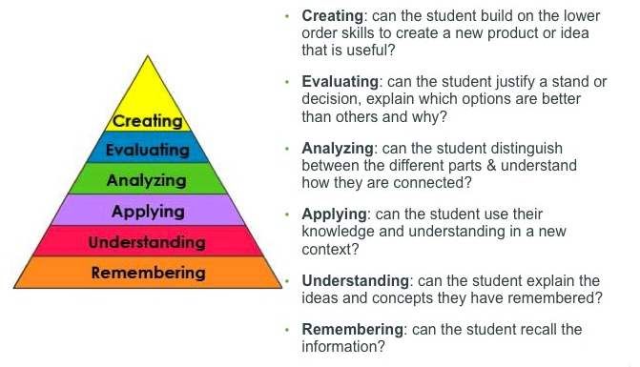
Classifying Exercises (2)
One such dimension is “Bloom’s Revised taxonomy”
In our case it is always “creating”

Slide 15
Classifying Exercises (3)
Other dimensions may include:
Intended student level (beginner/intermediate/advanced). (Probably, the same in our case)
Complexity of the task that can further be subdivided into “math complexity”, “cognitive effort”, “code complexity”.

Slide 16
Classifying Exercises (4)
There is also the dimension of Topics.
Again, no universal taxonomy of topics that we can rely on.
What we can do is, e. g., to take a good book and extract topics from table of contents. Say, in case of K&R book: “Types, operators, and expressions”, “Control flow”, “Functions and program structure”, “Pointers and arrays”, “Structures”, “Input and output”. This list can be significantly language dependent!
In addition, not all topics are equally relevant for board games.

Slide 17
Classifying Exercises (5)
By examining some actual games from the list I’ve decided to use the following topics for now:
Topic | Comment
Basics | Assignments, simple branches and loops.
Arrays | One-dimensional arrays and lists.
2D Arrays | Two-dimensional arrays
Algorithms | Basic algorithms (searching, sorting, etc.)
Algorithms+ | More advanced algorithms like matrix transposition and/or tricky techniques.
Graphs | Graph representations and algorithms

Slide 18
Implementation Aspects
What I code and why

Slide 19
Project Targets (1)
I can’t believe I can accurately evaluate the game unless I implement it ☺
My goal: “level 3 challenge” text and GUI versions, unit tests.
No save/load, networking, AI, etc.
Additional goals:
Isolate the “game core” and estimate its size (LOC).
Understand game category, CS topics, and GUI importance.
Provide a short and simple reference code (Python / PGZero)

Slide 20
Project Targets (2)
It would be also good to ensure a diversity of genres, game complexity scores and other attributes.
Note that some genres are far more prevalent in our game set.
Category
Dice
Abstract
Cards
Economic
Deduction

Slide 21
Results
Around 20 games so far:
https://github.com/rg-software/board-games
Sorted according to LOC and with enough meta information:
Name | BGG Rating | Core LOC | GUI value | Players | Category | Topics
Pig | 5.3 | 25 | Low | 2 | Dice | Basics
Mastermind | 5.6 | 25 | Low | 1-2 | Deduction | Basics, Arrays
…
Blokus Duo | 6.8 | 200 | High | 2 | Abstract | 2D Arrays, Algorithms+

Slide 22
Thanks!
Any questions?

