Slide 1
SoccerNet-Tracking: Multiple Object Tracking Dataset and Benchmark in Soccer Videos
Anthony Cioppa, Silvio Giancola, Adrien Deliege, Le Kang, Xin Zhou, Zhiyu Cheng, Bernard Ghanem, Marc Van Droogenbroeck
University of Liege, KAUST, Baidu Research

Slide 2
Outline
Abstract
Introduction
SoccerNet-Tracking Dataset
Data collection
Tracking annotations
Novelty
Data format
Benchmarks
Conclusion

Slide 3
Abstract
Background:
the availability of datasets to train learnable models and benchmarks to evaluate methods on a common testbed is very limited
Purpose :
Providing a novel dataset for multiple object tracking
Input :
videos from 12 complete soccer games recorded during the 2019 Swiss Super League which are captured at 1080p resolution (Full-HD) and provided at 25 frames per second
Output :
200 sequences of 30s each, representative of challenging soccer scenarios, and a complete 45-minutes half-time for long-term tracking

Slide 4
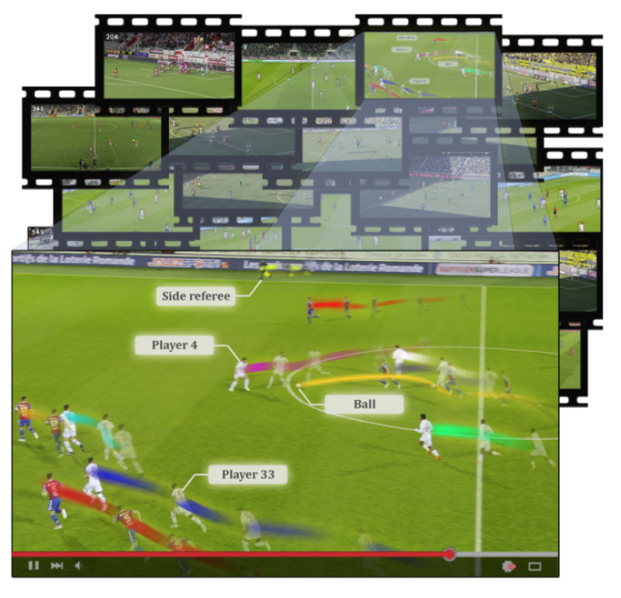
SoccerNet-Tracking
They propose a novel dataset for
Multiple Object Tracking (MOT) in soccer videos including the
players, the ball, and the referees. Their dataset is composed of 200
sequences of 30s each, representative of interesting moments from
12 soccer games, densely annotated with player tracklets, teams
and jersey numbers.

Slide 5
Introduction
players appear visually very similar between each others in soccer videos, with only a few characteristics to differentiate players from the same team (typically jersey number, or shoes color).
Players are often overlapped each others in specific game scenarios (e.g. corners), increasing the difficulty of recognizing them and with a risk of switching their identities.
Tracking the soccer ball is extremely challenging due to its small size (e.g. < 100 pixels), occlusions from players, fast motion, incurring blurring effects, and shape shifting on the video frames.

Slide 7
Introduction
Contribution:
the largest dataset for multi-object tracking in soccer videos. It is composed of 200 sequences of 30s each, fully annotated with bounding boxes and ID tracklets at 25fps, and a complete 45-minutes half-time for long-term tracking.
an extensive benchmark of the most recent multi-object trackers on new new dataset, highlighting the difficulties of soccer players tracking in different scenarios, and providing a first state of the art for the tracking task.

Slide 8
SoccerNet-Tracking Dataset
Data collection
SoccerNet-Tracking sequences consist of main-camera videos from 12 complete soccer games recorded during the 2019 Swiss Super League.
Tracking annotations.
define 5 classes of objects of interest to track, corresponding to the main actors of a soccer game: player, goalkeeper, referee, ball, and other (e.g. medical staff or coaches entering the field).
All bounding boxes are manually annotated as tight as possible around the object of interest at specific key frames.
they have annotated around 3.6M bounding boxes corresponding to 5,009 unique objects, with 96% of players and goalkeepers having a jersey number assigned.

Slide 9
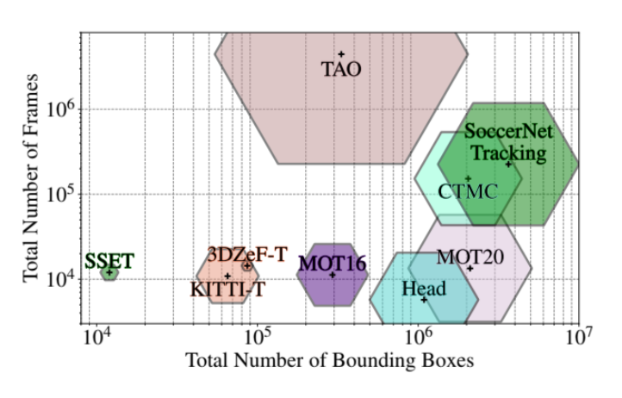
SoccerNet-Tracking Dataset
Novelty
Unlike traditional tracking datasets, we purposely choose to keep the same ID for an object that leaves the camera frame and comes back at a later time during the same clip.

Slide 10
Benchmarks
Task
a pure re-identification task that considers ground-truth detections
a complete tracking task that expects detecting the objects of interest from the raw video.
Baselines(3 MOT methods)
DeepSORT
FairMOT
ByteTrack

Slide 11
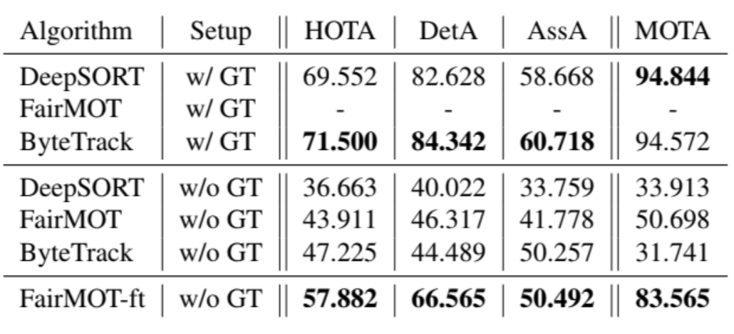
Benchmarks
Metrics
MOTA
HOTA ←current one
Implementation details
DeepSORT and FairMOT → PaddleDetection with input dimension 1088 × 608
ByteTrack →open source code provided by the authors

Slide 12
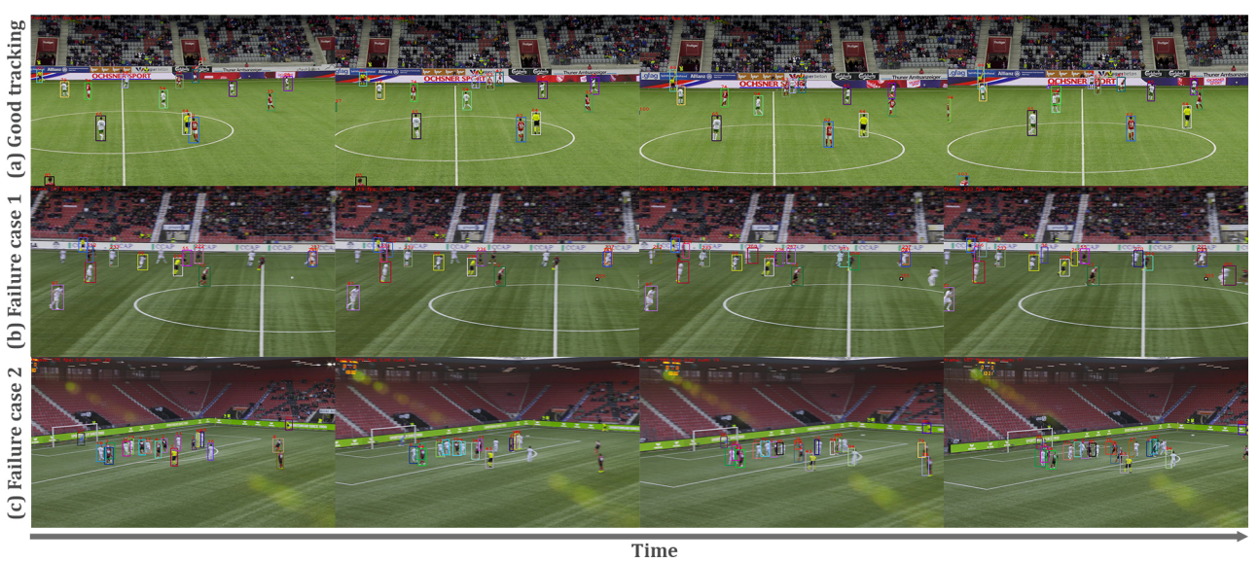
Benchmarks
(a) the players are well tracked even after some players or the referee partially occlude each other.
Sequence (b) shows an example of challenging association due to fast motion of the ball and players be-
tween consecutive frames. Sequence (c) shows a free-kick
scenario, where many players are clustered, resulting in
extreme occlusions and ByteTrack performing very badly.
They hope is that future methods have better re-identification

Slide 13
Conclusion
They proposed the novel SoccerNet-Tracking dataset, which is the largest dataset for multi-object tracking in soccer, featuring challenges such as high-speed movements and highly occluded objects.
As a first approach, they study for multi-object tracking and discuss the challenging situations in their dataset that are not correctly tackled by those methods in their current state.
With SoccerNetTracking, they have set a first benchmark and aim at pushing the computer vision community towards better tracking methods, including long-term re-identification in challenging environments, by organizing tracking challenges

