Slide 1
Measuring the Impact of Memory Replay in Training Pacman Agents using Reinforcement Learning
Fabian Fallas-Moya, Jeremiah Duncan, Tabitha Samuel and Amir Sadovnik Electrical Engineering and Computer Science Department The University of Tennessee Knoxville, United States
Notes:
I will give a presentation about ‘Measuring the Impact of Memory Replay in Training Pacman Agents using Reinforcement Learning’.

Slide 2
Abstract
This paper presents an analysis of the impact of three different techniques of memory replay in the performance of a Deep Q-Learning model using different levels of difficulty of the Pacman video game.
Also, this paper proposes a multi-channel image - a novel way to create input tensors for training the model - inspired by one-hot encoding.
Notes:
Abstract.
This paper focuses on two topics.
The first is an analysis of the impact of three different techniques of memory replay in the performance of a Deep Q-Learning model using different levels of difficulty of the Pacman video game.
The second is a multi-channel image. It is a novel way to create input tensors for training the model.

Slide 3
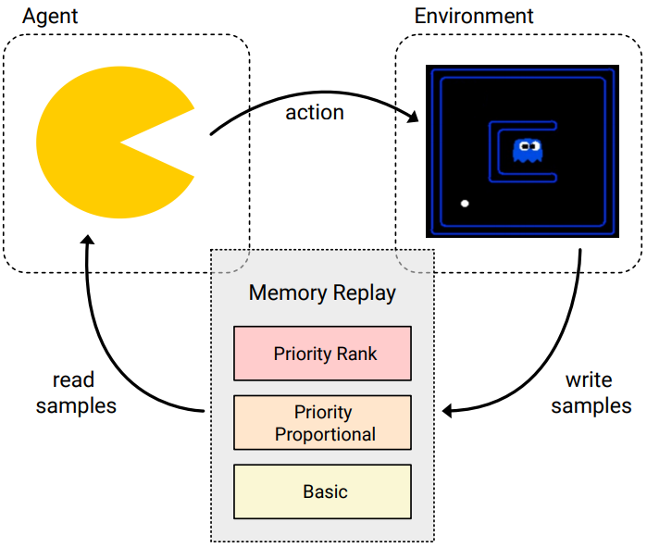
Approach
The main idea is that they have the memory replay as the intermediate buffer from where the agent takes samples for training.
Notes:
This figure shows the idea of this experiments.
Memory replay works as a buffer where the interaction between the agent and the environment generates a lot of future states and the training works by sampling from this buffer.

Slide 4
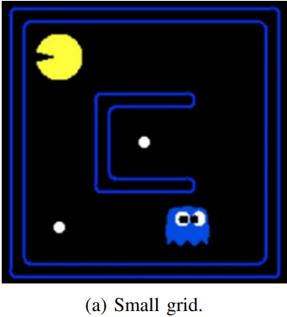
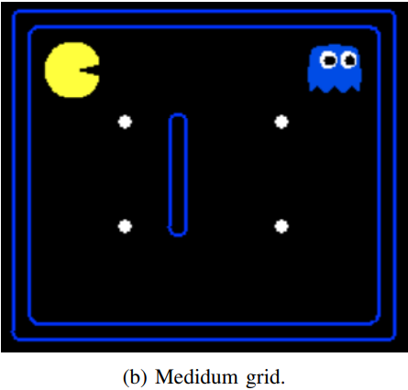
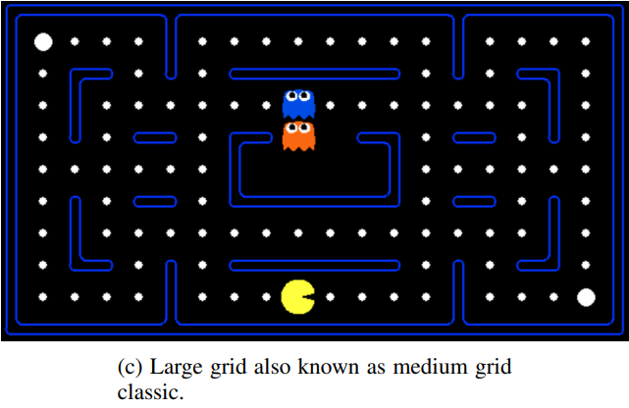
Environment
Notes:
In this work, they use three different size environment.
Two methods are used to make these environments input data.

Slide 5
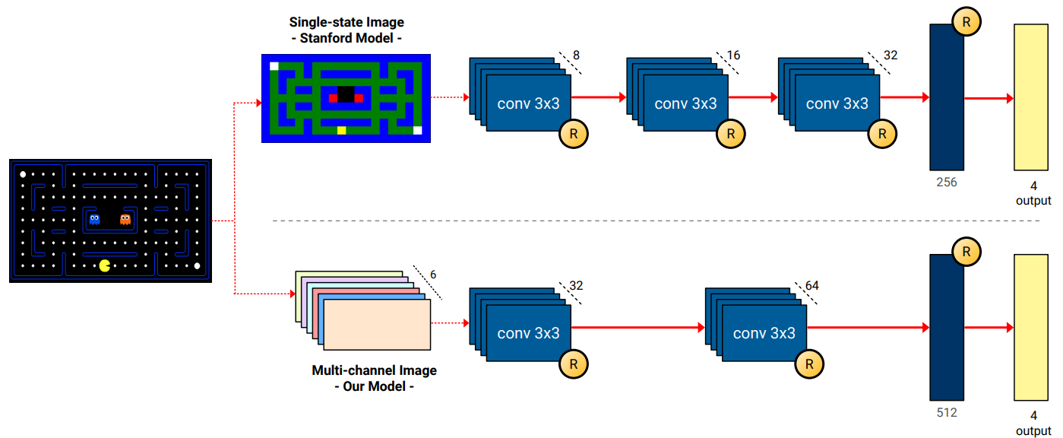
Input methods
Notes:
The first is single-state image. This is by converting the Pacman board and state into an image. The Pacman components are divided into six categories, including Pacman, food, ghosts, each component is distinguished by a different color.
The second is multi-channel image. This is to create 6 tensor where each channel corresponds to one of the different components. For instance, the first channel only contains the position of Pacman, while the second contains the location of walls, and so on.

Slide 6
Action space and Rewards
As for the action space, they allow the cardinal directions and stopping.
Rewards
All time steps | -1
Eaten by a ghost (losing) | -500
Eating food | +10
Eating a scared ghost | +200
Eating the last food capsule (winning) | +500
Notes:
As for the action space, they allow the cardinal directions and stopping to be valid actions.
The rewards are to give -1 points at all time steps, -500 if eaten by a ghost, +10 for eating food, +200 for eating a scared ghost, and +500 for eating the last food capsule.

Slide 7
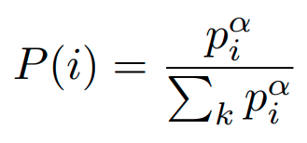
Memory replay
Basic : randomly samples 32 previous time steps.
Proportional : pi = |δi| + ε, ε is a small value
Rank-based : pi = 1 / rank(i) sorts the priorities according to |δ| to get the rank.
where δ is the error on that particular sample.
α and β are two hyper-parameters related to priority replay.
Notes:
The basic replay function stores new experiences in a large deque that gets rid of old experiences once it starts to overfill, and when they perform training steps, it randomly samples 32 previous time-steps.
The proportional priority type increases the priority in proportion to the error. Here, epsilon is a small value to ensure that the priority does not go to zero.
The Rank-based priority type determines priority by ranking according to the magnitude of the error.
There are two important hyperparameters for priority replay.
Alpha helps us to determine the level of prioritization.
Beta is a weighting value that indicates how much we want to update the weights of the model. So, beta controls how much prioritization to apply to the current batch.
Also, two loss functions are used: Huber Loss and Mean Squared Error Loss.

Slide 8
Summary of the options
Notes:
To summarize, the options for experimentation look like this. Also, the stanford model is a single state image and Our model is a multi-channel image.
In the experiments, the hyperparameters are set in all models and grids to the same values as in the paper that proposed the Stanford model because they wanted to give a fair comparison to all models.

Slide 9
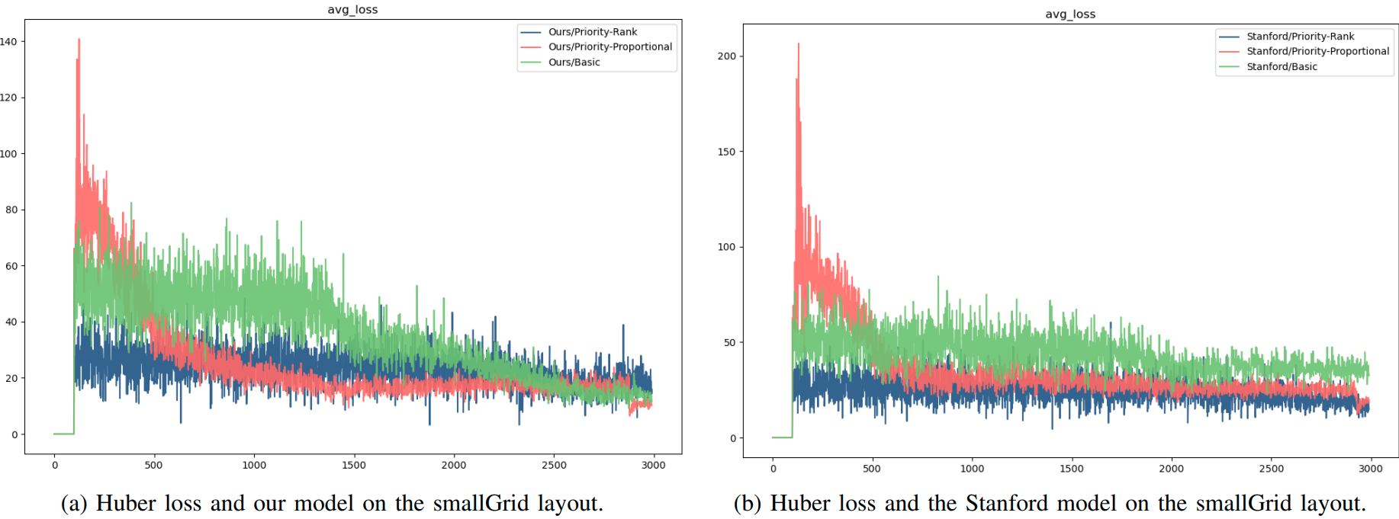
Results during training (Huber and small grid)
Notes:
This result during training is used Huber loss and small grid. The left is used multi-channel image and the right is used single-state image. Blue is Rank-based, Red is proportional, Green is basic.
An important aspect is to realize the size of y scale between the left and right. So, the model used multi-channel model has better results during training.

Slide 10
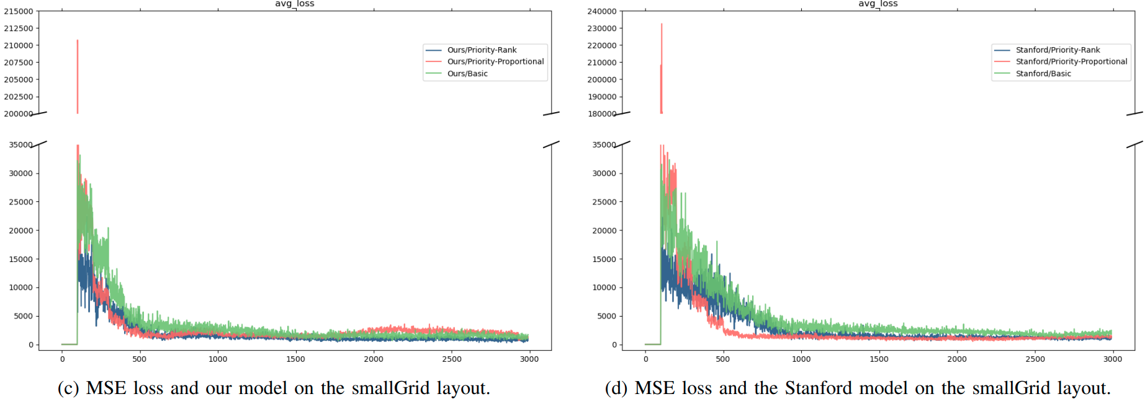
Results during training (MSE loss and small grid)
Notes:
The result is used MSE loss and small grid.
As seen, the three approaches of memory replay have similar behavior. However, by looking at the small differences, rank-based, it’s blue, has the best performance since it shows a linearly decreasing value in the average loss.

Slide 11
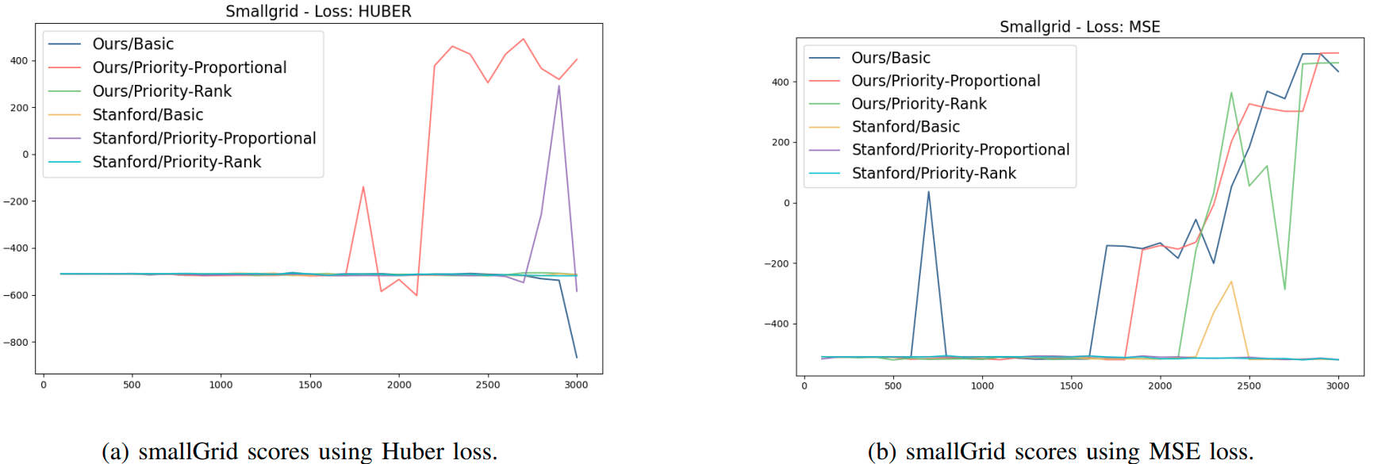
Results during testing (small grid)
Notes:
This shows the testing results for small grid. The left is used Huber loss, the right is used MSE loss.
The small grid behaves better when using MSE, as seen in the right where 3 out of 6 experiments show high scores in the last episodes. However, using Huber loss, just one model has an acceptable result. Also, the three successful experiments in the right were using their model, and it can be seen that their proposed model surpasses the Stanford model in the smallGrid experiments using all three different replay memory approaches.

Slide 12
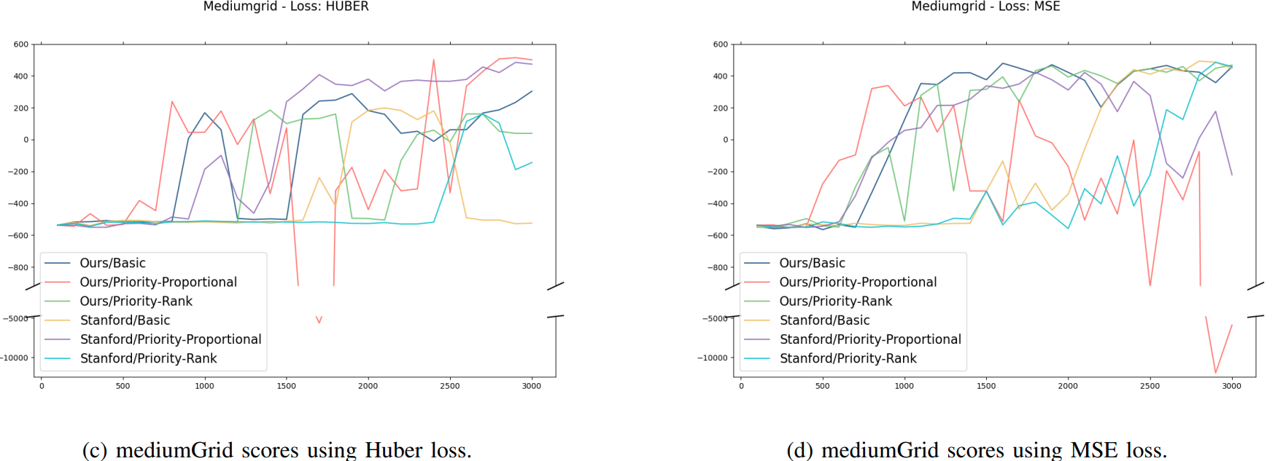
Results during testing (medium grid)
Notes:
This shows the testing results for medium grid.
The left shows that in the case of using Huber loss, the Stanford model and theirs have the best results when using prioritized proportional memory replay.
The right shows when using MSE, the behavior changes drastically where the Stanford model and theirs show the worst performance when using proportional replay. Proportional replays are red and violet.
Furthermore, 4 out of 6 experiments have good results when using MSE, and it seems that the combination here of MSE and basic and rank-based replay have the best results, and their model is more consistent in converging.

Slide 13
Results during testing (medium classic grid)
Notes:
This shows the testing results for medium classic grid.
The left shows using Huber, a trend to increase their scoring results. However, only their model using rank-based and basic replay, they are green and blue, is able to converge and consistently win on the medium classic board.
The right shows using MSE, none of the models are able to converge. Of all the experiments they performed, this is the only one where no positive scores were achieved.

Slide 14
Conclusions
MSE has better results in the small grid and medium grid. However, when using the medium classic grid, Huber has the best results over MSE which does not achieve any positive scoring. Consequently, Huber seems to be the right choice in the Pacman game, and most real Pacman levels are more similar to the medium classic.
Their model along with basic memory replay always shows promising results and it is the most consistent of all the different experiments.
Finally, throughout all the experiments that they proposed model performs better than the Stanford model.
Notes:
From the previous section, the MSE has better results in the small grid and medium grid.
However, when using the medium classic grid which is the most complicated scenario, Huber has the best results over MSE.
Consequently, with simple scenarios, MSE is an acceptable option whereas Huber needs a lot of episodes to converge, but for generalization purposes, Huber seems to be the right choice in the Pacman game, and most real Pacman levels are more similar to the mediumClassic experiment than to the smallGrid and mediumGrid ones.
In any case, their model along with basic memory replay always shows promising results and it is the most consistent of all the different experiments.
Finally, they see throughout all the experiments that their proposed model performs better than the Stanford model.

Slide 15
Future Work
Choosing the model is extremely important in this problem, so an interesting path for future experimentation would be to apply a parameter search to find the best architecture for the model.
Using their novel idea of the multichannel image, they got better results. Definitely, this idea is worth to be used instead of the regular RGB image.
Finally, due to time constraints, they did not implement double Deep Q-Networks (DDQN). It will be interesting to observe if DDQN can achieve comparable or better results than what they have achieved in the same or fewer episodes given that they needed to use 3000 episodes on average.
Notes:
They realize that choosing the model is extremely important in this problem, so an interesting path for future experimentation would be to apply a parameter search to find the best architecture for the model.
Also, they found that using their novel idea of the multi-channel image, they got much better results. Definitely, this idea is worth to be used instead of the regular RGB image when the problem setting allows using this idea.
And finally, due to time constraints, they they did not implement double Deep Q-Networks (DDQN). It will be interesting to observe if DDQN can achieve comparable or better results than what they have achieved in the same or fewer episodes given that they needed to use 3000 episodes on average.

Slide 16
Thank you for listening.

