Slide 1
Reusing Agent’s Representations for Adaptation to Tuned-environment in Fighting Game
Dae-Wook Kim
Electronics and Telecommunications Research Institute Daejeon, South Korea dooroomie@etri.re.kr
Sung-Yun Park
Electronics and Telecommunications Research Institute Daejeon, South Korea tjddbs5671@etri.re.kr
Seong-il Yang
Electronics and Telecommunications Research Institute Daejeon, South Korea siyang@etri.re.kr
2021 International Conference on Information and Communication Technology Convergence (ICTC)

Slide 2
Introduction
It is difficult to keep their performance when the game is updated
this paper will propose a method to adapt to new environment

Slide 3
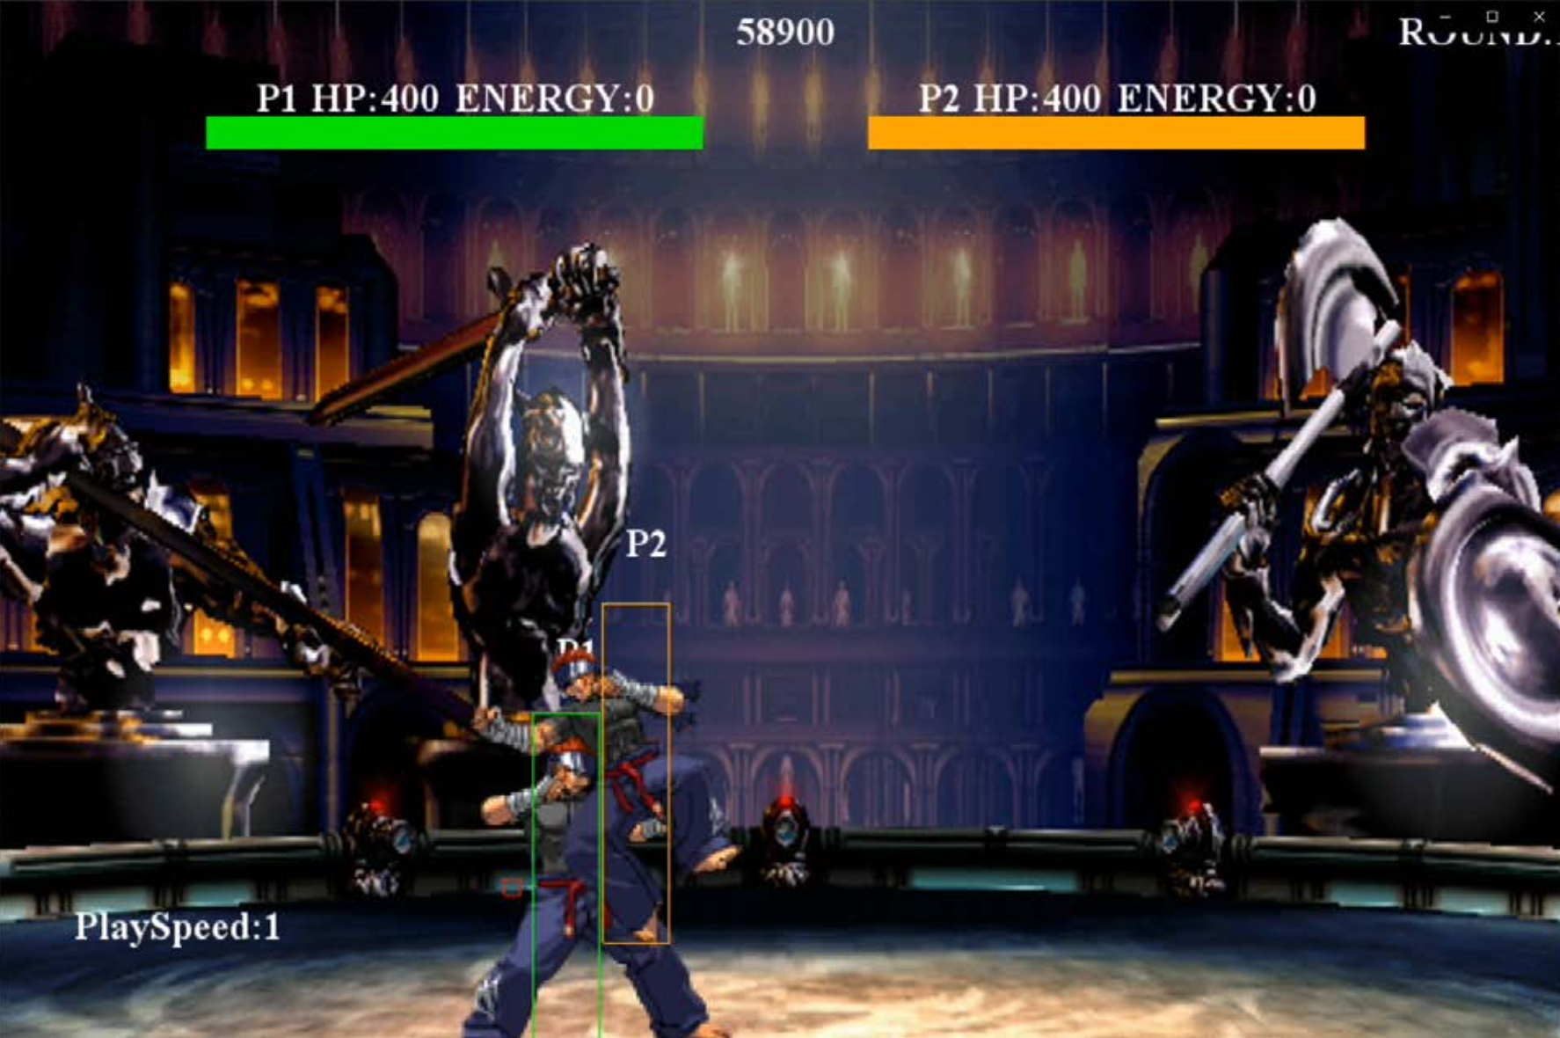
Environments
FightingICE
opponent: MCTS agent
env A: default FightingICE
env B: STAND_B(kick) is nerfed

Slide 4
Two Baseline
Baseline 1: training from scratch
Baseline 2: fine-tuning

Slide 5
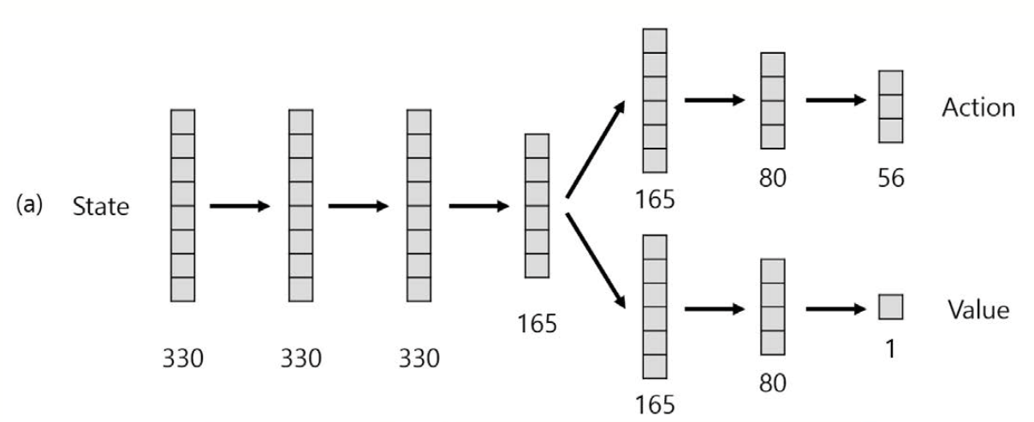
Reusing Representation
Neural Network of Reinforcement Agent

Slide 6
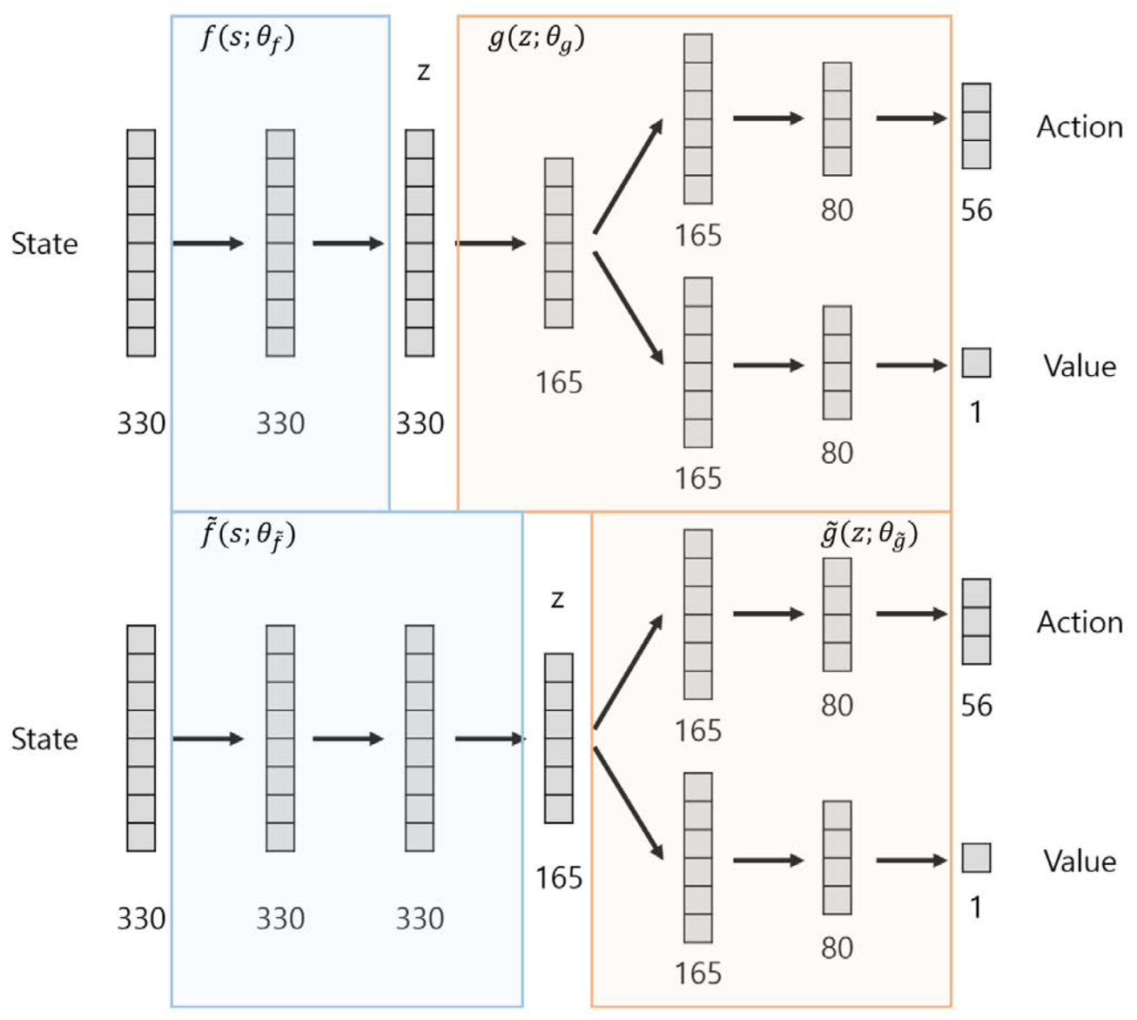
Reusing Representation
cut neural network to feature part and AC function part
Methods
RR v1: freese parameters except AC function g.
RR v2: similar to RR v1, but AC function initialized to a random number.
RR v1 L3
RR v2 L3
L3: first 3 layer is representation function

Slide 7
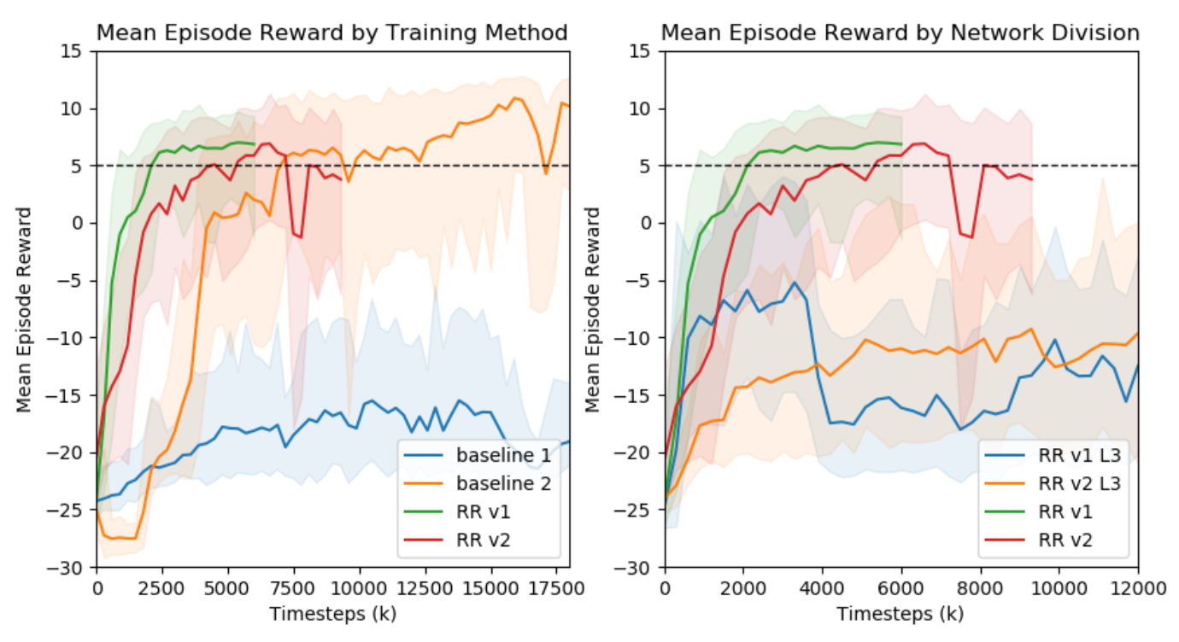
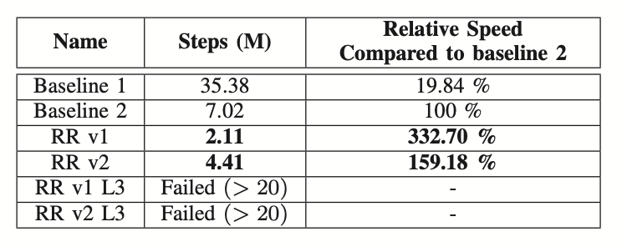
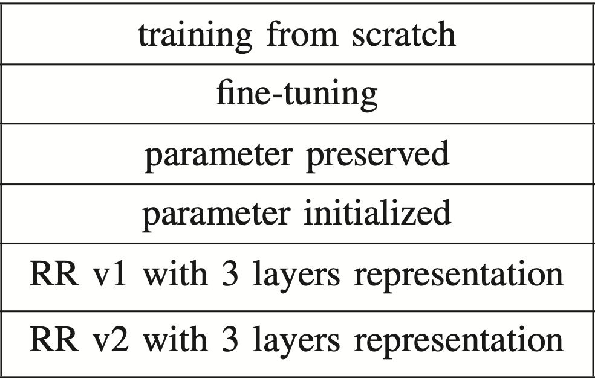
Result
RR v1 was the fastest
L3 took too long time
reason 1
reason 2

Slide 8
Action distributions

Slide 9
Failure of 3 layers representation
Actor-critic function was too small.
Second, policy and value outputs are limited by the representation function.

Slide 10
Thank you for listening.

