Slide 1
Mimicking Human Strategies
in Fighting Games using a Data Driven Finite State Machine
S. Saini, P. W. H. Chung, C. W. Dawson
2011 6th IEEE Joint International Information Technology and Artificial Intelligence Conference

Slide 2
Introduction
Purpose
Create fighting game AI that mimics human player
Approach
Imitate strategy and tactics of human player
> Strategy: long term (Inner, Outer, Defend)
> Tactics: short term (a move, combo)

Slide 3
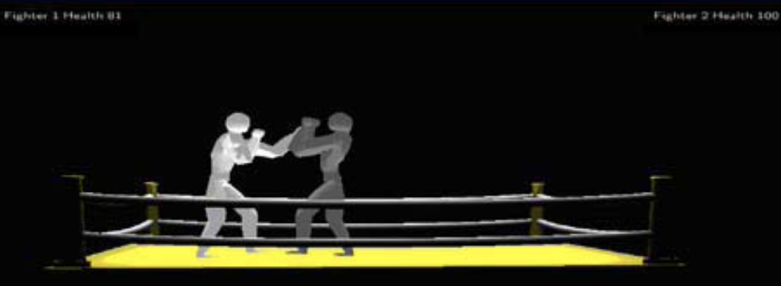
Proof of concept game
Original 2D fighting game is created for this research
Rules
Attack, block and move forward, back
20 moves
Each move has different range

Slide 4
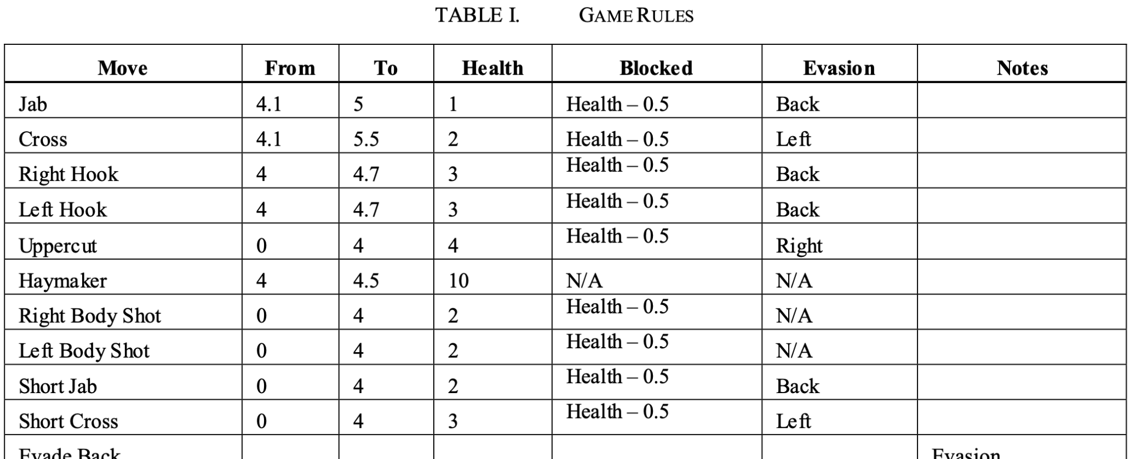
Proof of concept game

Slide 5
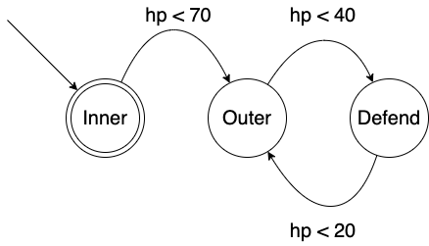
Finite State Machine (FSM)
Popular behaviour model
Consists of states and transition functions
State: strategy
Transition function: based on hp

Slide 6
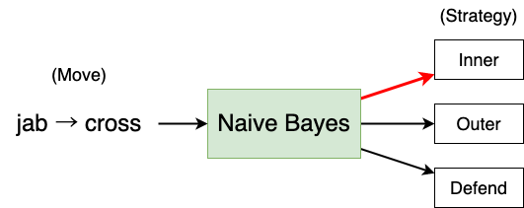
Naive Bayes classifier (NBC)
Simple supervised probabilistic classifier
Used to classify a move or combination of moves into strategies

Slide 7
Solution Architecture - create model
Record human vs. human game play
Either player’s play is recorded.
Create Naive Bayes classifier
Generate transition functions of Finite State Machine

Slide 8
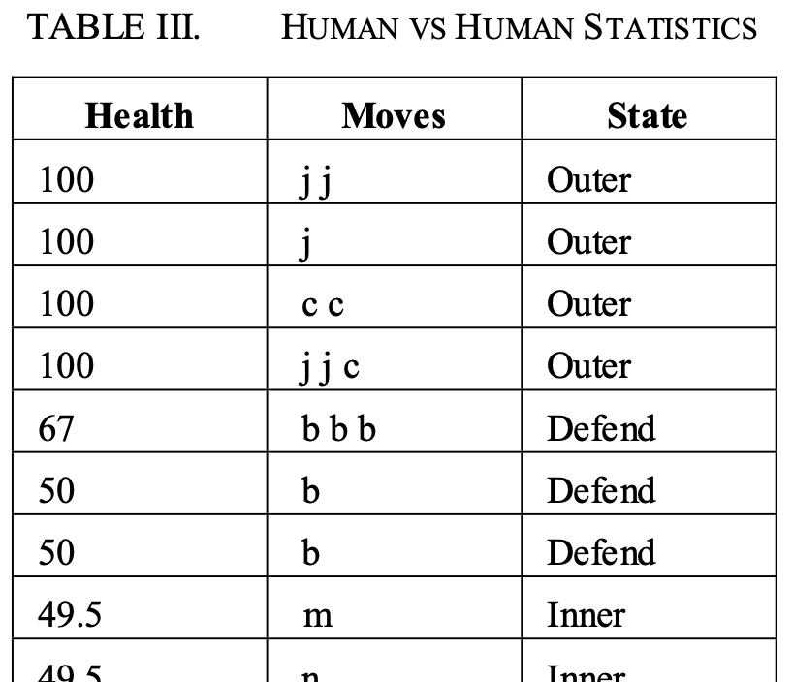
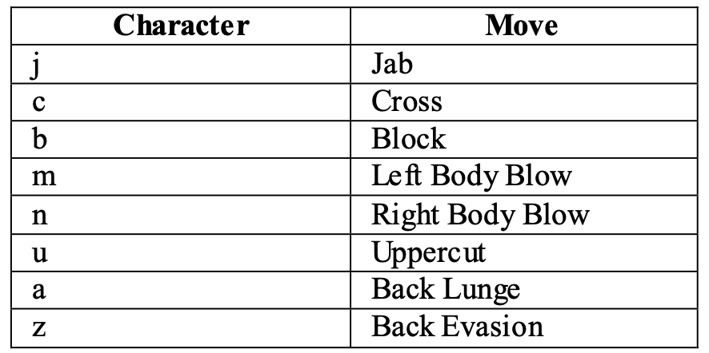
Solution Architecture - create model

Slide 9
Solution Architecture - simulation
FSM decides strategy(state)
Available moves for each strategy are already determined by NBC

Slide 10
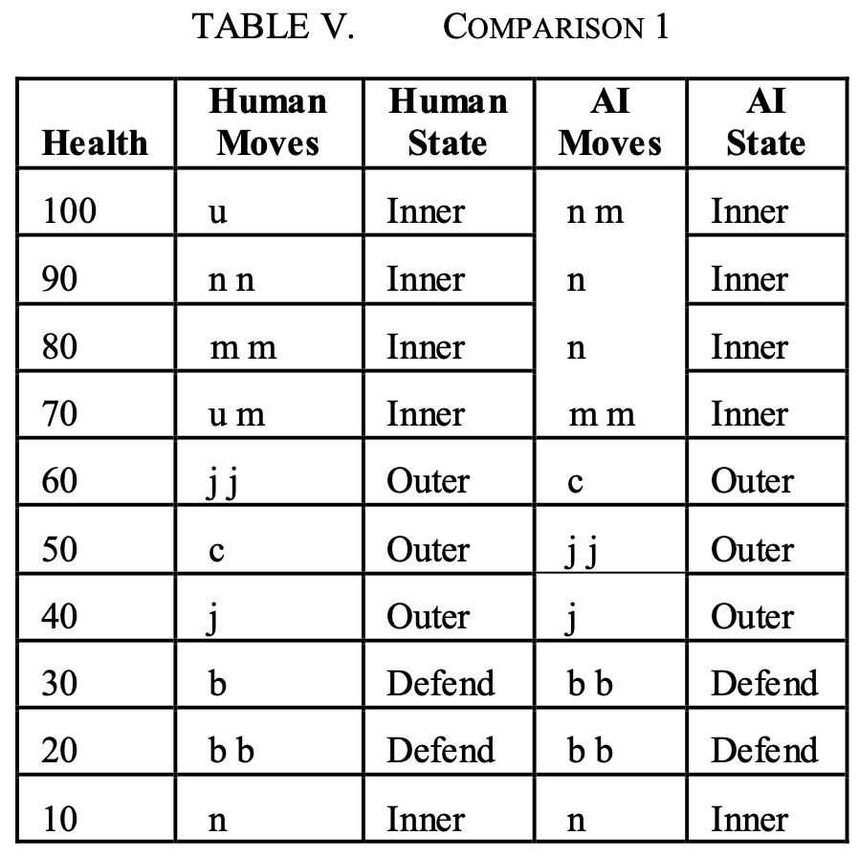
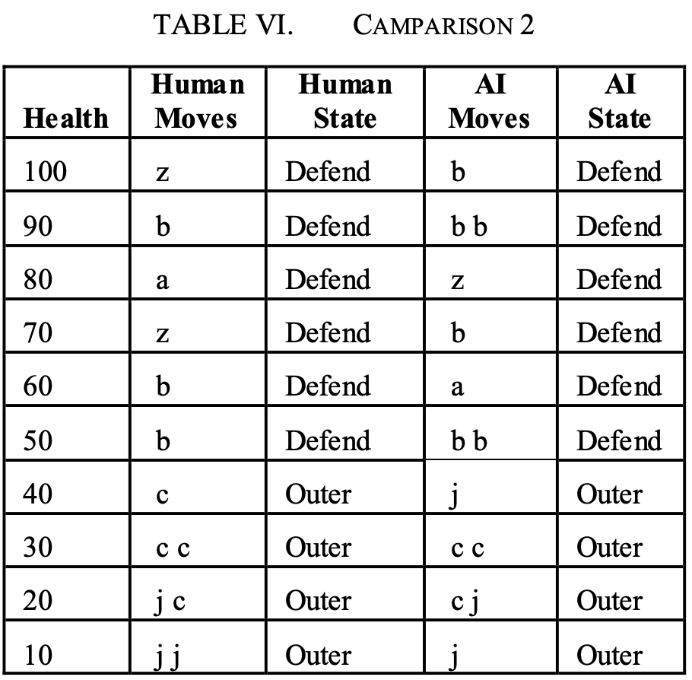
Experiment and Results

Slide 11
Conclusions and discussion
Conclusion
Their approach can be used to mimic human strategies.
Limitations
The approach only takes into account AI's hp when transitioning state
Player’s mistake could impact performance of AI
Frequency of each move in play data is not considered.

Slide 12
Thank you for listening

