Slide 1
Monte Carlo Tree Search Based Algorithms for Dynamic Difficulty Adjustment
Simon Demediuk, Marco Tamassia, William L. Raffe,
Fabio Zambetta, Xiaodong Li and Florian Floyd Mueller School of Science - School of Media and Communication Royal Melbourne Institute of Technology RMIT, Melbourne, Australia
Games Studio, Faculty of Engineering and IT University of Technology UTS, Sydney, Australia

Slide 2
Introduction
The author states that the AI opponent's strategy, behavior, and environment will be changed to match the player's skill level. It thereby changes the difficulty of the game to match the level of the player. The result is a longer lasting video game experience.
They develop a DDA AI agent that implements Monte Carlo Tree Search (MCTS) and presents many improvements on DDA systems with a new heuristic playout evaluation function and action selection criteria.
This research uses the FightingICE engine as a testbed for their agent.
They conducted experiments against artificial opponents and humans in the FightingICE 2D real-time fighting game. And they have demonstrated the agent's ability to change the difficulty level depending on the opponent.

Slide 3
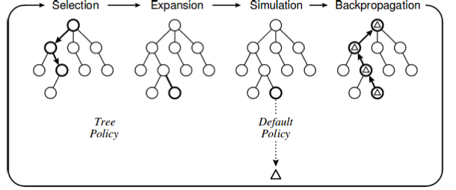
Background
In this section, a brief background of the traditional MCTS algorithm is given.
MCTS is a tree-based search algorithm used in decision processes.
To build the tree, MCTS repeatedly iterates through 4 phases (selection -> expansion -> simulation -> back-propagation), until the time allotted for the computation expires.
The techniques that they propose are variations of MCTS in that they use either a different action-selection strategy or a different heuristic to evaluate the results of playouts.

Slide 4
Dynamic difficulty adjustment AI agents
Reactive Outcome-Sensitive Action Selection (ROSAS)
Their first DDA AI agent, ROSAS is developed with the goal of matching as closely as possible the current skill level of the opponent.
ROSAS builds a search tree and evaluates the playout with the goal of promoting strong actions, just like a normal MCTS.
For example, in a 2D real-time competitive game, the difference in physical strength between players can be exploited. In particular, if the DDA AI agent is winning, the score will be positive, and if it is losing, the score will be negative. ROSAS selects the action whose score is closest to zero after the search tree is constructed.
The formula to select the action is: action = arg$\underline{max}$ − |r[a].score|
(where r is the root node of the tree and r[a] is the child of r corresponding to action a.)
a

Slide 5
2. Proactive Outcome-Sensitive Action Selection (POSAS)
The limitation of ROSAS is that it produces non-proactive behavior. As a result, the agent only reacts and never tries to take the initiative, which feels very unnatural.
To address this limitation, they have developed a second DDA AI agent is POSAS.
This agent also uses MCTS to build a tree and select an action based on the level of the opponent. It then takes a different approach to the final selection, where all actions in a defined interval around zero are all considered equally valuable, and one is selected at random.
The formula used is: action = argmax−(|r[a].score|−$I_{h}$)
(where r is the root node of the tree, r[a] is the child of r corresponding to action a, $I_{h}$ is the half-size of the interval around zero in which all actions are considered equally valuable, and (·)+ indicates the ramp function.)
This mechanism allows ROSAS to take the initiative and gain some advantage over the opponent.
+
a

Slide 6
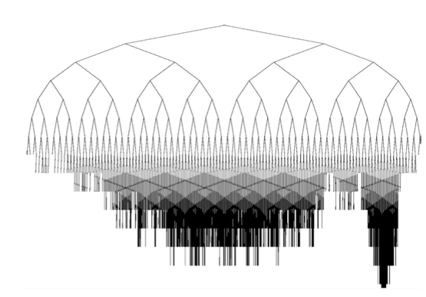
3. True ROSAS/POSAS
While this is effective in making the most informed decisions, the opposite happens with ROSAS and POSAS, where the regions of the tree of most interest are not fully explored.
This is due to the play-out evaluation strategy, where the favorable outcome is evaluated more highly and the search for that region becomes deeper.
To address this limitation, they propose two additional DDA AI agents, true ROSAS and true POSAS.
One of the greatest strengths of MCTS is that the most promising tree regions are more expanded and explored. The figure shows an example of such a tree.

Slide 7
True ROSAS evaluates nodes using the formula: node.score = −|$h_{s}$|
(where $h_{s}$ is the heuristic strategy employed; for their 2D real- time fighting game, this is the health points difference)
When the tree is fully built, True ROSAS selects the action with the most visits (or the one with highest score).
This ensures the tree expansion is in-line with the action selection policy of the ROSAS algorithm, ensuring the most relevant areas are explored more in depth.
True POSAS, evaluates nodes using the formula: node.score = −(|$h_{s}$ | − $I_{h}$ )
(where $h_{s}$is the heuristic strategy employed, $I_{h}$ is the half-size of the interval around zero in which all actions are considered equally valuable, and (·)+ indicates the ramp function)
This maintains the goal of POSAS while expanding the search tree in the areas that relate to the heuristic strategy rather than the most promising actions for victory.
+

Slide 8
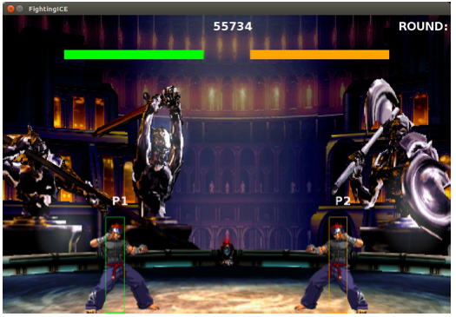
Experimental results
They developed the four agents ROSAS, POSAS, True ROSAS and True POSAS to play a 2D fighting game called FightingICE .
Two players face off in a 2D arena and using a combination of movement, jumping, crouching, blocking, punching, kicking and special attacks try to lower the opposing player health points. The game ends a round when the timer runs out or when one player's health reaches zero.

Slide 9
A. Bot Trials
The ability of the DDA AI agent to adapt to individual opponents and provide the appropriate level of challenge was tested against a number of bots that participated in the 2016 CIG FightingICE competition.
Each game consisted of three 90 second rounds with both players starting with 500 health points.
Additionally they develop an agent using Challenge Sensitive Action Selection(CSAS) to compare against their DDA AI agents. To provide a fair comparison, their implementation of CSAS uses MCTS to compute the actions value and rank. They tested the CSAS agent against the same bots as the other agents in the same setting.

Slide 10
Table I shows the mean and standard deviation of the final health point difference between their agents and the competition bots, aggregated over all 500 fights that their agents played.
A positive mean indicates that the agent, on average, finished with more health points than the opponent, and a negative mean indicates the opposite.

Slide 11
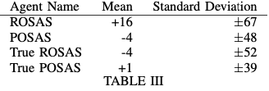
B. Player Trials
To test whether their agents perform suitably well against human players they conducted a small internal study.
The players then played four games, one game against each of their agents in random order. (As before, each game consisted of three 90 second rounds with the health points for both players set at 500.)
Table 3 shows the results. Due to the small number of games played, statistical test were not conducted on these results. A larger study is required to draw a conclusion.

Slide 12
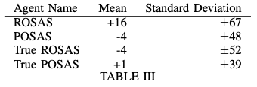
Discussion
Whilst the sample is not sufficiently large to draw any conclusion, the results shown in Table III suggest that the agents, when playing against human players, can achieve similar performance to those achieved when playing against bots. A larger study will be conducted in future work to confirm this hypothesis.

Slide 13
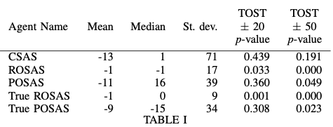
Table I shows that they agents have an improved mean and standard deviation when compared to CSAS.
Even though ROSAS and True ROSAS produce a mean closely matching zero and a small standard deviation, they will not take any initiative to engage with the player when there is no health point difference. It was also suggested by human players that ROSAS had the most unrealistic behaviour of all the agents.
POSAS and True POSAS provide a more interactive opponent that will initiate actions against the player even when there is no health point difference. While this results in a larger standard deviation when compared to ROSAS, it produces better perceived behaviours by human players.

Slide 14
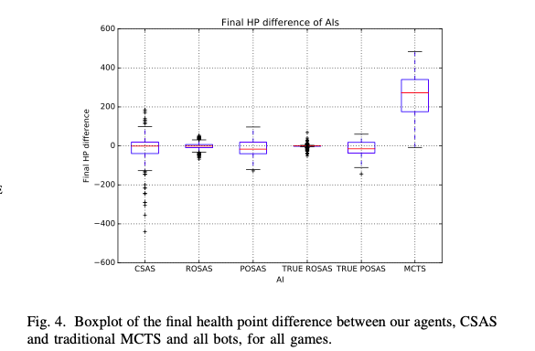
In Figure 4, the distribution of the final health point difference between the agents and the bots.
From this box-plot it is evident that True ROSAS is able to best track the desired outcome of a zero health points difference.

Slide 15
Conclusions
The proposed DDA AI agents have shown that they are capable of providing an appropriate level of difficulty for a range of different bots and human players. They also show improved performance when compared to existing methods for DDA in the fighting genre, additionally they are less complex in implementation than previous MCTS-based DDA algorithms.
In future work, they will be investigating how their approach can be applied to games that require longer term strategy, using a turn-based game.

Slide 16
Thank you

