Slide 1
How does AI play football? An analysis of RL and real-world football strategies
Atom Scott, Keisuke Fujii and Masaki Onishi
The International Conference on Agents and Artificial Intelligence (ICAART) 2022

Slide 2
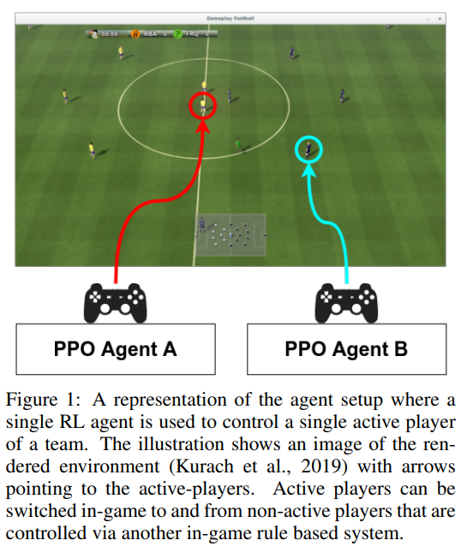
Introduction
The authors examine the play style characteristics of football RL agents and uncover how strategies may develop during training.
The Google Research Football environment is used to train football playing RL agents in a single agent manner.

Slide 3
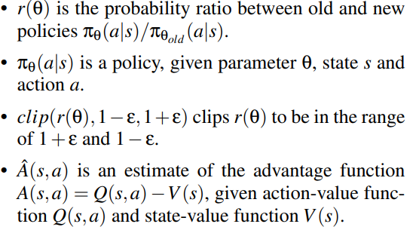
Proximal Policy Optimization (PPO)
The policy gradient methods try to find an optimal behavior strategy by alternating between optimizing a clipped surrogate objective function and sampling data through interactions with the environment

Slide 4
TrueSkill Ranking System
The TrueSkill ranking system is a skill based ranking system that quantifies a players’ rating using the Bayesian inference algorithm.
Each rating is characterized by a Gaussian distribution with mean µ and standard deviation σ.

Slide 5
Social Network Analysis (SNA)
Closeness Centrality: This score indicates how easy it is for a player to be connected with teammates. A high closeness score indicates that a player is well connected within the team.
Betweenness Centrality: This score indicates how players acts as a bridge between passing plays, high deviation within a team may indicate well-balanced passing strategy and less dependence on a single player.
Pagerank Centrality: A high pagerank score implies that the player is a popular choice for other players to pass too.

Slide 6
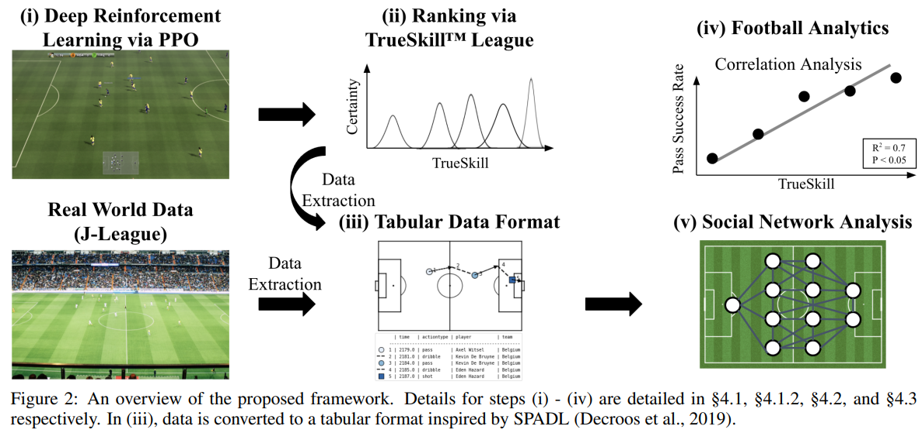
An overview of the proposed analysis framework

Slide 7
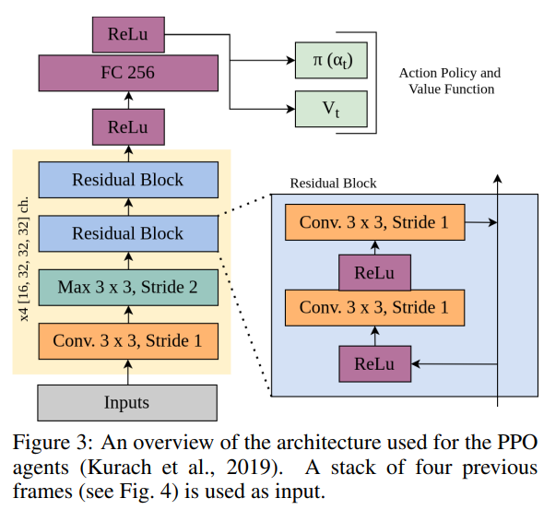
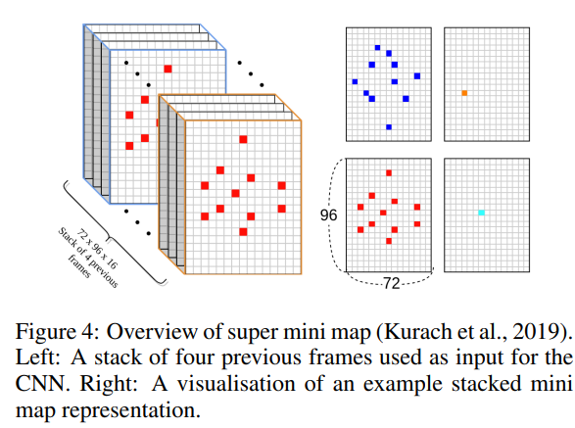
Deep RL Implementation

Slide 8
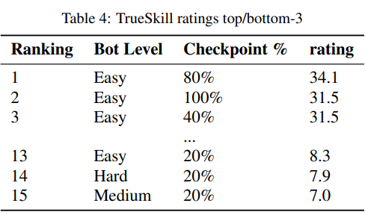
TrueSkill Ranking Implementation
In a single round-robin tournament, each agent play every other agent once.
The agents trained against the easy level built-in bot ranks top 1, 2 and 3.

Slide 9
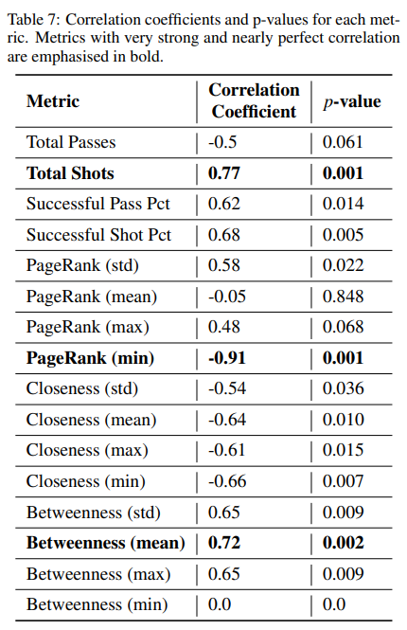
Results
The following criteria were used to interpret the magnitude of correlation:
Values less than 0.3 were interpreted as trivial
Between 0.3 and 0.5 as moderate
Between 0.5 and 0.7 as strong
Between 0.7 and 0.9 as very strong
More than 0.9 as nearly perfect

Slide 10
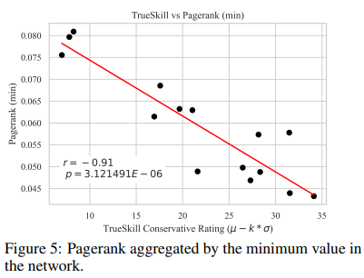
Results

Slide 11
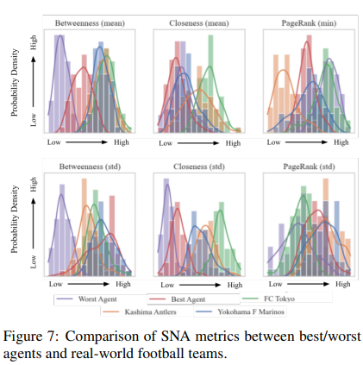
Results
Worst Agent
Best Agent
FC Tokyo
Kashima Antlers
Yokohama F Marinos

Slide 12
Thank you for listening

