Slide 1
Companion AI for Starbound Game Using Utility Theory
Elena Lebedeva,
Joseph Alexander Brown,
AI in Games Development Lab Innopolis University

Slide 2
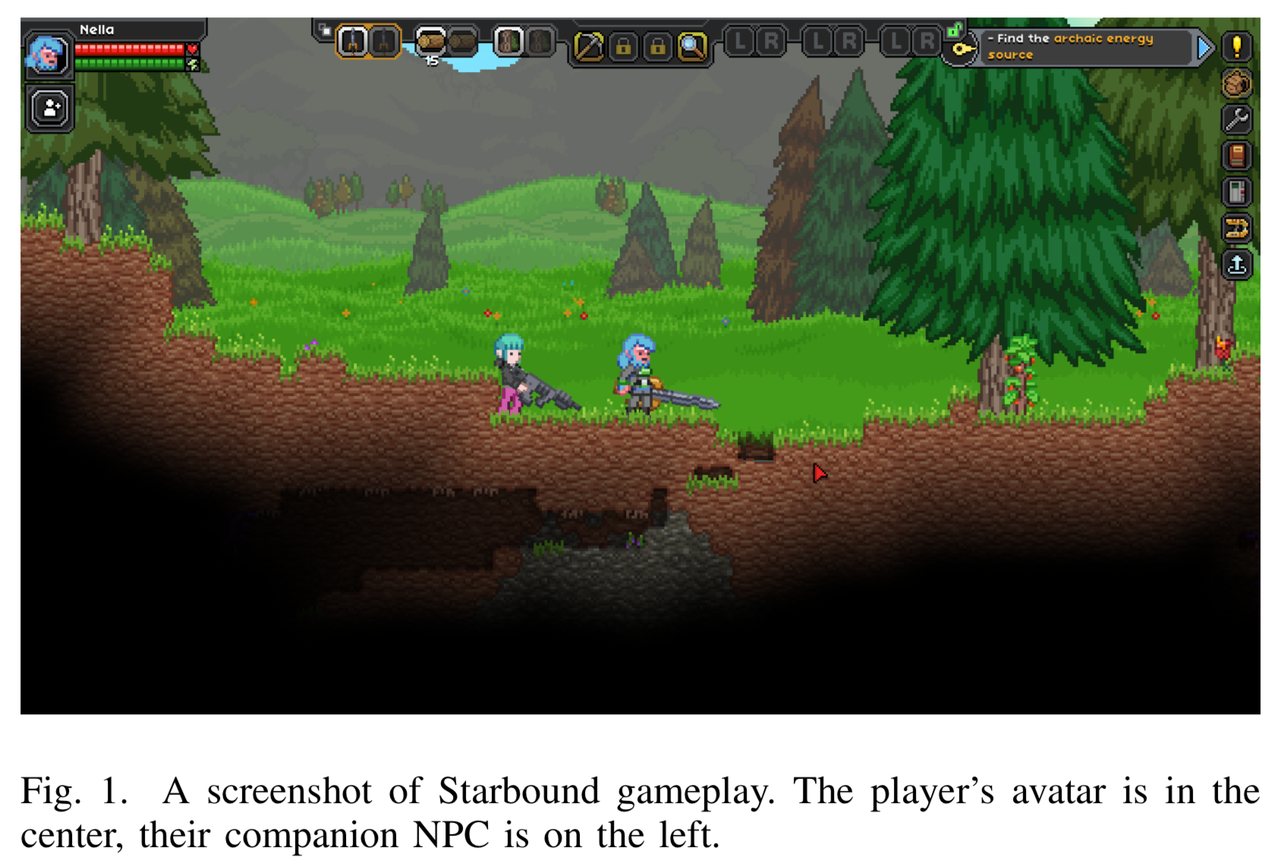
What is Starbound?
Starbound is a game that is set on a myriad of planets in space. The player can enjoy exploring the planets, collecting resources, crafting, and fighting enemies.
In Starbound, the player can hire Crew Member NPCs (Non-Player Character) to help the player.
These Crew member NPCs can travel with the player and assist in battles against hostile NPCs.

Slide 3
Problem with Crew Member NPC
There are some problems with the fighting ability of Crew Member NPCs.
No consideration of the player’s state
No consideration of own state
No consideration of the enemy’s state
These problems can create inefficient NPCs and decrease the quality of the game experience.

Slide 4
Utility Theory
Applying Utility Theory to the AI of NPCs will address this problem.
Utility Theory here is a theory that determines the considerations for judging which action is desirable for AI to perform, and then applies those considerations to an evaluation function (utility function).
Before selecting an action, AI weights the action with a real number from 0 to 1 by calculating the utility function.

Slide 5
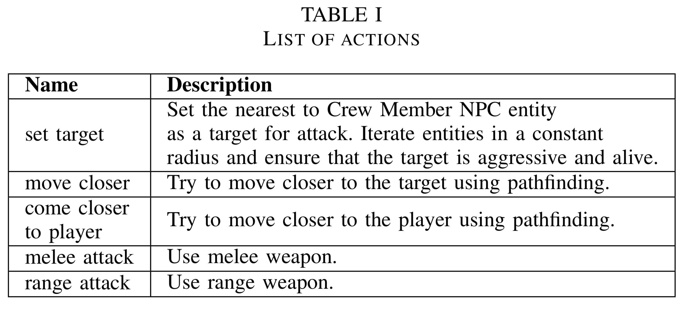
Actions
The AI can perform five actions.

Slide 6
Decorator
Each AI action has a factor called a decorator that determines the desirability of the action.
The decorator here is a consideration in Utility Theory.
The decorator is a function, and it returns a real number from 0 to 1.
The utility function of the action is configured by the decorator.

Slide 7
Decorator
Examples

Slide 8
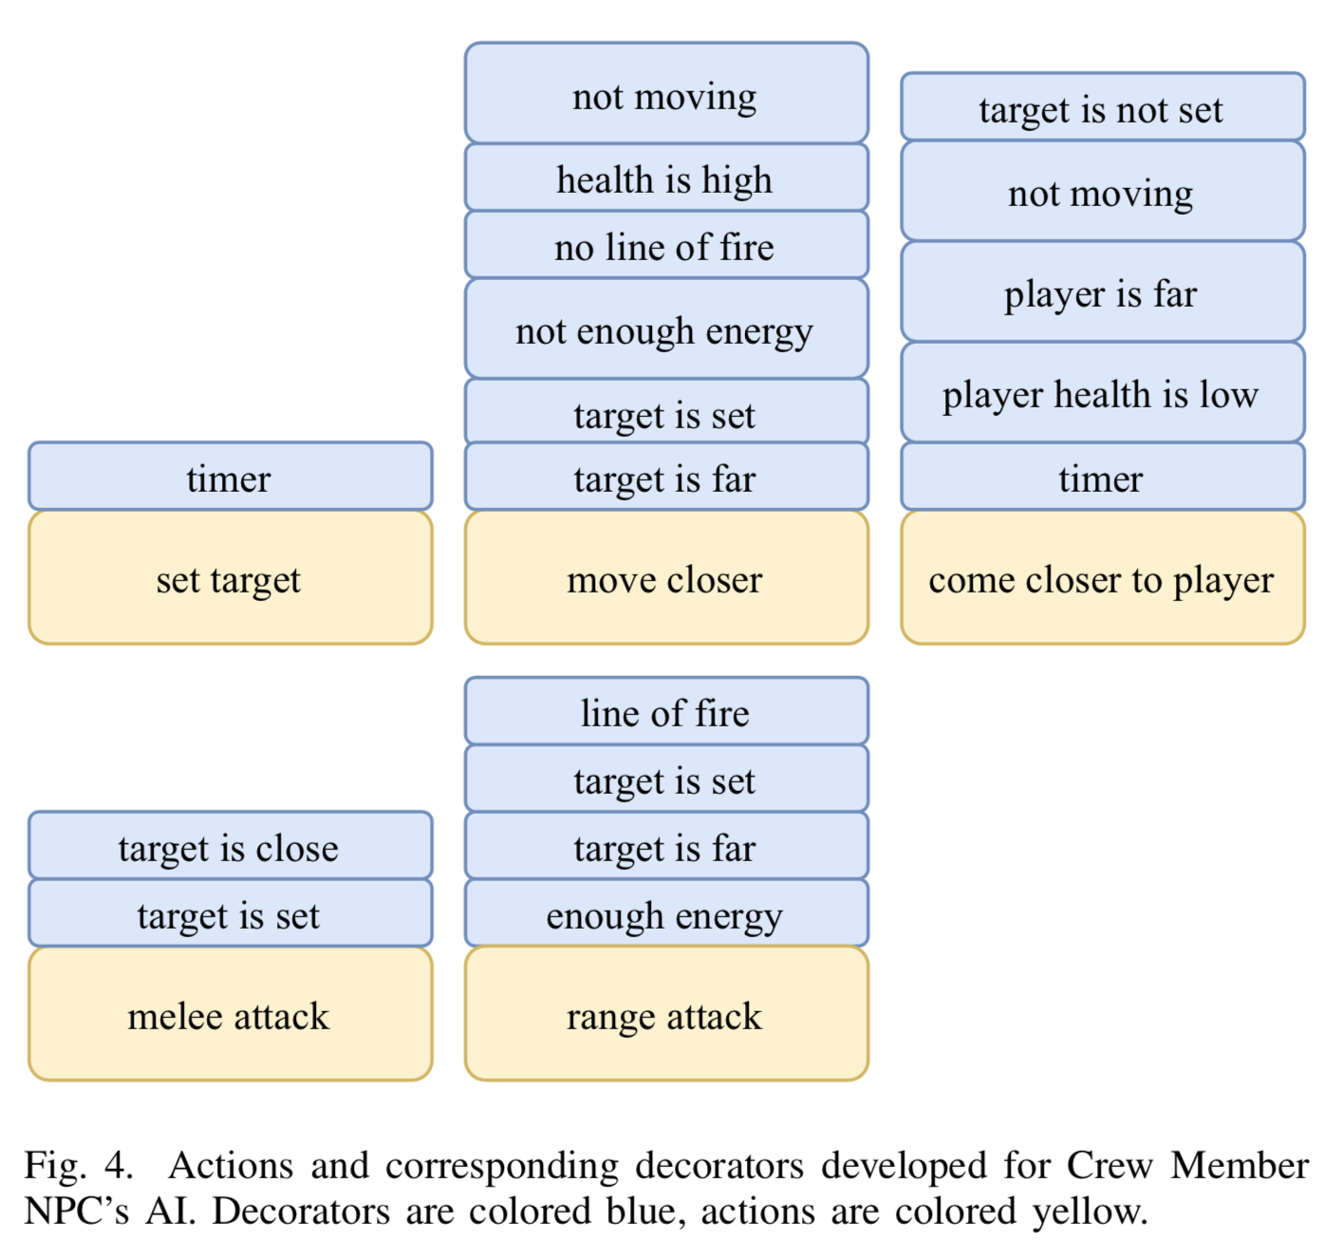
Decorator
Since each action has a different number of decorators, the final action weight is calculated by averaging the decorator scores.
So, the utility function is expressed as follows:
$$Utility=\frac{\sum_{i=1}^{N}{{Score}_{i}}}{N}$$

Slide 9
Experiments
In order to evaluate the quality of the developed Crew Member NPC's AI, a user study was conducted.
The participants played the game twice.
Game using built-in AI
Game using the developed utility-based AI
The participants were asked the following questions.
Whether they have experience with Starbound
Whether they noticed any differences between the two types of AI
If they noticed a difference, they were asked which AI they preferred.

Slide 10
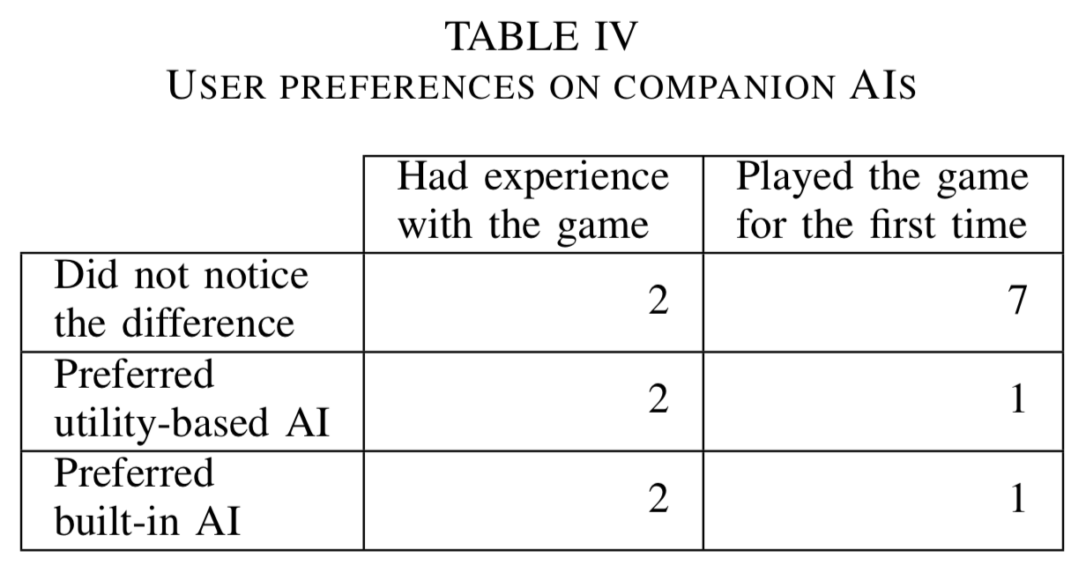
Experiments
There were 15 participants in the experiment, 6 of them had experience with Starbound, and the other 9 were beginners.
9 out of 15 participants did not notice any difference in AI.
3 of the 6 participants who noticed a difference preferred built-in AI.
The remaining 3 participants preferred utility-based AI.

Slide 11
Experiments
Also, to test the AI's fighting ability, two different AIs were asked to kill as many enemies as possible before they die, without the player's interaction.
Each AI was tested 30 times.
The survival time T and the damage D given to enemies were measured.
$$D=\frac{\sum_{i=1}^{N}{P_{i}}}{N}, P_{i}=1−\frac{h_{i}}{H_{i}}$$
$N$ is the number of enemies, $h_{i}$ is the i-th enemy’s health, and $H_{i}$ is the i-th enemy’s maximum health.

Slide 12
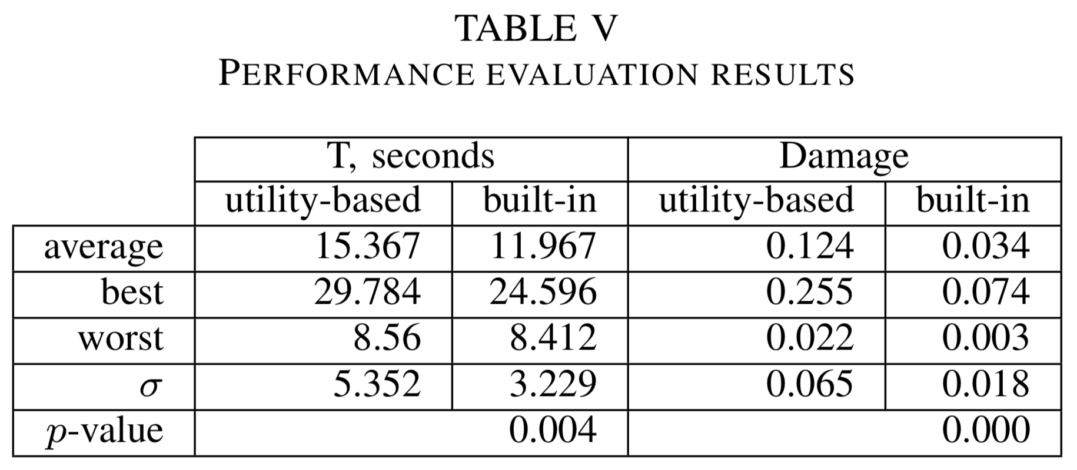
Experiments
A two-tailed t-test was performed to show that the differences in the two AIs were not due to random chance but due to the behavioral characteristics.
The p-value from the two-tailed t-test indicates that the differences are statistically significant.

Slide 13
Conclusion
Most of the user study participants did not notice the differences between the two AIs.
The participants who noticed the differences enjoyed each AI in equal measure.
The results of the fighting ability tests showed that the utility-based AI can stay alive longer and deal more damage on average.

Slide 14
Thank you for listening

