Slide 1
Hierarchical Macro Strategy Model for MOBA Game AI
Author: Bin Wu (benbinwu@tencent.com)

Slide 2
Introduction
Abstruct
RTS game
MOBA game
How to master RTS game?
Difficult aspect
Hierarchical Macro Strategy Model
Data setup
Experiment
Result

Slide 3
Abstruct
Since AlphaGo defeated the world champion in 2016, the existence of AI has come to light in general.
AlphaGo is a milestone towards a general AI goal, but the problem class that AlphaGo represents is still simple compared to the real world. That's why recent researchers are looking at real-time strategy (RTS) games such as “Defense of the Ancients” (Dota) (OpenAI 2018a) and “StarCraft” (Vinyalsetal. 2017; Tian et al. 2017).
This paper proposes a new learning-based hierarchical macro-strategy model for mastering MOBA games, a sub-genre of RTS games.

Slide 4
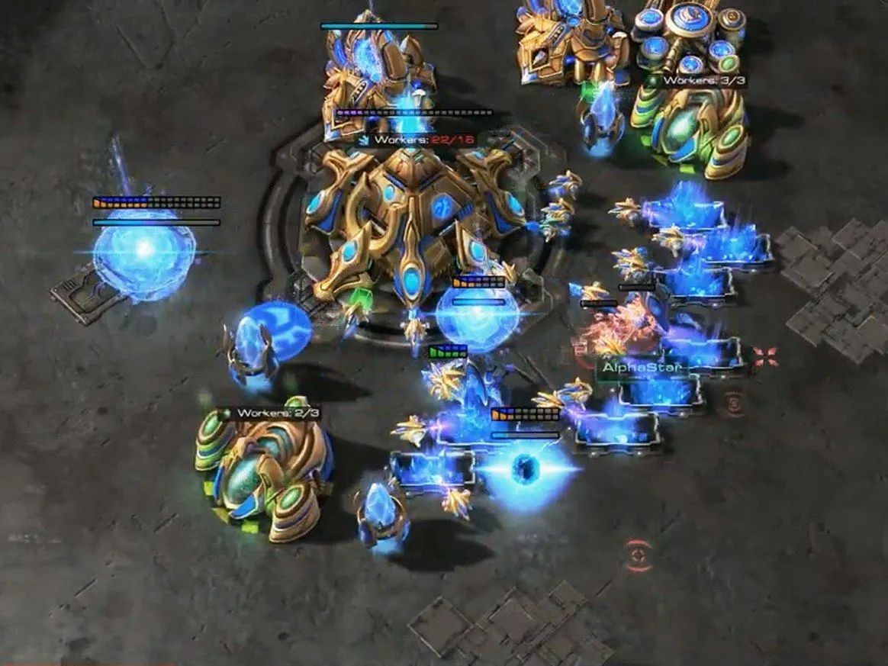
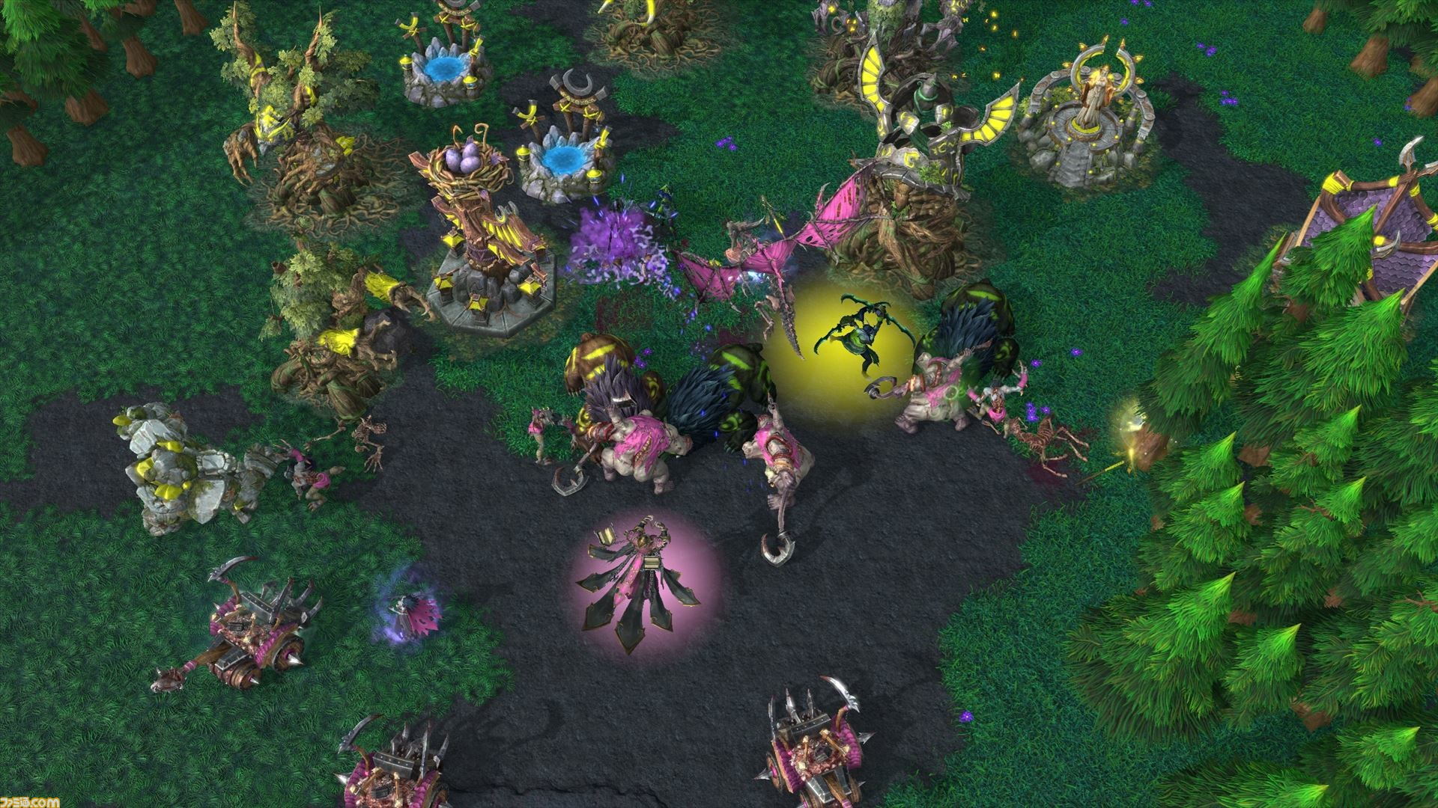
RTS game
In the real-time-strategy (RTS) game, one player controls all the characters on our team.
RTS games are basically individual competitions
It ’s the victory of the one who destroyed each other ’s position first.
ex. StarCraft, WarCraft
StarCraft2
WarCraft3

Slide 5
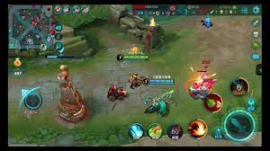
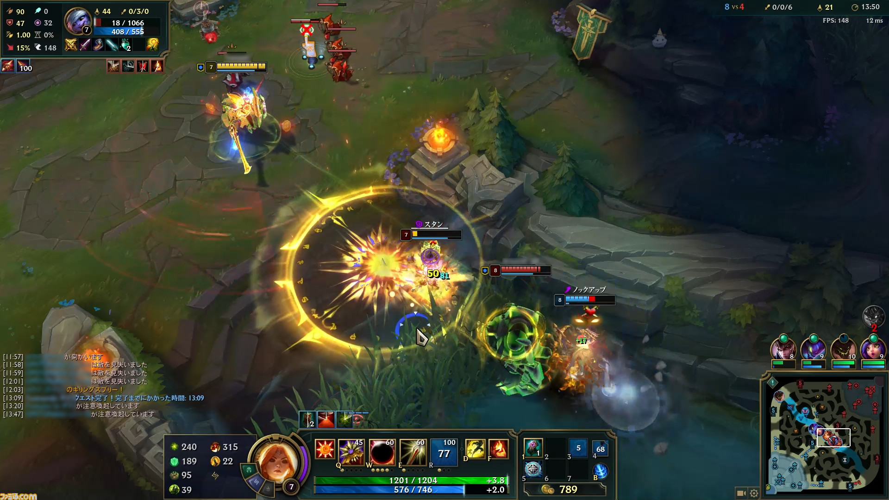
MOBA game
In Multi online battle arena(MOBA) game, multiple players form a team by selecting each operating character.
Game genre derived from RTS games
ex. League of Legends(LoL), Defense of the Ancients(Dota), Honour of Kings(HoK)
Honour of kings
LoL

Slide 6
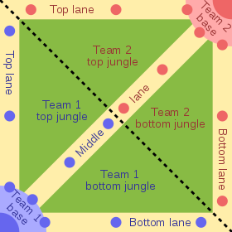
MOBA game
Players can also see the complete map status via the minimap in the upper left corner. Here we can see the observable turrets, creeps, and heroes as thumbnails. Units can only be observed if they are friendly units or within a certain distance of friendly units.
There are also four jungle areas on the map where we can collect creep resources to increase our gold and experience. Each hero starts with a minimum of gold and level 1. Each team will use their resources to try to earn as much gold and experience as possible to purchase items.
Upgrade the level.

Slide 7
How to master MOVA game?
To master MOBA games, players must have both good macro-strategy operations and skilled micro-level execution. A typical macro strategy consists of opening, laning, gambling, ambush, and so on. Skilled micro-level execution requires a high degree of control accuracy and a deep understanding of skill damage and impact. Good timing needs to be learned both in the operation of macro strategies and in the execution of micro-levels.
In addition to that, each agent has to think about where it's best to go on the map.

Slide 8
Difficult aspect
There are four main aspects of AI mastering MOBA games that make it much more difficult than mastering GO.
1) Computational complexity.
2) Multi-agent.
3) Imperfect information
4) Sparse and delayed rewards
This time, we will assume the case of Honor of Kings.

Slide 9
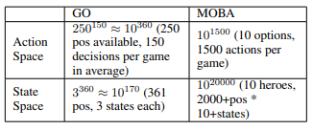
Computational Complexity
RTS games can have up to 1020,000 computations on action or state spaces, but GO complexity is around 10250.
There is an action space that manages movements such as skills and attacks, and a state space that manages the current remaining health, possession money, and level.
This table shows a comparison of MOBA and GO action and state spaces.

Slide 10
Multi-agent
Playing an MOBA game usually involves multiple agents. The synergistic effect of team-to-team cooperation and inter-agent skills is important because each agent has different skills and characteristics that can be used.
There are more than 80 characters in Honor of Kings

Slide 11
Imperfect information
Unlike GO, many MOBA games are highly uncertain and it is imperative to consider each other's games if the game map is not completely observable.

Slide 12
Sparse and delay rewards
MOBA games are often over 20,000 frames in length, but each GO game is typically less than 361 steps. Therefore, it is difficult to determine which operation in the fight contributed the most to the victory.

Slide 13
Hierarchical Macro Strategy(HMS)
This paper proposes a Hierarchical Macro Strategy (HMS) model.
This is a common supervised learning framework for MOBA games such as Dota. HMS directly addresses the computational complexity and multi-agent challenges of MOBA games.
HMS is a hierarchical model that performs macro-strategy operations by predicting attention on the game map under the guidance of game phase modeling. This allows HMS to reduce computational complexity by incorporating gaming knowledge. In addition, each HMS agent learns using a new communication mechanism with teammate agents to address multi-agent challenges.

Slide 14
Hierarchical Macro Strategy(HMS) Model
During MOBA games, experienced human players are fully aware of the game phases (opening phase, laning phase, mid-game phase, late-game phase, etc.).
In each phase, the player pays attention to the game map and makes the corresponding decisions about where to send the hero. For example, in the lane phase, players tend to focus on their lane.Rather than backing up allies, players pay attention to pushing team fight spots and enemy bases from mid to late.
Therefore, the operation process of the macro strategy is formulated as "phase recognition-attention prediction-execution".Therefore, they propose an “Attention layer” and a “Phase layer”.

Slide 15
Attention Layor
The attention layer aims to predict the best area on the game map for sending heroes.
Since it is difficult to define the optimum destination when setting the destination, we will try to direct many players from various battle data to the place where they are attacking or spending time.

Slide 16
Phase Layor
The phase layer is intended to recognize the current phase. There is a clear correlation between the game phase and key resources.
For example, in the opening phase, players typically target turrets and NPCs outside the jungle, but later in the game, players operate to destroy enemy bases. Therefore, model the phases of key resources

Slide 17
Imitated Cross-agents Communication
Communication between agents is essential for the team of agents to work together. We have designed a new cross-agent communication mechanism that allows agents to communicate in a supervised learning environment. At the training stage, the caution label of allies is affixed as a feature of the training. In the test phase, ally attention predictions are placed as a function and decisions are made accordingly. In this way, agents can learn to "communicate" with each other and cooperate in ally decisions.

Slide 18
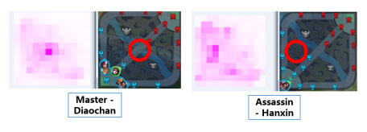
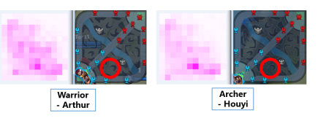
Data setup
Data Preparation Collect approximately 300,000 game replays of King Pro League matches and training records to train your model. Each subfigure consists of two square images. The square image on the left shows the attention distribution of the MOBA minimap on the right. The hottest areas are highlighted with red circles.
This opening is considered safe and efficient, and widely used in Honour of Kings games.

Slide 19
Experiment
Played against a human player team with an average ranking of Kings in the Honor of Kings ranking system (more than the top 1% of human players)

Slide 20
Result
AI achieved a 48% win rate in 250 games.(about 120 match wins)
It also records the battle results when the phase layer is deleted and when the communication function is deleted.
The percentage on the left is the full version AI value. Therefore, it became clear that communication and phase-by-phase work were important.

Slide 21
Thank you for listening

