Slide 1
Creating Pro-Level AI for a Real-Time Fighting Game Using Deep Reinforcement Learning
Inseok Oh*, Seungeun Rho* , Sangbin Moon, Seongho Son, Hyoil Lee and Jinyun Chung
Game AI Lab, AI Center, NCSOFT, South Korea
IEEE Transactions on Games-2021-Jan

Slide 2
Goal
Cause: In modern complex fight game, Fighting game agent < Human level.
Plan: Present practical reinforcement learning methods :
Novel self-play curriculum
Data skipping technique to better fighting agent behaviors.

Slide 3
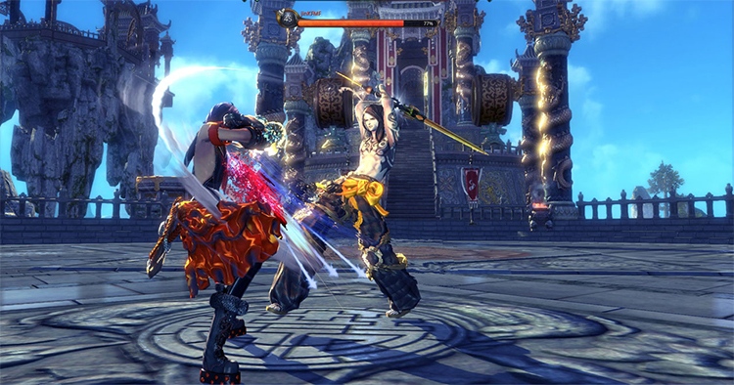
Test Bed
Blade & Soul Arena Battle(BAB) :
Blade & Soul is a commercial massively multiplayer online RPG(roleplaying game). It supports duels between two players, this part of the game is called Blade & Soul Arena Battle.

Slide 4
Test Bed 2
BAB has a more complex game dynamics and heavier game engines.
A large number of people play BAB and it has more active professional scenes (3D?) than other fighting games. GAME: Two players fight against each other to reduce their opponent's HP (health point) to zero within three minutes.
FICE | Fighting ICE
LF2 | Little Fighter 2
SSBM | Super Smash Bros. Melee
BAB | “Blade & Soul (B&S) Arena Battle

Slide 5
Challenges Agent facing
Vast actions and state spaces: 144 potential actions for each time step: (8 (avg. # of avail. skills) * 9 (8 directional + no move) * 2 (facing opponent or moving direction)). Average length of the game is 1200-time steps. (120s) A LOT
Dependencies btw skills: Out of the 45 skills in total (including “no-op”), the set of skills available at a given time constantly changes. Also, cooldown time with different available skills varies. COMPLEX
Imperfect information setting: It’s a real time game, 2 players make decisions simultaneously. DON’T KNOW

Slide 6
What they did for overcoming challenges
Devised a novel self-play curriculum with agents of different styles.
Diversified the fighting style of the game-playing AIs by reward shaping.
Introducing data skipping technique to enhance exploration in vast space.
Evaluate the result by putting agents against professional players in the 2018 B&S World Championship Blind Match.

Slide 7
Preparation - Background
Reinforcement Learning: They formalized the environment and agents as a Markov Decision Process(MDP).
MDP:{𝑆, 𝐴, 𝑃, 𝑅, 𝛾}, where 𝛾 ∈ [0,1] is a discount factor, which represents the preference for immediate reward over long-term reward. The value of γ is set to 0.995, which is close to 1.0, since all episodes in BAB are forced to terminate after 1,800 time steps (= 3 min).
Here, the agent samples an action from a policy π: 𝑆 → 𝑃(𝐴), where 𝑃(𝐴) represents the set of probability distributions.
Optimal policy
Real-Time Two Player Game
Actions
State transition
Then the MDP can be expressed as:
Notes:
For every discrete time step t, an agent receives a state 𝑠𝑡 ∈ 𝑆 and sends an action 𝑎𝑡 ∈ 𝐴 to the environment. Then, the environment makes a state transition from 𝑠𝑡 to 𝑠𝑡+1 with the state transition probability 𝑃𝑠𝑠′ 𝑎 = 𝑃[𝑠 ′ |𝑠, 𝑎] and gives a reward function 𝑅: 𝑆 × 𝐴 → ℝ, with the reward signal 𝑟𝑡 = 𝑅(𝑠𝑡 , 𝑎𝑡) ∈ ℝ given to the agent. Here, the agent samples an action from a policy π: 𝑆 → 𝑃(𝐴), where 𝑃(𝐴) represents the set of probability distributions. The learning process modifies the policy to encourage good actions and suppress bad actions. The objective of the learning is to find the optimal policy 𝜋 ∗ that maximizes the expected discounted cumulative reward.

Slide 8
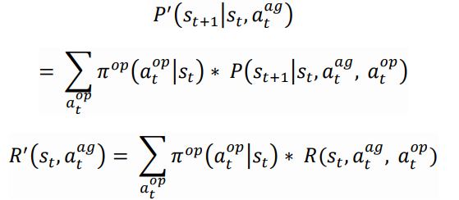
Preparation - Background
When is fixed, the opponent can be retreated as a part of environment, thus we can get

Slide 9
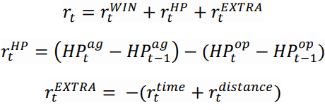
Preparation - Background
Notes:
For every time step with 0.1 sec intervals, state 𝑠𝑡 is constructed from the history of observations 𝐻𝑡 = {𝑜1 , 𝑜2 , … , 𝑜𝑡 }.
such as HP, SP, distance from opponent, distance from the arena wall, current position, remaining game time, remaining cooldown times for all 44 skills, an agent’s status info (midair, stun, down, kneel, etc.), and so on.

Slide 10
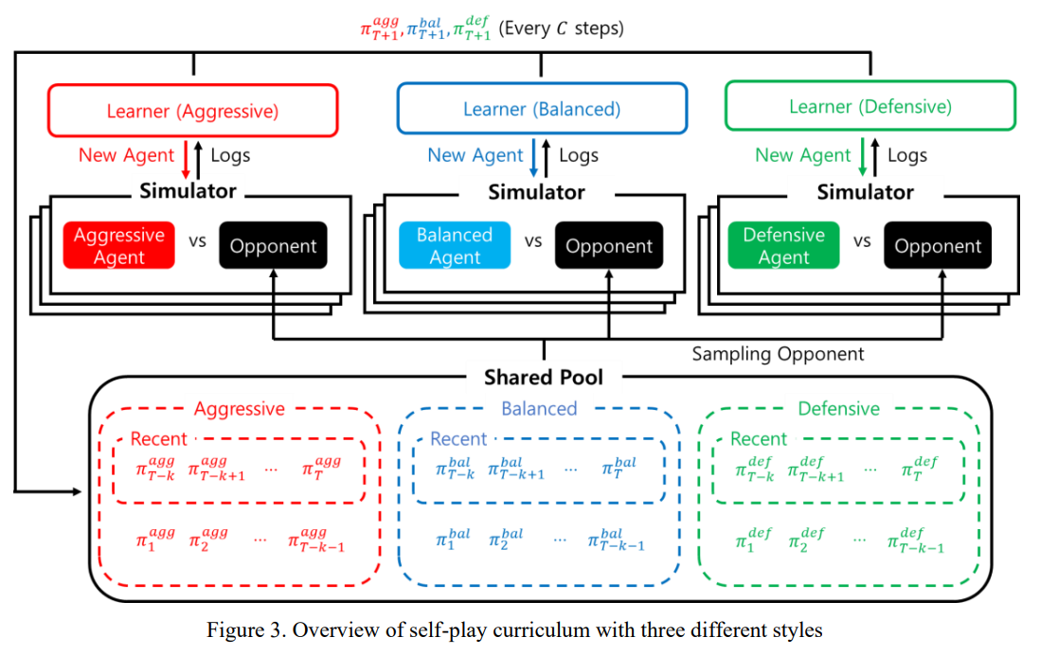
Self-play curriculum
Notes:
--Pi(op) fixed ? Self playing saving pi(ag) to the pool.
--Vanilla self-play alone does not guarantee enough coverage for games with large problem spaces: AlphaStar diversified the opponent pool by imitating different human strategy and introducing three types of agents with different match making scheme.
--all three agent types were trained in a concurrent manner. Also learner and simulators work asynchronously
--The most recent k models of each style are uniformly selected with total probability mass of p, while other models are chosen uniformly with probability 1-p. As training goes on, p is linearly annealed from 0.8 to 0.1. A higher p assists in swift adaptation to the latest opponents, while a lower p stabilizes the learning process by alleviating catastrophic forgetting.

Slide 11
Reward shaping.

Slide 12
Data skipping – Discarding Passive “No-op”
Data skipping techniques refer to the process of dropping certain data during training and evaluation procedures.
No-op can be Active use case and Passive case.
Passive “no-ops” are not used deliberately by an agent, so it is discarded in this research.
In addition, the method enables LSTM to reflect representations of longer time horizons because the data is not provided to the network.

Slide 13
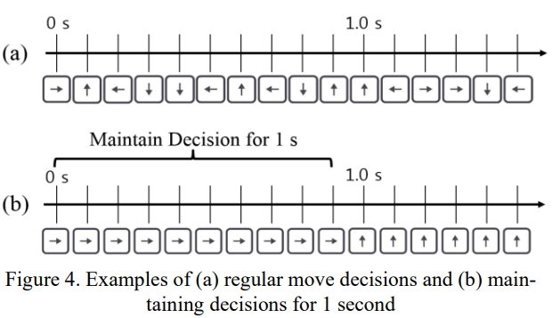
Data skipping – Maintain Move Decision
If the agent selects a move action, it skips the move decision for the following n-1 time steps. (Q: Can agent stop moving?)
In this sense, “maintain move decision” rather can be viewed as ‘amplifying advantage’ from.

Slide 14
Experiments - Implementation
1) Network:
The network is composed of LSTM-based architecture which has four heads with a shared state representation layer. Each head consists of 𝜋𝑠𝑘𝑖𝑙𝑙 , 𝑄𝑠𝑘𝑖𝑙𝑙 , 𝜋(𝑚𝑜𝑣𝑒,𝑡𝑎𝑟𝑔𝑒𝑡) and 𝑄(𝑚𝑜𝑣𝑒,𝑡𝑎𝑟𝑔𝑒𝑡) . 𝑄𝑠𝑘𝑖𝑙𝑙 and 𝑄(𝑚𝑜𝑣𝑒,𝑡𝑎𝑟𝑔𝑒𝑡) are used for the gradient update of 𝜋𝑠𝑘𝑖𝑙𝑙 and 𝜋(𝑚𝑜𝑣𝑒,𝑡𝑎𝑟𝑔𝑒𝑡) , respectively
2) Algorithm: Actor-critic off-policy learning algorithm
3) Learning System: In total, there are three learning processes with each learning process consisting of a learner and 100 simulators. Each learning process is largely similar to that proposed by [7] Distributed prioritized experience replay. The final agent is trained for two weeks, which is equivalent to four years of game play.

Slide 15
Effect of Self-Play Curriculum with Three Styles
Table 3:
Shared pool agents vs baseline agent
Table 4:
Ex. Average Agent with shared pool
VS
Independent pool Balanced Agent +
Independent pool Aggressive Agent

Slide 16
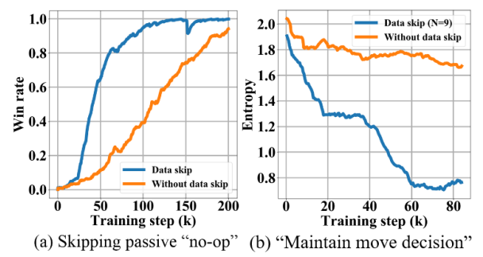
Effect of Discarding Data Skip
Agent they built train with BAB built-in AI (top 20% of the players). See how fast Agent learn to beat build-in AI.
Learning on self-play basis. One is with move decision for 9 more time step, another one is making move decision every time step. Calculate the Entropy:
Notes:
Before the technique was applied, the agent did not make any improvement from random motion, but it learned to approach and retreat with data skip.

Slide 17
Effect of Discarding Data Skip
Notes:
The longer the decision was repeated, the agent’s reaction became less immediate, but the agent moved more consistently.

Slide 18
Pro-Gamer Evaluation
Reaction Time:
Applied 230 ms of delay time on average to the AI’s decision-making process to add fairness against human players. (270ms human average)
Classes and Skill Set:
11 classes. Fixed class for both AI and player as “Destroyer” for all matches, training, and experiments conducted in experiments before. Destroyer is a class that has an infighting style and steadily appears in the B&S world championship.
Nicholas Parkinson (EU), Shen Haoran (CHN), and Sungjin Choi (KOR).
Notes:
the aggressive agent delivered continuous attacks preventing the human player from taking short breaks in between moves required for decision-making; the AI, on the other hand, does not require these breaks.

Slide 19
Conclusion
Training with different styles obtained through reward shaping can be an effective way to find the optimal policy.
Data skipping increased the efficiency of the training.
Consequently, their agents were able to compete with the best BAB pro-gamers in the world. The proposed training methods are generally applicable to other fighting games.

Slide 20
Q&A

