Slide 1

Identification of Distinctive Behavior Patterns of Bots and Human Teams in Soccer
Mola Bogdan Georgii, Maxim Mozgovoy
{d8212101, mozgovoy}@u-aizu.ac.jp

Slide 2
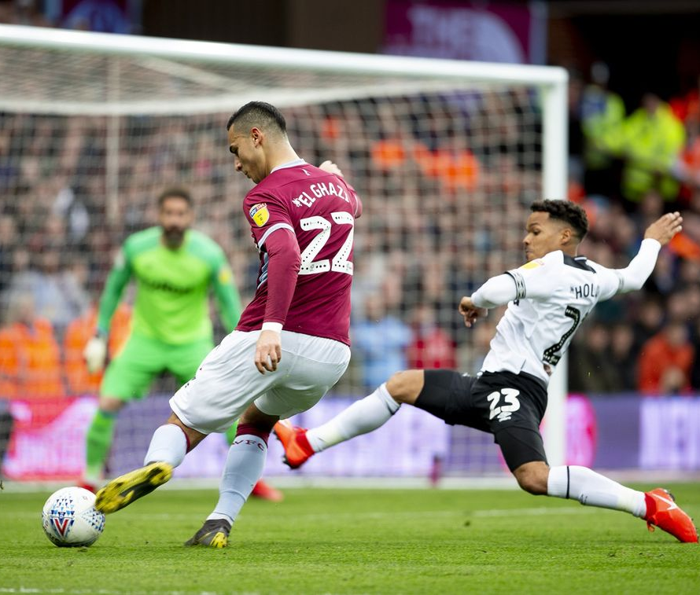
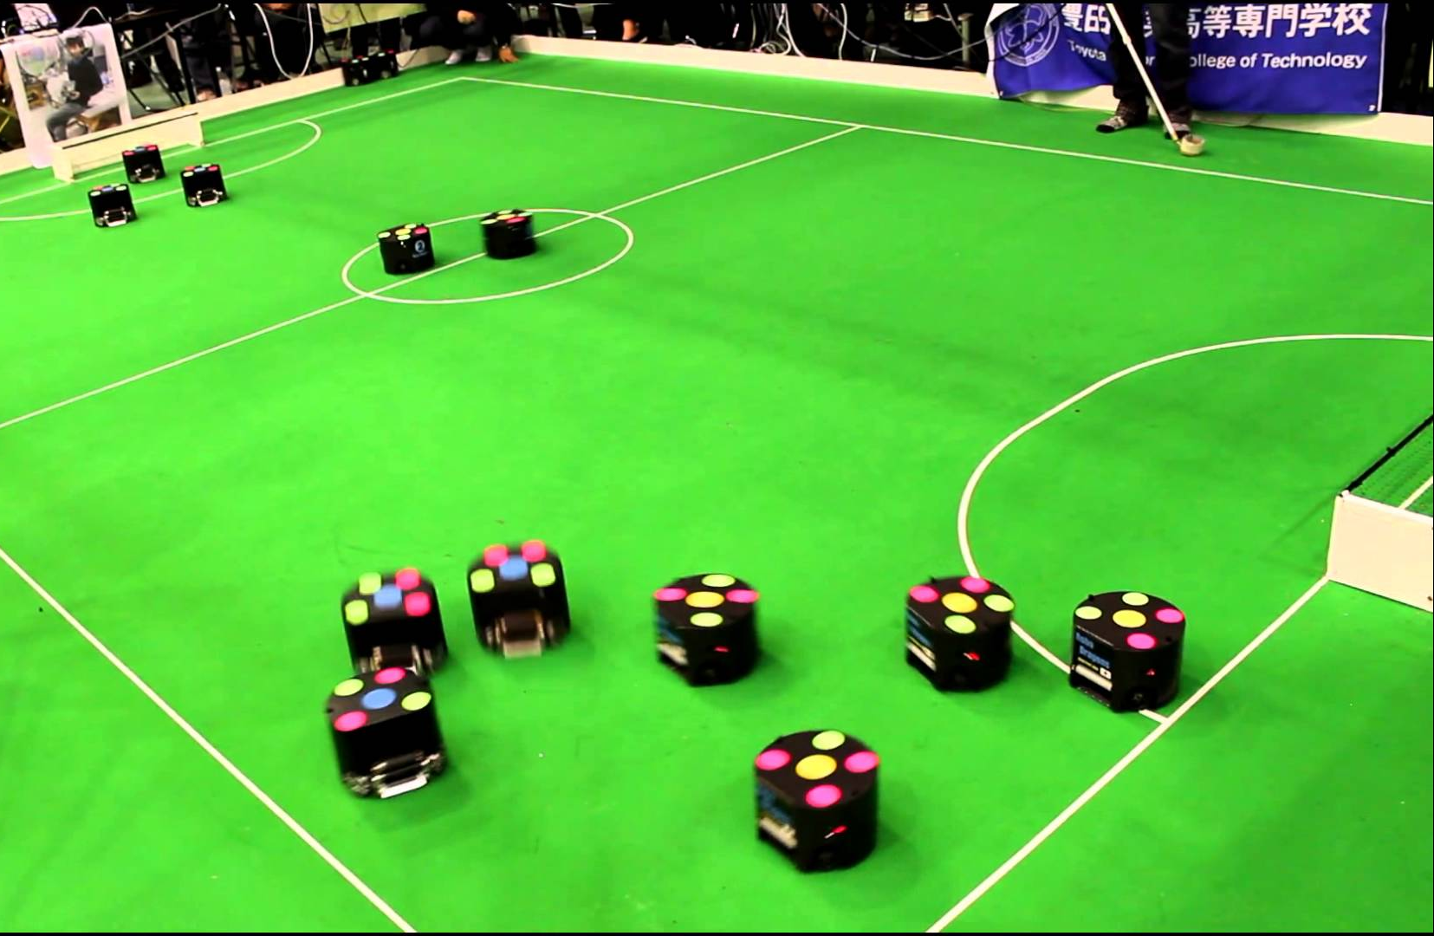
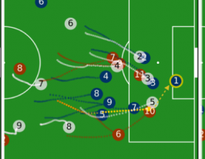
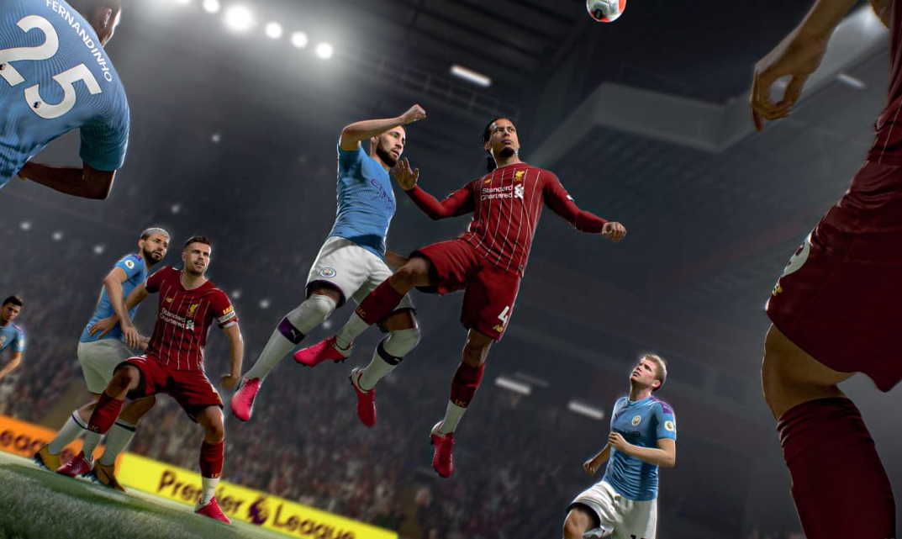
Introduction
Robotic competitions
Sport analysis
Video games
Notes:
Being a worldwide popular sport, soccer extended beyond its original scope and became both a serious media business and cultural factor and a de facto testbed for AI research and competitions due to its relatively complex multiagent environment (RoboCup)

Slide 3
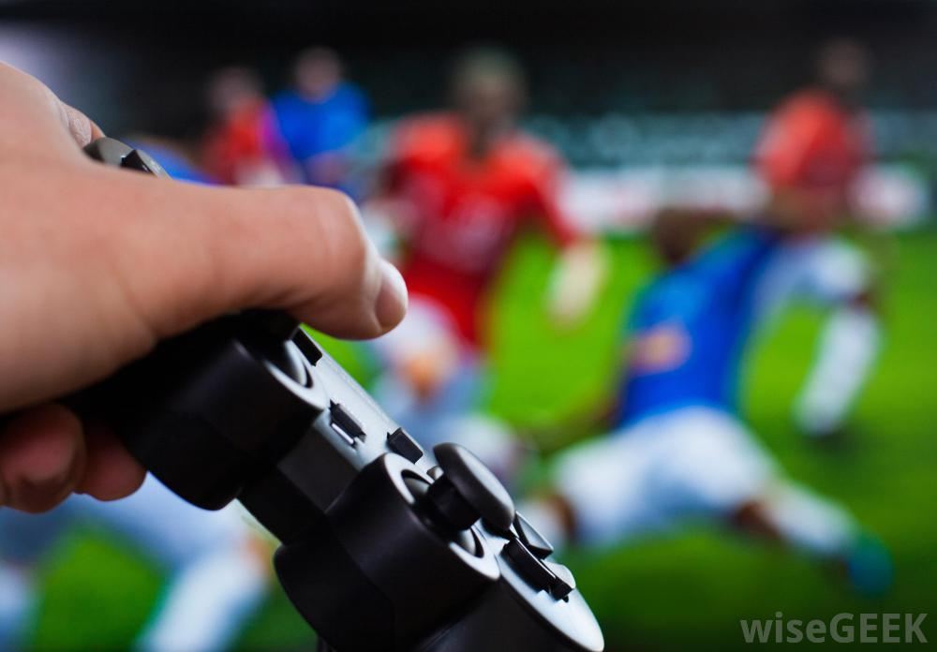
Soccer as video game
Game AI should keep balance between:
Believability
Effectiveness
Notes:
In addition, soccer-based video games are found among the most popular electronic entertainment products. As any video game it should possess some basic features or “fun factors” that keep the users engaged. One such feature
is suspension of disbelief which is considered as indicator of high quality, contributing to player immersion. Suspension of disbelief is usually associated with believability or human-likeness, which is crucial in case of soccer. Since soccer games are played by humans, their artificial representations in a game world are also supposed to be human-like. This task is partially accomplished by using highly detailed models of real athletes and real team structures/symbolics. However, we think that the ultimate contribution to believability can be achieved by interacting with AI agents that possess human-like behavior patterns. Arguably, the most straightforward approach to obtain such agents is to transfer knowledge from real players.

Slide 4
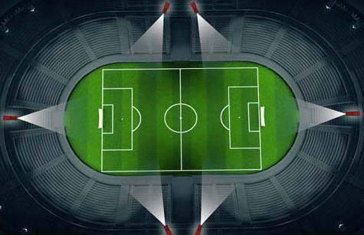
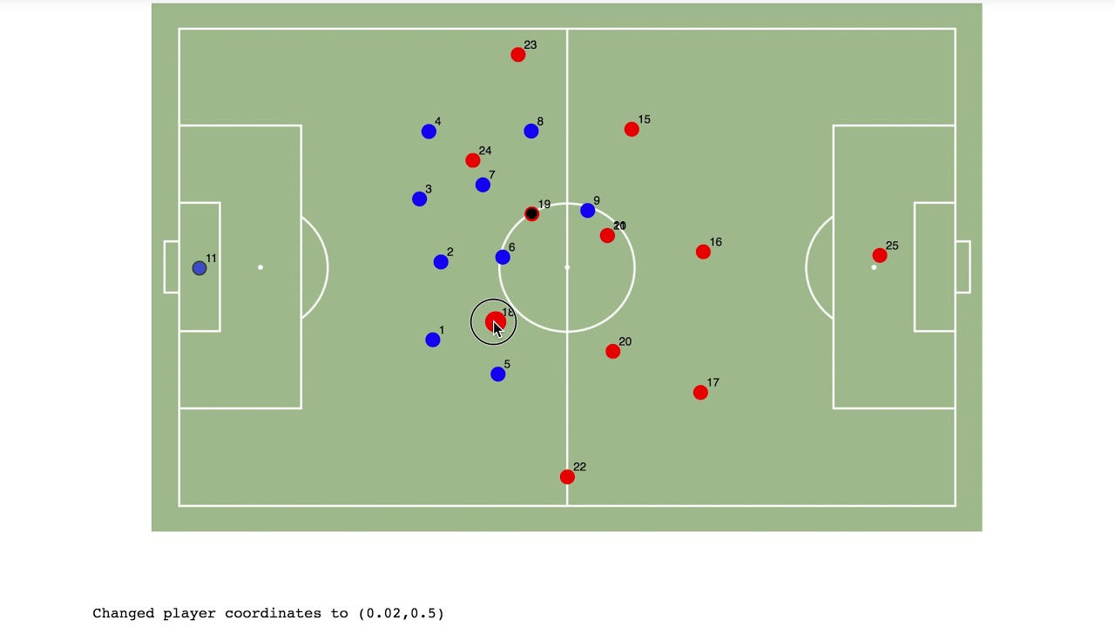
Sources of knowledge
Spatiotemporal data:
Array of game state vectors,
“digitalized” matches
Used by:
Media companies
Sport analytics
Coaches

Slide 5
Research questions
How to design a method that would allow to assess team play styles?
Does team style persist throughout match and/or between the matches?
Is it possible to distinguish one team from another?
Is it possible to distinguish human players from AI-controlled players?
Notes:
Our major goal is to design AI for soccer and this work is one of our intermediate goals. We are primarily focusing on believability rather than on efficiency due to our goal to provide “believable teams”, which is
reasonable from game development point of view. While reasonable AI skill level is expected, striving for the best performance is not the primary target for game AI, since
it must provide entertainment for players of varying skills.
Is it possible to define properties that represents teams’ unique behavior patterns in principle, and it is it possible to automate their analysis.
behavior patterns of team in different phases of the game may differ. Players can get tired in 2nd half. Reason that has no reflection in data set, meta-game. Adaptation to some team
4) if team behavior styles are identifiable, we should be able to distinguish them. Can we assess “human-likeness” by comparing behavior of human teams with their AI-controlled counterparts

Slide 6
datasets
DataStadium: complete matches | Google Research Football: virtual teams | STATS: Anonymized data
5 full games of Japanese J1 League | 4800 game sequences of virtual agents | 7578 short game episodes
Notes:
We analyze only the data of four teams that played twice to be able to compare team behavior in different matches.
Google Research Football with Manchester City F.C. competition. Player with ball, closest to ball. Still, the logic of player with the ball has a major impact on the whole team’s tactics. 501 and 432.
7578 short game episodes (from 5 to 150s) -> 45 matches played in a top European league. Total time 2220 min. Episode start with get ball, end with last ball. We treated this dataset as a “collective image” of a highly skilled human team.

Slide 7
Data preparations
Mirroring of left side team
Matches of Japanese league is divided into 2 parts
Notes:
Mirror left team
5 matches of Japanese teams cut by halfes

Slide 8
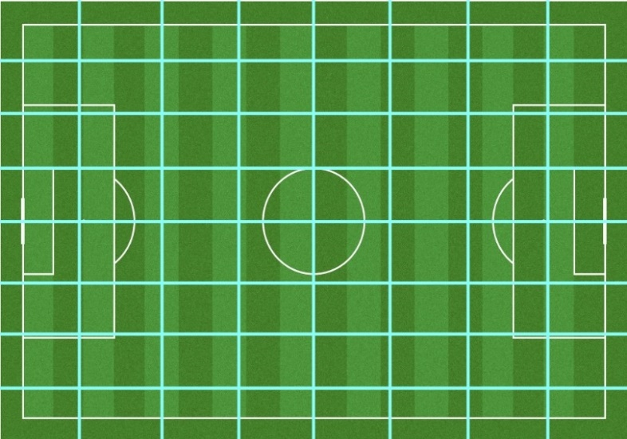
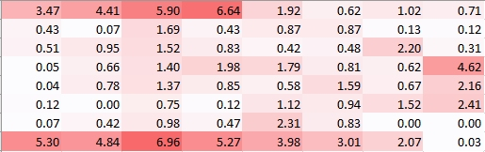
Ball possession-based fingerprinting
Cells for ball possession analysis
Sample heatmap of ball possession

Slide 9
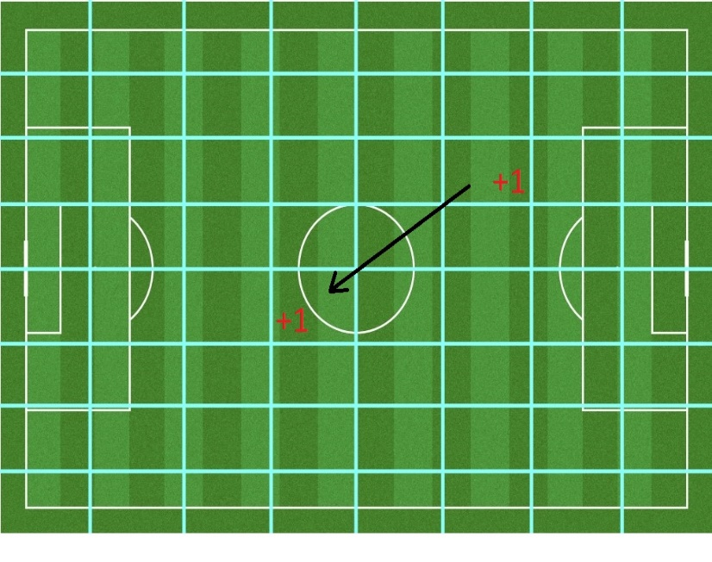
Pass-based fingerprinting
+1
Passing/receiving pass increases counter for cell
Pass is deliberate action that reflect tactical intention
+1
Pass/receive frequency counting

Slide 10
Results
Similarity of ball possession heatmaps (%)

Slide 11
results
Similarity of pass/receive heatmaps (%)

Slide 12
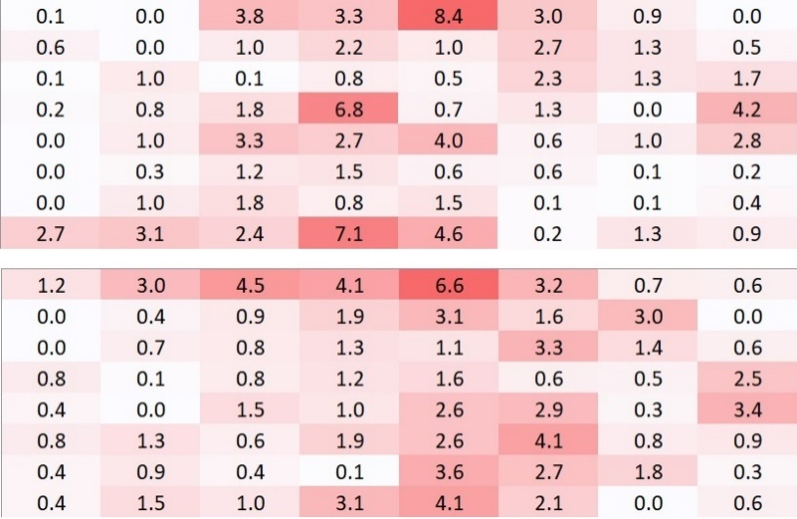
discussions
Ball possession heatmaps: 64-90%
Pass/receive heatmaps: 58-89%
Heatmaps of V11 (up) and N11 (down) (sim: 74%)
Notes:
1) The most straightforward theory would be to presume that there are indeed no clearly identifiable styles among professional teams in modern soccer. While this idea may sound implausible, some specialists voice similar opinions. For example, a well-known Italian manager and a former player Roberto Mancini argued in 2007 that future advances in football would come from physical preparation of players rather than tactics. The underlying reasoning is that the maturity of football as a game and widespread adoption of fresh ideas drive soccer to a certain global uniform style, where country-specific or team-specific innovations are unlikely (ibid).
2) Method take into account not enough nuances
3) The size of data set, and non-persistent nature of team due to frequency of matches, injures etc.

Slide 13
discussions
How to design a method that would allow to assess team play styles?
Does team style persist throughout match and/or between the matches?
Is it possible to distinguish one team from another?
Is it possible to distinguish human players from AI-controlled players?
Notes:
RQ1. We have limited success with a heatmap/cosine similarity-based evaluation algorithm. It provides reasonable results but fails to distinguish human teams in our dataset. While this method is simple, it could produce reliable player identification in boxing and tennis games.
RQ2, RQ3. The answers are “no” under presumption that heatmap comparison is a reliable method to analyze team play style. We see that the same teams behave differently in different matches and/or match halves, while distinct teams often show very similar behavioral patterns. However, a more sophisticated method of evaluation might be required.
RQ4. Yes, at least for the AI system built into Google Research Football. It is hard to say how representative are the two bot teams present in our datasets. Since we mostly rely on passes and movements of the player with the ball, the similarity between SaltyFish and WeKick could have been expected to be lower. On the other hand, both these bots optimize performance and rely on other players’ cooperation. Their behavior is described as “simple and reasonable” by the Google Research team, so we can suggest that a “typical” AI system should exhibit similar traits. Thus, human-likeness is not a natural property of a team of bots, and even our simple method can easily distinguish virtual teams from real teams.

Slide 14
Thank you for your attention!
Questions are welcome!

