Slide 1
Testable Modular Software with TDD, Simple Rules and Key Indicators
Maxim Mozgovoy

Slide 2
The Problem
Is this your code?

Slide 3
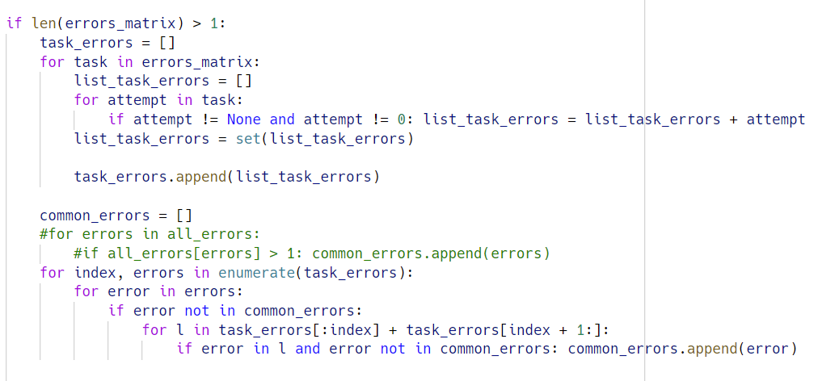
My latest code review: a 135-line long function
Notes:
There are 18 lines here, but it goes on and on for 135 lines.
Not exceptionally bad, but you can imagine how to deal with it.
This is a very common pattern to see code like this.
Why so and what to do?

Slide 4
A very general observation
A single algorithm is like an atom. It might be simple or complex inside, but it is understood “holistically” (as a whole).
Much time is spent learning/training algorithms.
A software project contains numerous algorithms.
Thus, it is a “system” that has structure.
Less time is spent on discussing structure.
Notes:
“Less time” because systems are larger, and hard to discuss at courses.
Also, the students have to be of some level do write them.
You can think this is “student code”, and “real life” is different.

Slide 5
The architecture that actually predominates in practice [is] the BIG BALL OF MUD.
[It] is haphazardly structured, sprawling, sloppy, duct-tape and bailing wire, spaghetti code jungle.
Foote, B., & Yoder, J. (1997). Big ball of mud. Pattern languages of program design, 4, 654-692.

Slide 6
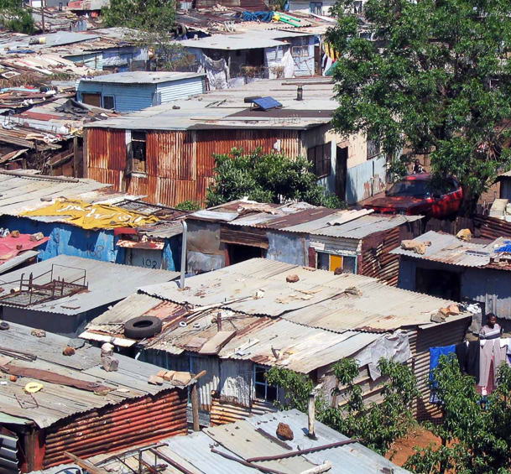
…many of our software systems are (…) shantytowns. [They] are usually built from common, inexpensive materials and simple tools (…) using relatively unskilled labor. (…) Shantytowns fulfill an immediate, local need for housing (…) Loftier architectural goals are a luxury that has to wait.
Notes:
If you have people with low skills and not many resources, a shantytown grows naturally.
Why don’t we like it? It looks like a cheap solution, but in fact it brings troubles with infrastructure (water, transport, electricity), and repairing anything is hard because all sort of skills are necessary.
In other words, we hit a “growth limit”, and we can’t really continue.

Slide 7
Architectural challenges
Your system should be designed well.
Design isn’t free.
But you can’t design everything in advance.
The system should be able to grow.
“Natural” growth leads to the big ball of mud.

Slide 8
Why So?
Why it happens the way it happens?

Slide 9
Programming as modeling
In most cases, a software system represent some processes that happen in real or imaginary world.
In a webshop a customer takes a product from a shelf and puts it into a cart, then proceeds to a checkout).
Pacman eats pills and runs from the ghosts chasing him.
You draw a picture on canvas with a brush, using a color from your favorite palette.

Slide 10
Natural systems are natural
What is the difference between “natural” and “engineered”?
Natural systems often consist of numerous interacting agents exhibiting emergent behavior.
Notes:
Emergency is a cool concept. One ant vs anthill.

Slide 11
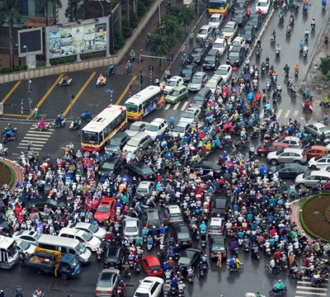
Natural systems are natural
What is the difference between “natural” and “engineered”?
This is not only about “nature”, this is also about processes happening in human society and daily life.
Notes:
Banking, shopping, education.

Slide 12
Engineered systems are hierarchical
What is the difference between “natural” and “engineered”?
Engineered systems consist of reusable components embedded into opaque modules
Notes:
Such systems are sometimes more efficient, and sometimes not.
The property of hierarchy is seemingly related to our brain capacity: we are simply unable to keep track of too many objects and links.
(We are also unable to deal with too many people simultaneously, and structure them into “units”)
So there is a fundamental difference between these types of systems, and we are trying to shoehorn one into another.

Slide 13
Everyone knows that debugging is twice as hard as writing a program in the first place. So if you're as
clever as you can be when you write it, how will you ever debug it?
B. Kernighan, P. Plauger. The Elements of Programming Style (2nd Ed). McGraw-Hill, 1978, p. 10.

Slide 14
Can We Fix It?
How to design good software

Slide 15
Which architecture is “the best” and how to make it
Unsurprisingly, there is no universal answer.
Different architecture types are good for different systems.
Different approaches to grow a healthy system exist.
Numerous books are written on the subject, e.g.:
Martin R. Clean Architecture. Prentice Hall, 2017
Freeman S., Pryce N. Growing Object-Oriented Software. Addison Wesley, 2010.
Microsoft Application Architecture Guide (2nd Ed). Microsoft Press, 2009.

Slide 16
Which architecture is “the best” and how to make it
One (relatively) simple approach is to make sure that your system satisfies some properties.
For example, the property of agility is comprised of:
Debuggability
Extensibility
Portability
Scalability
Securability
Testability
Understandability
Notes:
Focus on features
You can restrict yourself with some constraints that help you to stay within some “good” range of options.
It’s like weight management – stay within a range.
Watch some key metrics and properties, and you should be okay.

Slide 17
Which architecture is “the best” and how to make it
Similarly, you can follow some “rules of thumb” to make sure you are not doing something potentially bad.
A simple example of such a rule: “no public data class members”
class MyClass {
public int x; // bad
}
Other examples: Law of Demeter, Liskov substitution principle

Slide 18
TDD, Simple Rules, and Key Indicators
Let’s start with something simple

Slide 19
Lines of code (functions)
We don’t have hard evidence for good rules. Some expert views:
Functions should hardly ever be 20 lines long. Functions should do one thing. They should do it well. They should do it only. *
From time to time, a complex algorithm will lead to a longer routine, and in those circumstances, the routine should be allowed to grow organically up to 100-200 lines. **
* R. Martin. Clean Code. Pearson, 2008 (pp. 34-35.)
** S. McConnell. Code Complete (2nd Ed). MS Press, 2004 (sec. 7.4)
Notes:
McConnell cites some research and notes that 100 or 200 lines is “limit of understandability”
Also, “Modern programs tend to have volumes of extremely short routines mixed in with a few longer routines”

Slide 20
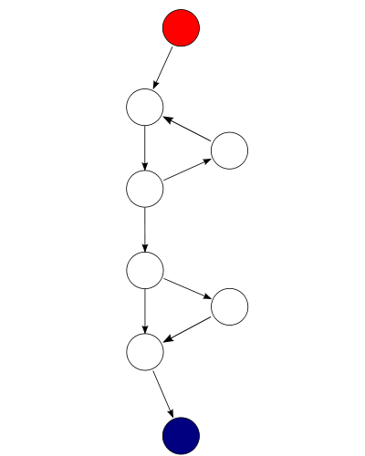
Cyclomatic (McCabe) complexity
“The cyclomatic complexity of a section of source code is the number of linearly independent paths within it” — Wikipedia
0…5: probably fine;
6…10: think how to simplify it;
10+: break routines into parts*
* S. McConnell. Code Complete (2nd Ed), sec. 19.6
Notes:
The complexity of this fragment is 3.

Slide 21
Obtaining code stats
Unfortunately, the process of getting these stats depends on your programming environment and the language you use.
For example, MS Visual Studio provides “Code metrics” functionality, but it works for C#, VB.NET, and F# only.
In MS Visual Studio Code you can use, e.g., Codalyze extension to calculate some simple metrics.

Slide 22
Codalyze results (1)
Notes:
Show my code, and how to use Codalyze.

Slide 23
Codalyze results (2)

Slide 24
Pylint and Black functionality
Other tools I use daily inside Visual Studio Code:
Pylint. Highlights potential flaws (like classes with too many functions) and possible improvements (like non-static methods that can be made static)
Black. Reformats Python code according to PEP8 guideline. In particular, it breaks long lines (> 88 characters or so).
Notes:
PEP8 specifies 79 chars per line.
Just mention there are other things like fan-in/fan-out.
Using too many is like a complete blood test ☺

Slide 25
TDD, Simple Rules, and Key Indicators
Principles to think about

Slide 26
A Polarizing Technique
Our tools are improved by means of two simple methods:
Give us something so we can use it.
Take something from us, so we can’t use it anymore.

Slide 27
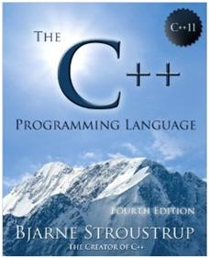
Evolution by growth: the case of C++, Java, Python…
Old tools can’t satisfy all our needs, so new functionality is added:
Year | Pages
1986 | 327
1991 | 691
1997 | 910
2013 | 1346

Slide 28
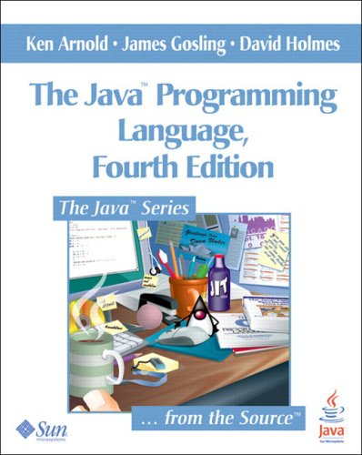
Evolution by growth: the case of C++, Java, Python…
Old tools can’t satisfy all our needs, so new functionality is added:
Year | Pages
1996 | 333
1998 | 442
2000 | 595
2005 | 928
2013 | 992

Slide 29
Evolution by growth: the case of C++, Java, Python…
“Programmers should be free to pick their own programming style, and that style should be fully supported by C++. Allowing a useful feature is more important than preventing every possible misuse of C++.” – B. Stroustrup
C++ | Java
templates (1990) | generics (2004)
string class (1998) | strings (1996)
range loop (2011) | 2004
lambda expr (2011) | 2014
std multithreading (2011) | 1996
std regexp (2011) | 2002

Slide 30
Evolution by restriction
Our tools are improved by means of two simple methods:
Give us something so we can use it.
Take something from us, so we can’t use it anymore.

Slide 31
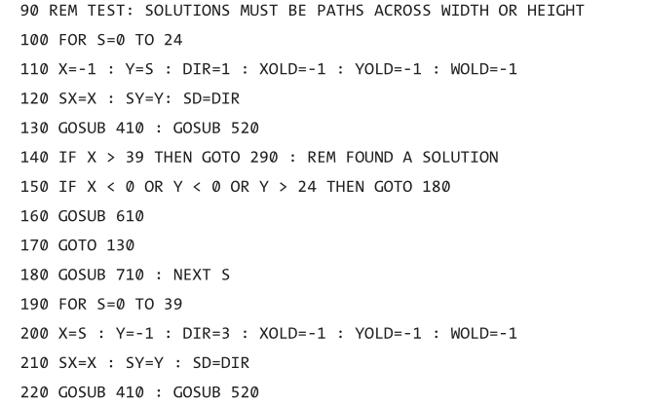
Example: take away GOTO
A fragment in BASIC:
Monfort N. et al.
10 PRINT CHR$(205.5+ RND(1)); : GOTO 10.
The MIT Press, 2012 (p. 258)
Notes:
Why taking away? To simplify reasoning about the code.

Slide 32
Example: take away GOTO
ON… GOSUB is not for the faint-hearted:
10 INPUT "Write a number, please"; A
20 ON A/4 GOSUB 1000,2000,3000: PRINT
999 END
1000 PRINT "1. Subroutine"
1001 A=A+1: RETURN
2000 PRINT "2. Subroutine"
2001 A=A+1: RETURN
3000 PRINT "3. Subroutine"
3001 A=A+1: RETURN

Slide 33
“For a number of years I have been familiar with the observation that the quality of programmers is a decreasing function of the density of go to statements in the programs they produce. More recently I discovered why the use of the go to statement has such disastrous effects, and I became convinced that the go to statement should be abolished from all "higher level" programming languages”
E. Dijkstra. Go To Statement Considered Harmful.
Communications of the ACM, 11(3), 1968, pp.147-148
Notes:
So we can take away GOTO statement (note that Dijkstra explains why its hard to reason with GOTO present).
It deals with space/time separation (space when writing, time when running).

Slide 34
Example: take away mutability
x = MyObject()
# is x the same or not after these lines?
y = x
z = x.calc()
x.do_it()
my_fun(x)
Notes:
If we don’t know the answer, we can’t reason about the code. It’s hard. If we put some constraints, we can simplify reasoning.

Slide 35
Example: take away mutability (command-query)
“Command-Query Separation principle:
functions should not produce abstract side effects”*
private int x; private int x;
public IncRetX() { public IncX() { x++; }
x++; public RetX() { return x; }
return x;
}
* B. Meyer. Object-oriented Software Construction (2nd Ed). Prentice-Hall, 2000 (p.751)
Notes:
In this case we at least know that some methods don’t change object state.

Slide 36
Example: take away mutability (just “be immutable”)
“make all classes immutable”* (i.e., do all the work in the class constructor and never touch it afterwards).
* Y. Bugaenko. Elegant objects, Vol.1. 2017 (Sec. 2.6)
class Student:
def __init__(self, name, id):
self._name = name
self._id = id
def name(self):
return self._name
def id(self):
return self._id
Notes:
What if we need to change a student’s name or id? We make a new student object.
(If we continue this thinking further, we’ll come to functional programming)

Slide 37
TDD, Simple Rules, and Key Indicators
Towards testable architecture

Slide 38
Test-driven development is a discipline that helps professional software developers ship clean, flexible
code that works, on time.
Martin, R. (2007). Professionalism and test-driven development. IEEE Software, 24(3), 32-36.

Slide 39
Be humble about what your unit tests can achieve (…)
Unit tests are unlikely to test more than one trillionth of the functionality of any given method in a
reasonable testing cycle. Get over it.
Coplien, J. Why Most Unit Testing is Waste. RBCS-US, 2014.

Slide 40
Approaching TDD
I am approaching TDD since the time of the Beck’s XP book*
“Best practices” weren’t codified well enough.
Tools and examples weren’t easily available.
Even today it is too easy to get into a mess and abandon TDD.
* K. Beck. Extreme Programming Explained. Addison-Wesley, 1999.

Slide 41
The Three Laws of TDD*
You may not write production code until you have written a failing unit test**.
You may not write more of a unit test than is sufficient to fail, and not compiling is failing.
You may not write more production code than is sufficient to pass the currently failing test.
* Martin, R. (2007). Professionalism and test-driven development. IEEE Software, 24(3), 32-36.
* A unit is the smallest testable part of an application.
Notes:
Well, let’s start with something…

Slide 42
More (implicit) rules
When you can pass the test, refactor the code to clean it up.
(You can and should also refactor tests).
As a rule, when your tests become more specific, the production code becomes more generic.
As a rule, you should not strive for 1-to-1 correspondence between tests and classes or functions; they are independent.
As a rule, you should not strive for 100% test coverage: e.g., trivial “glue” code and GUI is OK to test manually.

Slide 43
Even more stuff… how to start?
Practical development is complicated, so there are lots of cases, where it isn’t clear how to apply TDD.
However, many of them are widely discussed.
An easy way to start is to try out some “code katas” http://codekata.com https://kata-log.rocks/tdd

Slide 44
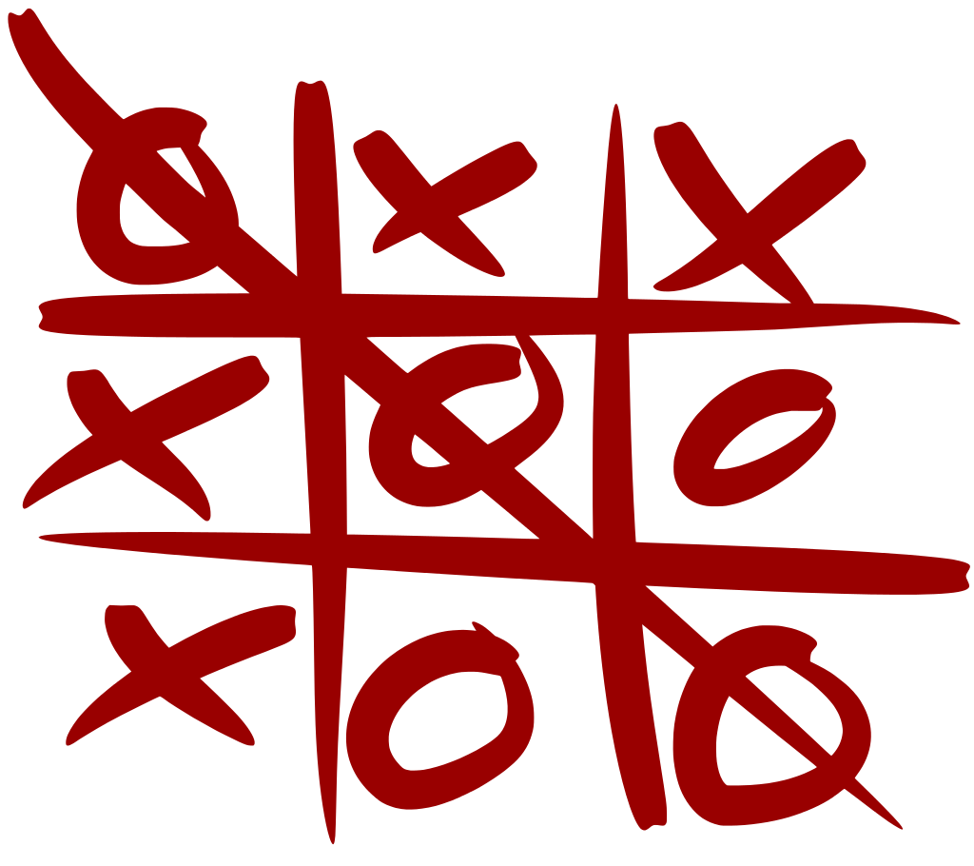
Case study: Tic tac toe kata
Let’s write the Tic tac toe game using TDD

Slide 45
Automated tests vs TDD
Many arguments in favor of TDD emphasize automated unit tests:
[We] write unit tests so that [our] confidence in the operation of the program can become part of the program itself.*
[on refactoring]: you have the tests, so you are less likely to break something without knowing it.**
* K. Beck. Extreme Programming Explained. Addison-Wesley, 1999 (Ch. 10). ** ibid., Ch. 11.

Slide 46
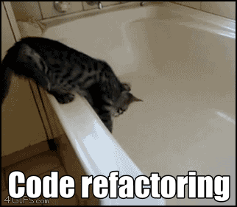
Automated tests vs TDD
Tests describe our software and make refactoring safer.
“To me, legacy code is simply code without tests”*
* M. Feathers. Working effectively with legacy code. Pearson, 2004.

Slide 47
TDD is “Test First”
However, there is another consideration:
TDD forces you to create testable architecture consisting of small isolated components. It won’t happen if you test after.
Testability is an important property of good software. A test is the simplest client of your component. If a component is hard to test, it is probably hard to reuse.
Thus, TDD is a way to add another constraint into the system.

Slide 48
Other architectural Implications (?)
Some authors criticize TDD for the alleged “no upfront design” approach (and thus for the lack of well-thought architecture).
TDD does not specify in which order you should implement classes and methods, and not against design thinking.
However, balancing “the big picture” and “the small picture” and establishing “natural growth” can be challenging.
Notes:
That’s why there are books on this subject!

Slide 49
THANKS!
Any questions?

