Slide 1
Enhanced Rolling Horizon Evolution Algorithm with Opponent Model Learning: Results for the Fighting Game AI Competition
Zhentao Tang, Student Member, IEEE, Yuanheng Zhu, Member, IEEE, Dongbin Zhao, Fellow, IEEE, and Simon M. Lucas, Senior Member, IEEE
Notes:
Hello,
The title of the paper is “Enhanced rolling horizon evolution algorithm with opponent model learning”.

Slide 2
Contents
Introduction
RHEA with opponent learning model
Experiment
Results and Discussion
Future work
Notes:
These are the contents of the paper

Slide 3
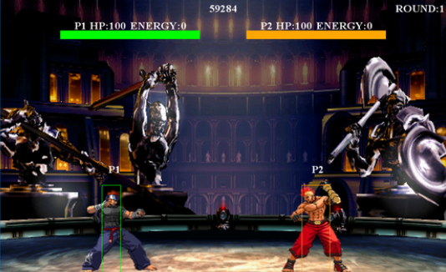
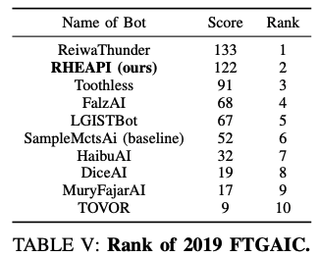
FTGICE competition 2019
Platform: fightingICE
Notes:
This paper introduces one of the agents in Fighting ICE competition in 2019.
The platform is fightingICE.
The agent named “RHEAPI” was in 2nd place in the competition.

Slide 4
(RHEA) Rolling Horizon Evolution Algorithm
Notes:
They used RHEA: Rolling Horizon Evolution Algorithm to make fighting agent.
RHEA is an algorithm that evolves action sequences through forward model.
This is the flow diagram of RHEA.
This time, gene of the algorithm is sequences of actions.
There is a fitness function to evaluate the score of new action sequence.

Slide 5
RHEAOMs (RHEA with Opponent Model)
RHEA needs opponent AI for efficient learning
RHEA none (don’t move)
RHEAOM-R random move
RHEAOM-SL supervised-learning
RHEAOM-Q Q-learning
RHEAOM-PG policy gradient
Notes:
RHEA is an algorithm only to consider future behavior of itself, it can’t do evaluation without thinking opponent movement.
They had to make opponent AI and combine to RHEA do efficient learning.
They made 5 types of RHEA with opponent model. Those are called RHEAOM.
RHEA combined with no opponent model, random opponent model, supervised-learning-based, Q-learning-based, and policy gradient-based opponent model.
The None-opponent model means that we assume the opponent does not take any action but just stands on the ground,
and Random-opponent model means that the opponent’s action is randomly sampled from possible actions.
Last three models were made by simple neural network.

Slide 6
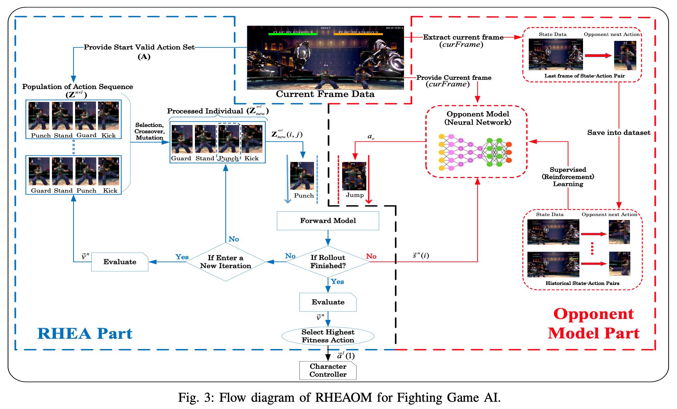
Notes:
This is the flow of the algorithm.
There is RHEA part and Opponent model part.
It use candidate action set and opponent model to infer enemy action to output charcter action.

Slide 7
Experiment
Characters: Zen Garnet Lud
Self-comparation with RHEAOM
fight against top 5 bots from 2018 competition
Notes:
Experiment has done with three character, ZEN, GARNET, and LUD.
First, they did self comparation with 5 RHEA-based algorithm.
Then they compared with bots from 2018 competition.

Slide 8
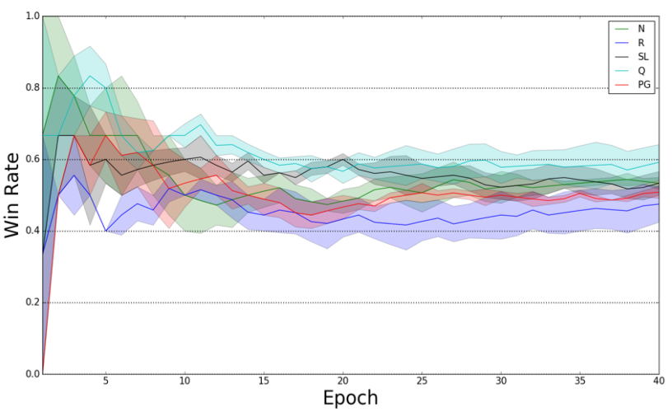
Result: Self-comparation
Winner
GAR: RHEAOM-R
LUD: RHEAOM-PG
ZEN: RHEAOM-PG
Notes:
Firstly, self-comparation was made.
As the table shows, the AI which had highest mean win rate was RHEAOM-PG, which is with policy-gradient-based opponent model
RHEAOM-R was highest in Garnet, but other characters with policy gradient are much higher in other characters.
The line graph shows how each RHEA-based approaches win rate converge.
Red line is RHEA with policy-gradient-based opponent model, and you can see the win rate is converging faster than other models.

Slide 9
vs. FTGAIC 2018 bots
most of their win rate was more than 80%
RHEAOM-PG did best
Notes:
After self-comparation, they compared with bots from competition in 2018.
Opponents were top 5 of the competition. Most of them are designed based on MTCS.
All of RHEA-based agents won to them.
Most of their win rate was more than 80%.
With RHEAOM-PG win rates were about 90%.

Slide 10
RHEAOM and MCTSOM
adapt opponent learning model to Thunder (2018 winner)
ThunderOM-SL, ThunderOM-PG
Notes:
They also compared RHEA with opponent model and MCTS with opponent model.
Thunder is a MTCS approach agent and a winner of 2018 competition.
They adapted the opponent learning model to Thunder and named ThunderOM.
The table is results of RHEAOM vs ThunderOM.
RHEAOM was little higher score than ThunderOM.
However, ThunderOM score was much higher than original thunder.
This shows opponent model is also suitable to MCTS.

Slide 11
Disscussion and Conclusion
RHEAOM have good performance for most agents
adaptable to any 2 player game
Future work
introduce a model-based deep reinforcement learning method
Notes:
Conclusion
It made a good performance in 2019 competition.
Though RHEA-based algorithm was in 2nd place of competition, it used much less domain knowledge than the winner.
The research was in fightingIce platform, but this RHEAOM is applicable to any 2 player game.
The future work is to introduce a model-based deep reinforcement learning method, to improve the adaption and generalization of the learning algorithm

Slide 12
Thank you for listening

