Slide 1
Imitation learning
at all levels of Game-AI
C. Thurau, G. Sagerer, C. Bauckhage
Proceedings of the international conference on computer games, artificial intelligence, design and education

Slide 2
Goal
- Present different algorithms that learn
from human play data.
- Show that machine learning can be applied on different levels of behaviours.

Slide 3
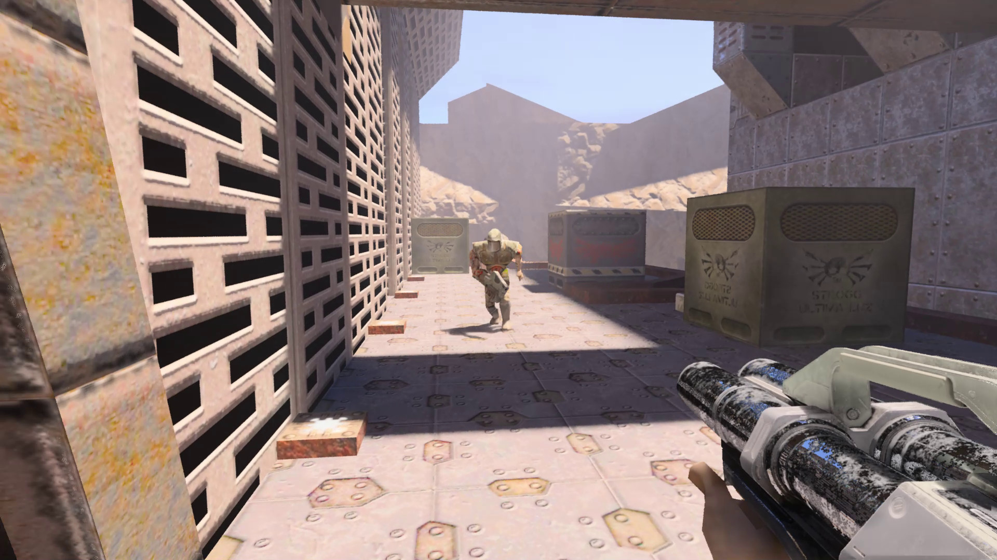
Quake II
- FPS game in 1997
- Many play data

Slide 4
Categories of Behaviours
- Strategy
- Tactics
- Reactive Behaviours

Slide 5
Strategy
Strategy is a long-term goal
ex. secure strong position, pick up important items
Strategy can be different on different situations

Slide 6
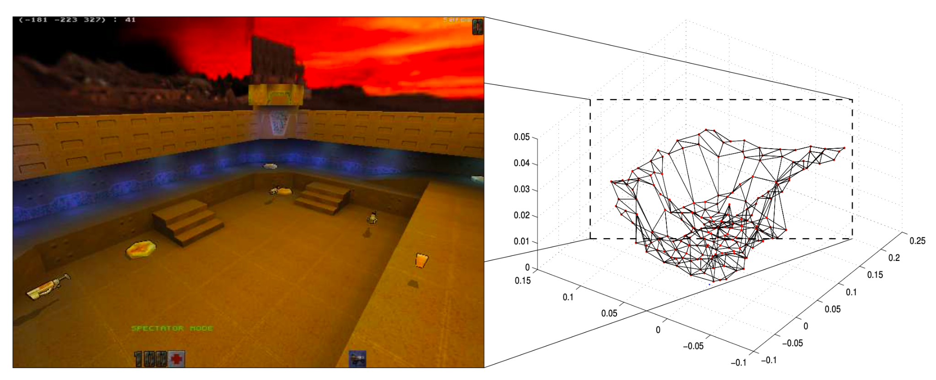
How to Learn Strategies
3D waypoint map

Slide 7
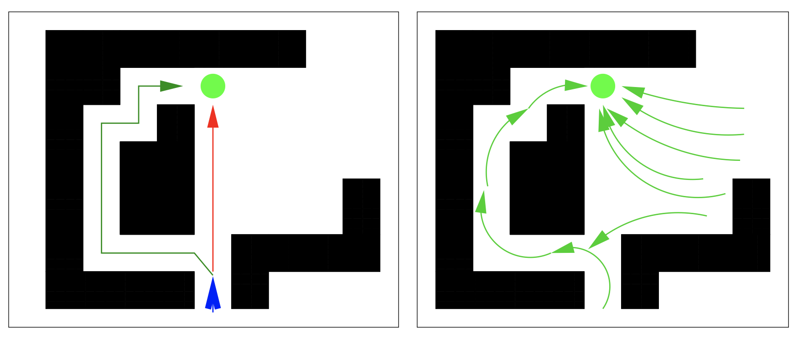
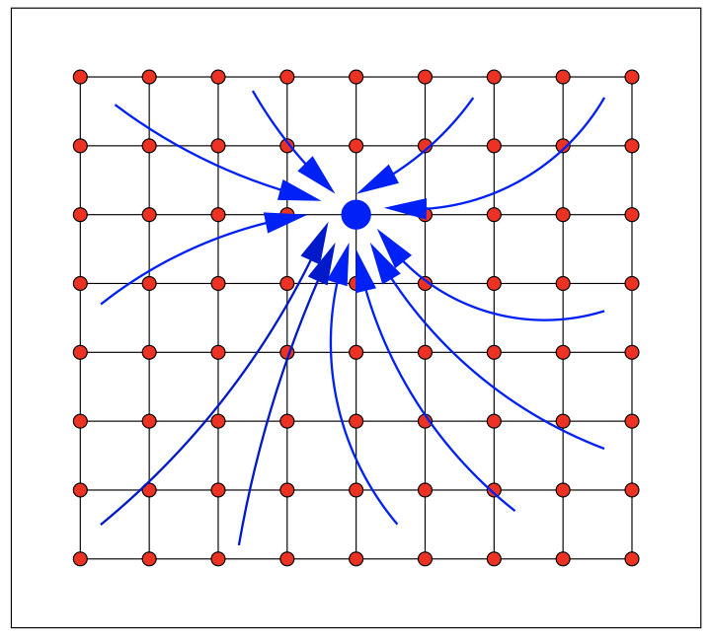
How to Learn Strategies
http://citeseerx.ist.psu.edu/viewdoc/download?doi=10.1.1.551.2301&rep=rep1&type=pdf
Potential fields

Slide 8
Tactics
Tactics is behaviour to deal with localized situation
ex. ambush enemy
How to Learn Tactics?
>> there are only little known techniques of how to approach

Slide 9
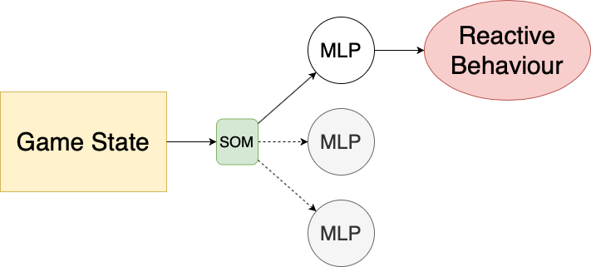
Reactive Behaviours
Reactive behaviour is simple reaction to audio or visual information
ex. movement, jumping, aiming, shooting enemy
How to learn Reactive Behaviours
Basic MLP
Input: game state
Output: Reactive Behaviour
https://www.researchgate.net/profile/Christian-Thurau/publication/221024424_Combining_Self_Organizing_Maps_and_Multilayer_Perceptrons_to_Learn_Bot-Behaviour_for_a_Commercial_Game/links/09e4151290bcc268b4000000/Combining-Self-Organizing-Maps-and-Multilayer-Perceptrons-to-Learn-Bot-Behaviour-for-a-Commercial-Game.pdf

Slide 10
Motion Modeling
https://www.researchgate.net/profile/Christian-Thurau/publication/221113941_Synthesizing_Movements_for_Computer_Game_Characters/links/09e4151290bd209df5000000/Synthesizing-Movements-for-Computer-Game-Characters.pdf
Complex movements in humans/animals are built up by combinations of simpler motor or movement primitives.
[7. Z. Gharamani. Building blocks of movement. Nature]
Agent performing long jump by means of movement primitives

Slide 11
Conclusion
- They presented a comprehensive approach for the imitation of a human controlled game agent for a FPS game.
- They identified different behavioural layers, namely strategic, tactical and reactive behaviours.
- They outlined suited approaches for behavioural learning in each of the mentioned layers and sketched their recent work on the topic of motion modeling.
- However, artificial player that integrates all the techniques presented so far was not yet realized.
- Their game-bots outperform conventional bots which are driven by finite state machines or similar architectures.

Slide 12
Thank you for listening

