Slide 1
A Hybrid Approach for the Fighting Game AI Challenge: Balancing Case Analysis and Monte Carlo Tree Search for the Ultimate Performance in Unknown Environment
Lam Gia Thuan1, Doina Logofatu2 and Costin Badica3
Proc. of 20th Engineering Applications of Neural Networks conferenc (EANN 2019), pp. 139-150, May 24-26, 2019.
Notes:
aaa

Slide 2
Introduction
This paper presents a submission to the Fighting Game AI challenge 2018, a challenging AI competition aimed at solving general real-time fighting problem.
This research focuses on the design of an algorithm that can handle the vast number of game states in a reasonable way given their average computational power.
The algorithm was appropriately blended with a general case analysis approach and a winning MCTS algorithm. The results show that it performs better than all the extant algorithms.

Slide 3
The fighting game AI challenge
The Fighting Game AI Challenge is initiated by the Intelligent Computer Entertainment Lab of the Ritsumeikan University to promote AI research towards general fighting games, in which players compete against each other until only one remains using techniques resembling those in martial arts.
The fighting game AI challenge
ZEN
GARNET
LUD
STANDARD
SPEED-RUNNING
STANDARD
SPEED-RUNNING
STANDARD
SPEED-RUNNING
・STANDARD: Participants fighting each other
・SPEED-RUNNING: participants defeating the organizer’s program in the shortest amount of time

Slide 4
The LUD division
The LUD division distinguishes itself from ZEN and GARNET by hiding all action data in advance.
An action is characterized by a number of parameters.
In the LUD division, such necessary information is only provided at the start of the game. This is where MCTS comes into play, as it does not require any prior training.

Slide 5
The winning solution to the LUD division
Analysis of the previous solutions:
A successful solution should be one that is based on MCTS but does not abuse it, and should implement an intelligent search method.
Action findBestAction (GameState state) {
Action action = intelligentSearch(state)
if (action != null) action = MCTS(state)
return action
}
Adaptive Intelligent Search
Factors on which the search for the best action depends potential, preselection and upper distance analysis.

Slide 6
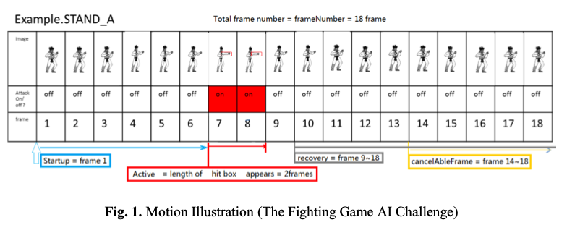
・Potential … To analyze each action’s potential, it is of paramount importance to analyze including the startup time and the resulting state of the player under attack.
The complete process for performing an attack consists of multiple periods, including a startup, active, recovery and canceling period

Slide 7
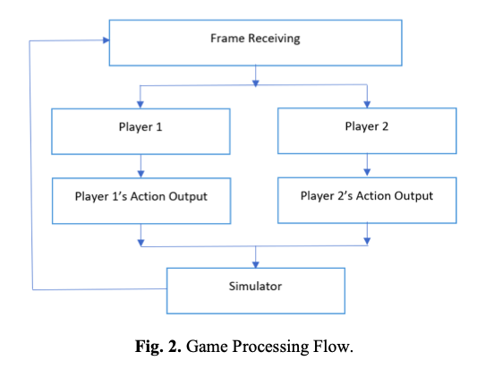
Startup is the most imperative period.
Players perform their respective action at the same time, implying the possibility that one player can be put under attack even before another is ready to act.
However fast startup alone does not guarantee an excellent action since the opponent still has a chance to revenge in the next attack. Hence actions that can result in the opponent’s DOWN state will be our first-class priority.

Slide 8
・Preselection ... The preselection of a minimum set of actions based on their potential for speed improvement during the playtime. After that, an additional reselection will be conducted and decide which actions to choose according to its respective total damage for the opponent.
List<Action> preselection(Int round1Size, Int round2Size) {
List<Action> firstRound = getAllActions()
.sortedAscBy (action -> action.getPotential())
.toList()
.subList(0, round1Size)
Map<Action,Int> damageByAction=simulateRandomGamesAndRecord(firstRound)
List<Action> secondRound = firstRound
.sortedDescBy (action -> damageByAction[action])
.toList()
return secondRound
}

Slide 9
・Upper distance analysis
The control of player movement. Simpler strategy: attack or defend.
The threshold to determine whether attack or defend depends solely on the difference between our current HP and the opponent HP as illustrated in the pseudocode below.
List<Action> upperDistanceAnalysis() {
if (myHP – opponentHP >= UPPER_LIMIT) {
return defendActions() // actions that runs away
}
else {
return attackActions() // actions that get us closer
}
}

Slide 10
A brief overview of our optimized MCTS
The key points of MCTS used in this program
・Upper Confidence Bound (UCB) formula
𝑊 is the average number of wins
𝑁𝑝 is the number of visits in the direct parent node
𝑁𝑐 is the number of visits in the current node.
𝑐 = √2 is the exploration parameter that is used to balances between exploitation (𝑊) and exploration (√ 𝑁𝑐 ).

Slide 11
The tree branch will go deep until we can decide if the current state is a win or loss and then we can recursively recompute all information such as the number of wins and the number of visits from the current state up to root. The entire process is repeated until time runs out (1 frame = 1/60 second).
Procedurefor this solution

Slide 12
Optimization
Avoiding the creation of the additional array by keeping track of only the number of unused actions.
Every newly used action will be swapped in 𝑂(1) with the first action that is not yet used.
By utilizing this trick, we manage to reduce the memory consumption by half and since the number of possible actions is relatively small.

Slide 13
Evaluation
Performance

Slide 14
Stability

Slide 15
Conclusion
This solution is combination of case analysis and Monte Carlo Tree Search that produces stable and remarkable results in the LUD division, the division closest to the general real-time fighting game.
Future direction
To automate the generation of generic heuristics
⇨ The use of Deep Learning and Neural Networks to learn and formularize the heuristics before the competition.
To further optimize MCTS for solving this challenge.
⇨ To introduce memorization into MCTS

