Slide 1
“Not All Passes are Created Equal:” Objectively Measuring the Risk and Reward of Passes in Soccer from Tracking Data
Paul Power, Hector Ruiz, Xinyu Wei, Patrick Lucey
KDD 2017 Applied Data Science Paper

Slide 2
Abstract
The purpose of this study is to show how to objectively measure both the risk and reward of a pass using player tracking and ball event data
This paper shows various applications of deployed passing system.

Slide 3
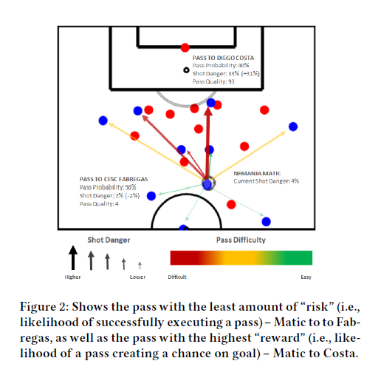
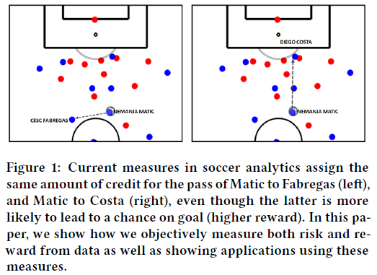
Passing measures in soccer

Slide 4
Defining Pass Risk and Pass Reward
The “risk” of a pass: likelihood that the player will successfully make the pass given a player has possession of the ball and has the ability to pass it in a given situation.
The “reward” of a pass: given a player has possession of the ball and has the ability to pass it in a given situation, pass reward is estimating the likelihood that the pass made will result in a shot within the next 10 seconds.

Slide 5
Features
Naive: the average pass completion to all passes
Ball Information: the starting and end position of the pass
Tracking/Feature-Crafted: craft soccer specific features
(1) Speed of the player in possession and the intended receiver
(2) Speed of the nearest defender toward the passer and the receiver
(3) Distance of the nearest defender to the passer and receiver
(4) Nearest defender angle to the passing line
(5) First time pass
(6) Time from regaining possession

Slide 6
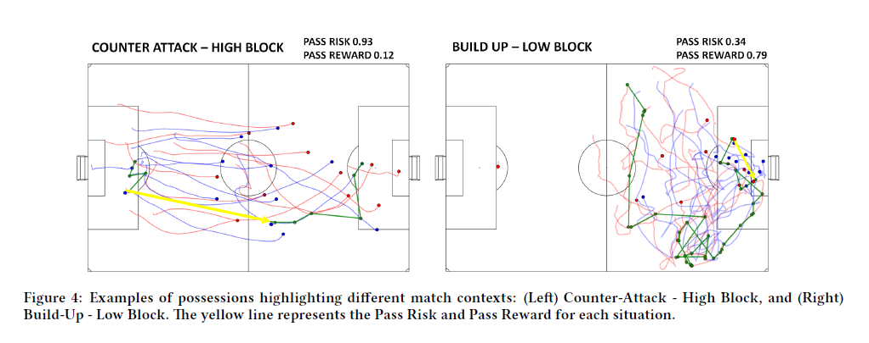
Examples of tactical and formation features

Slide 7
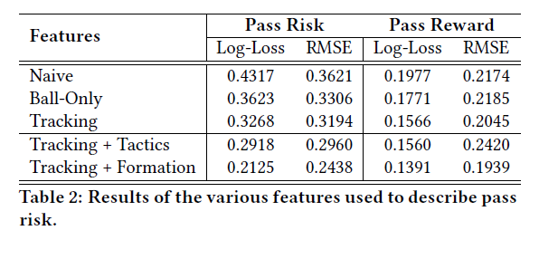
The performance of the classifiers
Using the tracking data obtains the best performance of the three at the top of the table.
The overall prediction of risk and reward improved by using the tactical and formation features.

Slide 8
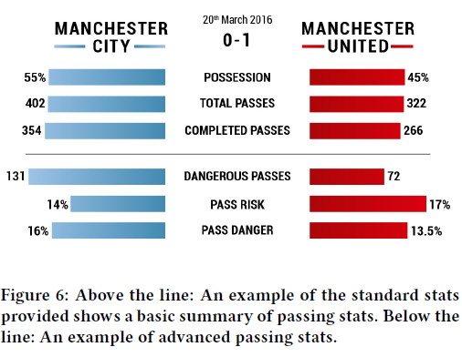
Application 1: Match Analysis

Slide 9
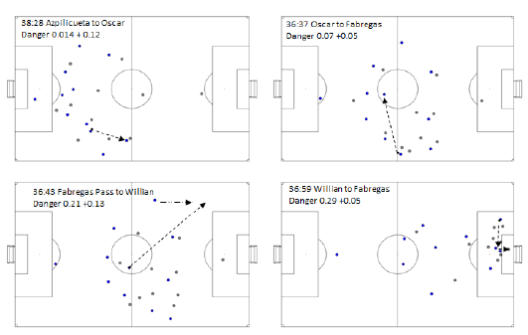
Application 2: Specific Play Analysis

Slide 10
Application 2: Specific Play Analysis

Slide 11
Thank you for listening

