Slide 1
A Fighting Game AI Using Highlight Cues for Generation of Entertaining Gameplay
Ryota Ishii, Suguru Ito, Ruck Thawonmas, Tomohiro Harada
2019 IEEE Conference on Games (CoG)

Slide 2
Introduction
Based on the highlight generation methods, build a fighting game AI for generating gameplay to entertain the spectators by incorporating highlight cues into the evaluation function of Monte-Carlo Tree Search (MCTS).
A highlight is a scene that attracts the spectator's interest in content such as sports.
The environment is FightingICE, a 2D fighting game often used in game AI competitions and research.

Slide 3
Monte-Carlo Tree Search (MCTS)
Monte-Carlo Tree Search (MCTS) is a method that combines the Monte-Carlo method with game tree search.
It has achieved good results in fighting game AI competitions.
The proposed AI will follow the fighting game AI using MCTS.

Slide 4
Highlight Generation
Typically, in sports, match scenes are evaluated automatically based on several highlight cues such as "Audio" and "Score Differential," and scenes with high evaluation values are selected for a highlight.
It was hypothesized that if these highlight cues are applied to fighting game AI, an exciting AI that can fight for highlights from start to finish can be built.
Build AI by incorporating the three highlight cues of "Score Transition," "Action," and "Distance" into the MCTS evaluation function.

Slide 5
Highlight Generation
"Score Transition" is a concept that combines the elapsed time of the current match round and the damage value that the AI gives to the opponent.
This concept causes the AI to prioritize actions with high damage value, and these fighting styles become more pronounced as the time is closer to the end of the round.
$$Score=RoundTime × Damage$$

Slide 6
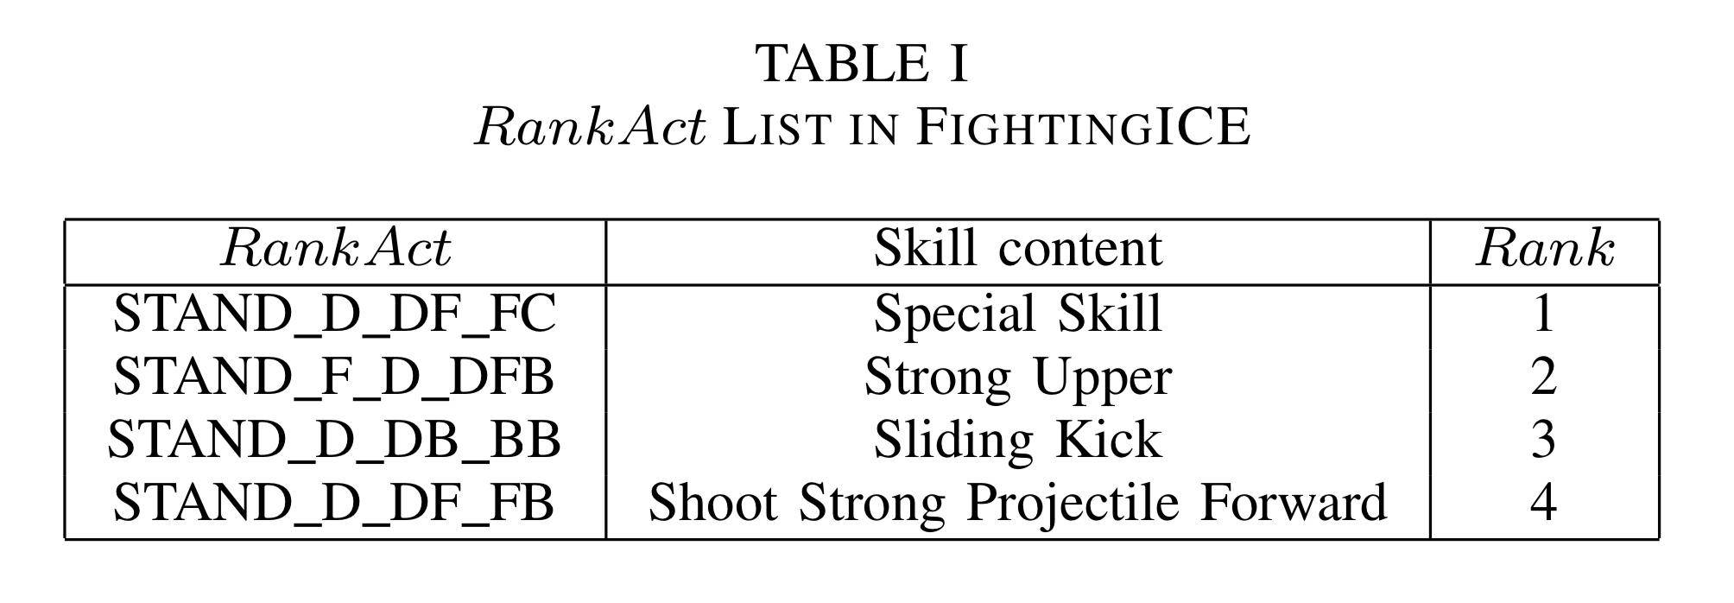
Highlight Generation
"Action" is a concept that prioritizes the actions included in the action list called RankAct.
Actions considered to have a high visual effect are added to the RankAct.
The higher the Rank, i.e., the smaller the Rank value, the larger the Action value, and so the action is given priority.
The value of an action that is not in the RankAct is 0.
$$Action=\left\{\begin{aligned}\frac{1}{2^{Rank−1}} \left(belongs to RankAct\right) \\ 0 \left(otherwise\right)\end{aligned}\right.$$

Slide 7
Highlight Generation
"Distance" is a concept that prioritizes close-distance fights near the center of the screen.
Center is the x coordinate of the center of the screen, and Xpos is the x coordinate of the AI.
Distance value will be higher when the AI is positioned closer to the center of the screen.
$Distance=1−\left|\frac{center −Xpos}{center}\right|$

Slide 8
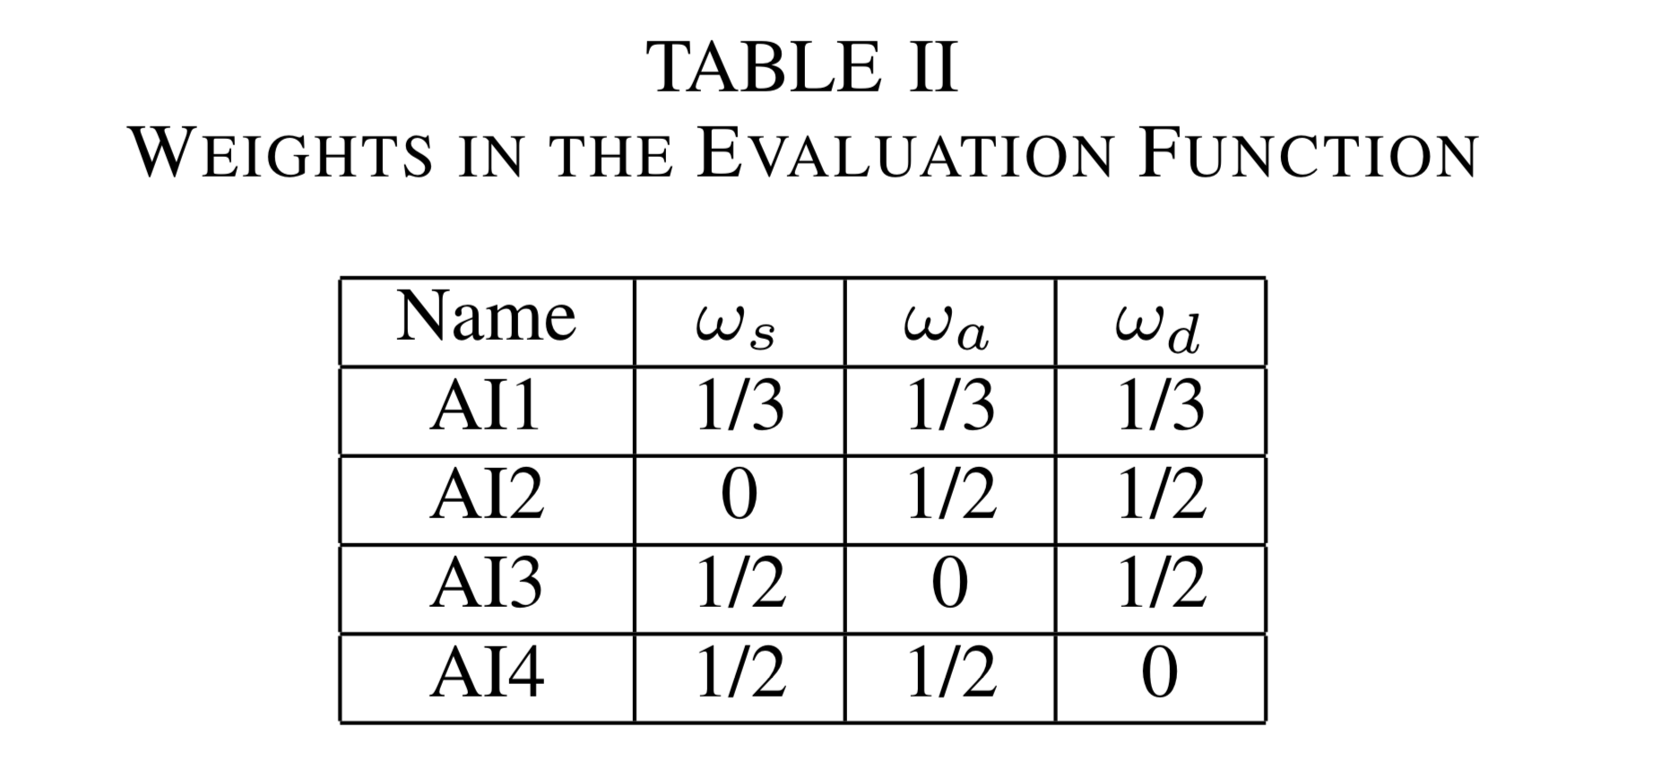
Experiments
The evaluation function of MCTS is defined as follows using the three highlight cues described above.
$$Eval=ω_{s}Score+ω_{a}Action+ω_{d}Distance$$
In the experiment, mAI (MCTS AI) and four other AIs, AI1, AI2, AI3, and AI4, are compared.
The four AIs have different weights of highlight cues in the evaluation function, as shown in Table 2.
AI1 uses all highlight cues.

Slide 9
Experiments
By conducting a user survey, the fun of the AI-generated gameplay was evaluated.
The participants in it were asked to watch two gameplay videos.
A match between mAIs
A match between one same type of AI1~AI4 (e.g. AI2 vs AI2)
Also, they were asked to answer which of the two gameplays (AIs) was more fun, and the exact binomial test was conducted based on the results.

Slide 10
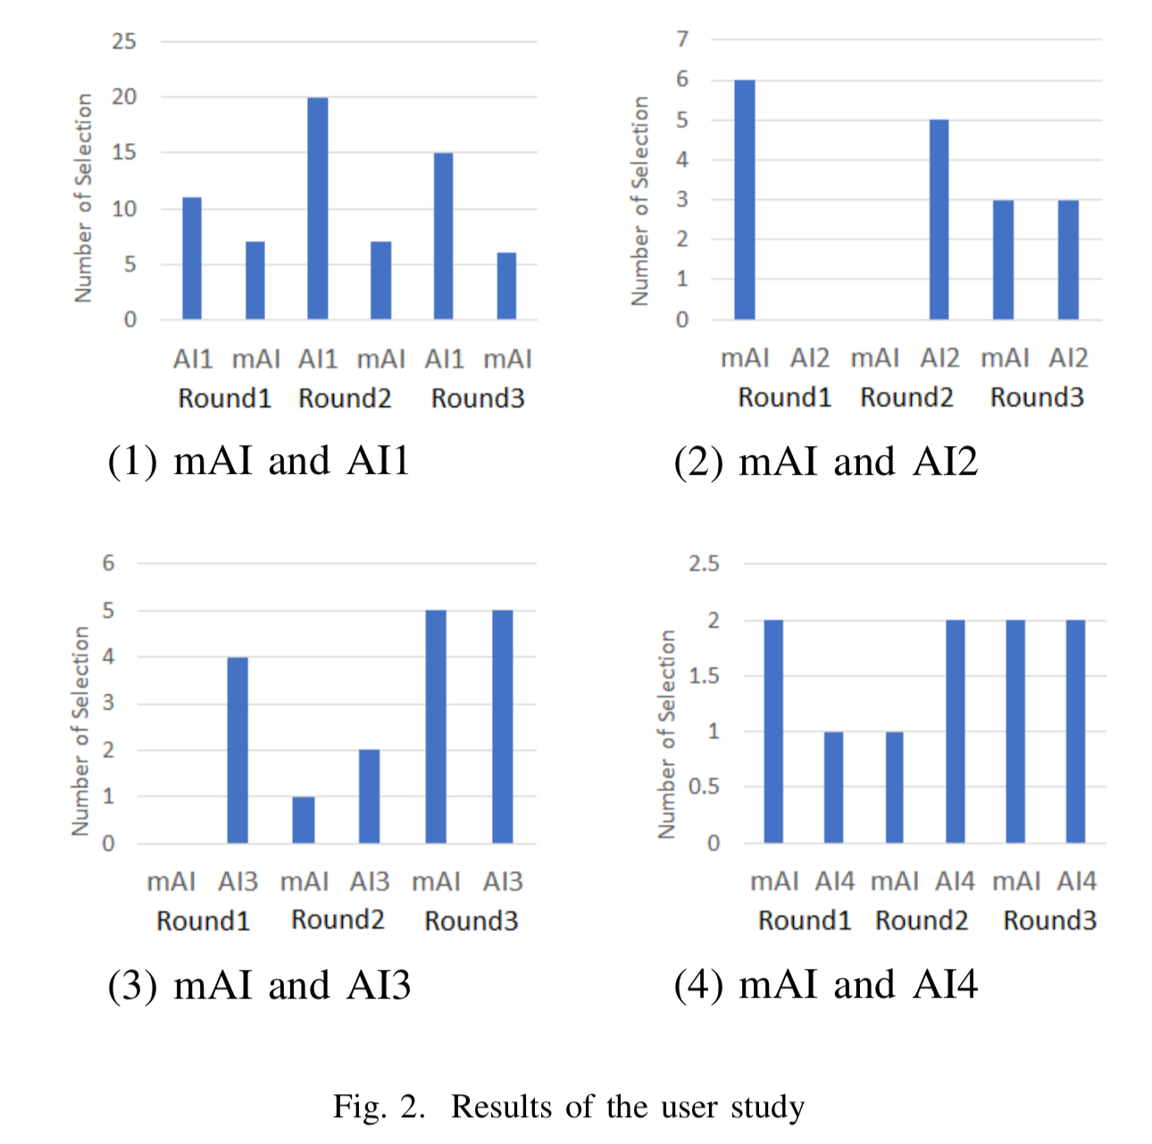
Results
n=66
n=17
The fun was evaluated for each round.
The y-axis is the number of people who found it fun.
Analysis result by binomial test:
AI1 with all highlight cues is more fun than mAI in all rounds.
"mAI and AI2" and "mAI and AI4" are no different in terms of fun.
In "mAI and AI3", AI3 was more fun, but less reliable than AI1's fun.
n=17
n=10

Slide 11
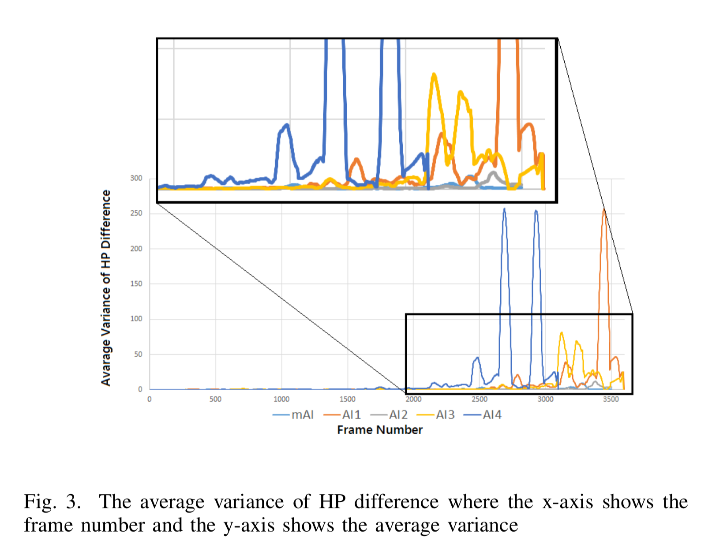
Results
Also, 1000 rounds of gameplay were generated for each of the five AI types and analyzed using three criteria:
the Average Variance of the HP Difference
the Average Use of RankAct Actions
the Average Distance Between the Two Characters
The AI that uses "Score Transition" shows the HP difference is changing sharply at the end of the round.
$⟹$ "Score Transition" is working well.

Slide 12
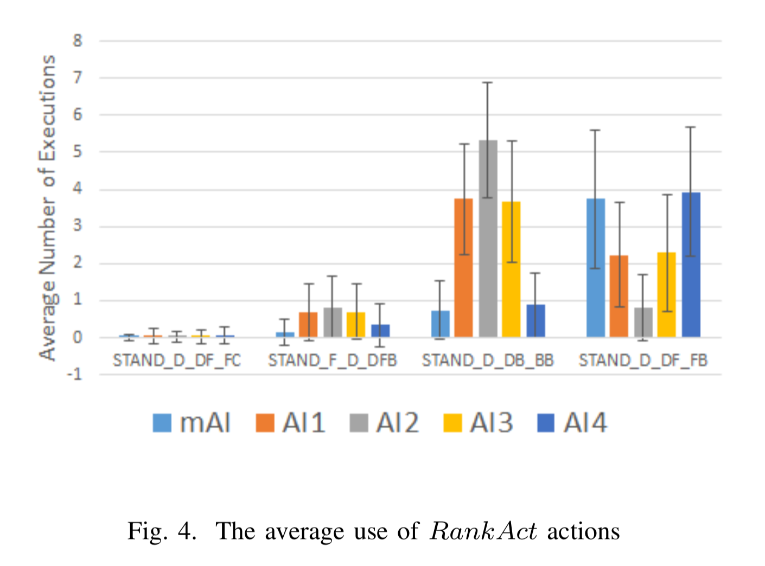
Results
1st ranked action in RankAct, which is the highest visual effects and requires a large amount of energy, was rarely performed by all the AIs.
How to promote the execution of this kind of action is a future issue.
Rank 1
Rank 2
Rank 3
Rank 4

Slide 13
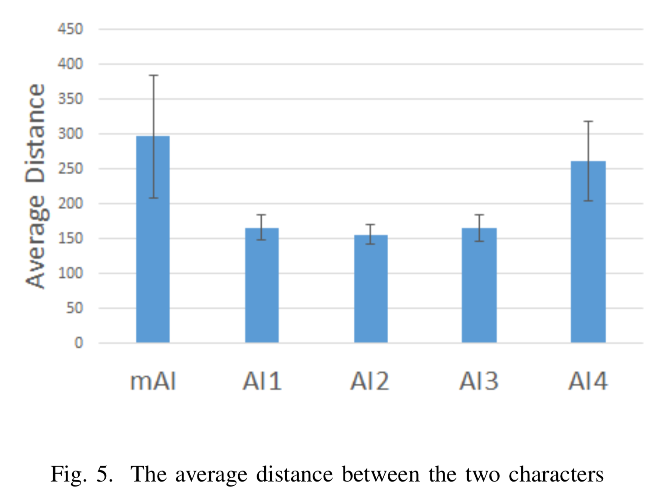
Results
AI1, AI2, and AI3, which include "Distance" in their evaluation functions, are mainly fighting at close range.
On the other hand, mAI and AI4, which don't include "Distance" in their evaluation function, are fighting at a distance.
$⟹$"Distance" is working well.

Slide 14
Thank you for listening

