Slide 1
Report on “Similarity Analysis of Action Trajectories based on Kick Distributions”
Mola Bogdan Georgii

Slide 2
Introduction and motivation
Goals
Similarity test based on distance between two kick distribution
Understand team strategies in a similar manner to human’s subjectivity
Key aspects:
Conversion of data set
Do applied methods conform to human subjectivity?
Notes:
Method should be online

Slide 3
Similarity in Team Strategies. intro
No perfect strategy
Team should adapt according to opponent
Distinguish strategies
Similarity analysis
Prediction of game result
Pick up more efficient strategy
Similarity analysis is necessary
Notes:
Team strategy is combination of action(passes, dribbles) and positional roles
Positions left for future research.
No perfect strategy
Team should adapt
Prediction suppose that opponent keeps behavior, but we can change our to more winning behavior.
Prediction means generalization of strategies and labeling weak/strong cases?

Slide 4
Kick distribution

Slide 5
Kick distribution
Data point includes x,y position of kick and length of kick
Absolute values of kick point has been used

Slide 6
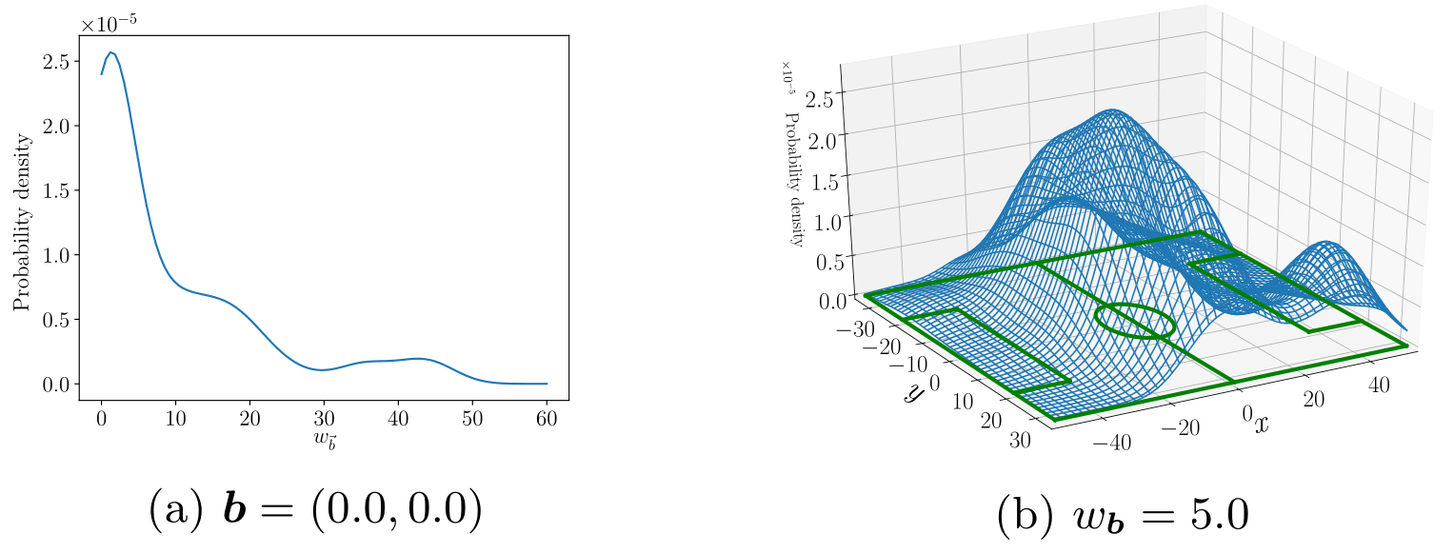
KDE – Kernel density estimation
$p\left(b,w_{b}\right)$, $b$ – location of kick, $w_{b}$ – distance that ball travel after kick
Notes:
Checking “ as is” computationally heavy -> switching to continuous probability distribution using Kernel Density Estimation
Non-parametric method to estimate the probability density function of a population from a sample.

Slide 7
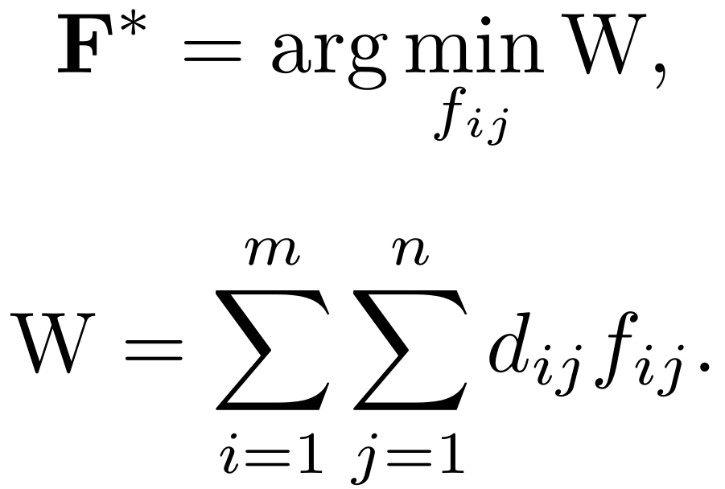
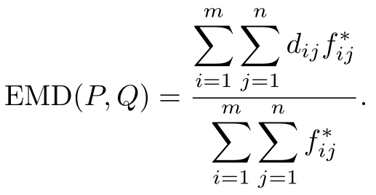
Earth Mover’s Distance
$P=\{\left(p_{1},w_{p1}\right),…,(p_{m}w_{mn})\}$
$Q=\{\left(q_{1},w_{q1}\right),…,(q_{n}w_{qn})\}$
$D=\left[d_{ij}\right] ,F=[f_{ij}]$
(a) d(x,y) ≥ 0;
(b) d(x,y) = 0 ⇔ x = y;
(c) d(x,y) = d(y,x);
(d) d(x,z) ≤ d(x,y) + d(y,z)
Notes:
(a) non-negative
(b) non-degenerate
(c) symmetry
(d) triangle inequality

Slide 8
$L^{2}$ distance
(a) d(x,y) ≥ 0;
(b) d(x,y) = 0 ⇔ x = y;
(c) d(x,y) = d(y,x);
(d) d(x,z) ≤ d(x,y) + d(y,z)

Slide 9
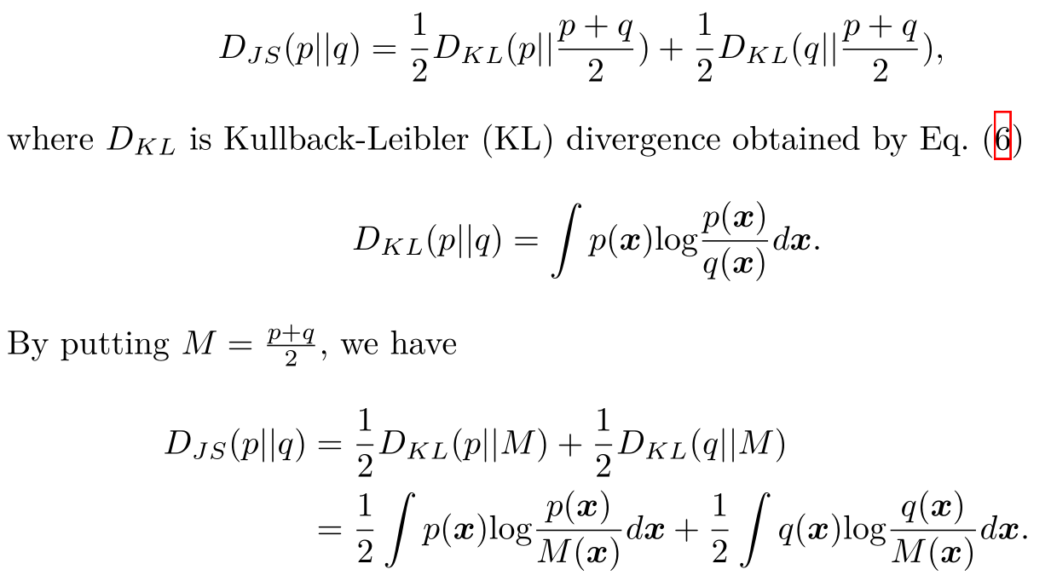
Jensen-Shannon Divergence
(a) d(x,y) ≥ 0;
(b) d(x,y) = 0 ⇔ x = y;
(c) d(x,y) = d(y,x);
(d) d(x,z) ≤ d(x,y) + d(y,z)

Slide 10
experiment
A. CYRUS2018
B. FRA-UNIted
C. Gliders2016
D. HELIOS2018
E. MT2018
F. Oxsy
G. WrightEagle
Notes:
“Team A is more similar
to the target team than Team B”, 9 points are added to A→B and 1/9 points
are added to B→A

Slide 11
Kick sequences extracted from the teams (excerpt)

Slide 12
Results

Slide 13
Thanks for listening!

