Slide 1
Guided Emotional State Regulation: Understanding and Shaping Players’ Affective Experiences in Digital Games
Proceedings of the AAAI Conference on Artificial Intelligence and Interactive Digital Entertainment 2013
Pedro A. Nogueira, Rui Rodrigues, Eugénio Oliveira, Lennart E. Nacke
Artificial Intelligence and Computer Science Laboratory,
INESC-TEC,
University of Porto, Portugal GAMER Lab,
University of Ontario Institute of Technology, Canada

Slide 2
Outline
Motivation
Emotion Regulations
Related Work
Proposed Framework
Applicational Case Study
Discussion

Slide 3
Motivation
Problem:
There is currently a lack of software that can identify and learn how emotional states in games are triggered.
Purpose:
Describe a framework to regulate players’ affective experiences.
Present an example of how they are adapting an indie videogame to use this framework.

Slide 4
Emotion Regulations
General definition: “an individual’s ability to evaluate, understand and modulate their emotional responses to events according to some strategy.”
Definition in this research: “A process through which users’ emotional responses are induced by a set of carefully chosen stimuli, aimed at eliciting a certain emotional state or pattern over time”.
I. Modelling and monitoring the user’s emotional state in real-time
II. Providing emotionally-charged stimuli as a means through which the emotional state is modulated to the desired states or patterns
III. Observing the user’s emotional responses to each stimulus, while storing them for future reference.

Slide 5
Related work
Emotion Recognition
Electroencephalographic (EEG), Skin conductance (SC), Blood volume pressure(BVP), Heart rate(HR), Skin temperature and Respiration(RSP) rates, Facial EMG.
Biofeedback & Experience Modelling
“Oshiete Your Heart”, where the player’s BVP and SC levels influenced the result of the date.
Tetris 64, released for the Nintendo64 platform featured an ear sensor that monitored the player’s heart rate, using it to modulate the game’s speed.
Bernhaupt et al. (2007) has contributed with a simple emotionally driven game that uses players’ facial expressions to directly control the growth rate of virtual flowers.
HOWEVER…
The most application provides players with affective information but does not take into account the reactions this same information elicits. SO, the system doesn’t know how the information are perceived by players…

Slide 6
Proposed Framework
Framework Architecture-- Emotion Engine
Emotion Engine (E^2 ) biofeedback loop system.
• Develop a generic method for measuring emotional states. It should provide a continuous measure of emotion in real-time, while also requiring as minimal pre-usage calibration as possible
• Propose a methodology to: a) automatically associate emotional reactions to their eliciting events, and b) compile the user reactions into a time evolving affective reaction profile (ARP)
• Define a method to leverage the user-collated data in order to reinforce a set of desired emotional states and patterns.
Notes:
identify and create the player’s affective response profile (ARP) and 2) regulate the player’s affective experience based on what is known of his emotional preferences.
ARE2 S creates the player’s ARP by associating the changes in his emotional state output to the occurring events, which he obtains from GLaDOS – a generic game-interfacing module.

Slide 7
Proposed Framework

Slide 8
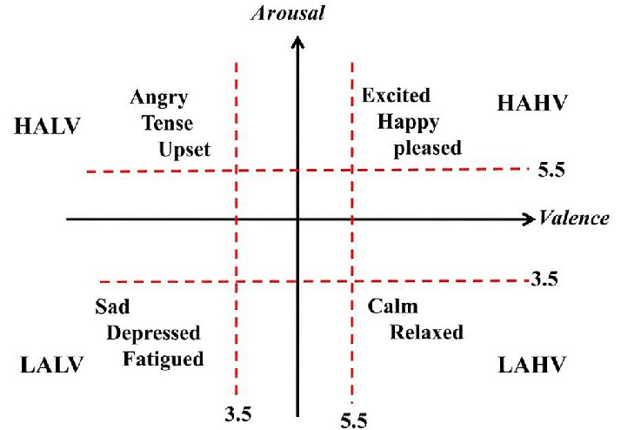
Proposed Framework
Physiologically-Inductive Emotion Recognition Sub-system (PIERS)
To categorize participants’ AV rating through two-layer classification process.
-Regression Models → Normalize Input and corelate them to AV dimension
-Combines the arousal and valence ratings into one final rating by averaging the models’ residual sum of squares (RSS) error // RSS = ∑^{n}_{i=1} (y^{i} - f(x_{i}))^{2 In case you curious}
Convincing Accuracy Rate : 85% A 78% V
Russell’s arousal/Valence(AV) Space
Back

Slide 9
Proposed Framework
Affective Reaction Extraction and Extension Sub-system(AREES) and Affective Reaction Compendium (ARC)
ARRES: Extracting the information of which regulation mechanisms should be triggered, given player’s past reactions. It achieves by obtaining the game log stream and linking the logged events to PIERS’s emotional state output.
ARC: represents a database containing the full set of amassed affective reaction profiles (ARP) for each user.
Back

Slide 10
Proposed Framework
Closed-Loop Emotional Adjustment and Regulation Sub-system (CLEARS) , Game Layer alteration Daemon Operating Script(GLaDOS) & Implicit Mechanism Pool (IMP)
CLEARS: For monitoring and eliciting the predetermined emotional states/patterns.
GLaDOS: A generic interfacing module used to trigger the events.
IMP: Consists of all the available events that can be triggered to influence the user. Also contains the information of the ways to trigger those events.
Back
Notes:
CLEARS does so by monitoring the user’s emotional state and triggering the events that minimize the distance d to the desired ES in the AV space, such that d is given by the Euclidean distance between two emotional states.
Risk also take account since can’t only on the distance metric. Anyways, they just minimized both distance and risk to get a desired event.

Slide 11
Applicational Case Study
Vanish : A survival horror videogame.
-Find items.
-Avoid a stalking creature.
-Other events: lights failing, distant cries, and steam pips bursting without notice.
Events occur quasi-randomly, in order to keep the player about his wits.

Slide 12
Apply
Step 1 : Access Game through GLaDOS, keep records of triggering events information and emotions of player toward the event. Save them to ARP.
Step 2: Then define following parameters. Developers also can control the events through GLaDOS in case some events are not available at the specific moment.
1. How often the system is allowed to trigger events
2. Which events are logged (and later triggered)
3. What range of emotional states the system should aim to elicit.
Step 3: The experimental setup. Get player’s emo state output.

Slide 13
Result of application

Slide 14
Discussion
“content lifetime” -- (replay ability in video game parlance)
It has become increasingly clear that emotions drive peoples’ experiences in video games.
Paper: Microsoft Word - Camera Ready_26_Jul_2013.docx (up.pt)

