Slide 1
A Family of Turn-Based Strategy Games with Moose
D. Ashlock, J. Brown, C. Gregor, M. Makhmutov
IEEE Symposium Series on Computational Intelligence (IEEE SSCI 2021)

Slide 2
The Goal
Design a simple competitive game, suitable as a testbed for student AI agents (within a university AI course)
Multiple scenarios requiring different AI behaviors are desired

Slide 3
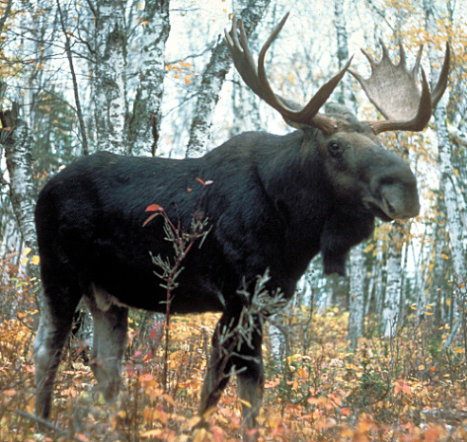
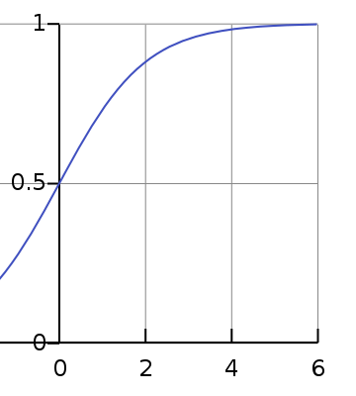
Moose Game Rules
There are three adjacent fields.
Each field has a step value x (initially x = 1), which determines the amount of grass on the field
Field 2 x = 1
Grass formula
Field 1 x = 1
$$f\left(x\right)=\frac{Ce^{x}}{1+e^{x}}$$
Field 3 x = 1
$$grass= f\left(x\right)−f(0)$$

Slide 4
Moose Game Rules
On every turn, each player moves own moose to any desired field (players move simultaneously)
Field 2
M
Field 1
M
Field 3

Slide 5
Moose Game Rules
Then grass is updated. For each field we do:
x = x + 1
If a field has one moose, the moose gets f(x) – f(0) food units, x = 0
If a field has two moose, none of them gets food, x = min(x – 1, 0)

Slide 6
Observations
The goal is to collect more food than the opponent over a fixed number of rounds (≈100)
Staying in the same empty field provides little but stable score increase.
Foraging into an empty field gives a large bonus.
Staying with another moose gives no score.

Slide 7
Basic Strategy
Stay in one field until another field has a value of 5 or 6, then collect harvest.
Use greedy algorithms in case of moose strife.
(not sure how it works exactly)

Slide 8
Variations
Adjusting richness capacity C: C = 1, 2, 3, … (and using different C for each field)
Altering grass growth rate: instead of x = x + 1 use x = x + rate

Slide 9
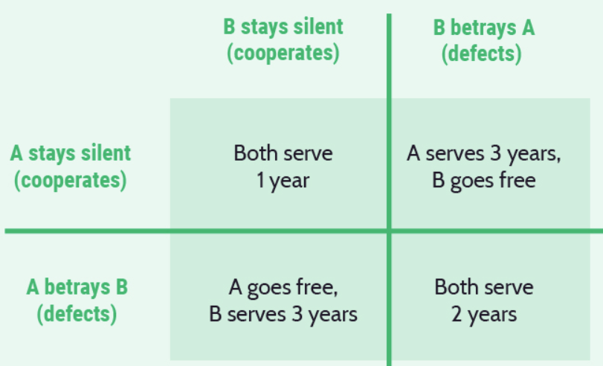
Prisoner’s Dilemma (?)
Authors believe they are related. I am not sure.

Slide 10
Exploration of strategies
Model moose behavior with a probabilistic finite state machine
Use an evolutionary algorithm to optimize it
FSM relies on game state and previous moose actions

Slide 11
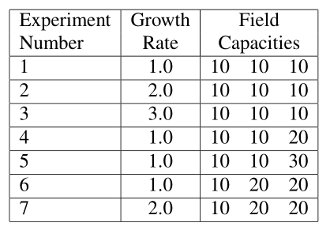
Experiments
Increasing growth rate
Increasing capacity
Moose paradise

Slide 12
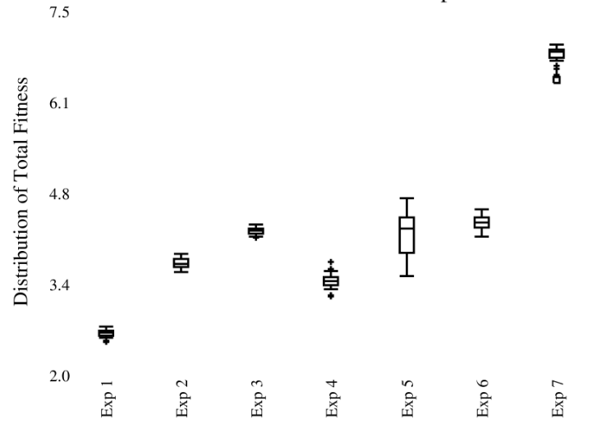
Results

Slide 13
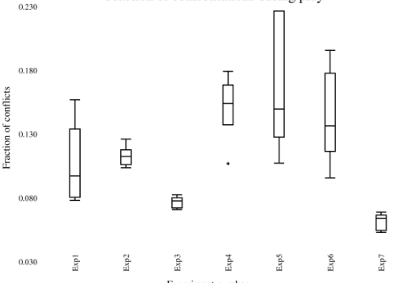
Results

Slide 14
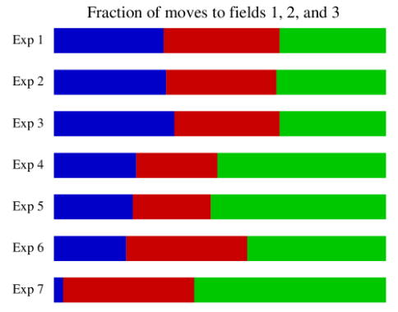
Results

Slide 15
Reflections
Can be adjusted and used in AI classes (explore different AI algorithms)
Can be reskinned into a war game (armies pillaging)
Can be turned into a board game.

