Slide 1
Application of Retrograde Analysis on Fighting Games
Kristen Yu, Nathan R. Sturtevant
2019 IEEE Conference on Games (CoG)
Notes:
Hello, I’m Ryoma Usui.
The title of the paper is “Appllication of Retrograde Analysis on Fighting Games”.

Slide 2
Contents
Introduction
Related work
Fighting game design
Solving a fighting game
Results and Discussion
Future work
Notes:
These are the contents of the paper.

Slide 3
Introduction
notion of building a perfect AI for fighting games is ill-defined
Focus of this paper
build a broad definition of the state space
solve AI with retrograde analysis and using Nash equilibria
builds an optimal strategy and characterize the solution
Notes:
In introduction, the Author pointed out that the notion of building perfect fighting game AI is ill-defined.
And the goal of this paper is to understanding how AI solve the simultaneous action model and the impact it has on the game design.
First, build a broad definition of the state space of a fighting game based on finite state machines.
Then, solve AI with retrograde analysis and using Nash equilibrium to determine optimal play over the information sets.
Finally, builds an optimal strategy for a small fighting AI game and characterizes the solution to the game.

Slide 4
Related Work
using N-grams as a prediction algorithm
using decision trees to model AI behavior
Amiibo algorithm
MCTS approach
no published work to understand why this algorithm is effective
Notes:
In related work section, it show some algorithm for fighting game like using N-grams, decision trees, and MCTS.
It said nintendo amiibo shows that a machine learning model can also be effective in learning to play a fighting game, not just using rule-based AI.

Slide 5
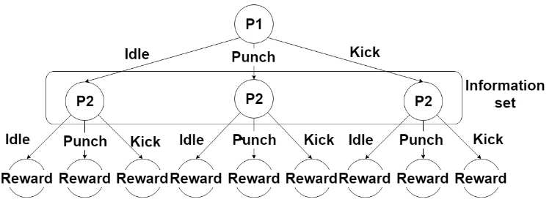
Fighting game design
Each player has its own reward matrix
Notes:
//////////////////This paper analyse with MDA perspective.)))))))))))))))
In fighting game, each player have finite state, and the whole state ‘sg’ is included in (player1 fsm) * (player2 fsm).
This is a game play tree which creates an information set.
The reward is dependent on the action from player one and player two.
The depth 1 represents information set which is unknown when player 2 select an action.
The simultaneous move game can be modeled as a matrix game.
If they have n types of actions, each player has n * n reward matrix.

Slide 6
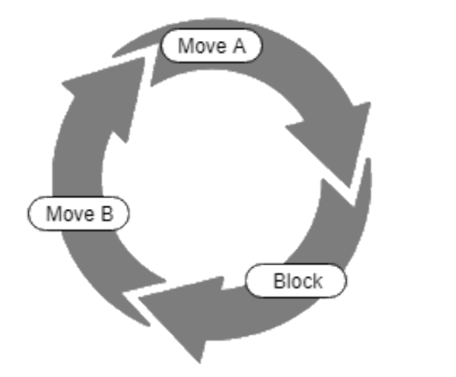
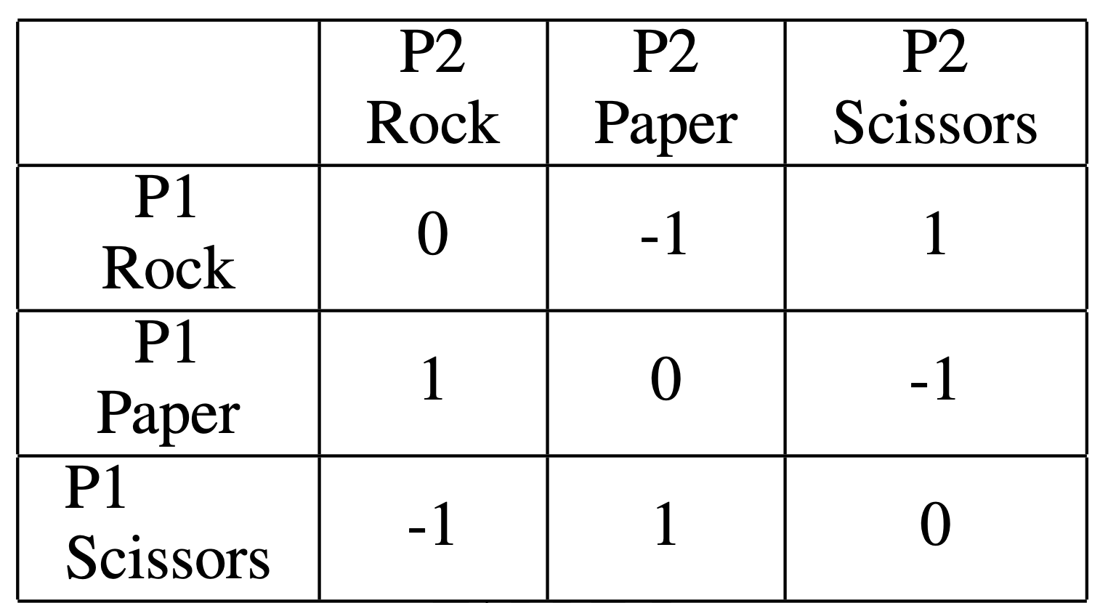
Fighting game design
It can be modeled as rock paper siccors
Notes:
To simplify the game dynamics, it was assumed that the FSM has no lead or lag time.
Since it is simultaneous game, this can be modeled as RPS game.
By replacing the moves of RPS with moves from a fighting game, a similar reward matrix can be generated.
As the circle figure shows, effectiveness relationship between actions in fighting game can be like RPS.
Like moveA wins to block, block wins to moveB and moveB wins to moveA.

Slide 7
Reward Matrix
The rewards in the matrix are then influenced both by the positions of the players, and the rewards of the previous matrices.
Notes:
These are sample matrix of reward.
If players are out of attack distance, reward matrix would be zero.
The left matrix is rewards in intial time. The red numbers is chaging.
This shows that rewards of matrix in time t is influenced by both positions of the players and the previous matrices.

Slide 8
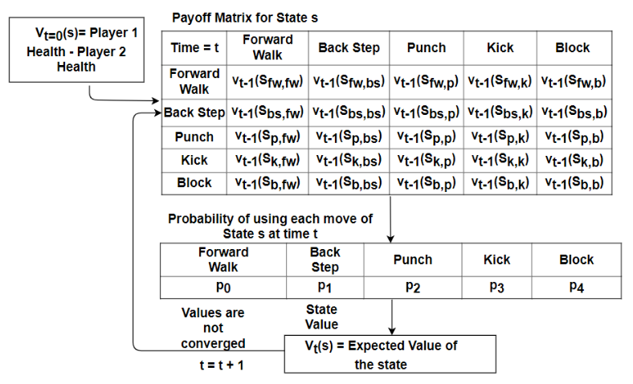
Retrograde analysis
Notes:
This is payoff matrix.
There are simple five movements.
In retrograde analysis, time t starts from the end of the game.
When t=0, the value of state s is player1 health - player2 health. If it is positive number, the reward will be highest because it means player 1 won.
Time is going to the begening of the game and calculate the value.
This procedure continue until the values are converged.

Slide 9
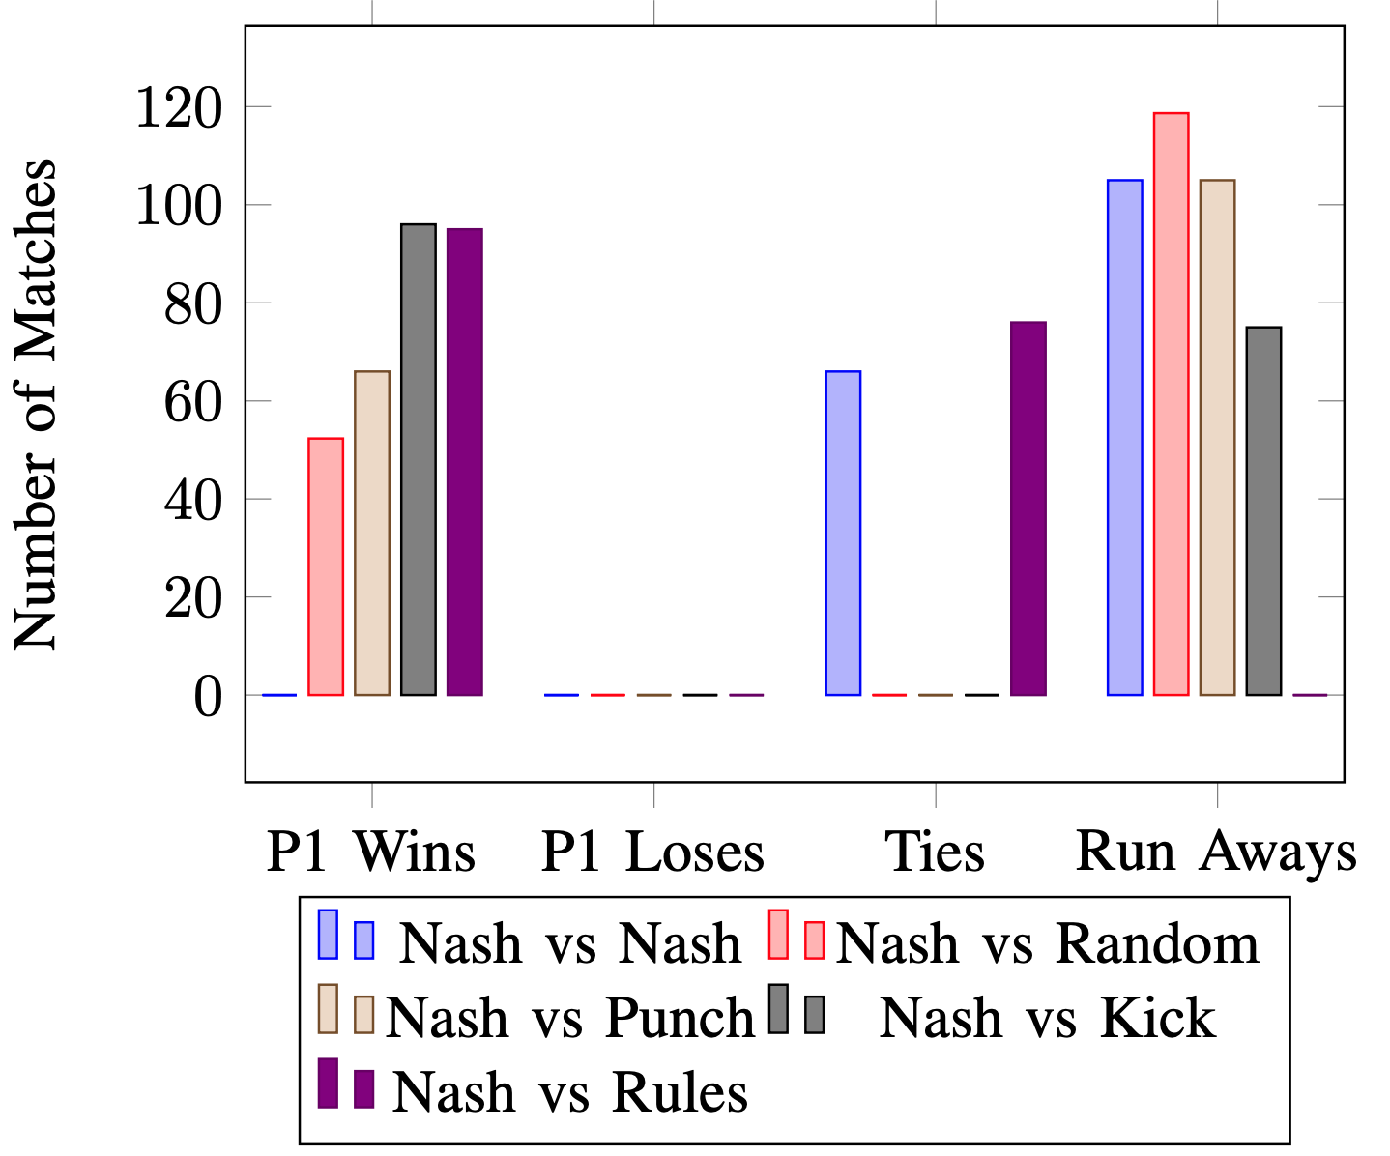
Result
Punch: always punch
Kick: always kick
random: randomly select an action
Rules: punch if near kick if little far otherwise walk forward
Notes:
To understand how the nash equilibrium model work, some other AI were prepared.
There are four other AI. Player which only punch, only kick, acting ramdomly, and act with simple rules.
This is the result of the games. The player1 is nash AI.
The games ended in four ways.
Player 1 win, lose, tie, and run away.
Run away is situation when both player choosed to keep moveing to out of range.
Nash AI never lost to other types of players.
Most fights ended with running away.

Slide 10
Discussion
Mixed actions is only 2%
Nash player is playing a deterministic strategy in most of the states
Notes:
As mentioned earlier, fighting game has a moving mechanics like RPS.
However, as the table shows, mixed actions in the games was only 2.07%.
This means in most states, the nash player is playing deterministic strategy.

Slide 11
Future work
Scale to larger game
expand number of moves
increase range of distances
Change the restriction of player actions
lead time, attack duration, lag time
Notes:
Future work on this project.
One is scaling it to larger games by expand the number of moves available to the agent ,
or increase the range of distances.
In this study, each action has same lead time, attack duration, lag time.
So, these can be varied.

Slide 12
Thank you for listening.

