Slide 1
Position Prediction of Opponent Players by SIRMs Fuzzy Models for RoboCup Soccer 2D Simulation
2016 Joint 8th International Conference on Soft Computing and Intelligent Systems (SCIS) and 17th International Symposium on Advanced Intelligent Systems (ISIS)
Tomonari Nakade; Tomoharu Nakashima; Hidehisa Akiyama; Hirosato Seki
Notes:
Hello, I’m Yuto Takiguchi. I’ll give a presentation about ‘Position Prediction of Opponent Players by SIRMs Fuzzy Models for RoboCup Soccer 2D simukation’.

Slide 2
Structure of the paper
Abstract
Introduction
RoboCup
Proposed Method
Experiments
Conclustions
Notes:
Structure of the paper is Abstract, Introduction, RoboCup, Proposed Method, Experiments, and Conclusions.

Slide 3
Abstract and Introduction
This paper proposes a method for position prediction of opponent attacking players using Single Input Rule Modules (SIRMs) fuzzy model in the RoboCup soccer simulation 2D league. This prediction method is applied to one-to-one defense.
Notes:
This paper proposes a method for position prediction of opponent attacking players using Single Input Rule Modules (SIRMs) fuzzy model in the RoboCup soccer simulation 2D league to reduce time cost of finding the optimal parameters for the behavior. This prediction method is applied to one-to-one defense only. So, This paper doesn’t consider defending with two players.

Slide 4
RoboCup
RoboCup is a research project that involves various topics such as robotics and artificial intelligence. Soccer robots,rescue robots, and home robots are the main subjects of the project.
The aim of RoboCup soccer is to develop the autonomous robot that beats the human world champion team of soccer by the year 2050.
Notes:
RoboCup is a research project that involves various topics such as robotics and artificial intelligence. Soccer robots,rescue robots, and home robots are the main subjects of the project.
The aim of RoboCup soccer is to develop the autonomous robot that beats the human world champion team of soccer by the year 2050. So, this paper research one-to-one defense that is one of the important parts of soccer to achieve the goal.

Slide 5
Proposed Method -SIRMs Fuzzy Model-
A single-input-rule modules (SIRMs) fuzzy model is one variation of fuzzy systems.
In SIRMs fuzzy model, A fuzzy if-then rule in a rule module has only one attribute in its antecedent part. (in other fuzzy model, if-then rule has some attribute in its antecedent)
IF x is A THEN y is B
Notes:
A single-input-rule modules (SIRMs) fuzzy model is one variation of fuzzy systems. Fuzzy model has some rule modules. It is if-then rule, such as IF x is A THEN y is B. In SIRMs fuzzy model, A fuzzy if-then rule in a rule module has only one attribute in its antecedent part.

Slide 6
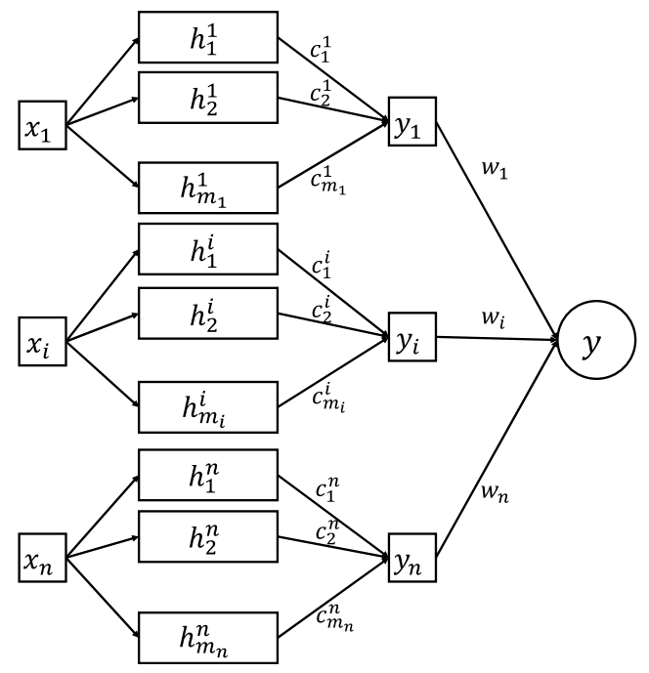
xi is input attribute
yi is the inference result from the i-th rule module
hij is the compatibility of the antecedent part with the input vector.
cij is the consequent real value of the fuzzy if-then rule.
wi is the degree of importance
y is the final output of the SIRMs fuzzy model.
Notes:
This is overview of the SIRMs fuzzy model.
xi is input attribute.
yi is the inference result from the i-th rule module.
hij is the compatibility of the antecedent part with the input vector.
cij is the consequent real value of the fuzzy if-then rule.
wi is the degree of importance, and
y is the final output of the SIRMs fuzzy model.

Slide 7
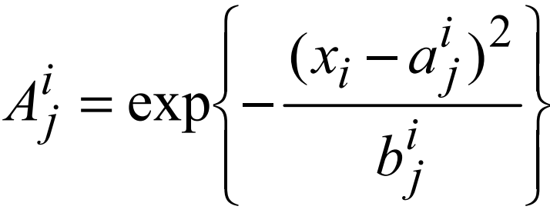
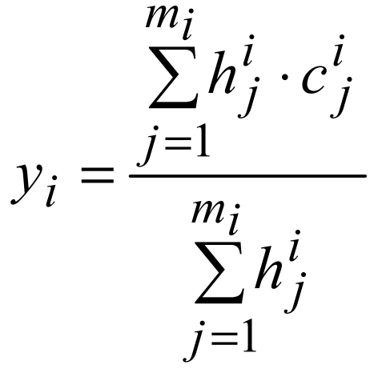
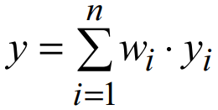
Notes:
Let me consider that I have an n-dimensional input real vector. Then hij can be calculated by the above 2 equation, where Aij is assumed to be a Gaussian function and aij, bij are the parameter of the Gaussian function.
yi and y is calculated by this equation.

Slide 8
Steepest Descent Method
The steepest descent is a technique to modify a model parameter so that the loss (i.e., the error between the true output and the model output) is minimized
The parameters to learn are aij, bij (in the Gaussian function), yi, and wi.
Notes:
In this paper, the steepest descent method is used for the learning of the parameters of the SIRMs fuzzy model. The steepest descent is a technique to modify a model parameter so that the loss is minimized. The parameters to learn in an SIRMs model are aij, bij, yi, and wi.

Slide 9
Experiments -Evaluation of Position Prediction Accuracy-
The one-to-one situation is defined as the following:
There is only one opponent player within a radius of five meters of the teammate player.
The player who kicked the ball just before that is the target opponent player to be predicted.
The ball is within a radius of less than five meters of the target opponent player.
The teammate player who predicts the position of the target opponent player is nearest to the target opponent player.
The model predicts the position of the target opponent player one, two or three, and five cycles later from the current time.
Notes:
This paper investigate the prediction accuracy of a dribbling opponent player by the SIRMs fuzzy model. Training patterns for the SIRMs fuzzy model were obtained from 100 game-logs. From the game logs, one-to-one situations are extracted to generate labeled patterns. The one-to-one situation is defined as following:
There is only one opponent player within a radius of five meters of the teammate player.
The player who kicked the ball just before that is the target opponent player to be predicted.
The ball is within a radius of less than five meters of the target opponent player.
The teammate player who predicts the position of the target opponent player is nearest to the target opponent player.
The model predicts the position of the target opponent player one, two or three, and five cycles later from the current time. And, this is the average errors of the trained SIRMs fuzzy models. It is observed that the prediction error becomes larger as the prediction cycles increases. This is because the prediction for far future states is more difficult than that for near future states.

Slide 10
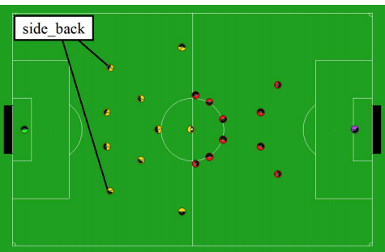
Experiments -Evaluation of Defense Performance-
The trained SIRMs fuzzy models are only employed by two side-back players as this position has the most number of defense chances during the games.
Notes:
Next, the defence performance of the teammate players is investigated. The trained SIRMs fuzzy models are only employed by two side-back players as this position has the most number of defense chances during the games.

Slide 11
Experiments -Evaluation of Defense Performance-
The defense performance is evaluated in terms of the following six criteria for the computational experiments in this subsection:
Pass
Advance with pass
Advance with dribble
Opponent setplay
Our setplay
Our kick
Notes:
The defense performance is evaluated in terms of the following six criteria for the computational experiments in this subsection:
pass is the number of successful passes by the opponent players.
advance with pass is the number of times the ball was brought by more than five meters along the x-axis by the opponent players’ passes.
advance with dribble is the number of times the ball was brought by more than 10 meters along the x-axis by the opponent players’ dribbles.
opponent setplay is the number of opponent setplays as a result of the one-to-one defense.
our setplay is the number of self-team setplays as a result of the one-to-one defense.
our kick is the number of kicks by the defending teammate players.
After 100 games, it is results of the computational experiments. The number of passes are decreased by introducing the prediction of the attacking opponent players. Especially, the number of passes is the smallest when the predicted cycle by the SIRMs fuzzy model is two. This suggests that there is an optimal cycle of prediction when it is applied to the defensive behavior. This is also the case for the other criterion except opponent setplay. The opponent setplay did not happen in the experiments and there is no significant difference for this measure comparing with the others.

Slide 12
Conclusions
One direction for improving the defense performance is to improve the accuracy of the position prediction by SIRMs fuzzy models.
In order to increase the prediction accuracy, more training patterns should be generated from log data of more soccer games.
Notes:
In conclusion, this paper shows one direction for improving the defense performance is to improve the accuracy of the position prediction by SIRMs fuzzy models. And, in order to increase the prediction accuracy, more training patterns should be generated from log data of more soccer games.

Slide 13
Thank you.

