Slide 1
Development of an Autonomous Agent based on Reinforcement Learning for a Digital Fighting Game
Luis Fabr ́ıcio Wanderley Go ́es
Joa ̃o Ribeiro Bezerra
Luis Fabr ́ıcio Wanderley Go ́es
Alysson Ribeiro da Silva
S1260182 Risa Nishizawa

Slide 2
Construction
Introduction
Related work
Theoretical Framework
Fighters Arena
Agent deployment
Methodology
Results
Conclusion

Slide 3
Introduction
Objective : To develop an autonomous agent based on reinforcement learning for a digital fighting game.
The implemented agent : Fusion Architecture for Learning, Cognition, and Navigation(FALCON) and Associative Resonance Map (ARAM)
Experimental results : Achieves a winning rate of up to 90%

Slide 4
Related work
It related work from the technical literature on the topics involved in this work are presented (machine learning and its use in digital games).
In the work of P. G. Patel, N. Carver, and S. Rahimi
They have found that using Q-learning, agents learn different behaviors based on the rewards they get from their actions.
In the work of M. R. F. Mendonc ̧a, H. S. Bernardino, and R. F. Neto
The results of the experiments indicate that the methods using Q-learning achieve better performance with human players when compared to other existing methods.
S. Saini, P. Chung, and C. W. Dawson
They have developed a way for an avatar to learn and replicate a player’s playing style.
A.Carpenter, S. Grossberg, and D. B. Rosen
They investigated variations of fuzzy Q-learning algorithms for training intelligent agents playing Ms. PacMan.
G. Andrade, G. Ramalho, H. Santana, and V. Corruble
They implement an agent using artificial intelligence for a fighting game using Q-learning, and justify its use for simplicity and good results.
A.R.daSilvaandL.F.W.Goes
They implement agents that can use machine learning to play the digital card game Heartstone, train them, and develop the ability to achieve an average win rate of 80%.
D. Wang and A. H. Tan
They implemented agents using the falcon architecture and fuzzy ARAM neural networks, developed strategies without human intervention, and investigated the effectiveness of various in-game combat tools.
These works are exploring the use of artificial intelligence in digital games, similar to the present study.

Slide 5
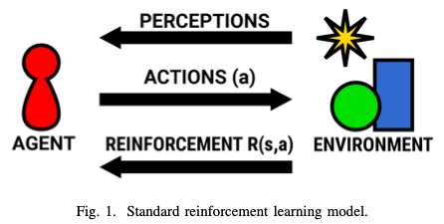
Theoretical framework
1. Machine learning : The reinforcement learning method consists of an artificial intelligence technique in which the agent learns to solve a given problem from his experiences of previous actions.
2.Q-Learning :Q-Learning is a reinforcement learning technique in which, based on a set of states, a set of actions and a reward function, it is possible to obtain a quality metric for each action performed in each state.
γ parameter…the discount factor (0<γ <1),
α parameter…the learning rate,
(t)…the current time
(s)…the external stimulus
(a)…the selected action

Slide 6
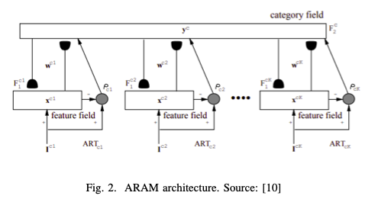
3. Artificial Neural Networks for Reinforcement Learning (ANN)
1)ARAM networks
These networks allow agents to adapt to different scenarios.
Since these are based on the ART module, environment mapping is possible.
ART fuzzy networks are known as multi-channel FFS fuzzy networks.
2) FALCON architecture
FALCON able to evolve systematically to incorporate new information
FALCON retrieving knowledge and updating knowledge
FALCON dynamically expands its network architecture in response to new entry standards in progress
A FALCON network has 7 sets of meta-parameters.
i) vigilance standards, {ρ 1, ρ 2, ρ 3 }
ii) Learning rate parameters, {β 1, β 2, β 3 }
iii) Contributing factors, {γ 1, γ 2, γ 3 }
iv) Choice parameters {α 1, α 2, α 3 }
v) Learning rate parameter α
vi) Learning discount parameter γ
vii) Selection policy threshold ε

Slide 7
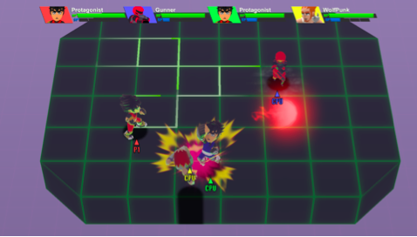
Fighters arena
the competitive fighting game in development by the author called Fighters Arena is used.
This game is matches involving 2 to 4 players - human or machine con- trolled - are carried out in three-dimensional arenas with top- down view as illustrated in Fig.
The game used in this work has an implementation of an avatar with fixed behavior for players controlled by the machine. In this work, it was proposed to implement a new methodology for the behavior of these players controlled by the machine using neural networks in order to make a comparative analysis of these two methodologies

Slide 8
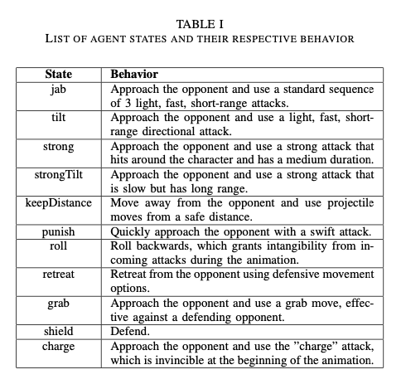
Agent deployment
A. Neural Network Architecture
Ex)
If the agent hits the opponent : The reward function returns 0.8⇨1.0 (being greater the more damage is inflicted)
if the opponent attacked and missed the agent or if the agent defends an attack by the opponent : 0.6
if the agent was hit by the opponent : 0.1
Any other situation : 0.5
Table 1 defines 11 basic actions that represent the strategies that agents can perform.

Slide 9
B. Agent Algorithm
The implemented agent is a three-step routine.
Get the game environment through sensors, starting from the initial state
The algorithm then selects the action through the selection policy. The chosen action is performed until the agent hits the opponent or is hit by the opponent.
Then analyzed and the reward is calculated based on the result
The routine is then repeated from the beginning.

Slide 10
Methodology
Experiment setup
All experiments were performed on an Ubuntu Linux in- stalled on an Intel i5-6500 with 4 threads and 8 GB of memory. The code for the proposed agent was implemented in C# on the Unity engine as a component of the game, which was run at 4 times its standard speed (240 frames per second).
B. Choice of parameters
Vigilance parameters {ρ1, ρ2, ρ3 } = {0.9; 0.9; 0.8 }
learning rate parameters {β1, β2, β3 } ={0.2; 0.2; 0.1 }
choice parameters {α1, α2, α3 } = {0.5; 0.5; 0.5 }
C. Simulations
three groups of tests were performed
Agents were trained in each group, testing autonomous agents with matches with fixed-action agents and matching each.
each game, the values of proportion of remaining life of the autonomous agent and number of neurons in the network used by the autonomous agent were counted.

Slide 11
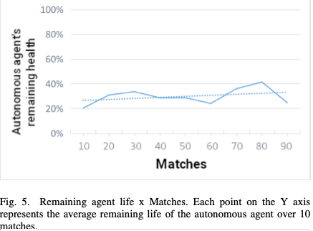
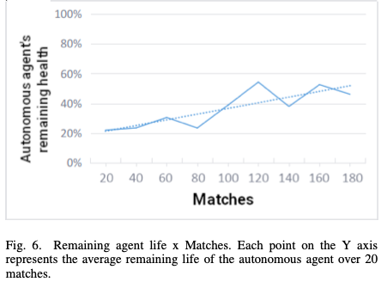
Result
The results obtained with the simulations
The values of the first half of the simulations matches had a greater standard deviation than the second half: 0.21, 0.19, and 0.20 for the first halves, 0.18, 0.17, and 0.19 for the second halves. It was possible to note that the autonomous agent was able to learn to react in a similar way to the optimum predicted for the situations in which he found himself during the matches.

Slide 12
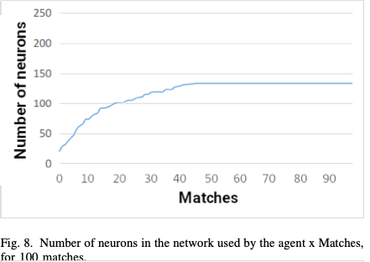
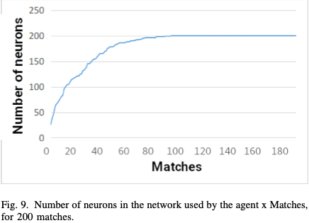
The number of neurons in the network of each test group
The number of neurons was higher in the test groups in which more matches were performed because, as a result of the greater number of matches, the agent was in contact with more different situations.

Slide 13
Conclusion
From the results of the experiments, it can be said that it was possible to implement the artificial intelligence technique based on reinforcement learning that made the machine
capable of learning and developing game strategies with a c

