Slide 1
Monte-Carlo Tree Search Implementation of Fighting Game AIs Having Personas
R.Ishii, S.Ito, M.Ishihara, T.Harada, R.Thawonmas
Proc. 2018 IEEE Conference on Computational Intelligence and Games

Slide 2
Introduction
Background
- Many spectators watch gameplay videos using streaming platforms
- The authors proposed Procedural Play Generation (PPG)
in another paper
Purpose
- Create AIs that have personas to generate various gameplay
videos in fighting game

Slide 3
Related Work
Persona
> Playstyle of the player in the game context
Puppet-Master MCTS
> Variant of MCTS, proposed by the same authers
> Controls all characters using only a single tree
(usually one tree for one agent)

Slide 4
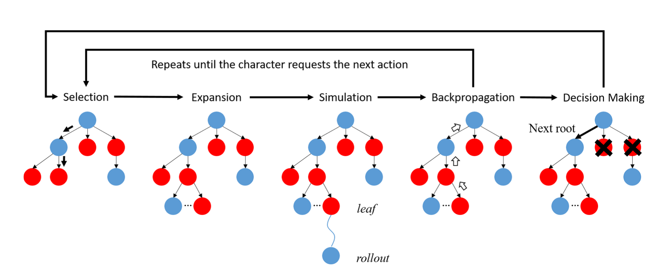
Puppet-Master MCTS

Slide 5
Personas in Fighting Game
RashDown
Player prefers to fight in close ranges
Zoning
Player prefers to fight keeping a certain distance
with the opponent

Slide 6
Proposed Method
Evaluation function in selection step
- Used UCB1
- When the player acts like its persona and damage the
opponent, the reward value is going to be high

Slide 7
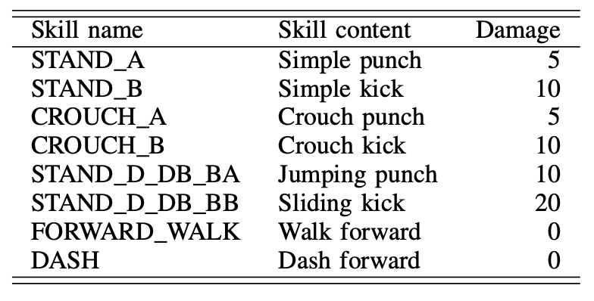
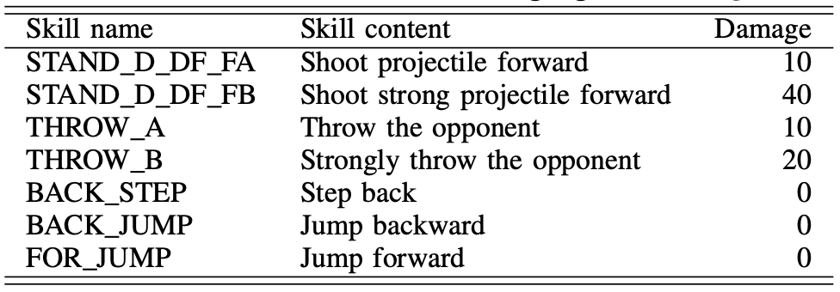
Proposed Method
Selection of actions in simulation step
Players behave randomly
but like their personas
RushDown or Zoning

Slide 8
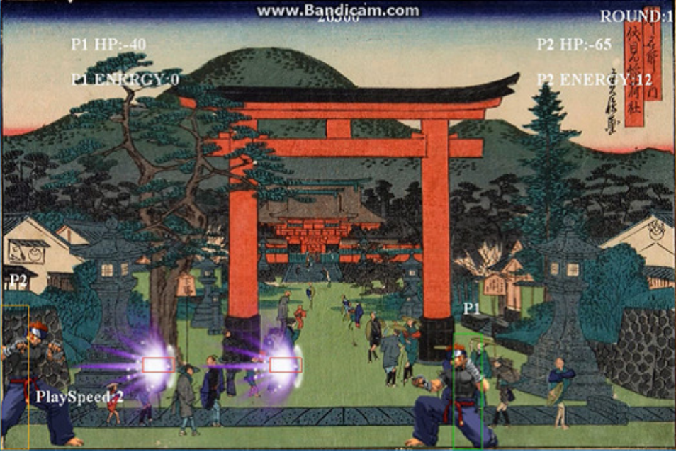
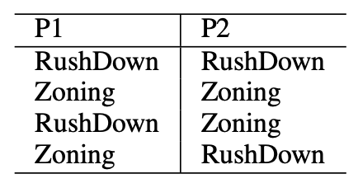
Experiment
- Experiment on FightingICE
- Compared the proposed AI and another MCTS-based AI
- Generated 8 videos and showed them to participants
- Asked participants which player is which persona

Slide 9
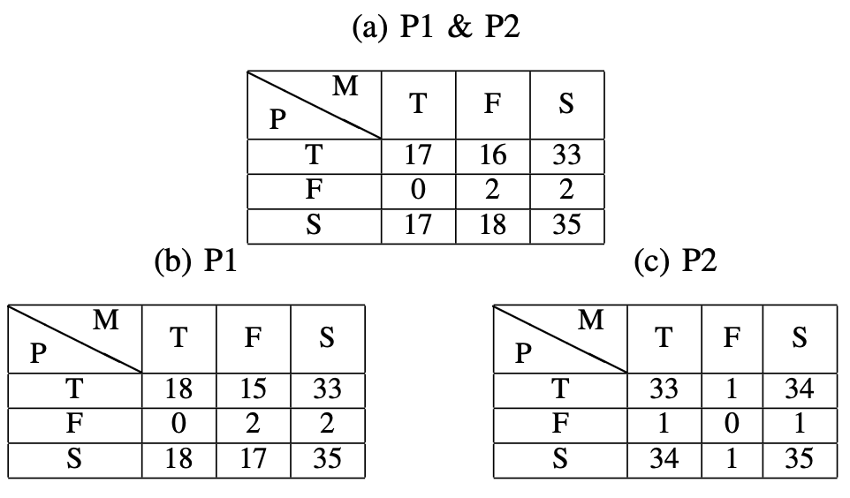
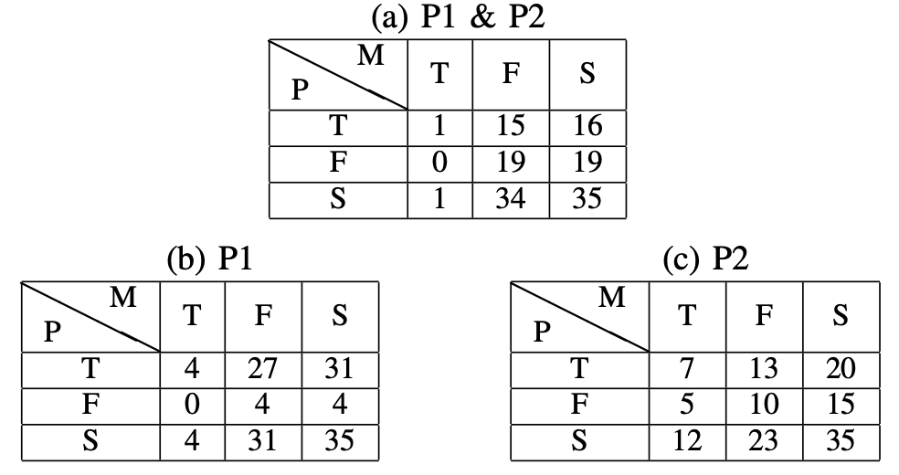
Results and Discussions
Participants could better identify both personas in P-AI than M-AI.
Zoning controlled by P-AI still has an issue.
RushDown vs RushDown
Zoning vs Zoning

Slide 10
Thank you for listening!

