Slide 1
Valuing On-the-Ball Actions in Soccer: A Critical Comparison of xT and VAEP
Maaike Van Roy, Pieter Robberechts, Tom Decroos, Jesse Davis
KU Leuven, Department of Computer Science

Slide 2
Dataset
Event stream data annotates the times and locations of specific events.(e.g. passes, shots, and cards) that occurs in a game.
Optical tracking data records the locations of the players and the ball multiple times per second.

Slide 3
Approaches for valuing actions using event stream data
Count-based approaches. These techniques rate players by assigning a weight to each action type, and calculating a weighting sum of the number of times a player performs each action type during a match.
Expected possession value(EPV) approaches. These models value each action that progresses the ball. xT model is an exemplar for this style of approach.
Action-based approaches. These approaches value a broader set of actions and take the action and game context into account. VAEP model is an exemplar for this style of approach.

Slide 4
xT model
xT model is a possession-based Markov model. This modeling approach implies that soccer games are divided into possessions.
xT represents each game state by only considering the location of the ball.
xT can only value actions that move the ball from one zone to another(i.e., passes, dribbles and crosses). Hence, it ignores defensive actions like tackles and interceptions, as well as valuable offensive actions such as take-ons within the same zone of the pitch.

Slide 5
VAEP
VAEP uses a much more complex game state representation than xT. It considers the three last actions that happened during the game.
VAEP values an action by looking at the probability of a goal being scored within a finite number of actions.
VAEP can value ‘failed’ actions accurately.

Slide 6
Experimental comparison of action values
Backward passes into a team’s own penalty box
First ball progression of counter attacks
Forward dribbles inside the penalty box
Completed forward passes to the border of the penalty box

Slide 7
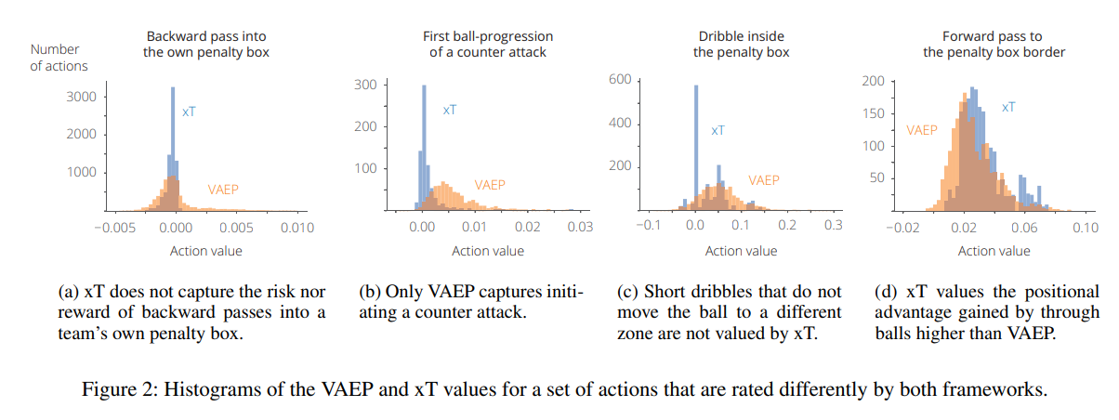
Results for comparison of action values

Slide 8
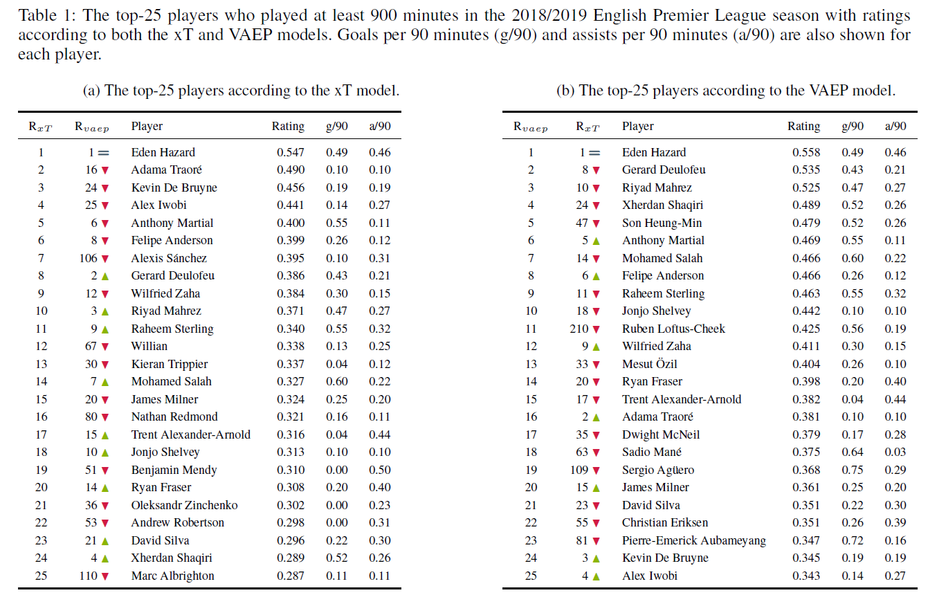
Comparison of top-25 player rankings

Slide 9
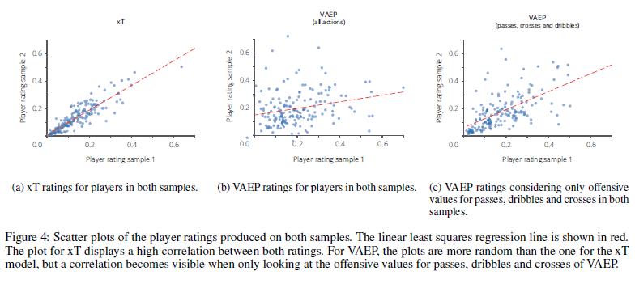
Robustness

