Slide 1
Opponent Modeling based on Action Table for MCTS-based Fighting Game AI
Man-Je Kim, Kyung-Joong Kim
Department of Computer Science and Engineering Sejong University, Seoul, South Korea

Slide 2
Construction of paper
Introduction
MCTS with opponent prediction
Experimental results
Conclusion

Slide 3
Introduction
Monte-Carlo Tree Search (MCTS) has achieved good results in fighting game AI competitions.
MCTS is an algorithm for efficient tree search by using an evaluation function that takes randomness into account.
MCTS in the fighting games simulates only a few random actions of the opponent, does not simulate all actions.
$⇒$ This simple approach may affect the performance of AI.

Slide 4
Introduction
Instead of the random choice, they use an Action Table (AT) that holds the opponent's predicted actions to select the actions.
The environment is FightingICE.
It is a 2D fighting game used in competitions for the performance of fighting game AI.
Each game consists of three one-minute rounds.

Slide 5
MCTS with opponent prediction
Action Table (AT) is a table to represent the opponent’s playing patterns and holds the top five actions executed frequently, by condition.
The AI's action patterns usually depend on the distance to the opponent, and whether the opponent is on the ground or in the air.
$⇒$ Two conditions are used in AT:
Distance between the opponent and my AI
Whether the opponent is on the ground or in the air

Slide 6
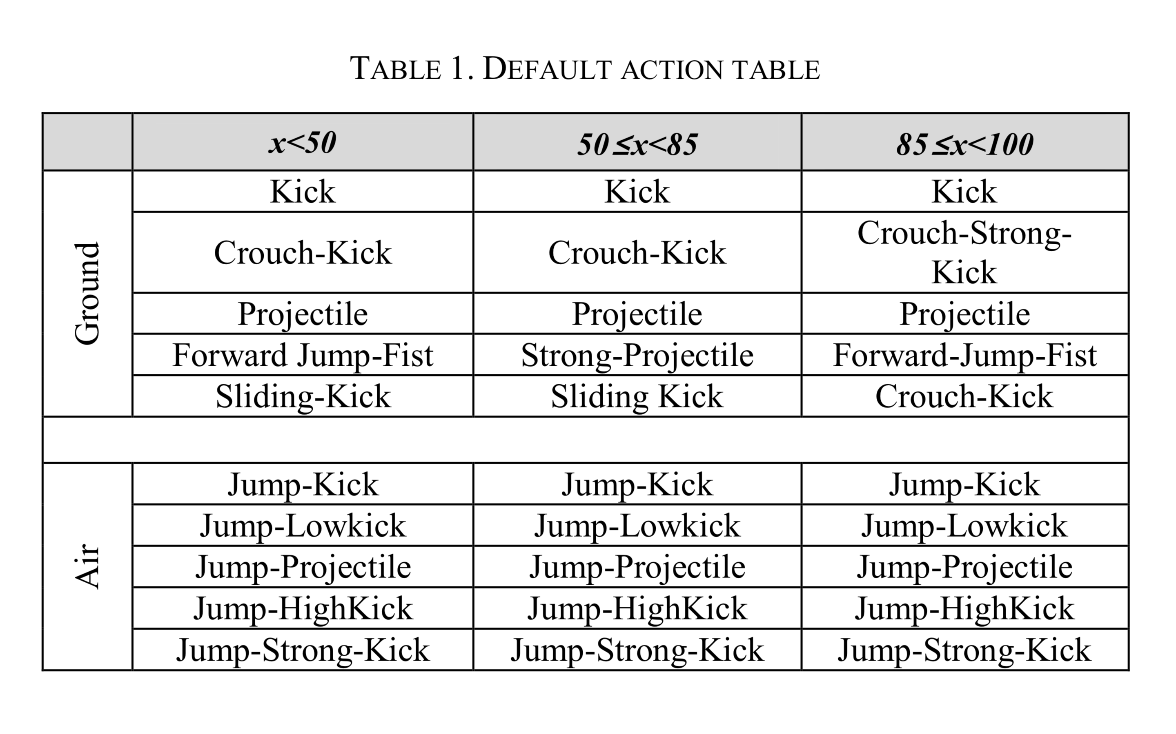
MCTS with opponent prediction
At the start of round 1, there is no information about the opponent, so AT cannot be created.
Create a default AT based on the actions of the top three AIs of the 2015 AI competition.
Get the AI's actions via API, record the number of actions, and select five high-frequency actions for each condition.
x = distance

Slide 7
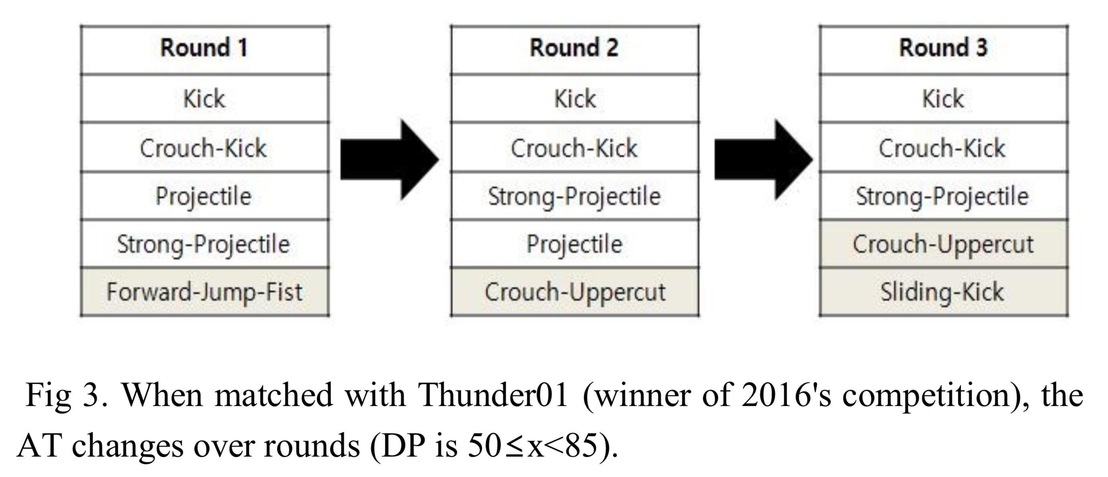
MCTS with opponent prediction
Play games using the five actions on AT to simulate MCTS.
After each round, select two opponent’s most frequent actions, and update AT
If the selected action is already in the current AT, move up one rank.
If not, replace it with the action of the lowest rank (least frequent).
High frequency
Low frequency

Slide 8
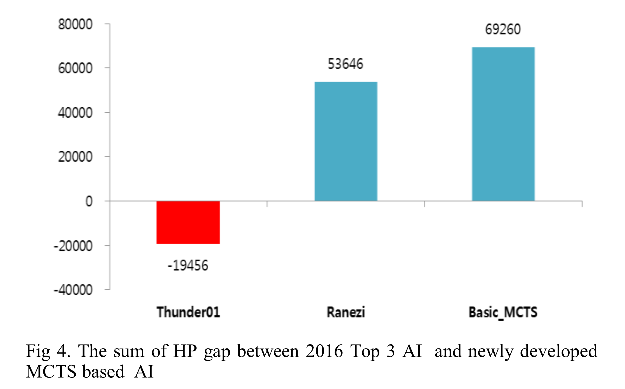
Experimental results & Conclusion
They played 200 games between the developed AI and each of the top three AIs from the 2016 competition and evaluated the AI’s performance based on the HP gaps.
HP gap = given damage – received damage
Winning rate
40% against Thunder01
76% against Ranezi
86% against Basic MCTS AI

Slide 9
Experimental results & Conclusion

Slide 10
Thank you for listening!

