Slide 1
The Believability Gene in Virtual Bots バーチャルボットの人間のような動き
M. Polceanu, A.M. Mora, J.L. Jimenez, C. Buche, A.J. Fernandez-Leiva
FLAIRS Conference 2016: 346-349
Florida International University, USA
Depto. TSTC, Universidad de Granada, Spain
LAB-STICC, ENIB, France
Depto. LCC, Universidad of Malaga, Spain

Slide 2
Abstract 要約
This paper deals with making human-like AI by describing two very different approaches that were proposed for creating believable bots and applied, with some degree of success (in BotPrize 2014), in the context of a first-person shooter (FPS) game.
人間がプレイするような動きを目標として、二つの全く異なったアプローチで作られたAIについて。環境はFPS。

Slide 3
Construction 論文の構造
Introduction 序章
MirrorBot – “the Almost-Human”
NizorBot – “the Semi-Human”
Obtained Results and Analysis 結果と分析
Future Lines of Improvement for Obtaining a ‘Human’ Bot今後の課題
Conclusions まとめ

Slide 4
MirrorBot – “the Almost-Human”
Its design consists in two main behavior modules: default and mirroring.
デフォルトとミラーモードがある
Mirroring, is only activated when an opponent is considered as unaggressive
相手が攻撃的でないときのみミラー
When the mirroring behavior is activated for a target, MirrorBot will begin recording all observable low-level actions of the opponent: aim, movement, fire, jumping, crouching and weapon choice. These are stored as frames in a sequence, which are to be replayed by MirrorBot itself.
相手の観察できるアクションをインプットして、真似する
Notes:
An opponent is by default unaggressive, but this status changes as soon as MirrorBot detects that the given player shoots directly at it with a dangerous weapon; i.e., a weapon that does or can inflict damage. More specifically, receiving damage is not the only criterion for deciding aggressiveness

Slide 5
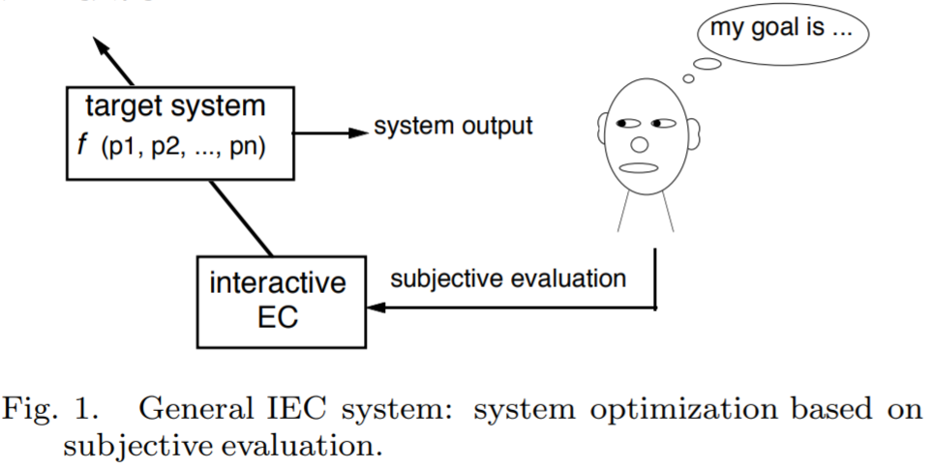
NizorBot – “the Semi-Human”
Using Interactive Evolutionary Algorithm (IEA) in which human experts guide the optimization of the bot’s parameters in order to obtain a humanlike bot
人間の感性を重視したアルゴリズム
The evaluators must fill in the form to identify those specific features (e.g. distance selection, weapon selection, etc.) that they consider more humanlike
専門家が最適さを項目に応じて評価する
Notes:
The distance selection block [Genes 0-2] controls the distance ranges that influence weapon choice, attacking and defending. The Weapon selection block [Genes 3-11]

Slide 6
Obtained Results and Analysis
it does not reach the value for being considered human according to the competition rules (i.e., 0.5)
人間と見なされる基準には達していない。
BotPrize 2014 was the first edition that featured both first- (real-time) and third- (crowdsourcing platform) person assessments of humanness
TPAを使った評価は導入されたのはこの年から。
Both bots are quite human like
二つのボットはかなり人間らしい

Slide 7
Advantages and Shortcomings
Mirrorbot
MirrorBot has demonstrated the advantage of online mirroring, smooth navigation and simultaneous activation of several behavior modules which led to complex behavior using simple rules.
オンラインでのミラーモードでスムーズに同時に複数のことができる
However, the rules were a result of a lengthy fine-tuning process by its creator. Therefore, improving its behavior or porting it to different scenarios will be cumbersome using the same approach.
他のシーンに応用することが難しい。
NizorBot
NizorBot was obtained using minimal expert intervention, by using an automated evolution process.
自動化された評価システムがあるため最小限の調整で済む
However, unlike MirrorBot, it only exploited a limited set of techniques and did not focus on online interaction.
オンラインでの予想されていない出来事には対応していない
Notes:
It also uses a knowledge database (bot’s memory) to retain important information about the fighting arena, such as the position of items and weapons, or advantageous locations. This information is stored once the bot has discovered them, as a human player would do.

