Slide 1
Recognizing Emotional Expression in Game Streams
Game AI lab paper discussion 2021/7/14
CHI PLAY'19, October 22–25, 2019, Barcelona, Spain
Paper Session 5: Emotions, Traits and Player Experiences
Aalto University

Slide 2
Introduction
Related Work
Dataset
Automated multimodal emotion expression annotation
Evaluation & Discussion & Conclusion

Slide 3
Introduction
Purpose:
Build a system which can automatically annotate the emotion events in streaming videos or gameplay testing videos like human annotation.
Contribution:
New dataset with 17 videos(11 hours, 2015 emotion events).
A neural network system trained to mimic human annotation behavior with four inputs: Facial expression, video transcript sentiment analysis, voice emotion analysis, and additional voice features like loudness and pitch.

Slide 4
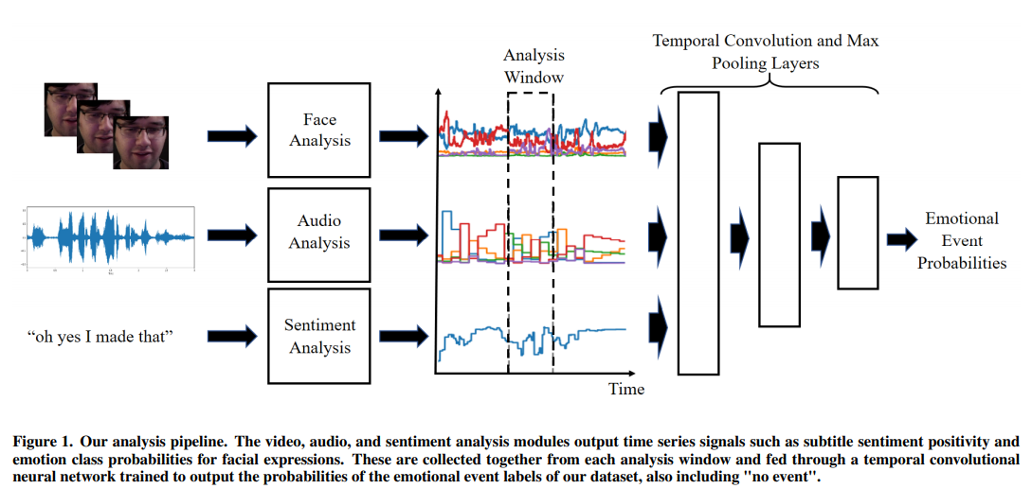
Method
Dataset

Slide 5
Related Work
Emotion detection
Biometrics (gameplay events)
Facial Electromyography -- fEMG
Think-Aloud (game events)
Automated emotion analysis from Video and Audio
Deep convolutional neural networks
Non-streamer player may not express any emotions while playing ☹

Slide 6
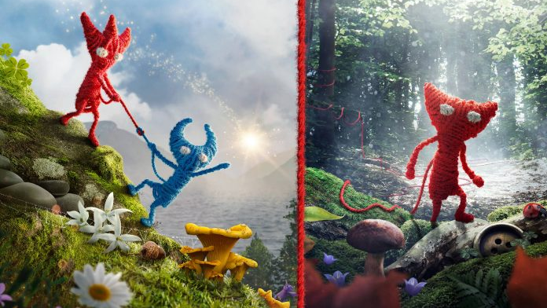
Dataset
Game and Video Selection
Unravel & Unravel Two
New release
Level design is largely linear
Emotional engaging
Videos requirements
Face visible throughout the video
English
Single streamer
Subtitle transcript available
Notes:
Games: puzzle platformers, where the player controls a humanoid figure made of yarn through different levels, overcome obstacles and solving puzzles along the way

Slide 7
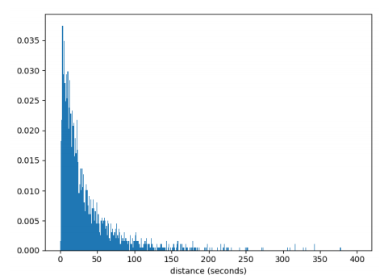
Dataset
Emotion Expression Annotation
13 set of emotion events + no event
4 authors annotated the videos, each video was annotated by 2 authors.
Each annotator flagged top 5 most intensively emotional events for each video.

Slide 8
Dataset
Data Windowing, Reliability, and Analysis Granularity
Data window: the data was divided into time windows with one second overlap, each window constituting a single data point.
4 levels of Granularity
2 classes, either "no event" or "event”.
2 classes, either “no event” or “event -- in top 5 intensively emotional events”
4 classes, including "no event", "pleasant event", "unpleasant event", "neutral event".
14 classes, including "no event" and the full set of 13 codes

Slide 9
Automated multimodal emotion expression annotation
System is implemented using the Keras deep learning framework
A facial expression analysis neural network. (%)
VGG16 convolutional neural network + OpenCV capture face & resize
An audio analysis module. (% == FEANN, voice features)
VGG16 image classification network with audio segment => 2D Spectrogram
A speech sentiment analysis neural network.(subtitle)
A Kaggle dataset of Amazon reviews
A temporal convolutional neural network. (In.windows >network> Out.Emotion.labels.%)
Standard softmax cross-entropy classification loss function
1D-convolution and max-pooling layers

Slide 10
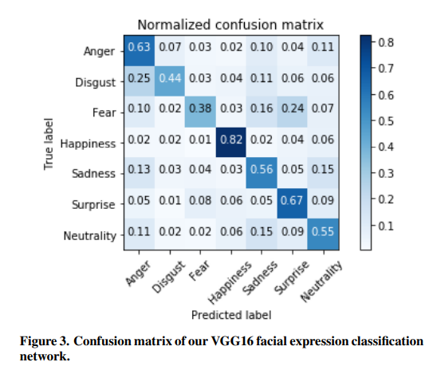
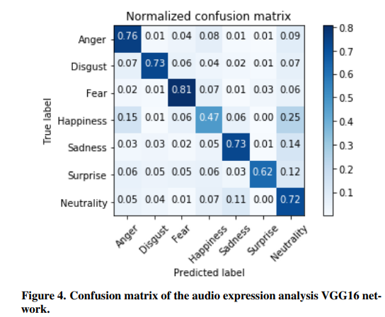
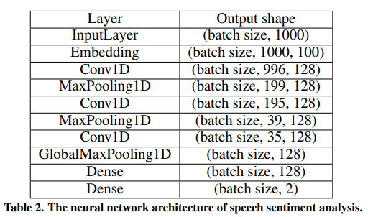
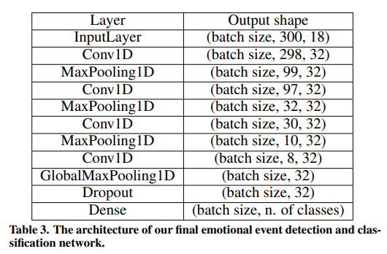

Slide 12
Evaluation & Discussion & Conclusion

Slide 13
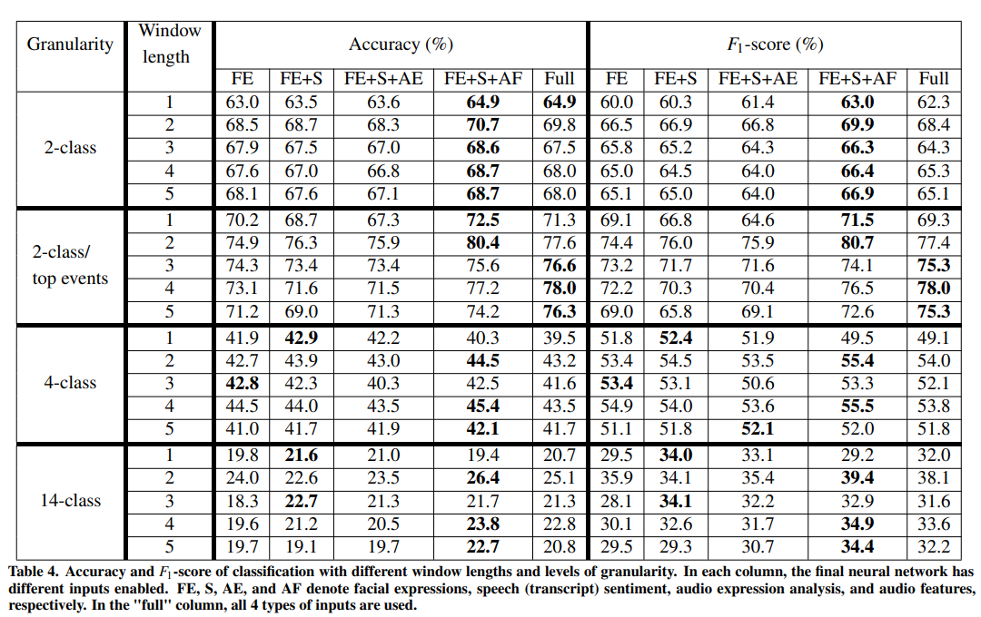
Evaluation & Discussion & Conclusion
Notes:
F1-scores were calculated using class weights to reduce the class imbalance bias

Slide 14
Questions?

