Slide 1
Individual ball possession in soccer
Weekly rubric "Share the Article"

Slide 2
Foreword
Notes:
Before I will describe today’s article it is important to explain background.
The topic of my research is machine learning for a human-like soccer. The major application for us is video game. For now, I will not fall into details of how system works, but just say that it reached initial state when soccer players can move and make some action. It is not stable enough and there are plenty of ways to improve it and tune. And here comes one of the many interesting problems. Even simple, not sophisticated improvement most likely bring some outcome, stability may increase and so on. We as persons who have struggles fun with it, can figure it out. However, it has nothing common with scientific approach. We can’t write in paper “We did this, and it became better” or “It became better because we did this”. “Better” than what? It is necessary to introduce some measurements. It will serve us as reference point, so we will understand whether we improve or not. What is important, having description of our measurement system other researchers can do so.
Since our goal to imitate human teams, we decided to investigate if it is possible to distinguish behavior patterns of human teams. In other words, extract fingerprint.

Slide 3
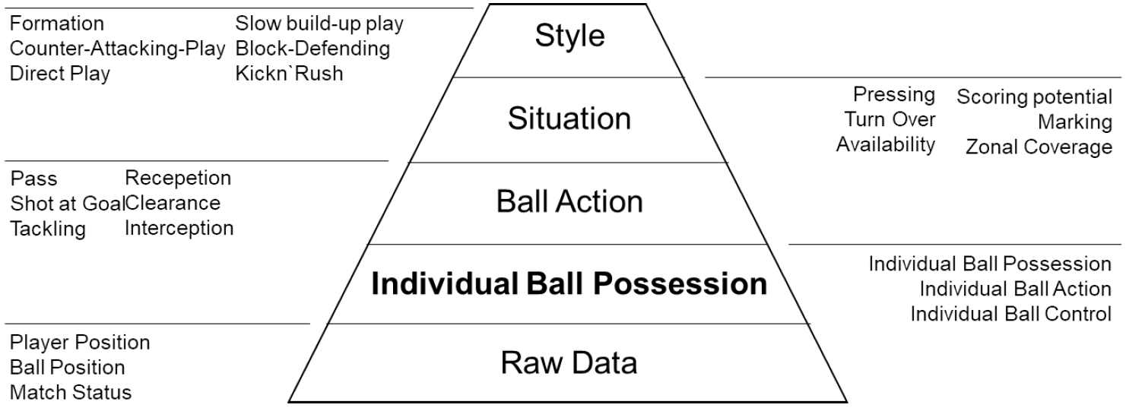
Hierarchy of soccer constructs.
Notes:
hierarchy of constructs

Slide 4
Ball possession is not so much a causal variable, but rather the consequence of a process of interaction that is determined by several contextual factors, such as the venue, the quality of the opponent, the tactical configuration and the current score.

Slide 5
Relationships between the different types of ball possession.
[TBP] Team ball possession
[IBP] Individual ball possession
[IBA] Individual ball action
[IBC] Individual ball control
[TPC] Team ball control
[TPM] Team playmaking

Slide 6
Relationships between the different types of ball possession.
Before ball reach teammate it is still possessed by player who performed a pass
IBP starts when ball is in players action space
Ends when

Slide 7
Relationships between the different types of ball possession.
The time interval in which a player can do an action
The configuration on the field during this time interval determines the tactical options available and their chances of success
Excludes time when no influence can be exerted on the ball

Slide 8
Relationships between the different types of ball possession.
Related to the level of control
Not counted when player is under the pressure
This distinction is made because it is only possible to draw reliable conclusions about team or individual tactics during game analysis if the ball is fully under control.

Slide 9
Detection of IBP & IBA starting point

Slide 10
Detection of IBA endpoint
Notes:
the game is interrupted
another player gains IBA
the player is no longer able to interact with the ball

Slide 11
Quality of IBA & IBP detection

Slide 12
Results.

Slide 13
Heatmaps based on all positions (left) compared to positions during IBC (right).
*for CF only
Notes:
CF

