Slide 1
Applying Hybrid Reward Architecture to a Fighting Game AI
Ippo wakana

Slide 2
Introduction
Use “Hybrid Reward Architecture”
Using HRA, Perfect score of 999990 in Pac-man
Deep-Q-Network couldn't win the pros in fighting game
Trying HRA in fighting game

Slide 3
What is HRA?
Weigh environmental reward functions to some reward functions
Behavioral value function converges quickly
Define Reward function RHRA = Reward(offence)t + Reward(defense)t Reward(offence)t = HPopp(t) – HPopp(t+1) Reward(defence)t = HPself(t+1) – HPself(t)

Slide 4
Network Architecture
This work is determined based on empirical results
There are 40 actions
The game information such as HP, Energy and coordinates of the AI and the opponent. - Self information: Max 56 - Opponent information: Max 56 - Projectile information: Max 4

Slide 6
Training
Training partner is 2015 champion Machete - 1400 rounds

Slide 7
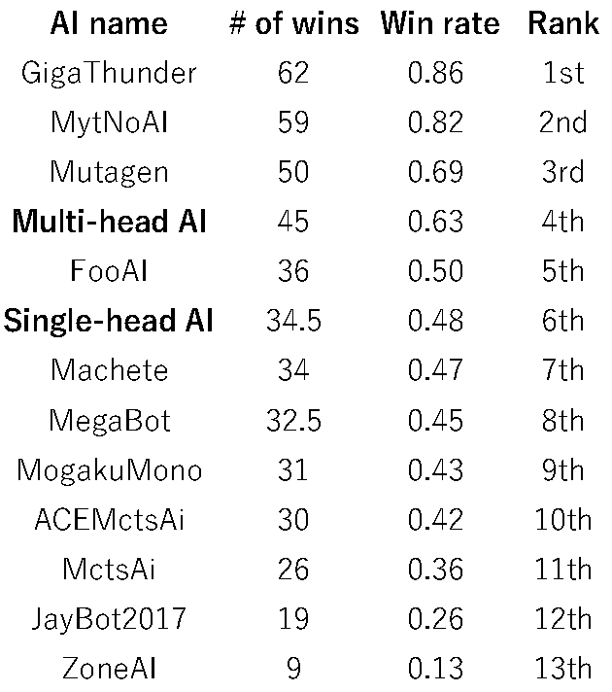
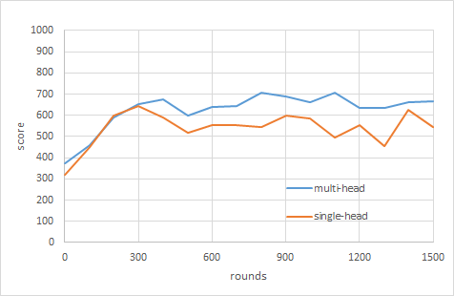
Result(in 2018)
At first lose to DQN
Win at the end

Slide 8
Improve
Add head
More training

