Slide 1
StarCraft strategy classification of a large human versus human game replay dataset
Š. Krištofík, P. Malík, M. Kasáš
FedCSIS 2021

Slide 2
What is StarCraft?
A classic RTS game. Released in 1998, still very popular today.
Usually played with an extension pack Brood war.
Remastered edition released in 2017, original is free now.
A very popular world for AI research and competitions.
(There is a BWAPI library for communicating with StarCraft).

Slide 3
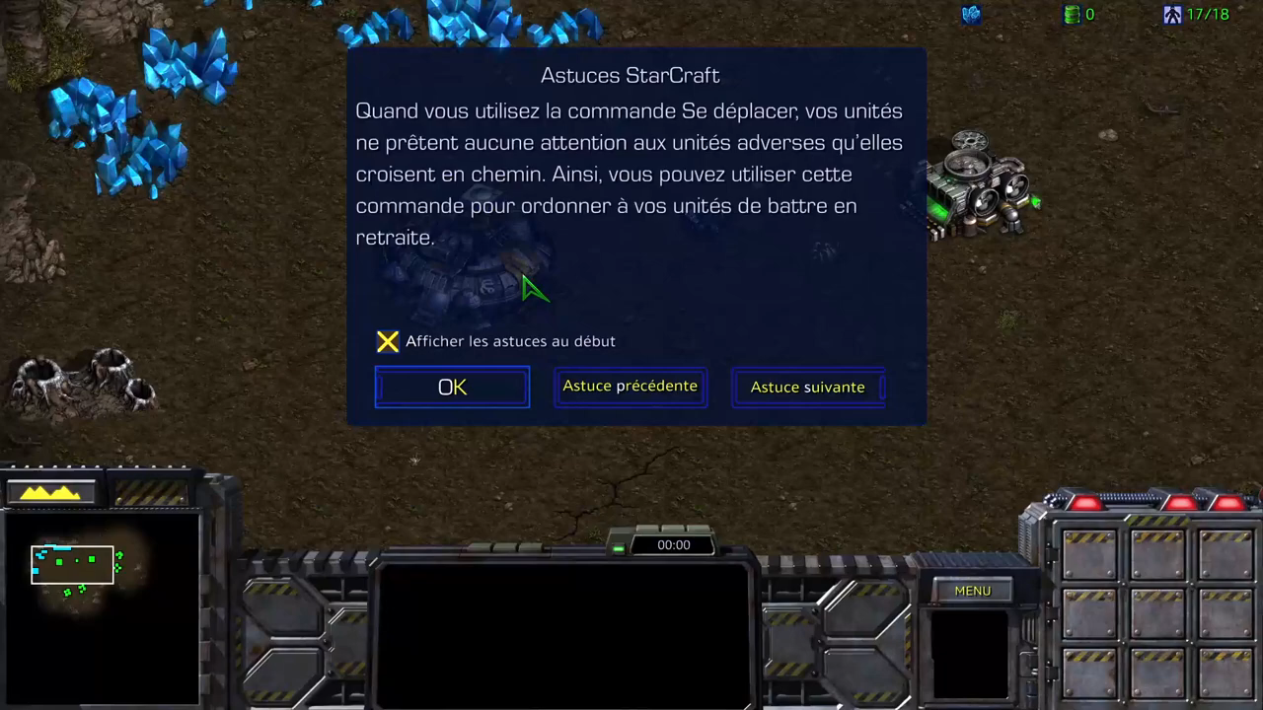
What is StarCraft?
Highlight: three highly diverse playable races:
Terrans: kind of humans, adaptable, universal, flexible.
Protoss: hi-tech, lots of different units & buildings.
Zerg: insect-like, mobile, fast, large in numbers, “bio-weapons”

Slide 4
Current AI Research
DeepMind got good results with AlphaStar for StarCraft.
However, their approach needs enormous resources and still provides limited results (one race, one map).
To understand how humans play StarCraft,
several data sources are available.
The largest is STARDATA released in 2017 by Facebook:
65646 human-human replays.

Slide 5
The Goal
Classify player strategies
in all possible race/race match types (six in total).
Matches shorter than 15 mins are taken from STARDATA (34111 plays),
focus on short strategies
Protoss
Terrans
Zerg

Slide 6
Presumptions
StarCraft strategy is defined with:
Build order. It reveals player intention due to tech trees. E.g.:
Barracks → Marines
Barracks → Academy 
 → Medics
Army composition. A list of most used unit types.

Slide 7
Replay Info Used
Basic information (player names, races, etc.)
Count of all structure types.
Average units per minute present.
Timestamp of the 1st appearance of each structure & unit type.

Slide 8
Clustering
During clustering, only some hand-picked structure and unit types are taken into account (5-10 types).
A simple k-means algorithm is used to cluster data.
(Looks like no specialized distance function is used).
For each race/race combination, ten clusters are built.
(So it’s been decided to identify 10 strategies per race/race).

Slide 9
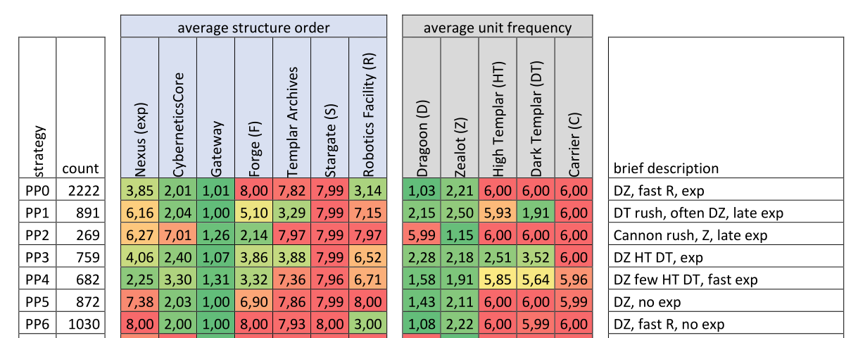
Clusters: 10x3=30 rows/race; 90 in total
Structures:
1=built first, 8=never built
Units:
1=always used, 6=not used

Slide 10
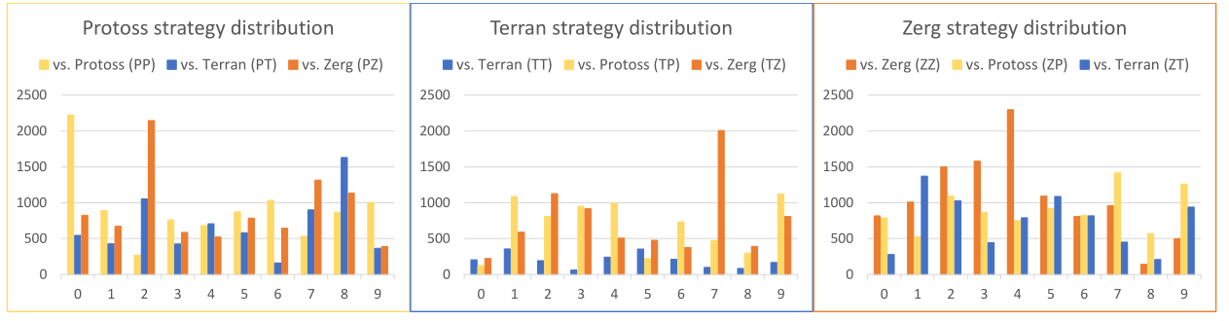
Authors’ notes
some strategy-defining structures or units were chosen incorrectly (because some are always used or never used).
There is a variety of strategies, and they depend on opponents.

Slide 11
Thanks!
Any questions ?
You can find me at
@username
user@mail.me

Slide 12
Presentation design
This presentation uses the following typographies and colors:
Titles: Lora
Body copy: Quattrocento Sans
You can download the fonts on these pages:
https://www.fontsquirrel.com/fonts/lora
https://www.fontsquirrel.com/fonts/quattrocento-sans
Yellow #ffcd00 | Black #000000 | Grey #cccccc
You don’t need to keep this slide in your presentation. It’s only here to serve you as a design guide if you need to create new slides or download the fonts to edit the presentation in PowerPoint®

Slide 13
SlidesCarnival icons are editable shapes.
This means that you can:
Resize them without losing quality.
Change line color, width and style.
Isn’t that nice? :)
Examples:

Slide 14
😉
Now you can use any emoji as an icon!
And of course it resizes without losing quality and you can change the color.
How? Follow Google instructions https://twitter.com/googledocs/status/730087240156643328
✋👆👉👍👤👦👧👨👩👪💃🏃💑❤😂😉😋😒😭👶😸🐟🍒🍔💣📌📖🔨🎃🎈🎨🏈🏰🌏🔌🔑 and many more...

Slide 15

Free templates for all your presentation needs
For PowerPoint and Google Slides
100% free for personal or commercial use
Ready to use, professional and customizable
Blow your audience away with attractive visuals

