Slide 1
Google Research Football: A Novel Reinforcement Learning Environment
Paper Club
Conference: AAAI-20
Authors: Google Research, Brain Team

Slide 2
Paper video

Slide 3
Key Contributions
Football Engine, a highly-optimized game engine that simulates the game of football,
Football Benchmarks, a versatile set of benchmark tasks of varying difficulties that can be used to compare different algorithms,
Football Academy, a set of progressively harder and diverse reinforcement learning scenarios,
Evaluation of state-of-the-art algorithms on both the Football Benchmarks and the Football Academy, providing an extensive set of reference results for future comparison

Slide 4
Paper structure
Introduction
Motivation and Other Related Work
Football Engine
Football Benchmarks
Football Academy
Promising Research Directions
Conclusions

Slide 5
Motivation and Other Related Work
Problems with other environments, addressed in GRF:
Easy to solve (Atari games, DeepMind Lab, etc.);
Computationally expensive (Starcraft II, Dota 2, etc.);
Lack of stochasticity – real-world is not deterministic;
Lack of open-source license;
Single-player;
Other football environments focus on low-level controls

Slide 6
Football Engine
Based on GameplayFootball simulator, which implements football game under standard rules.
Opponent AI Built-in Bots with variable difficulty (0 to 1).
Levels: easy (θ = 0.05), medium (θ = 0.6), and hard (θ = 0.95)
Stochastic or deterministic mode.
Compatible with a widely used OpenAI Gym API.
Written in highly optimized C++ code.

Slide 7
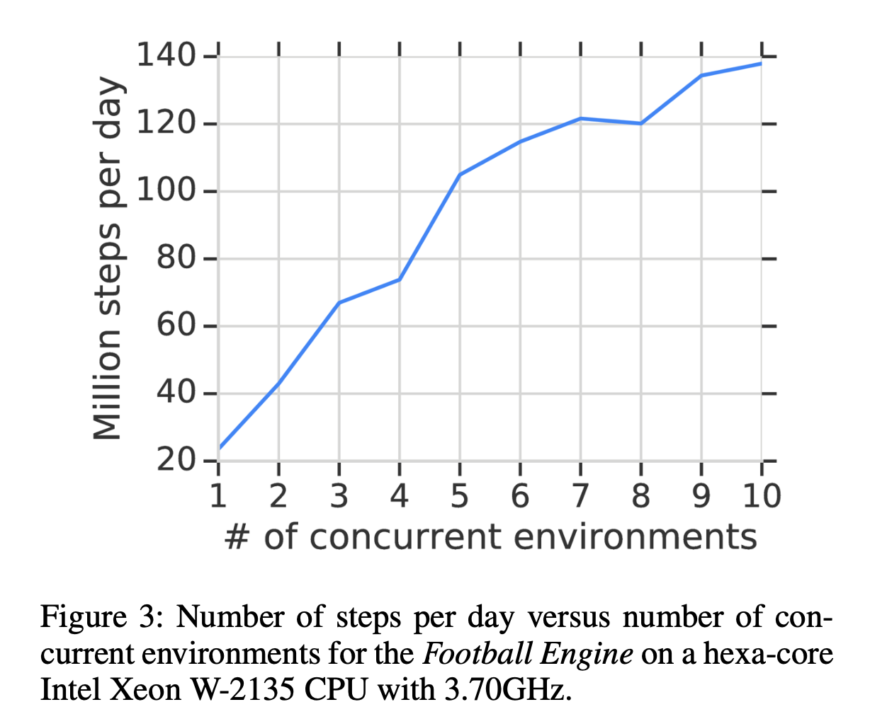
Scalability

Slide 9
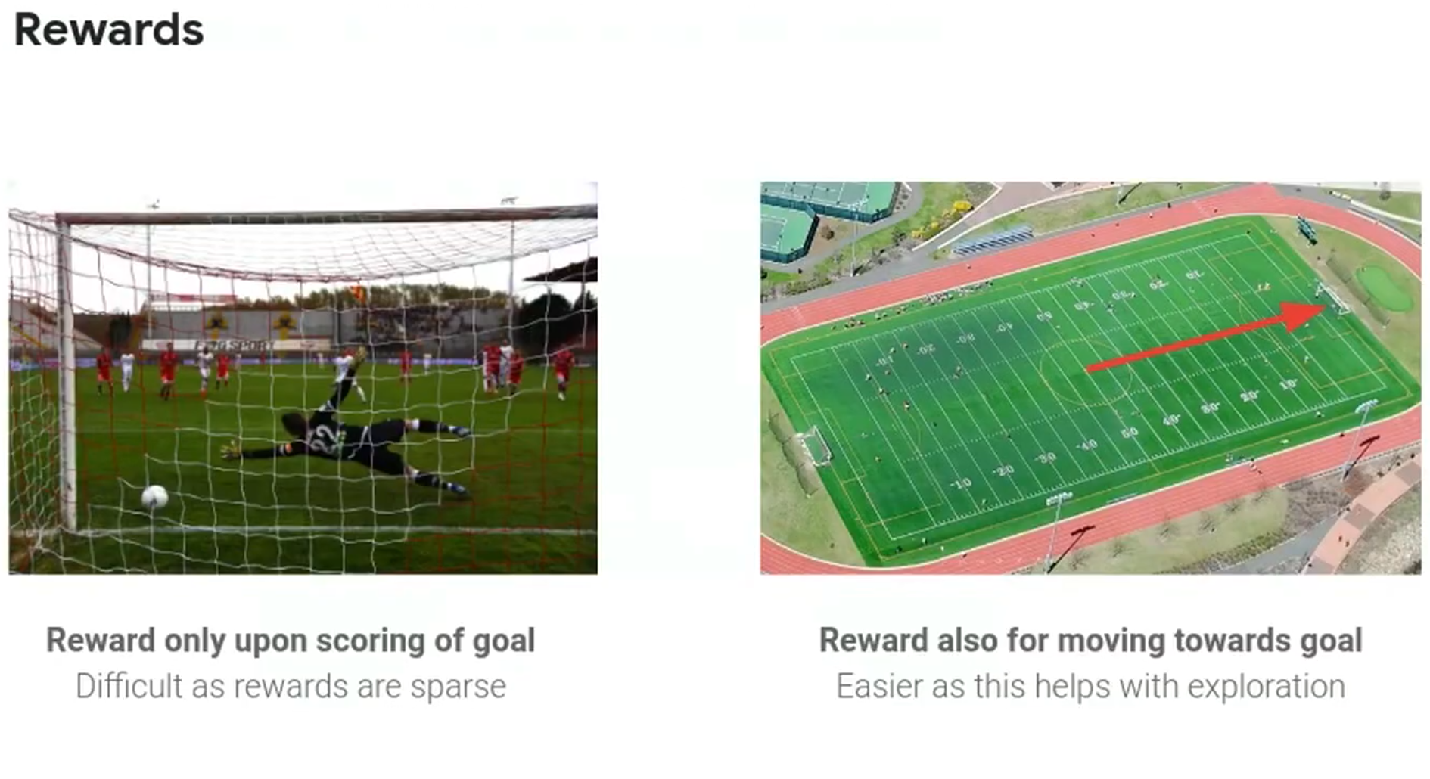

Slide 10
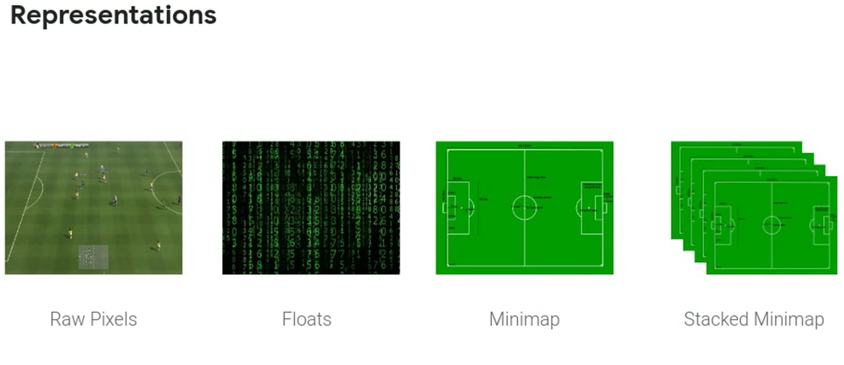

Slide 11
Football Academy
Empty Goal and Empty Goal Close;
Run to Score and Run to Score with Keeper;
Pass and Shoot with Keeper and Run, Pass and Shoot;
3 versus 1 with Keeper;
Easy and Hard Counter-Attack;
Corner;
11 versus 11 with Lazy Opponents.

Slide 12
Algorithms applied
IMPALA - Importance Weighted Actor-Learner Architec- ture (Espeholt et al., 2018)
PPO - Proximal Policy Optimization (Schulman et al., 2017);
Ape-X DQN – version of a family of Q-learning algorithms.

Slide 13
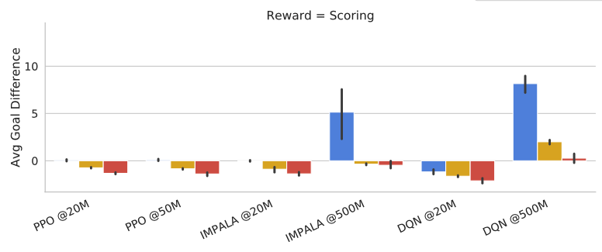
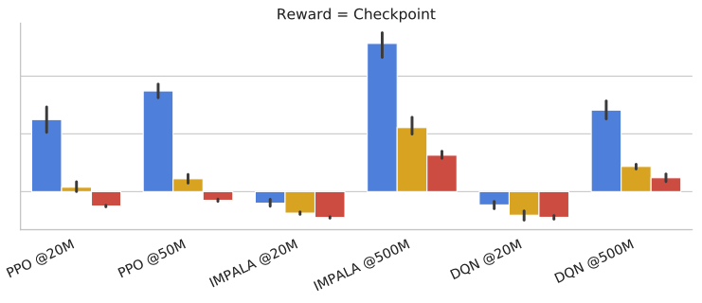
Results for state-of-the-art algorithms

Slide 14
Links
Paper on arXiv
GitHub repository
Blogpost with an announcement
Presentation by the lead researcher
More recent presentation by another researcher

